Slide 1
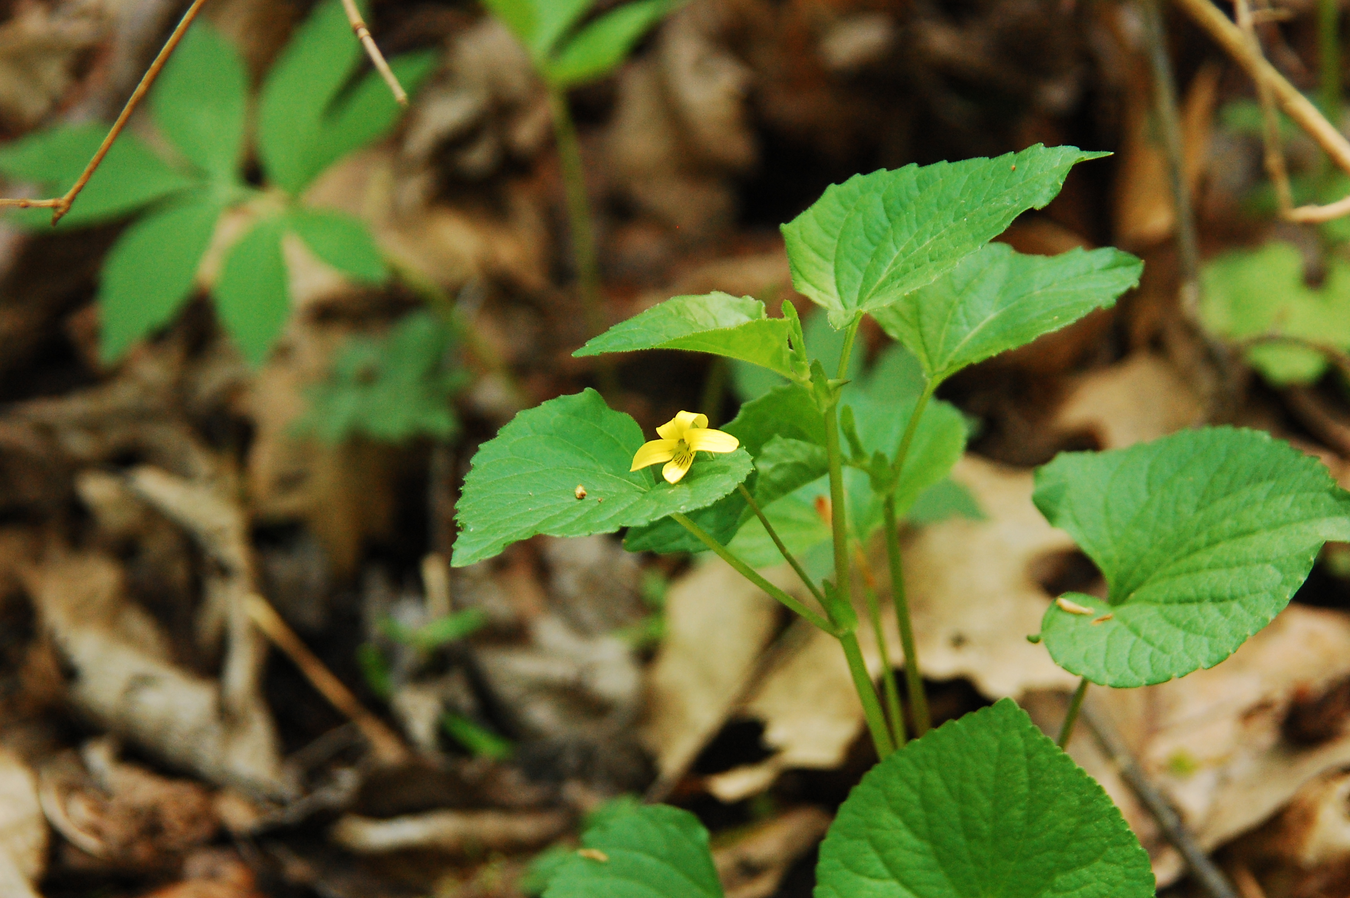
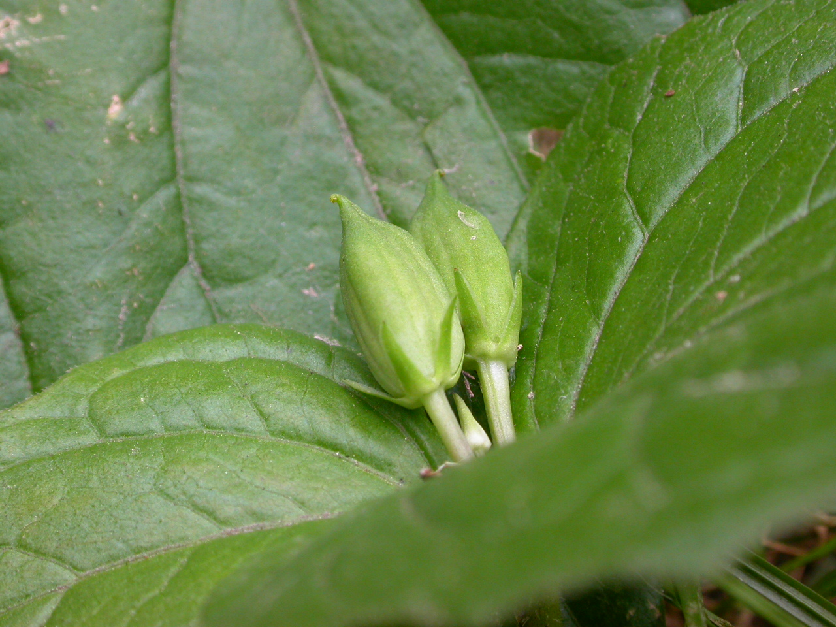
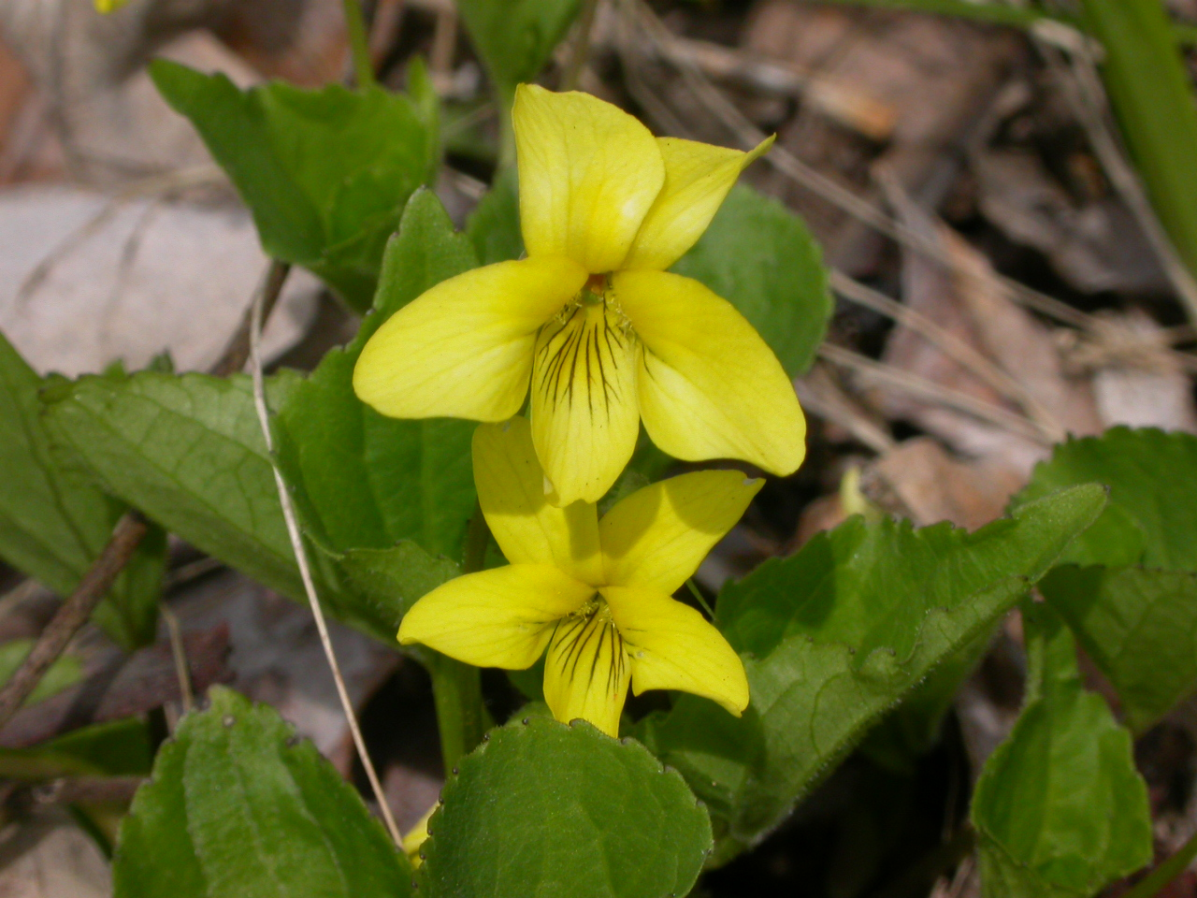
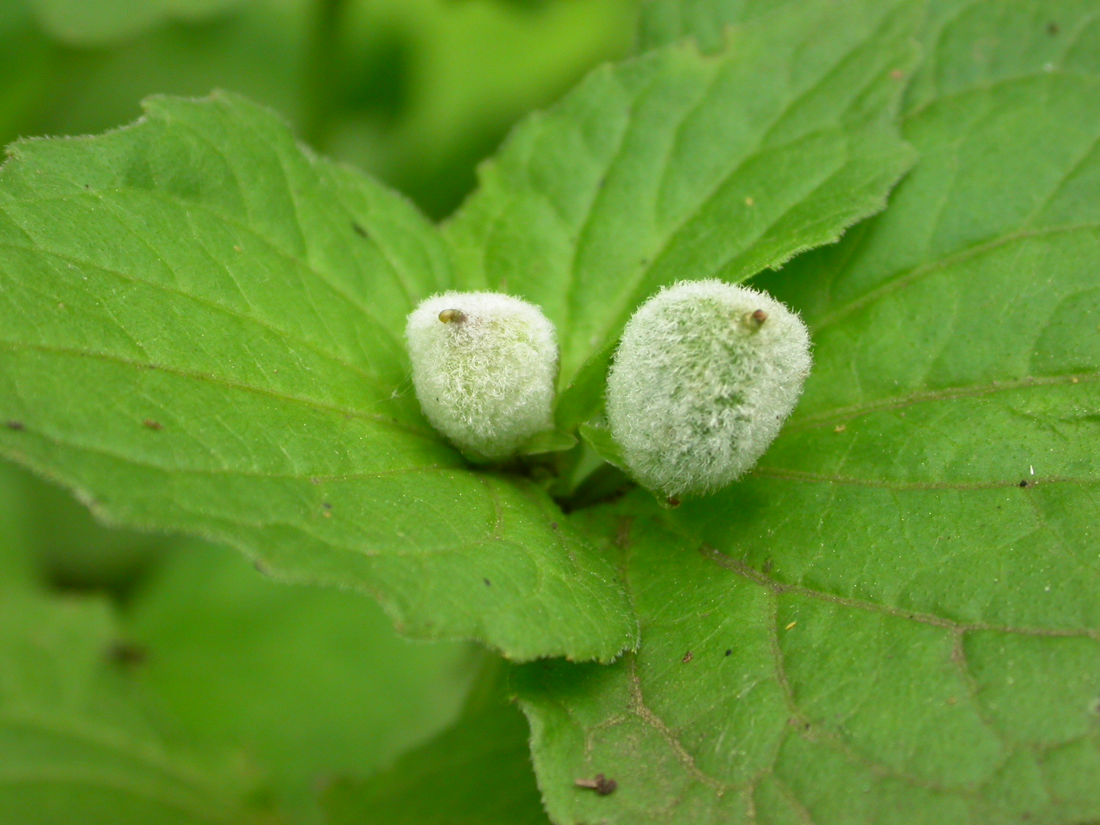
Yellow Forest Violet
Viola pubescens
Notes:
2013_05_18_035 Wehr
2007_05_04_006 Wehr
2007_06_06_028 Wehr
2007_07_13_007 Kickapoo

Slide 2
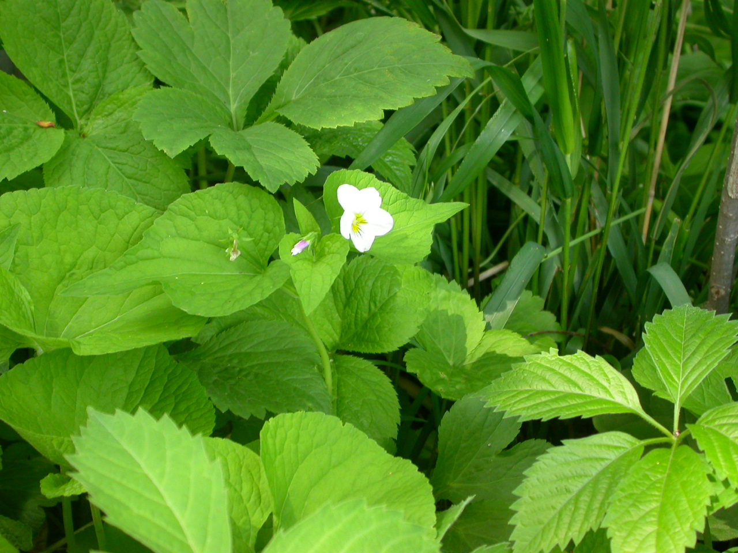
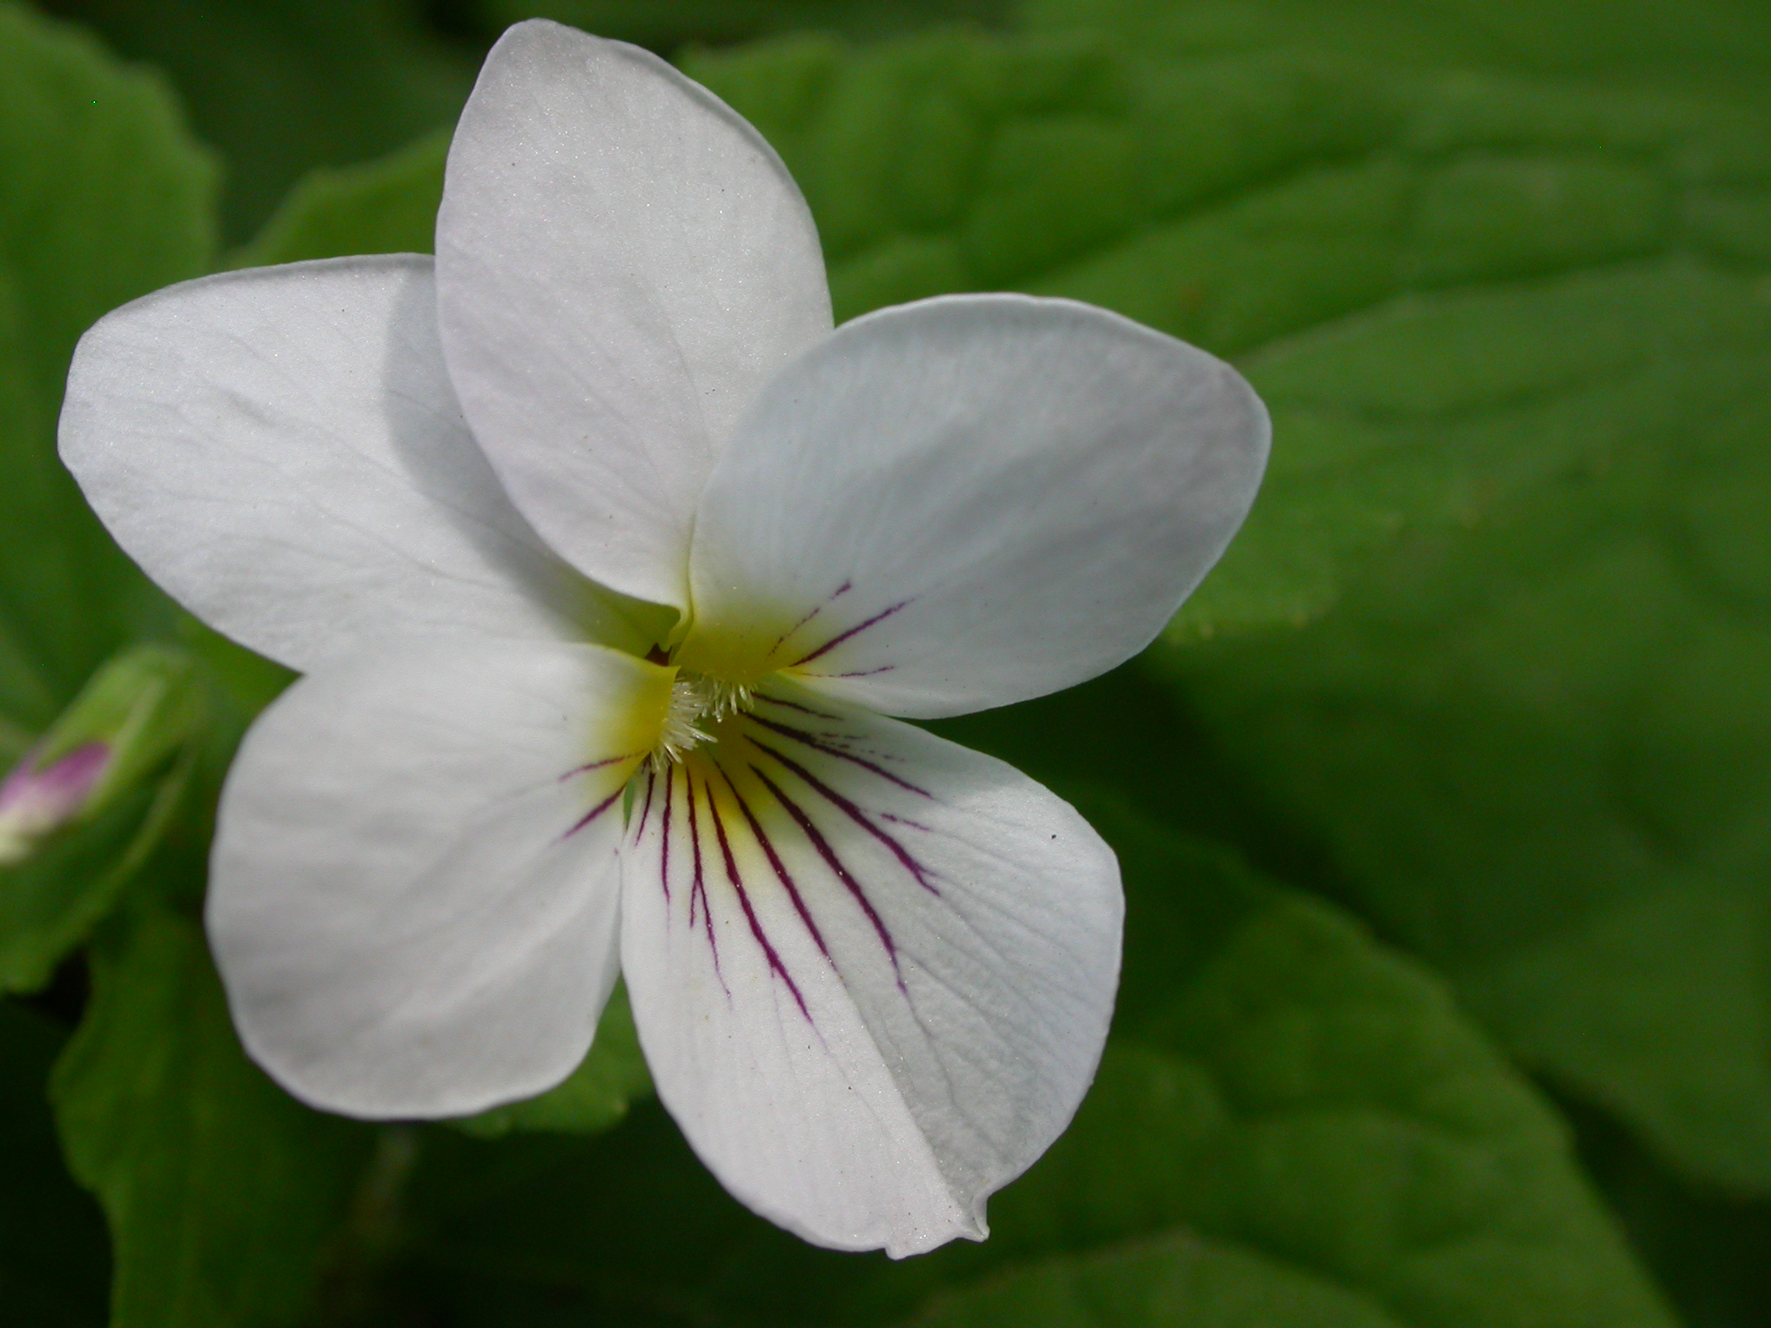
Canada violet
Viola canadensis
Notes:
2007_05_21_001 Wehr
2009_05_25_017 Home

Slide 3
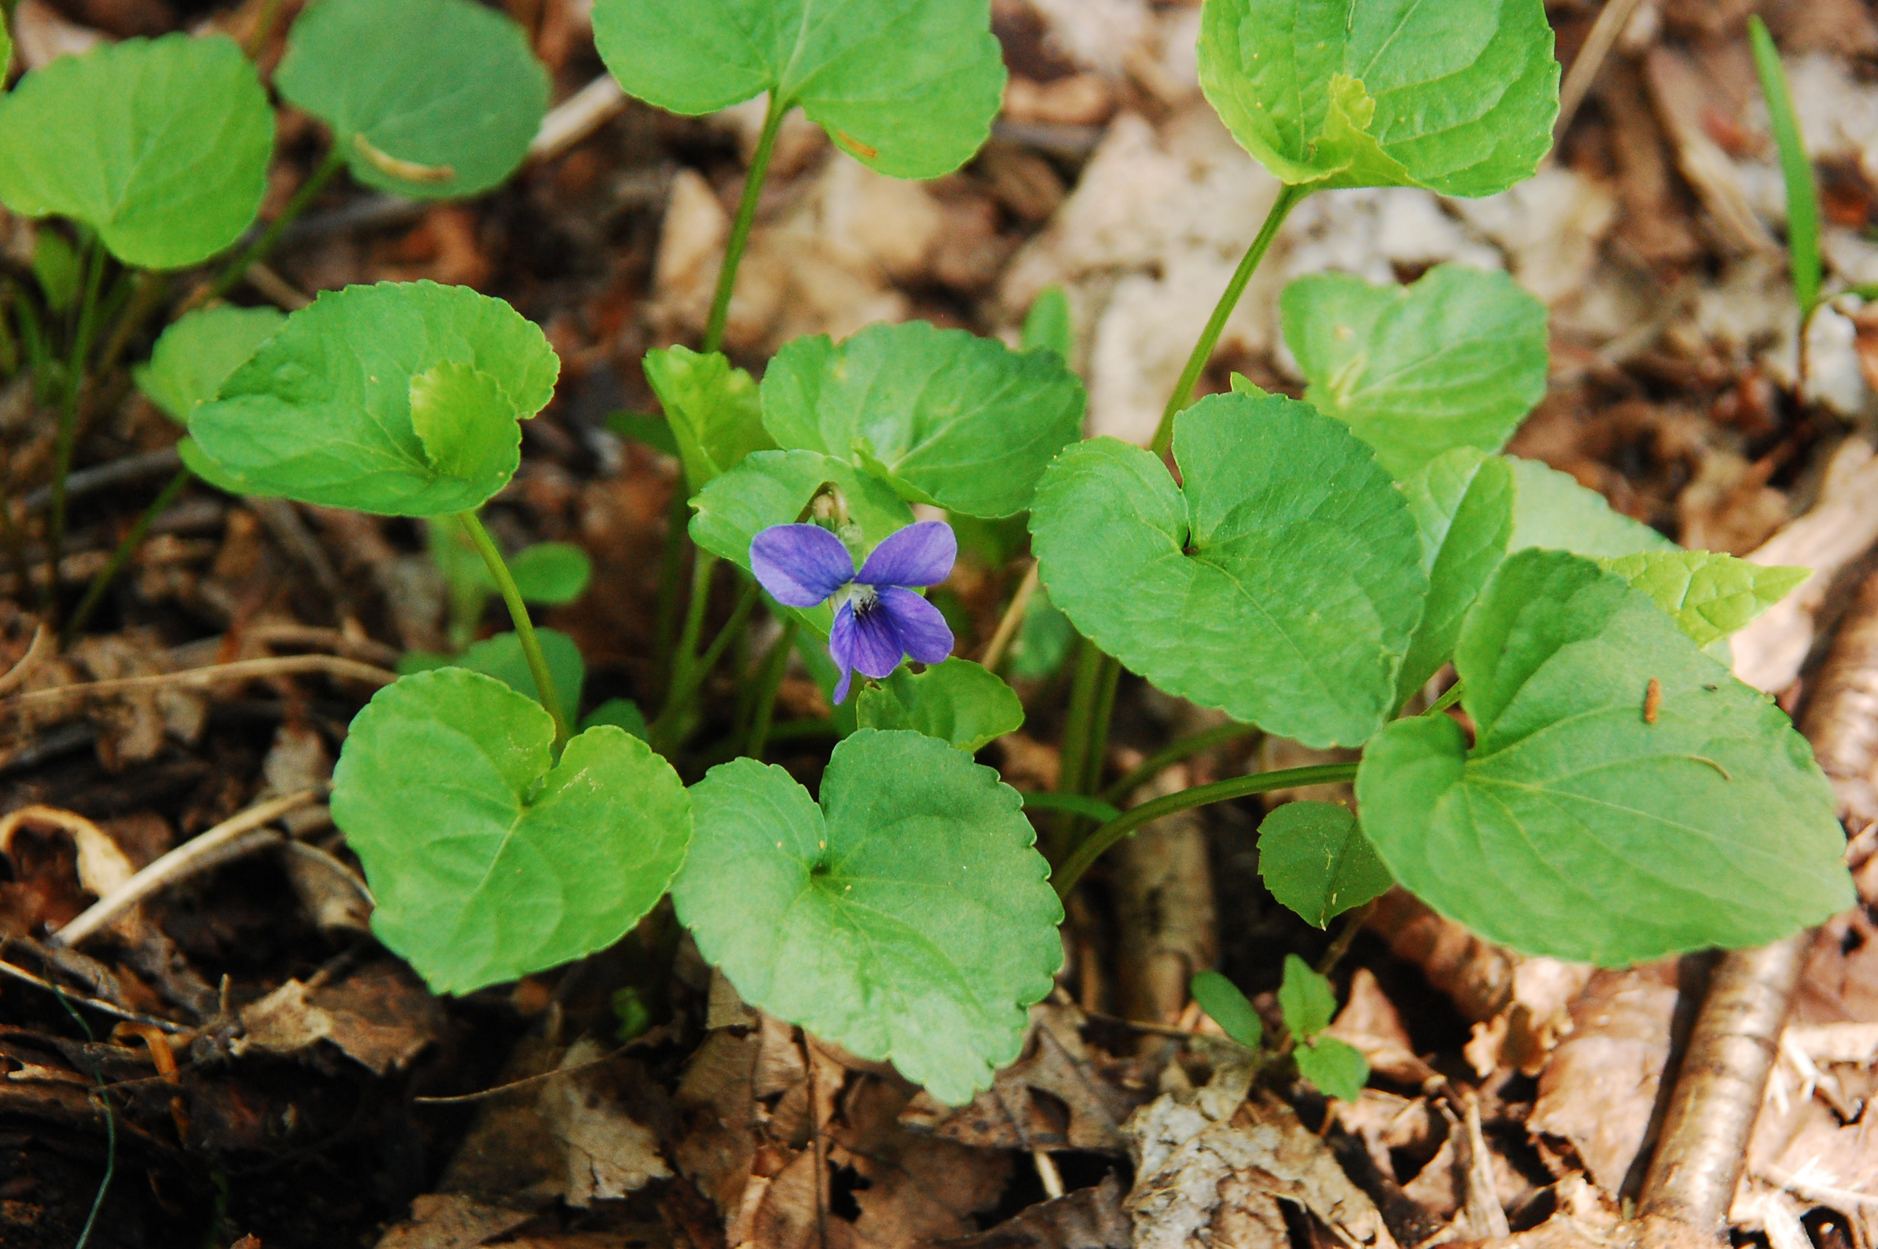
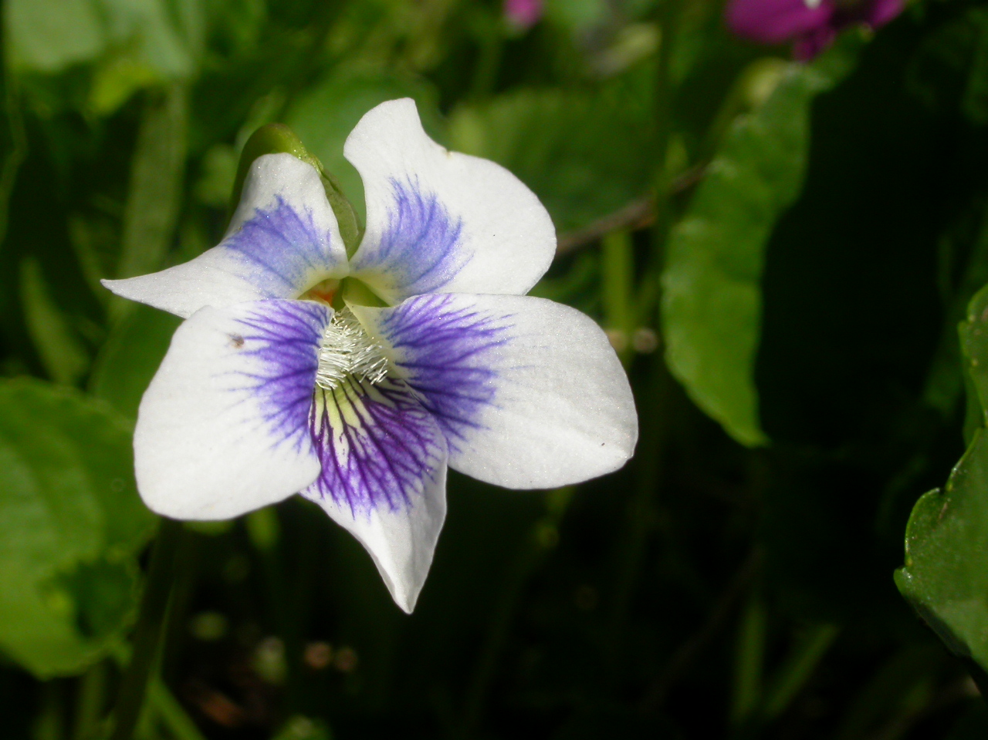
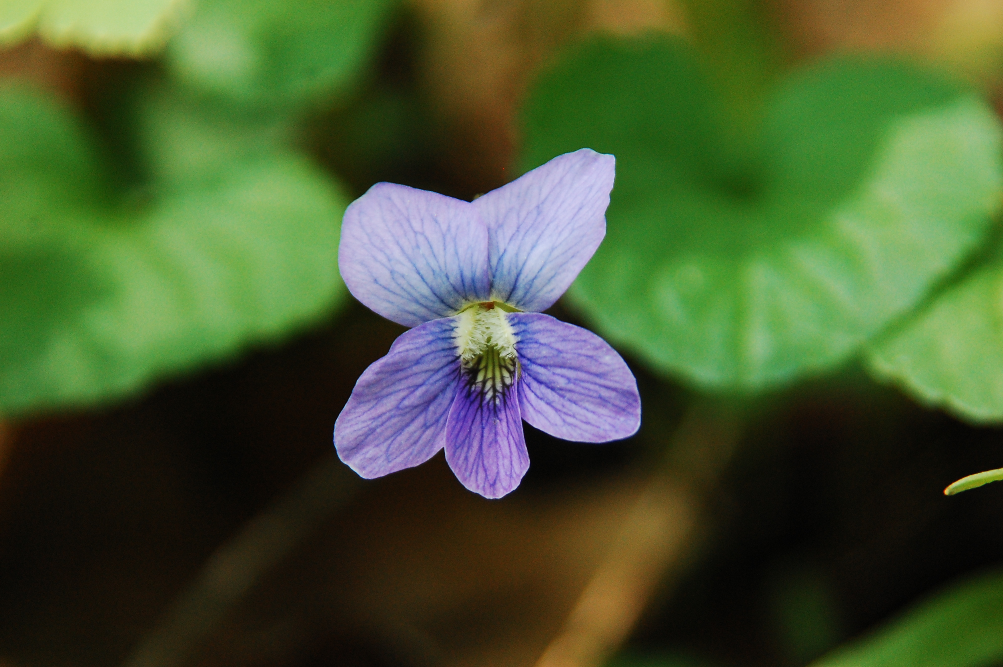
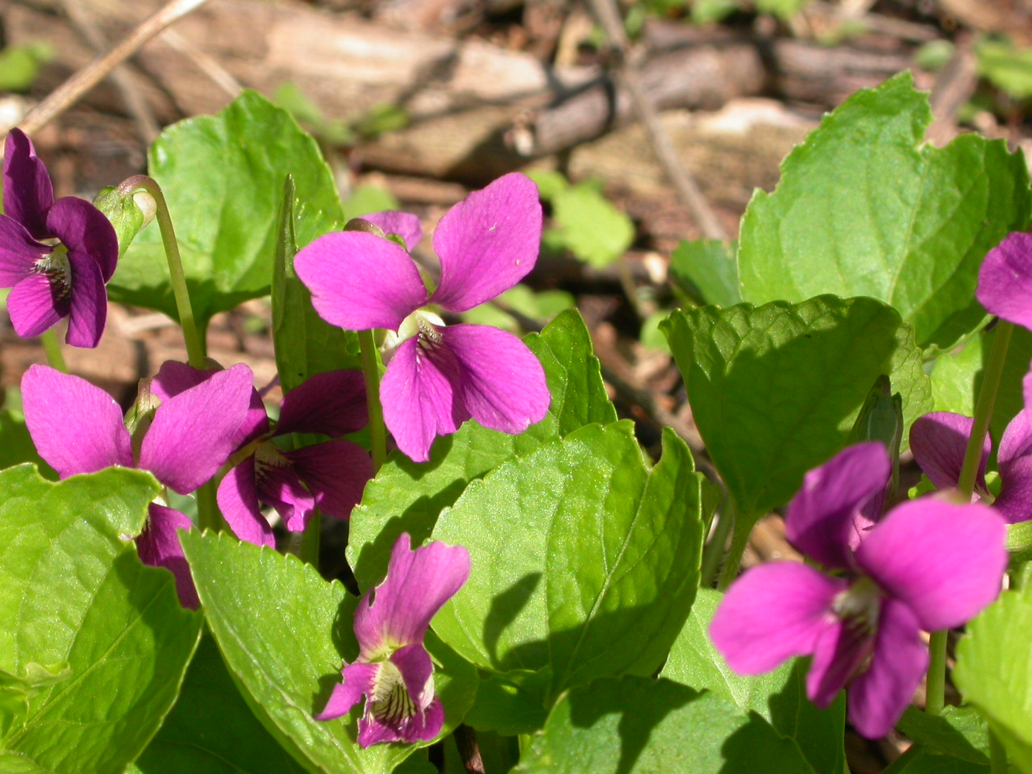
Common Blue violet
Viola sororia
Notes:
2013_05_18_039 Wehr
2007_05_02_013 Wehr – Confederate
2013_05_18_037 Wehr - Blue
2007_05_02_020 Wehr – Red Violet

Slide 4
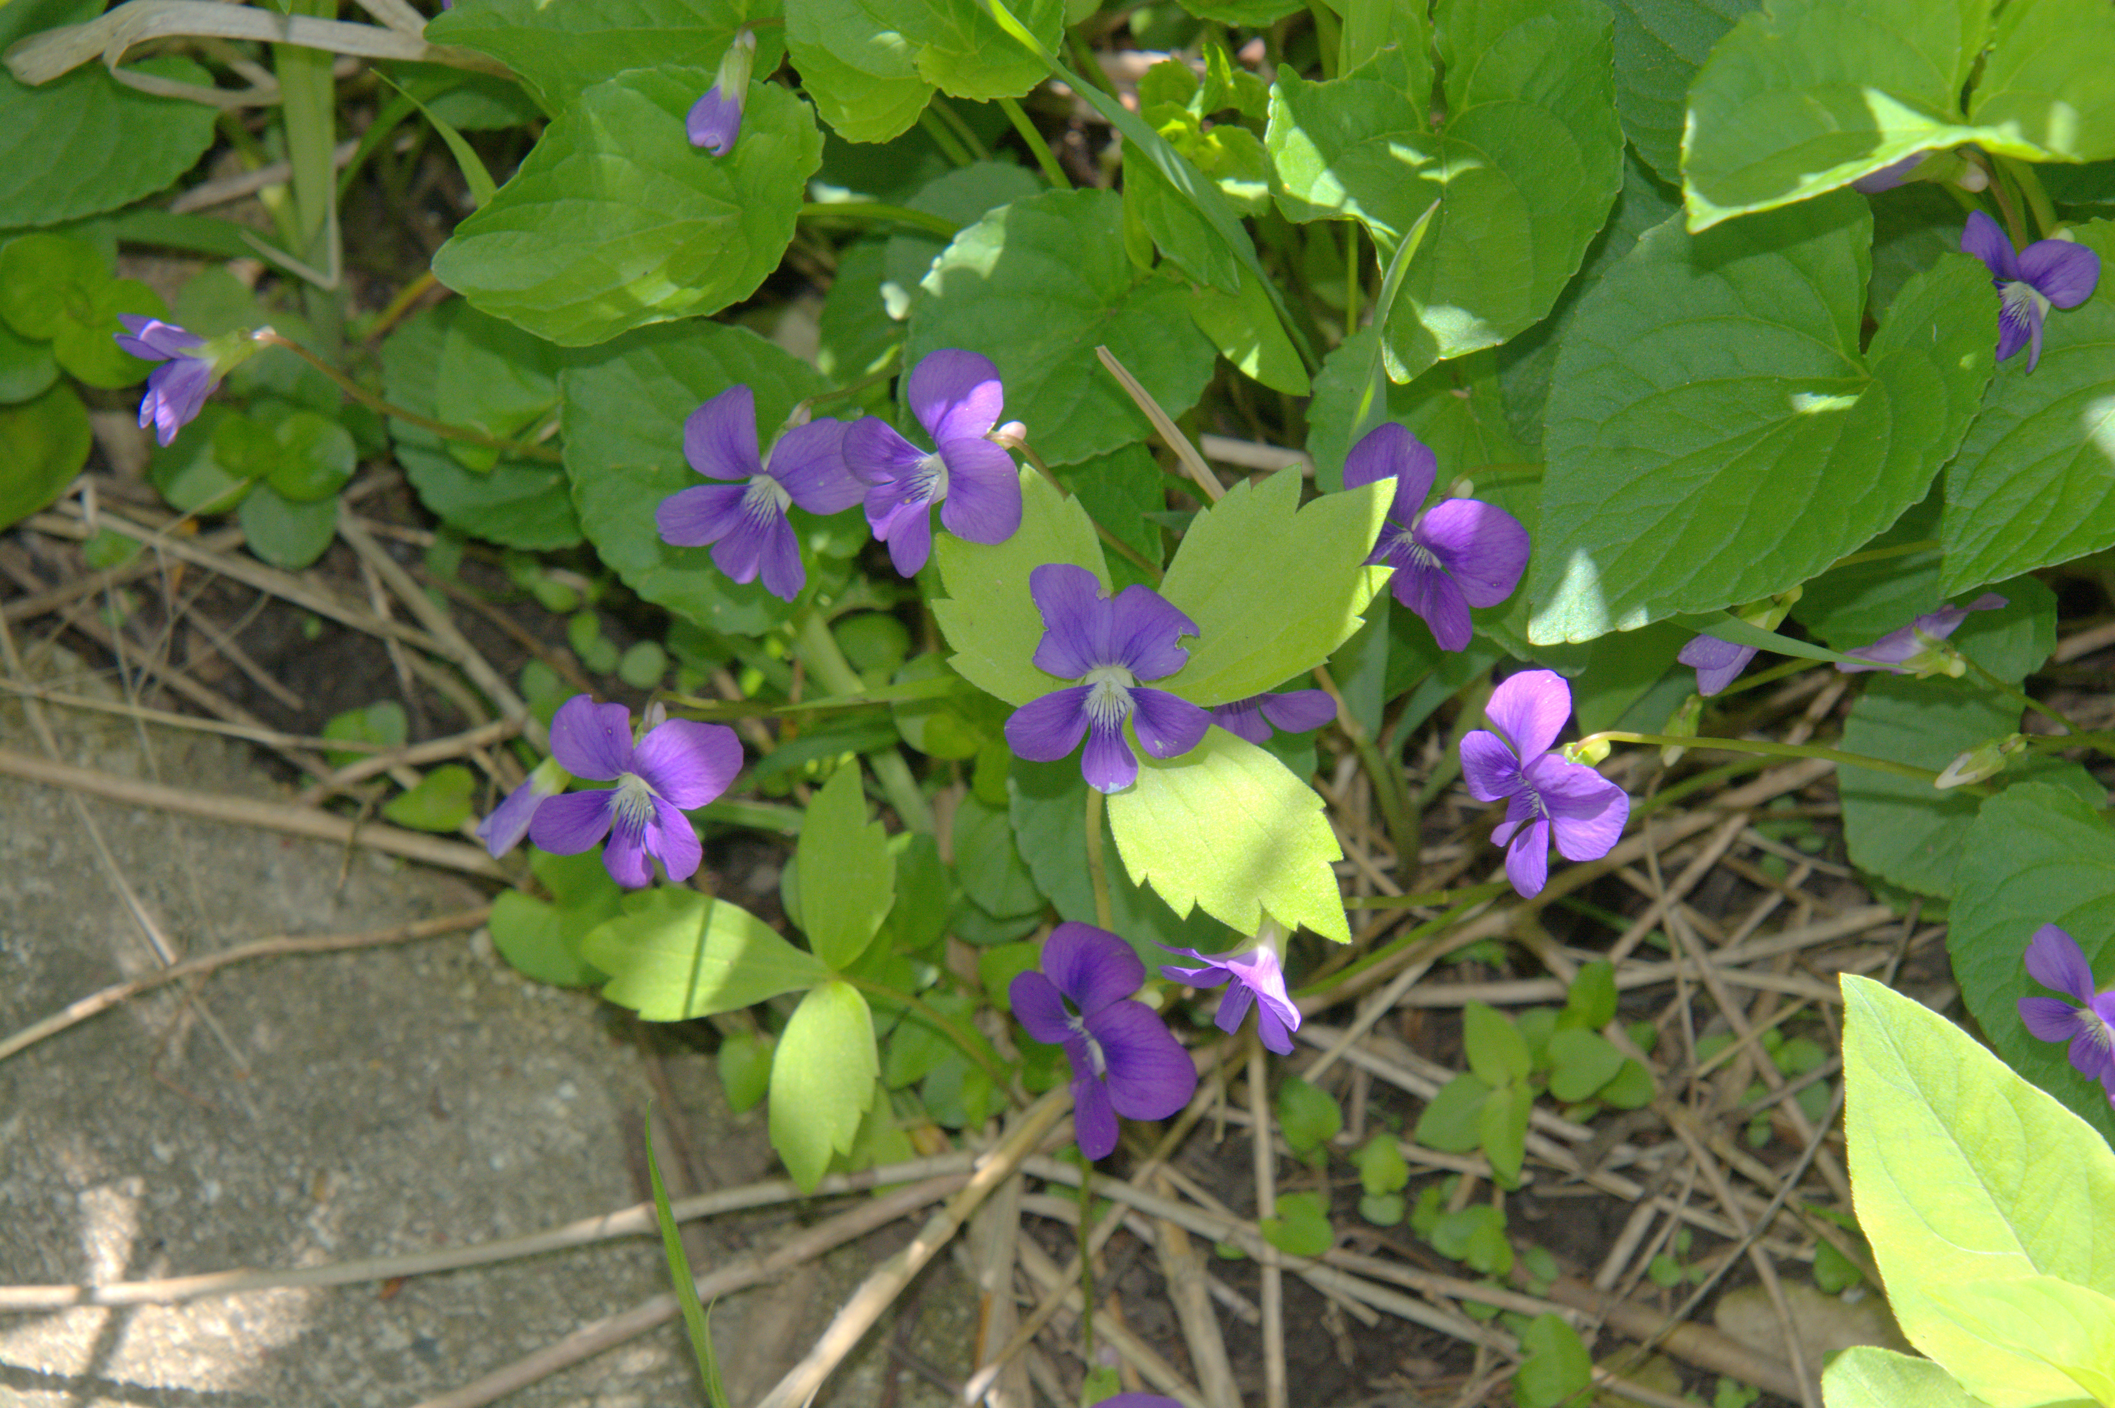
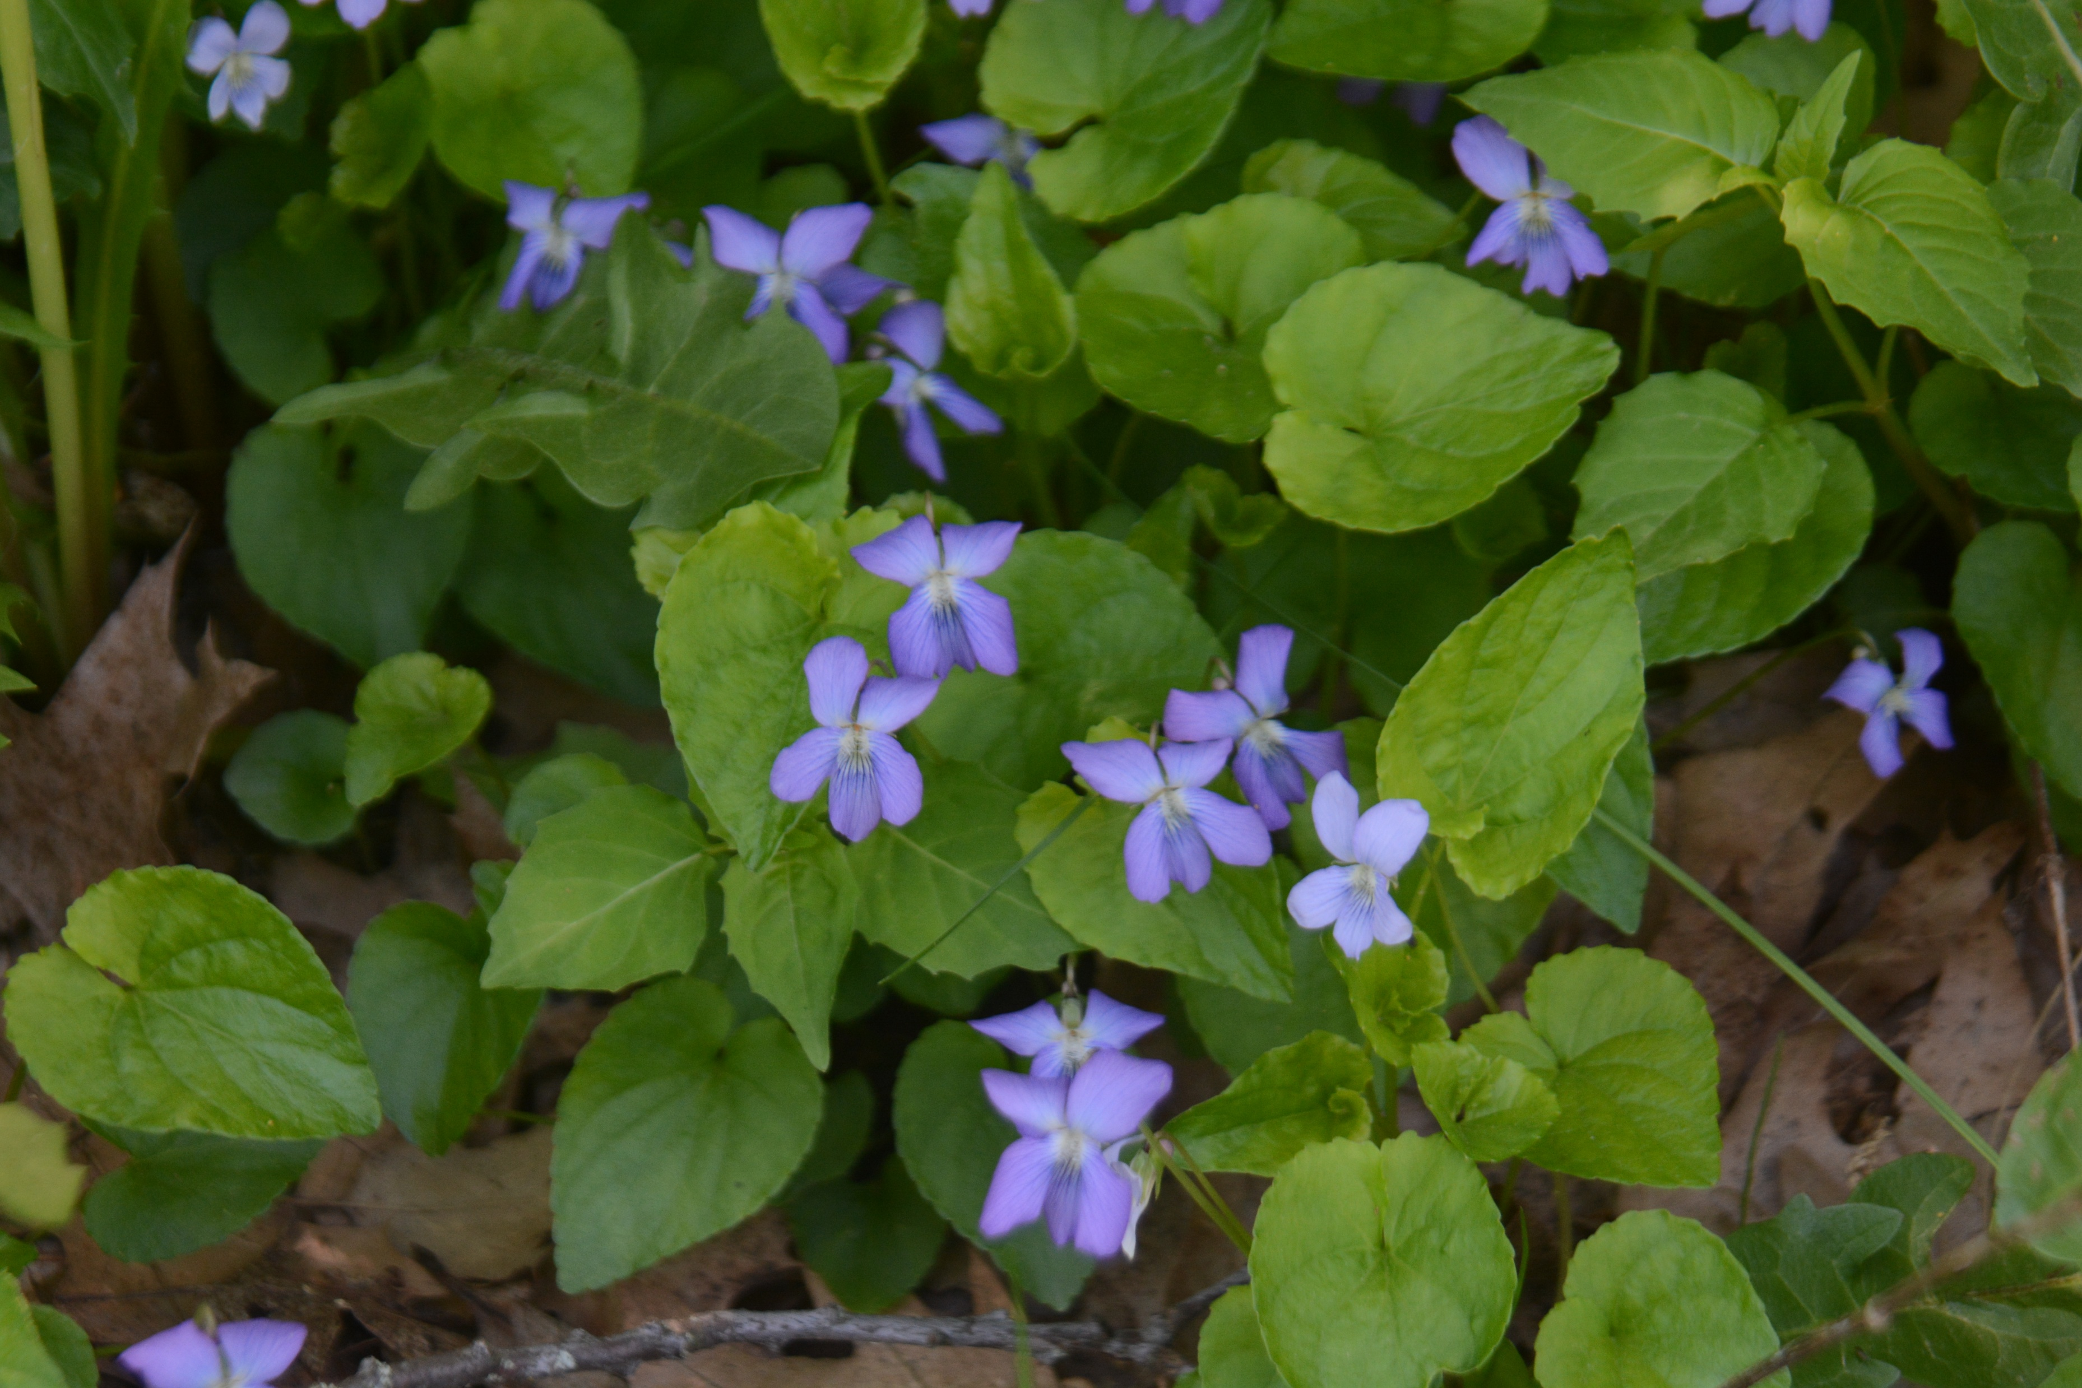
Marsh Blue violet
Viola cucculata
Notes:
2025_05_26_017a Wehr Nature Center
2023_05_21_003 Minooka Park.JPG

Slide 5
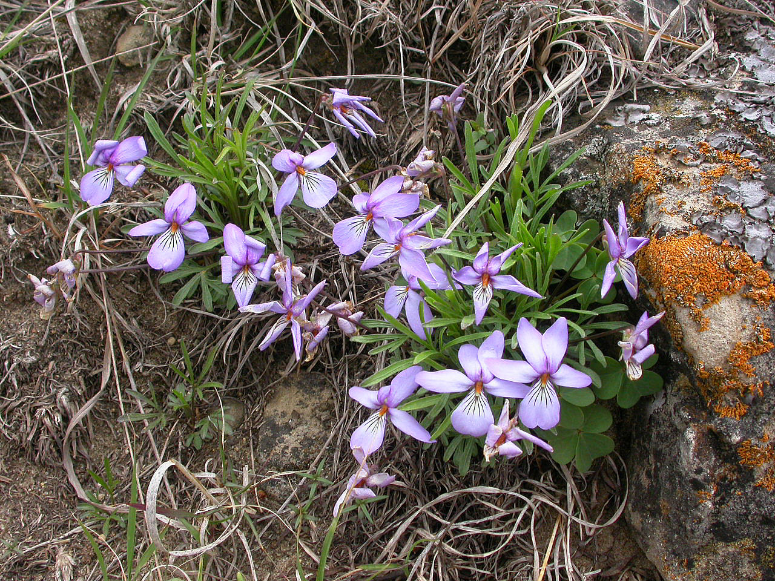
Bird’s-foot violet
Viola pedata
Notes:
2005_05_09_027a
2005_05_09_027 Hogback

Slide 6
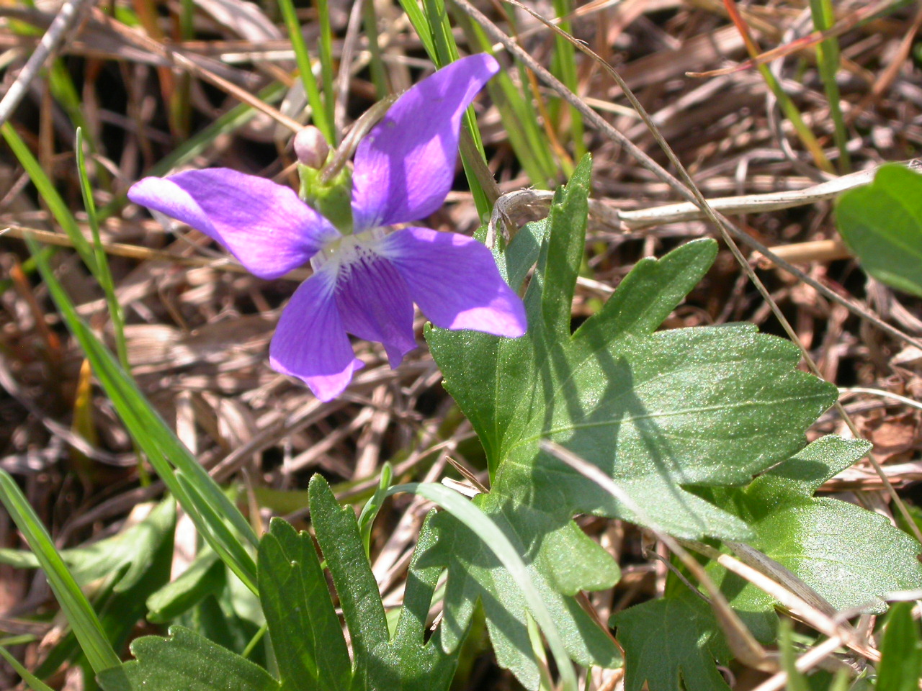
Prairie violet
Viola pedatifida
Notes:
2007_05_10_010 HogBack

Slide 7
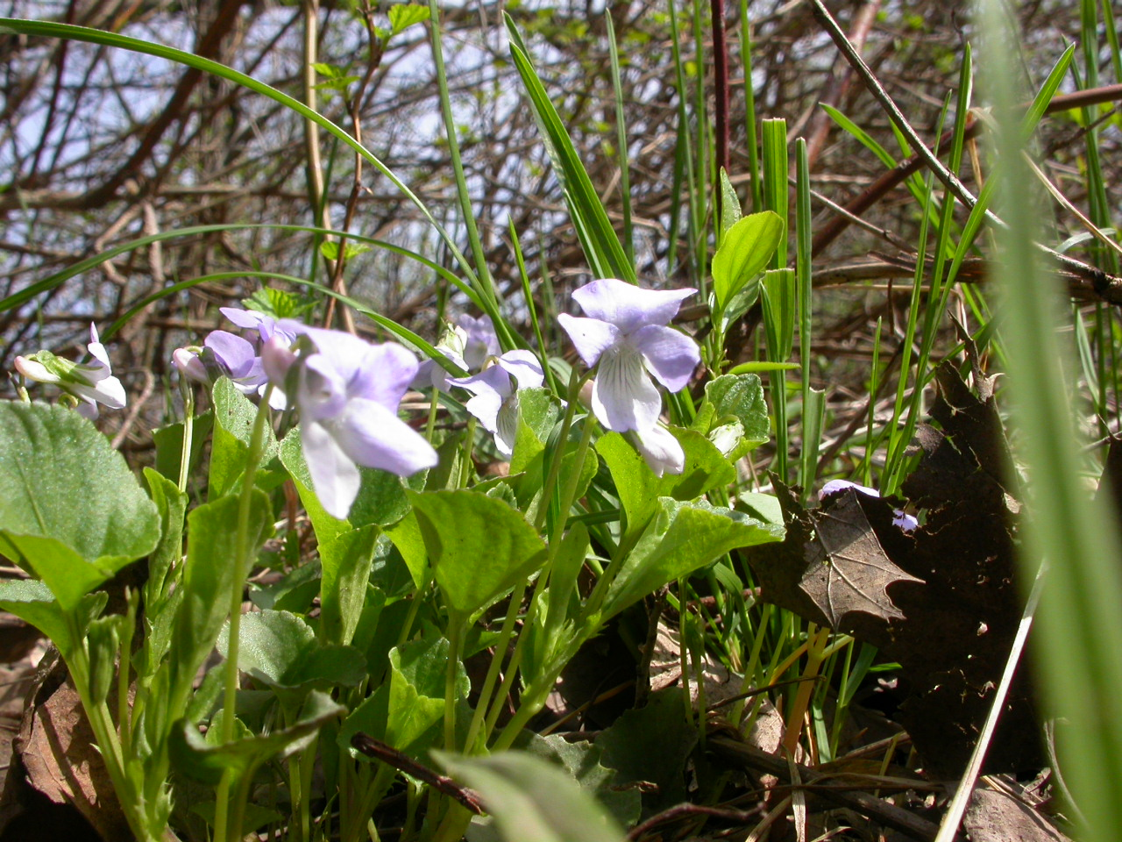
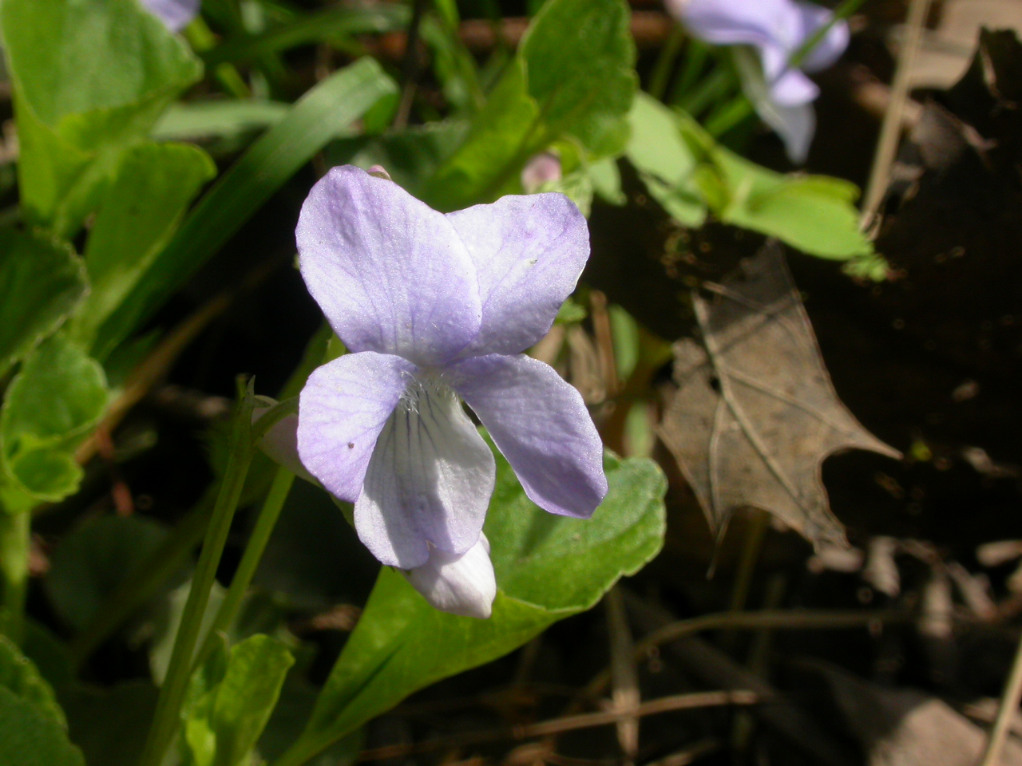
Labradore Violet
Viola labradorica
Notes:
2007_04_30_007 Wehr
2007_04_30_005 Wehr

