Slide 1
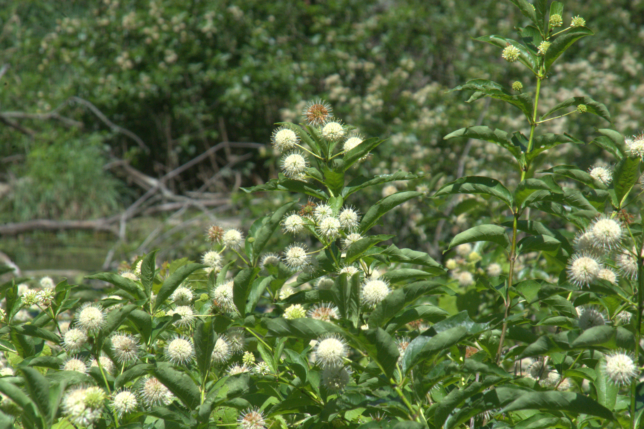
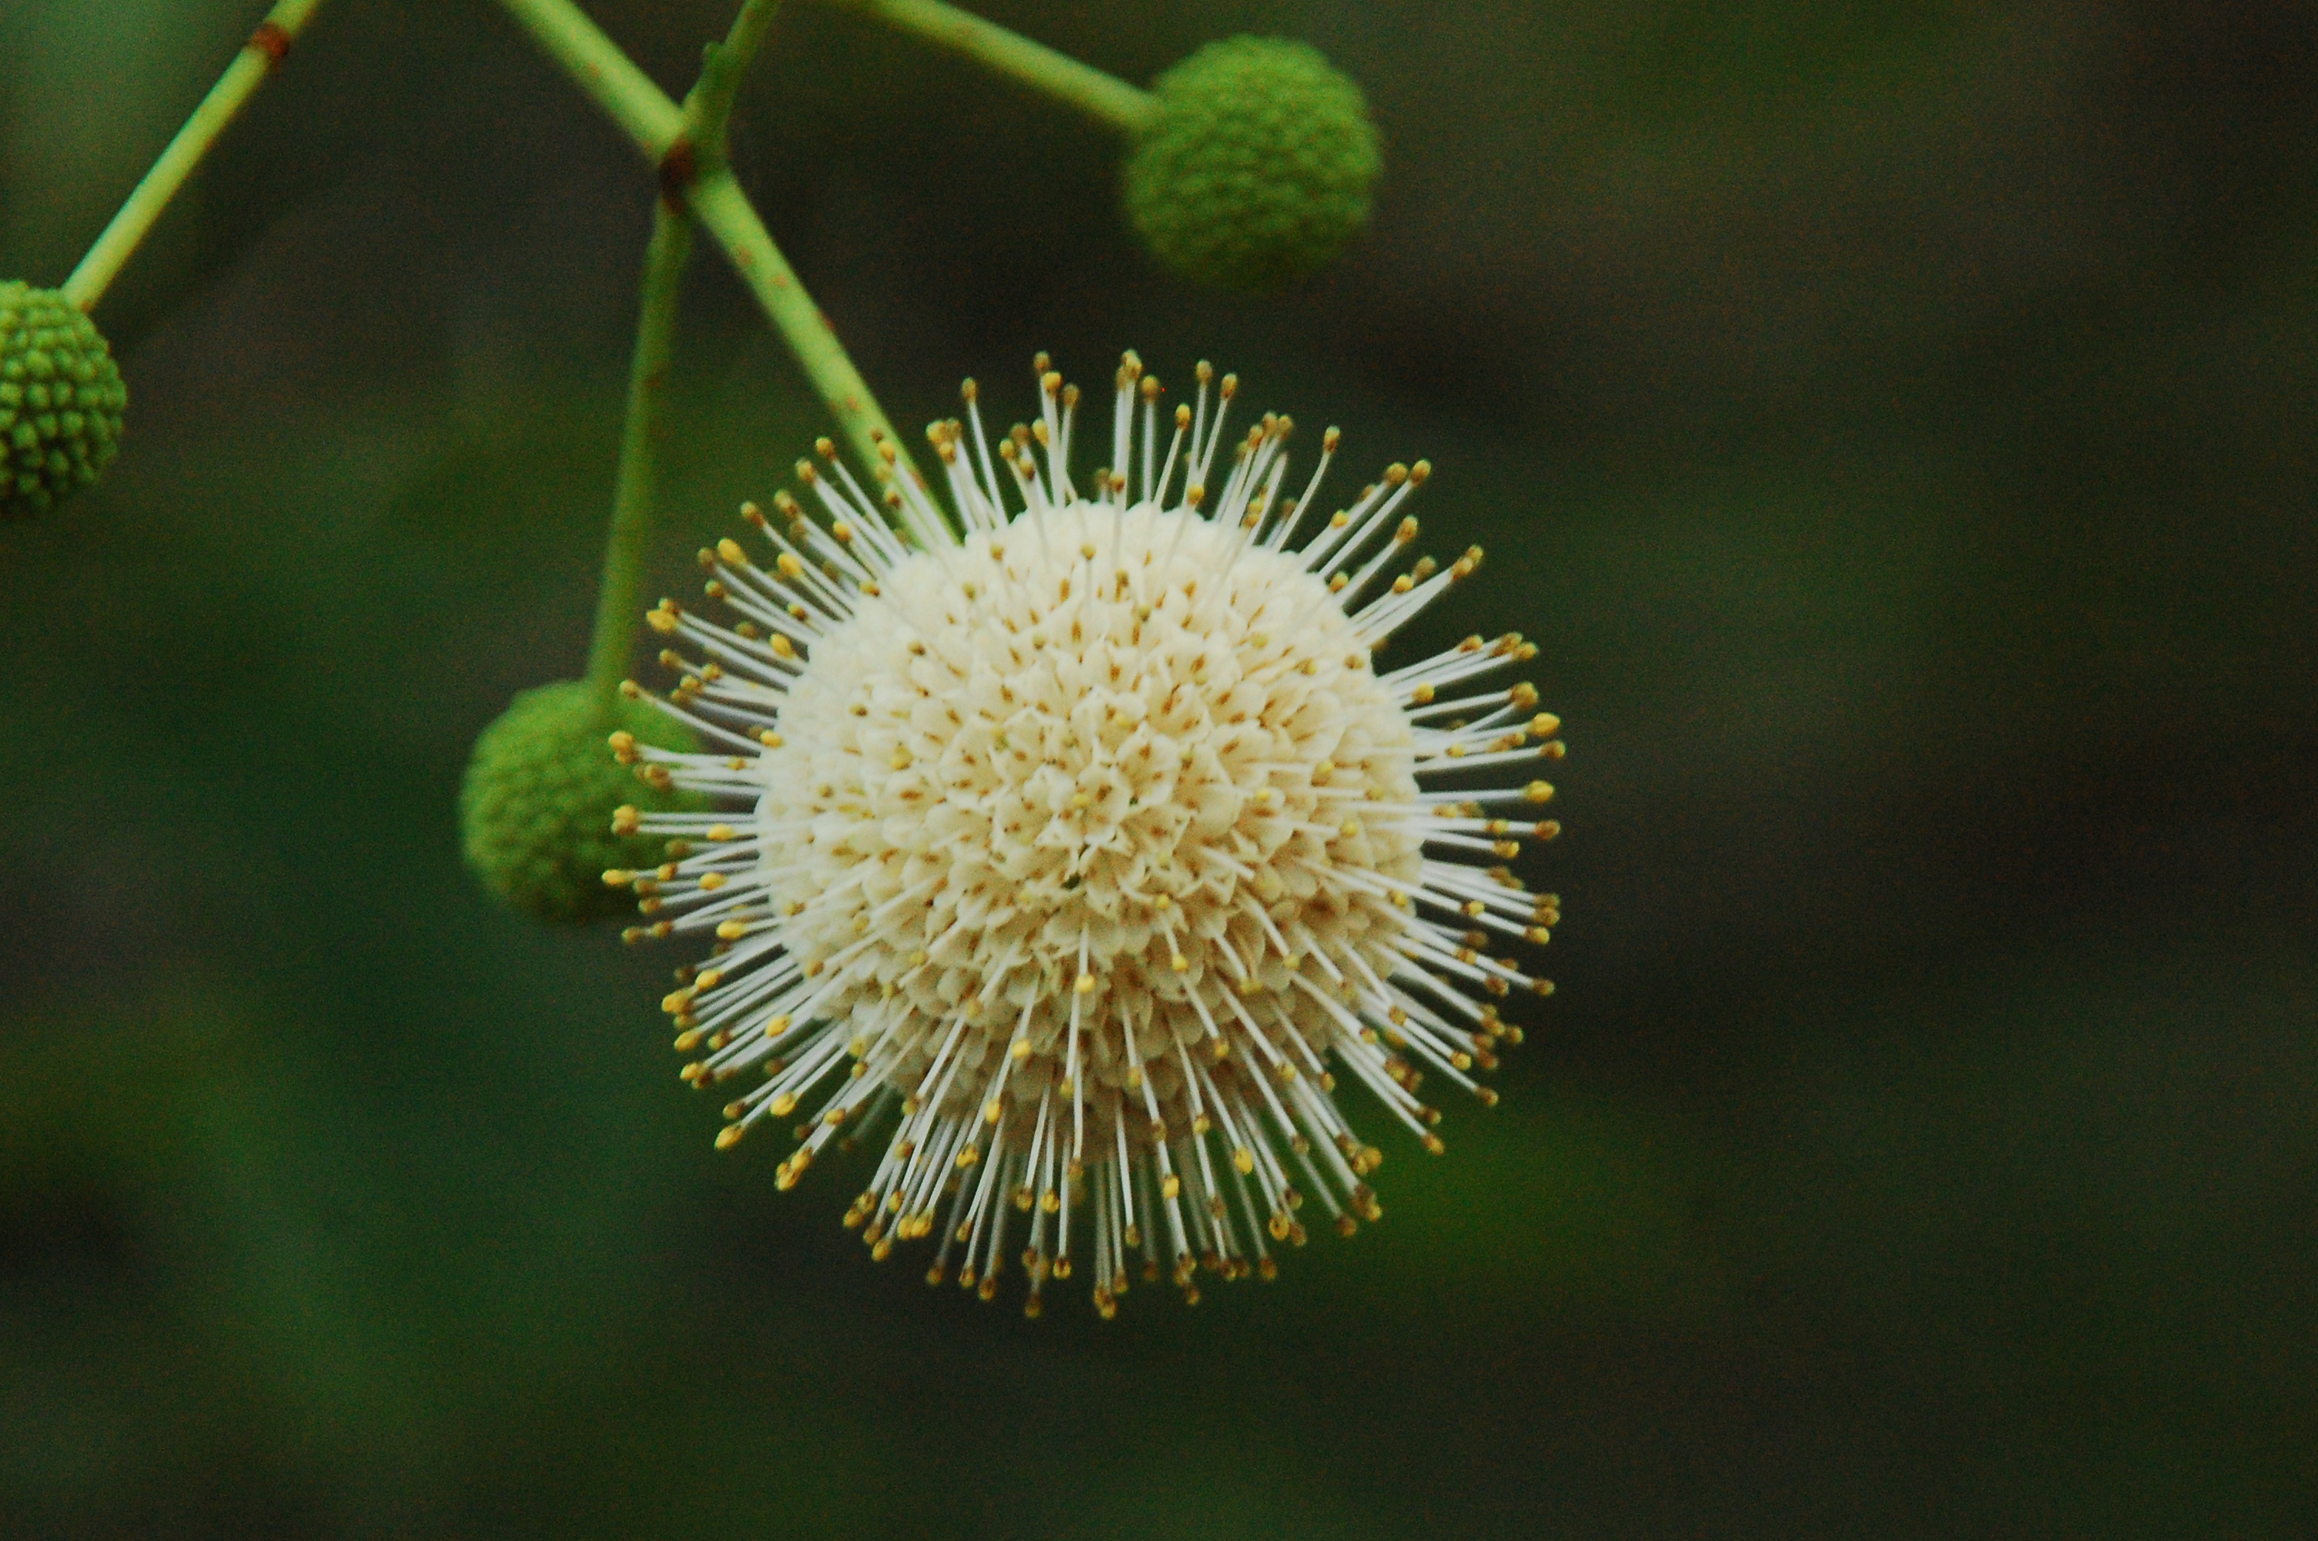
Buttonbush
Cephalanthus occidentalis
Notes:
2018_07_10_003 Sugar River
2013_04_29_020Fakahatchee

Slide 2
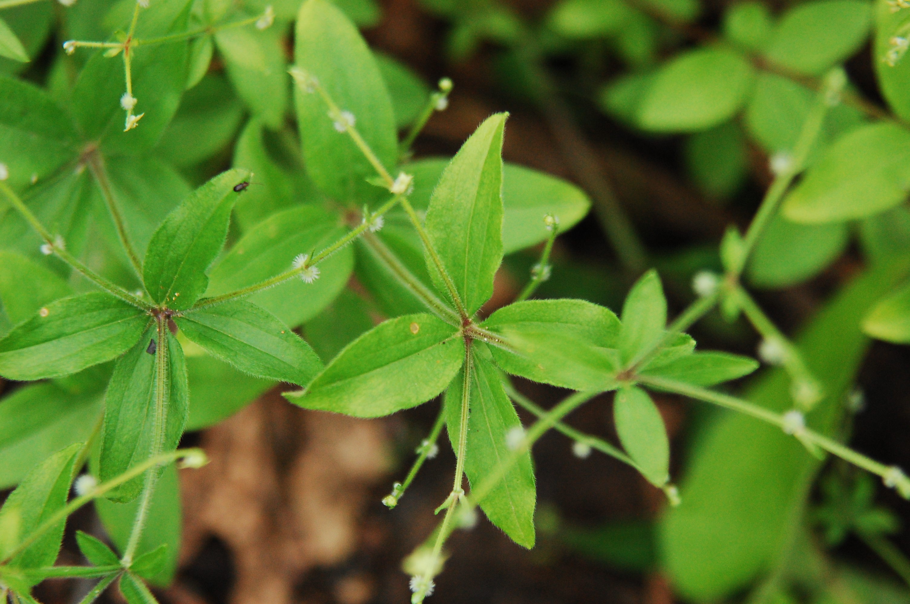
Wild Licorice
Galium circaezans
Notes:
2013_06_26_075 Mudgett Property

Slide 3
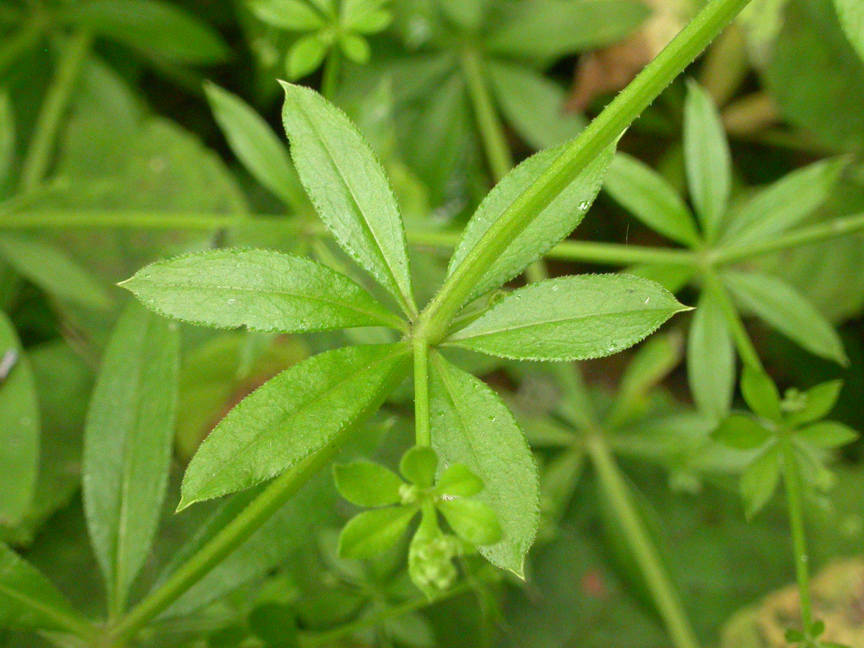
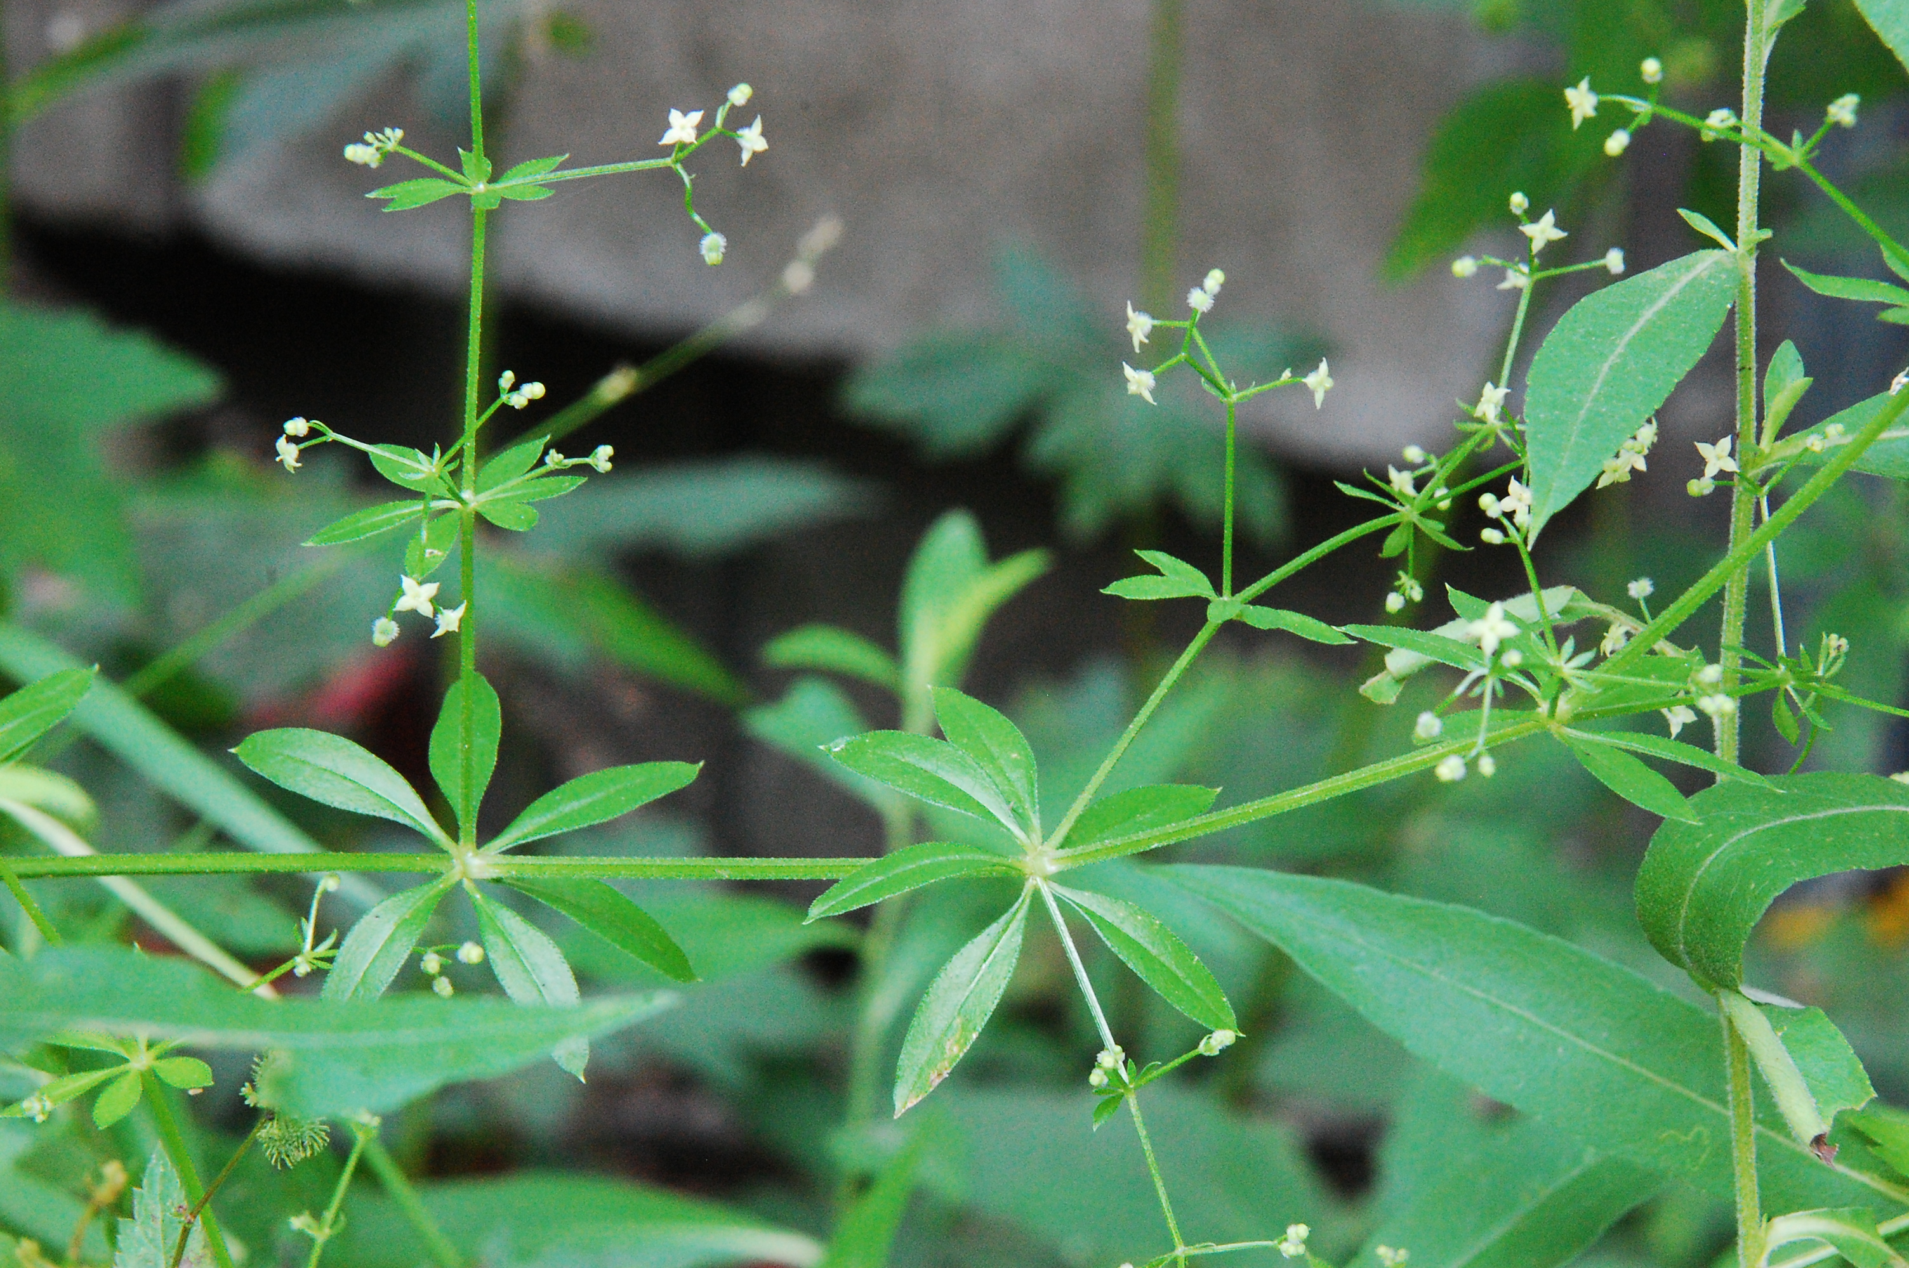
Fragrant Bedstraw
Galium triflorum
Notes:
2009_07_04_025Kickapoo
2010_07_04_020 Kickapoo.jpg

Slide 4

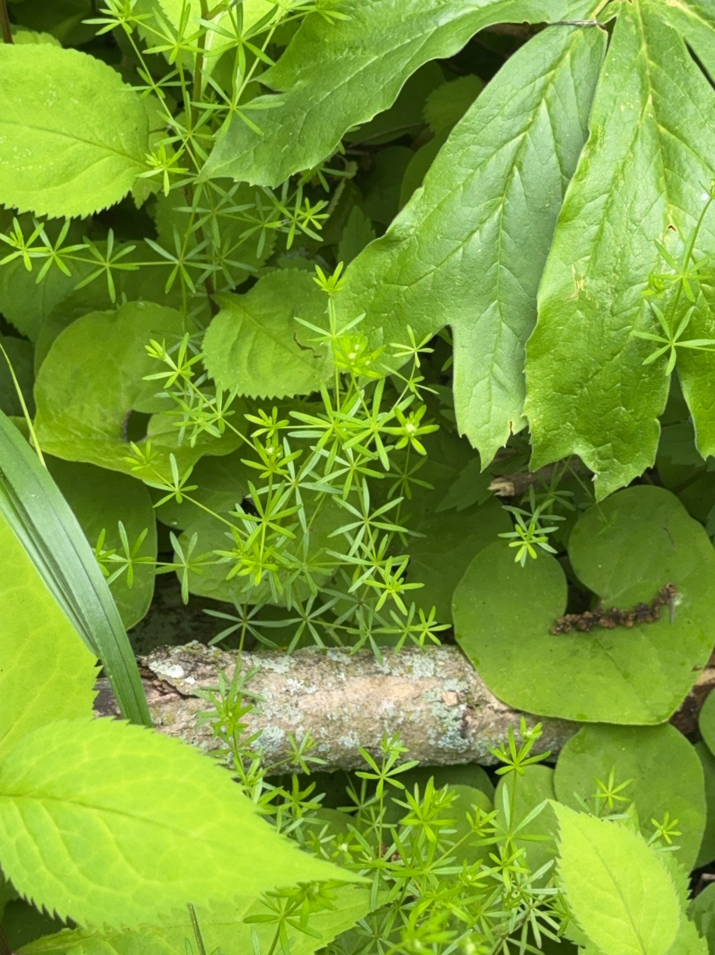
Pretty Bedstraw
Galium concinnum

Slide 5
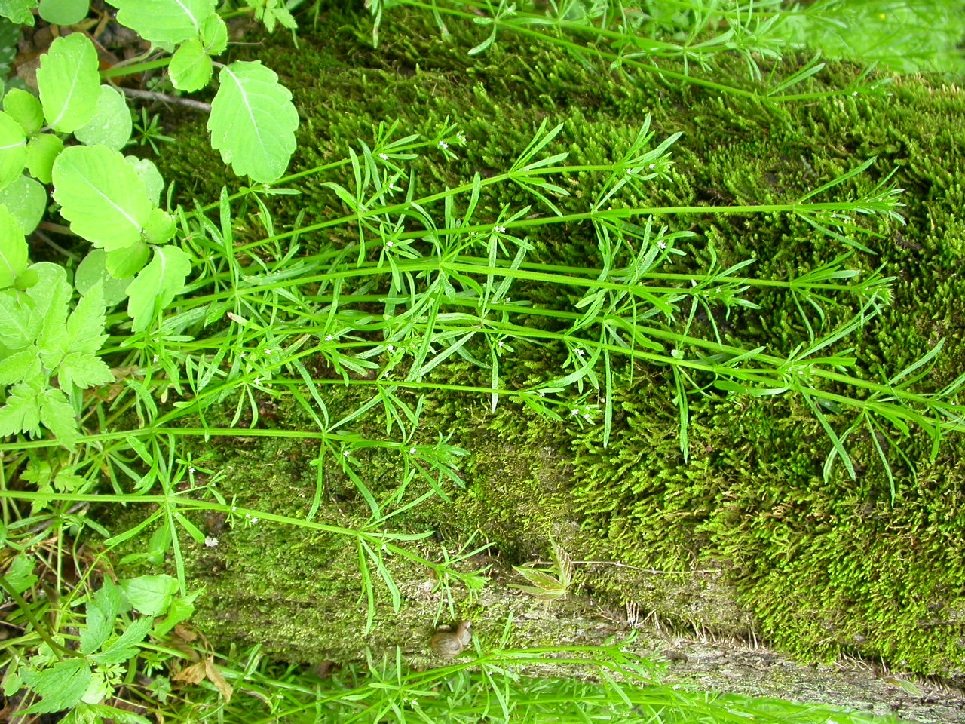
Cleavers
Galium aparine
Notes:
2005_05_13_025 Kickapoo

Slide 6
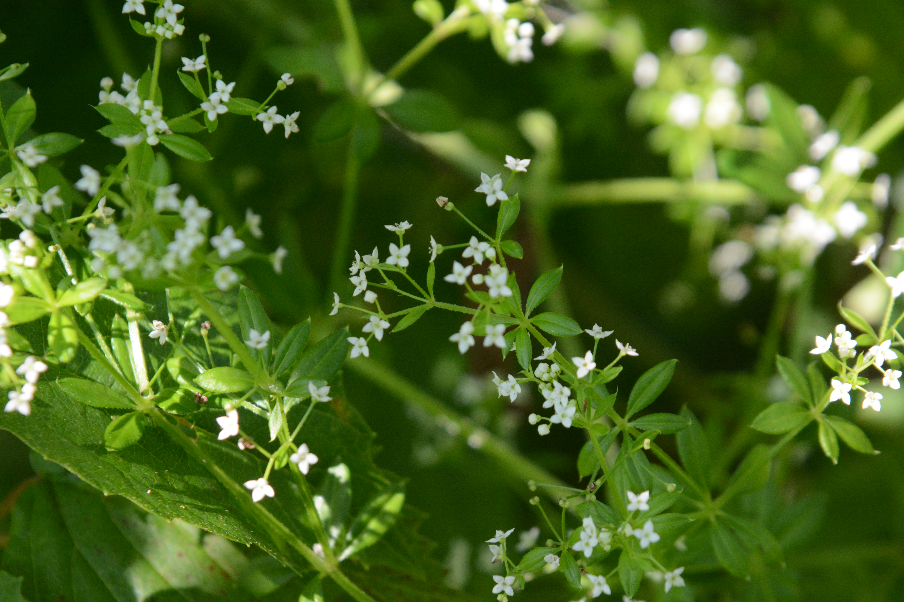
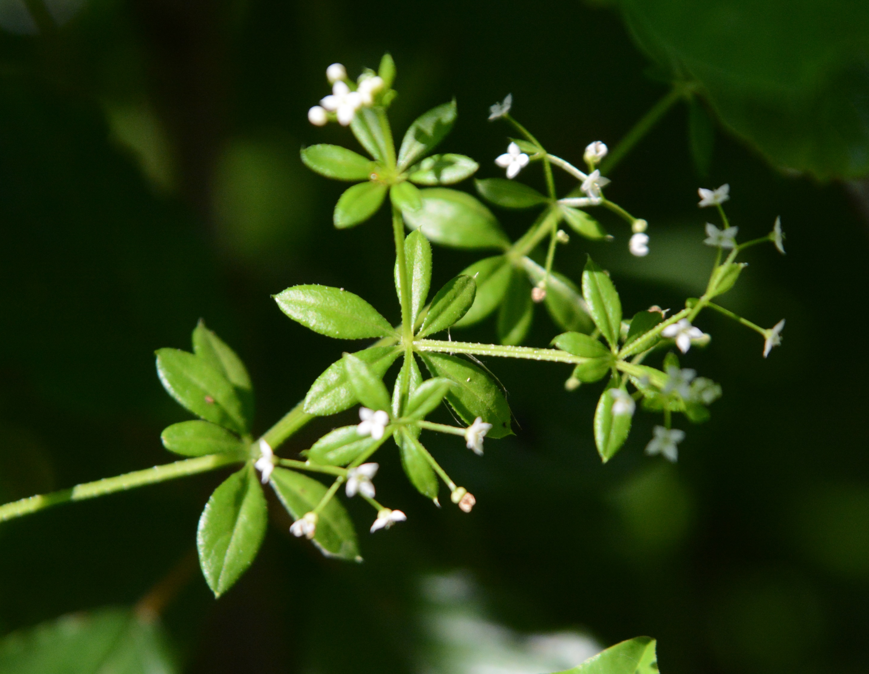
Rough Bedstraw
Galium asprellum
Notes:
2015_07_28_015 Wehr
2015_07_28_017 Wehr

Slide 7
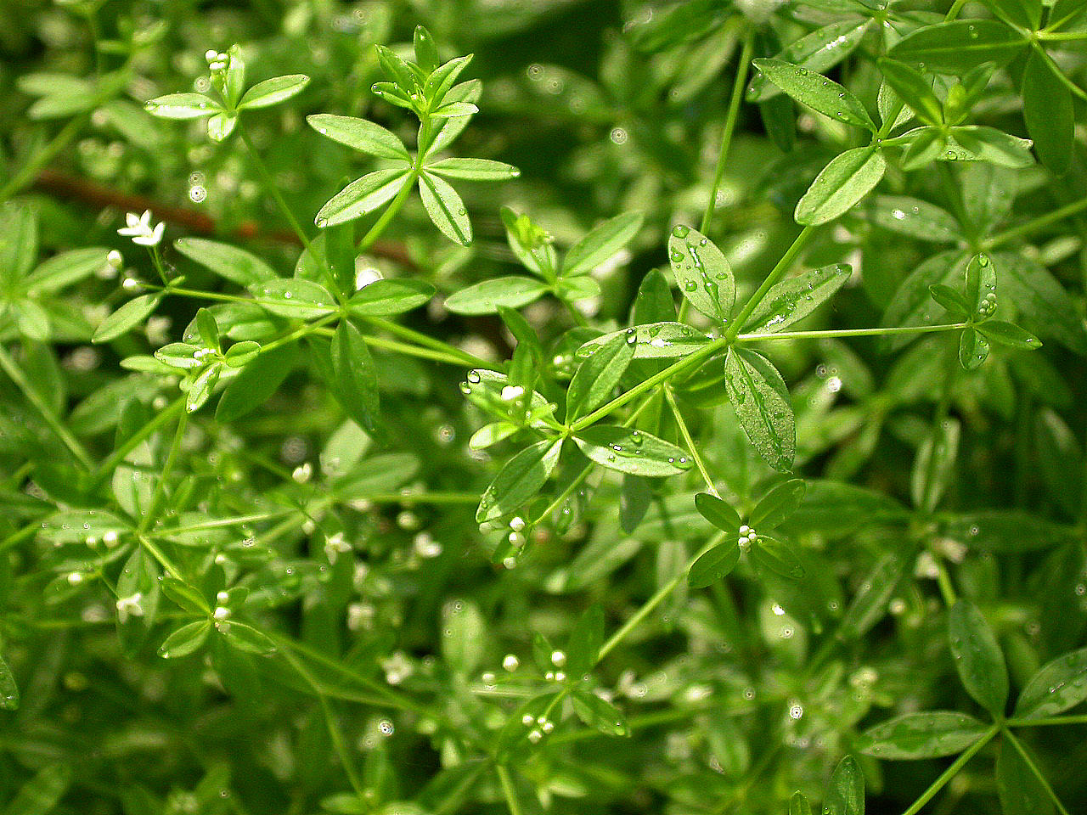
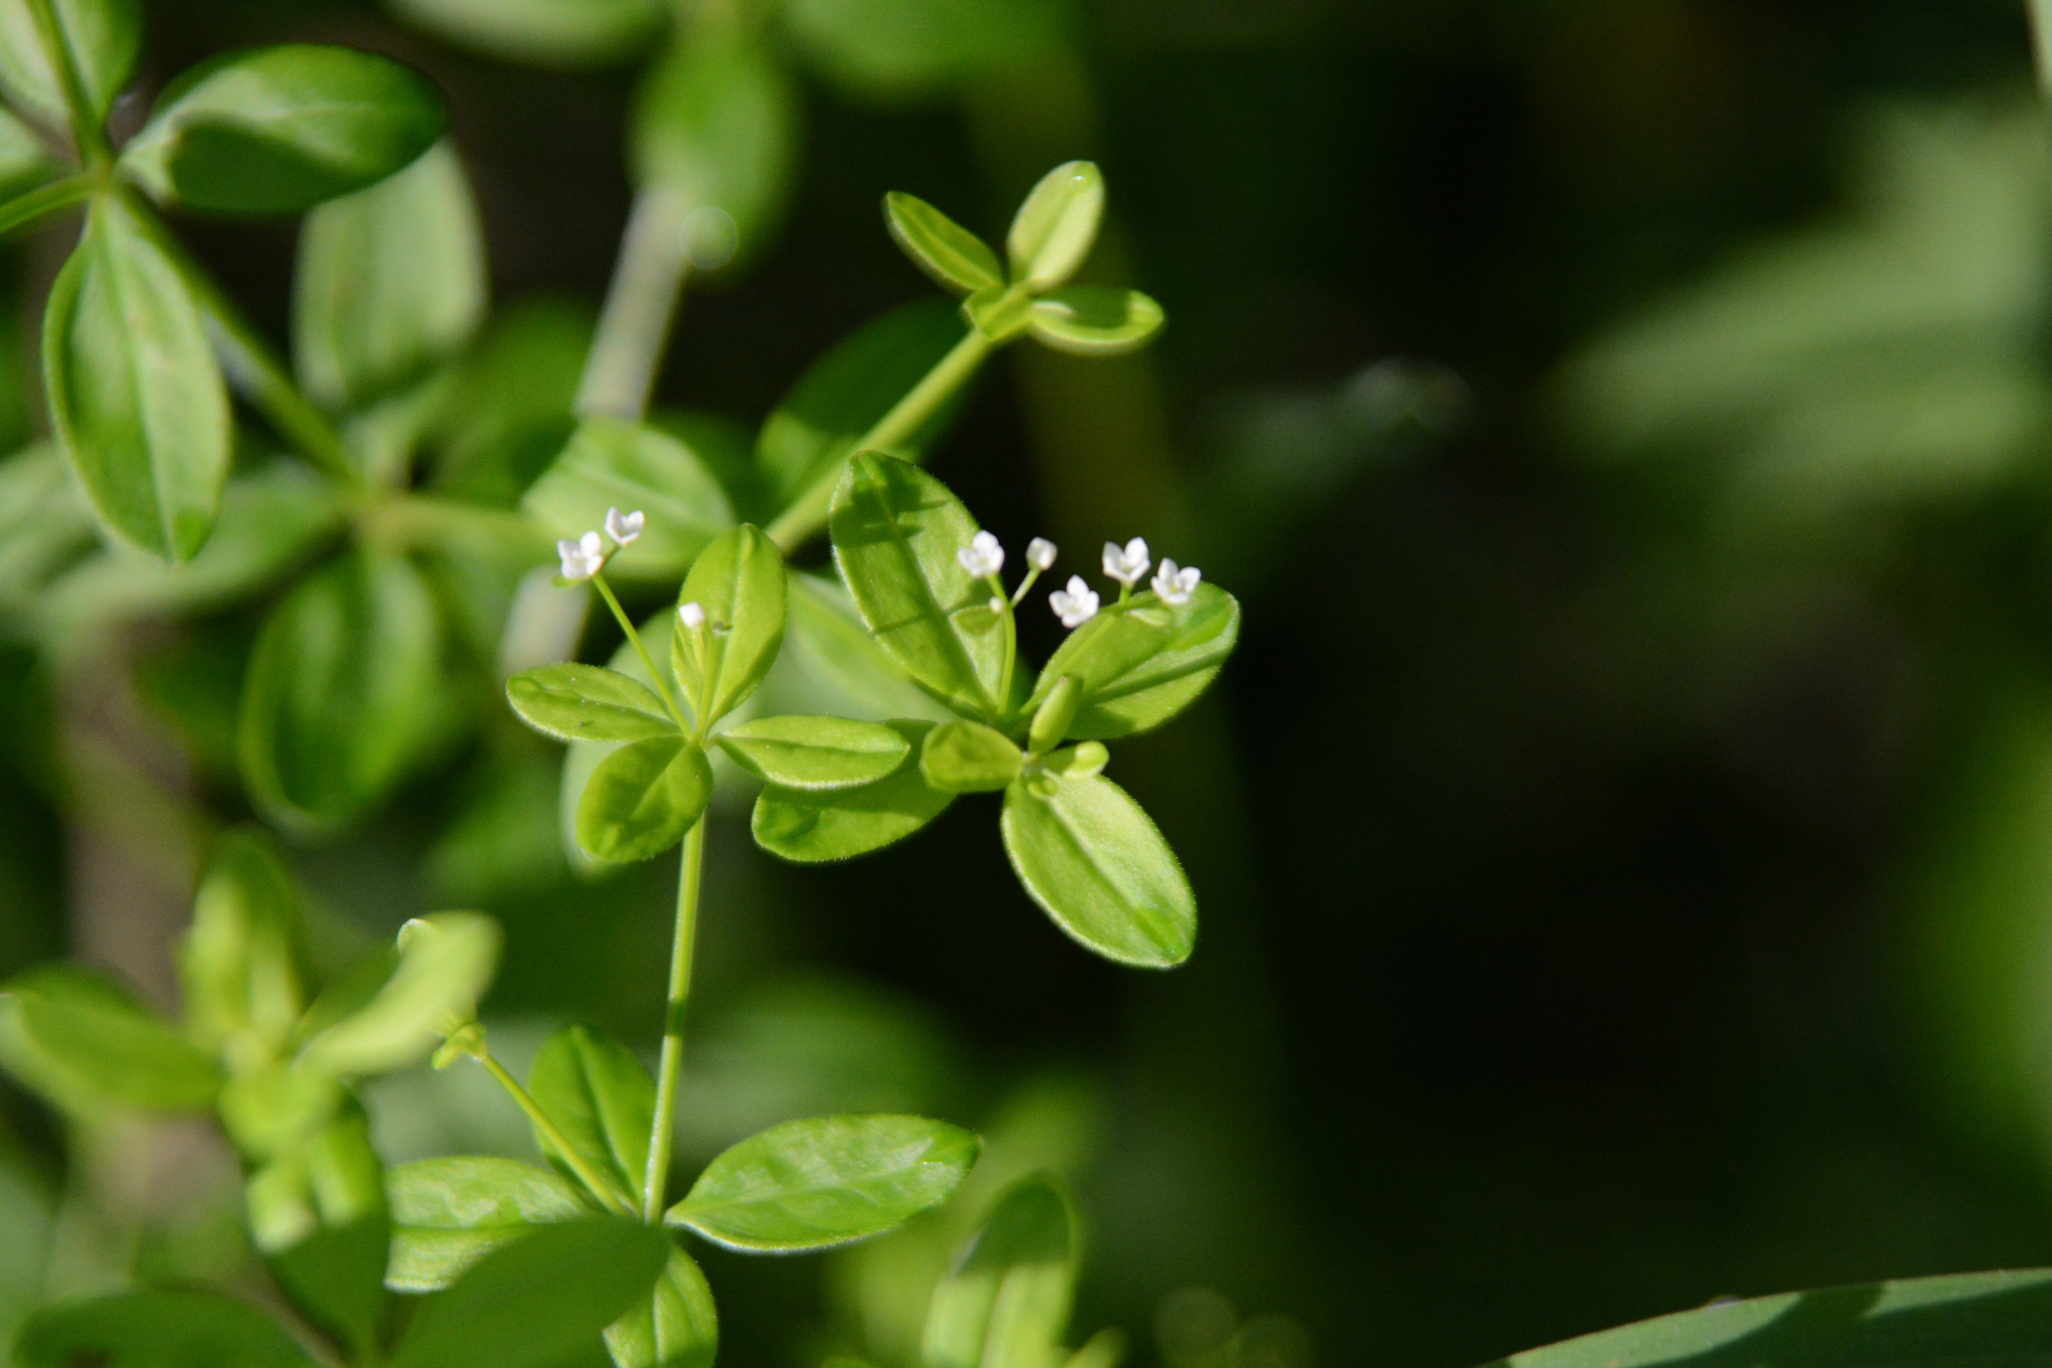
Blunt-leaved Bedstraw
Galium obtusum
Notes:
2025_05_29_003 Vernon Wildlife Area 2005_06_11_003 Kickapoo
2015_06_19_005 Kickapoo.JPG

