Slide 1
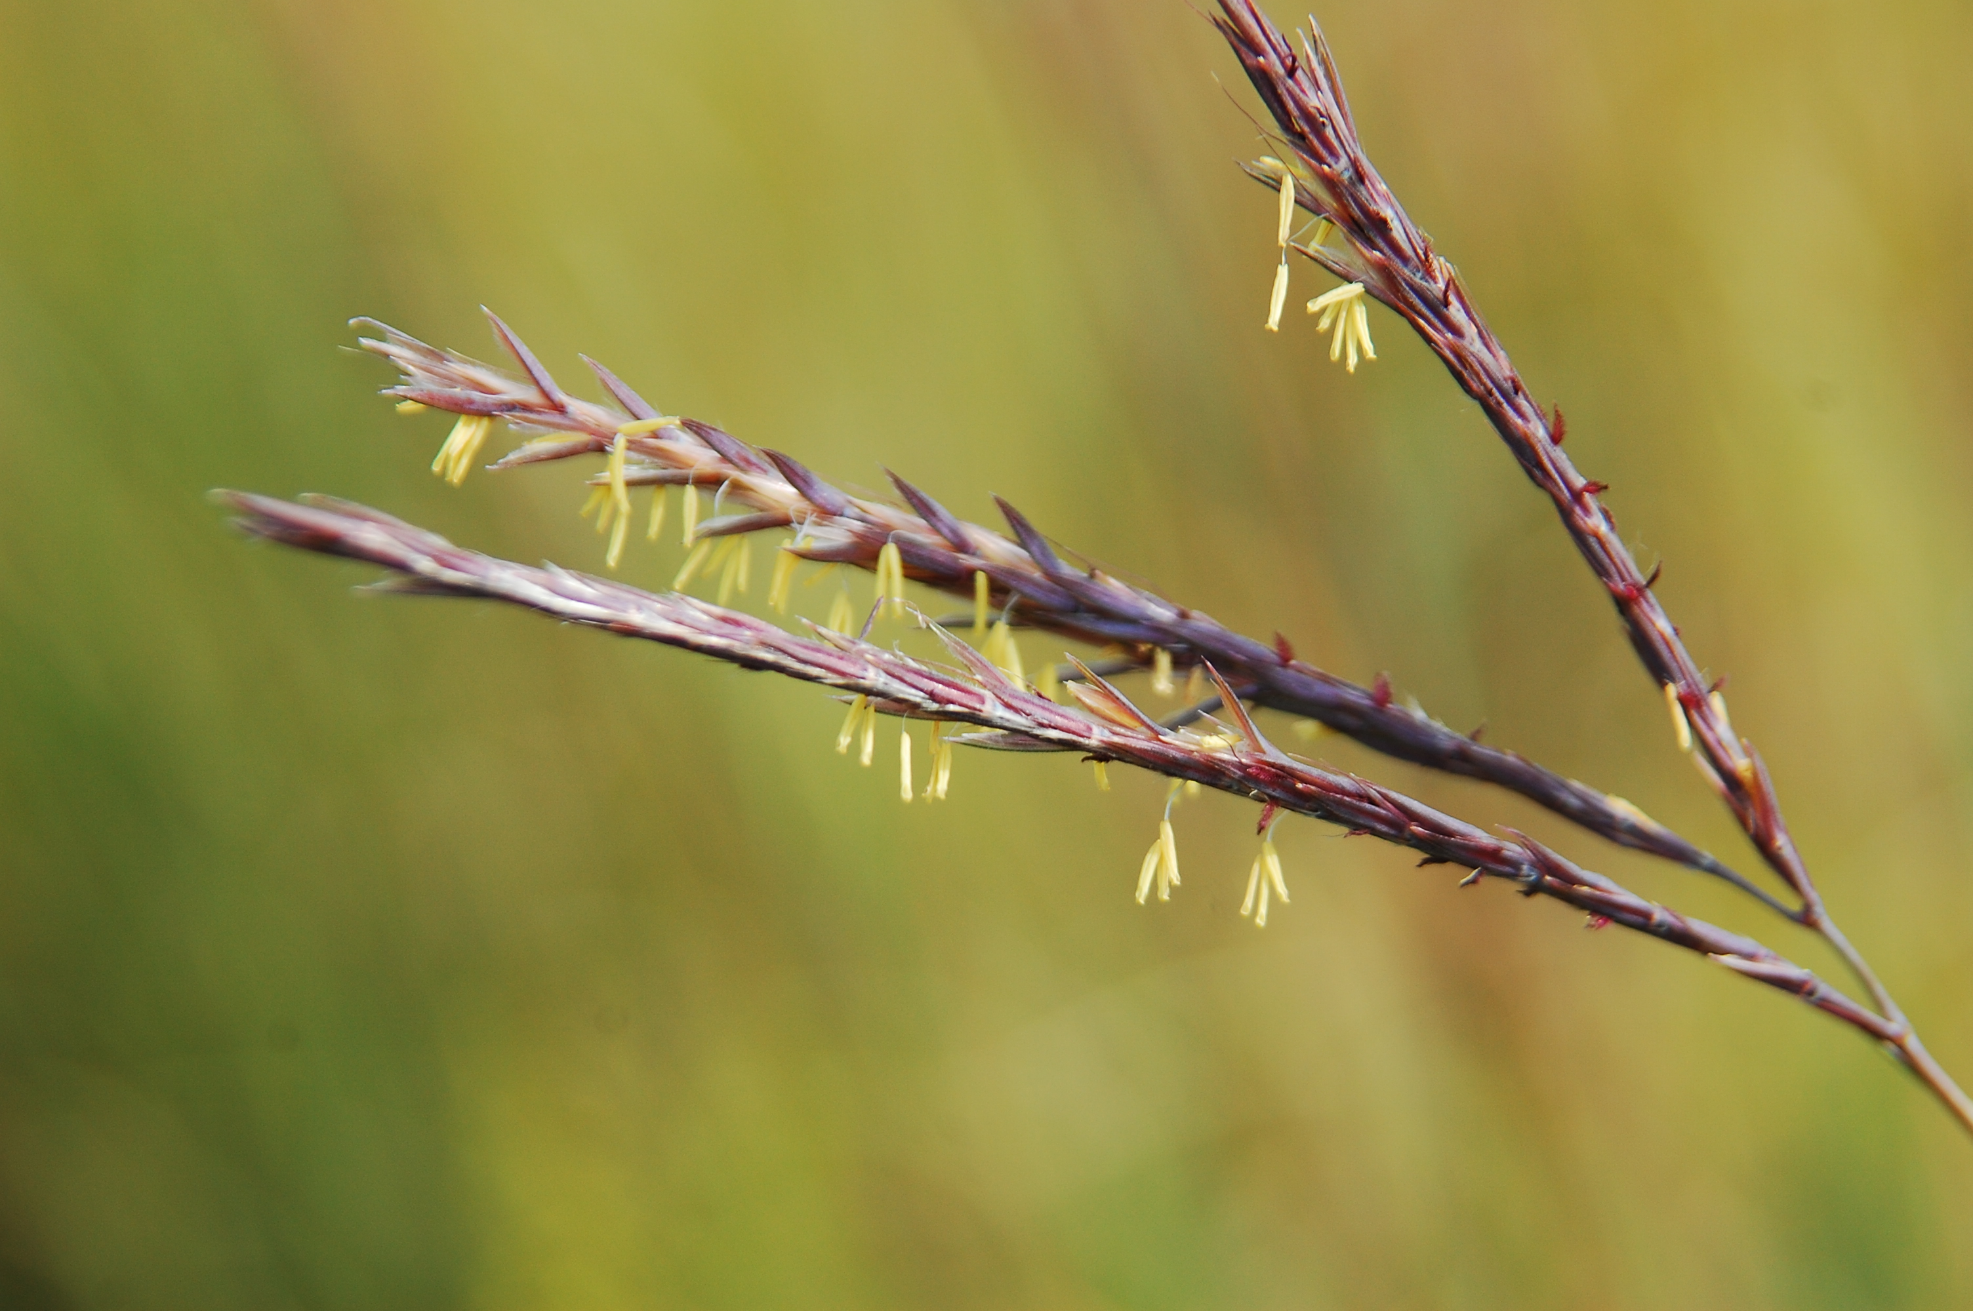
Big Bluestem
Andropogon gerardi
Notes:
2012_09_01_018 Wehr

Slide 2
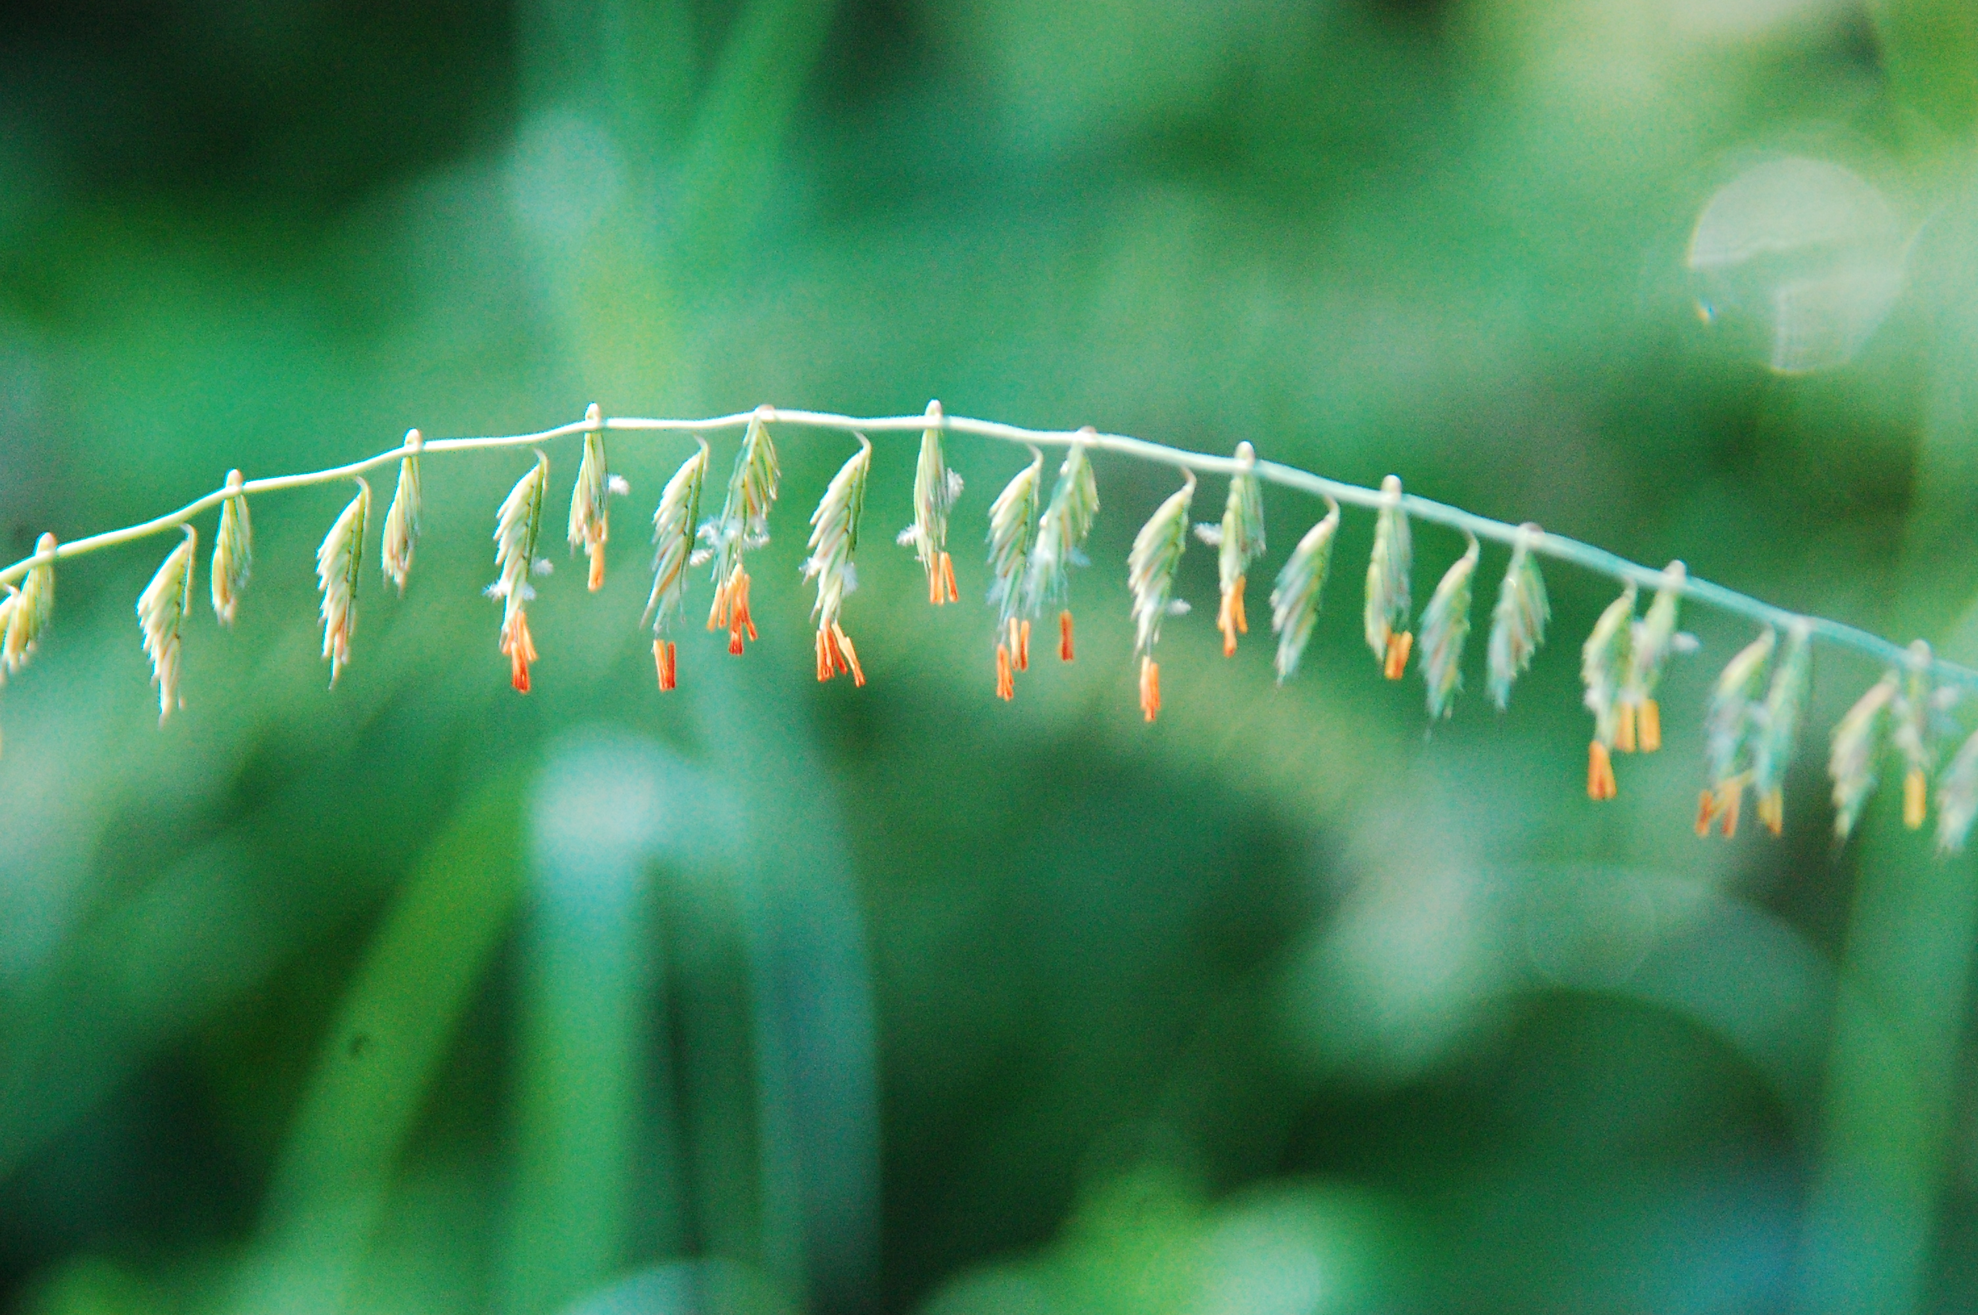
Side Oats Gramma
Bouteloua curtipendula
Notes:
2011_0 8_15_001Wehr

Slide 3
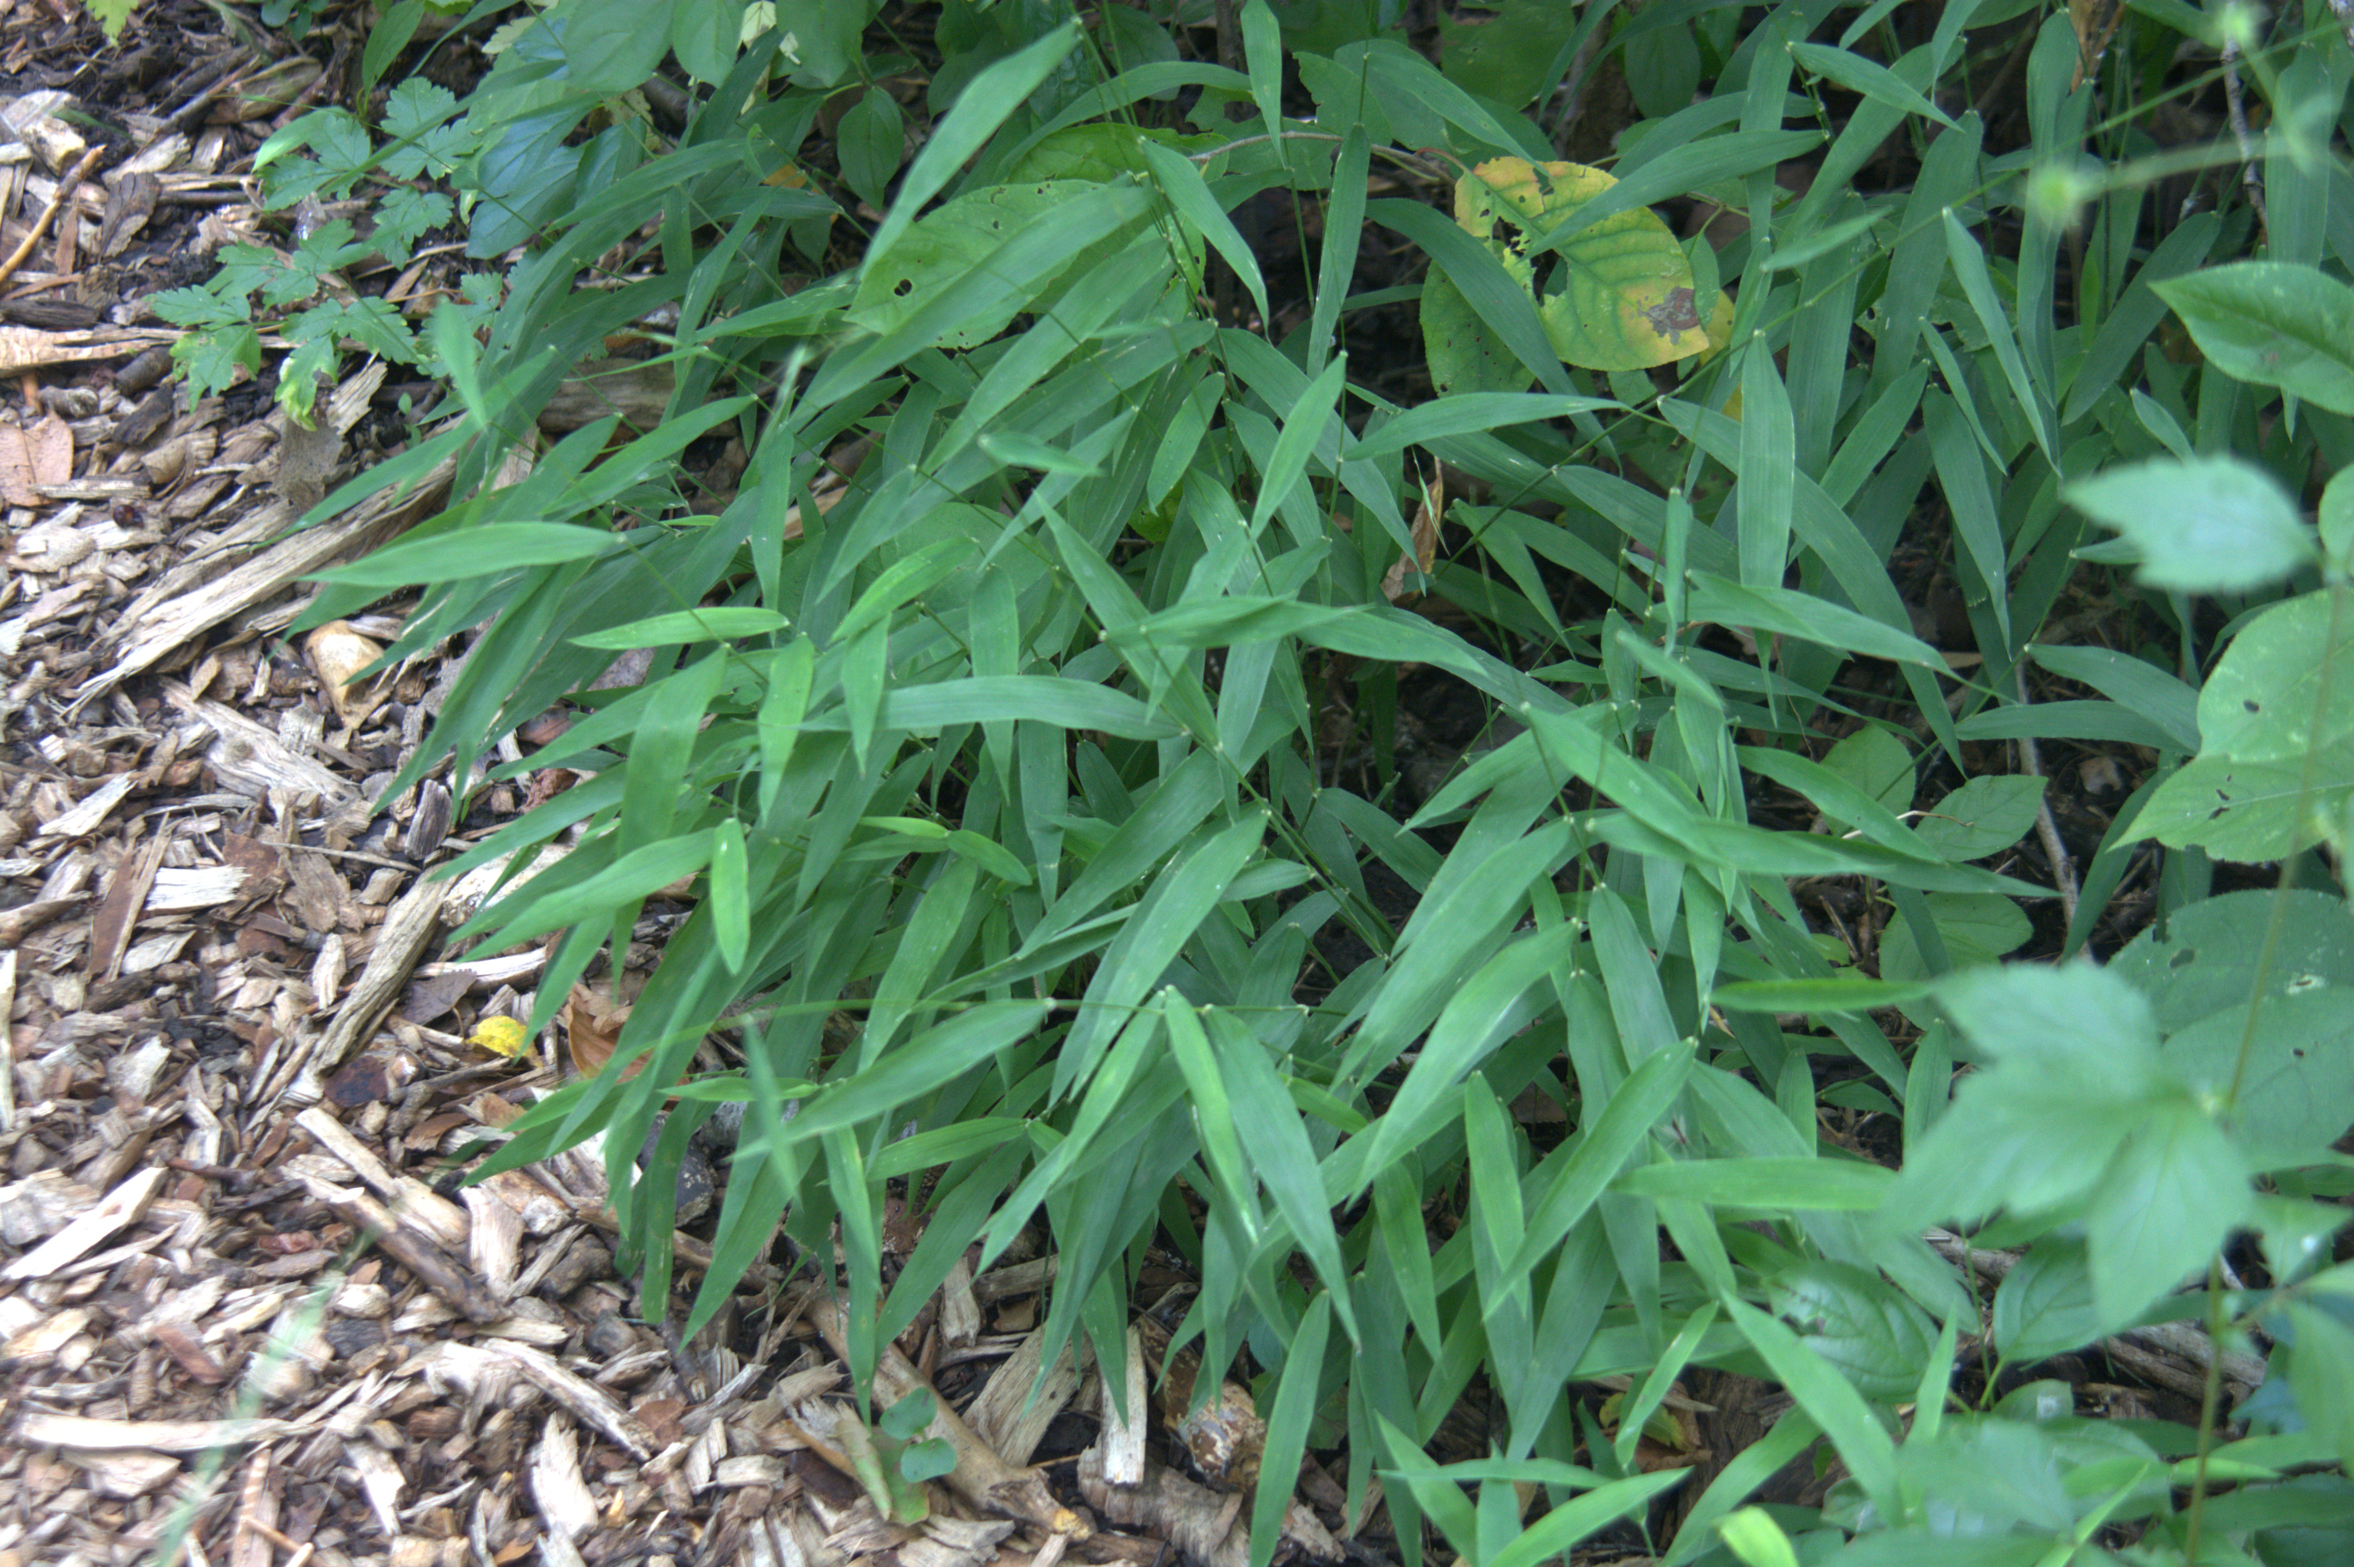
Long-awned Wood Grass
Brachyelytrum erectum
Notes:
2018_08_07_019 Wehr

Slide 4
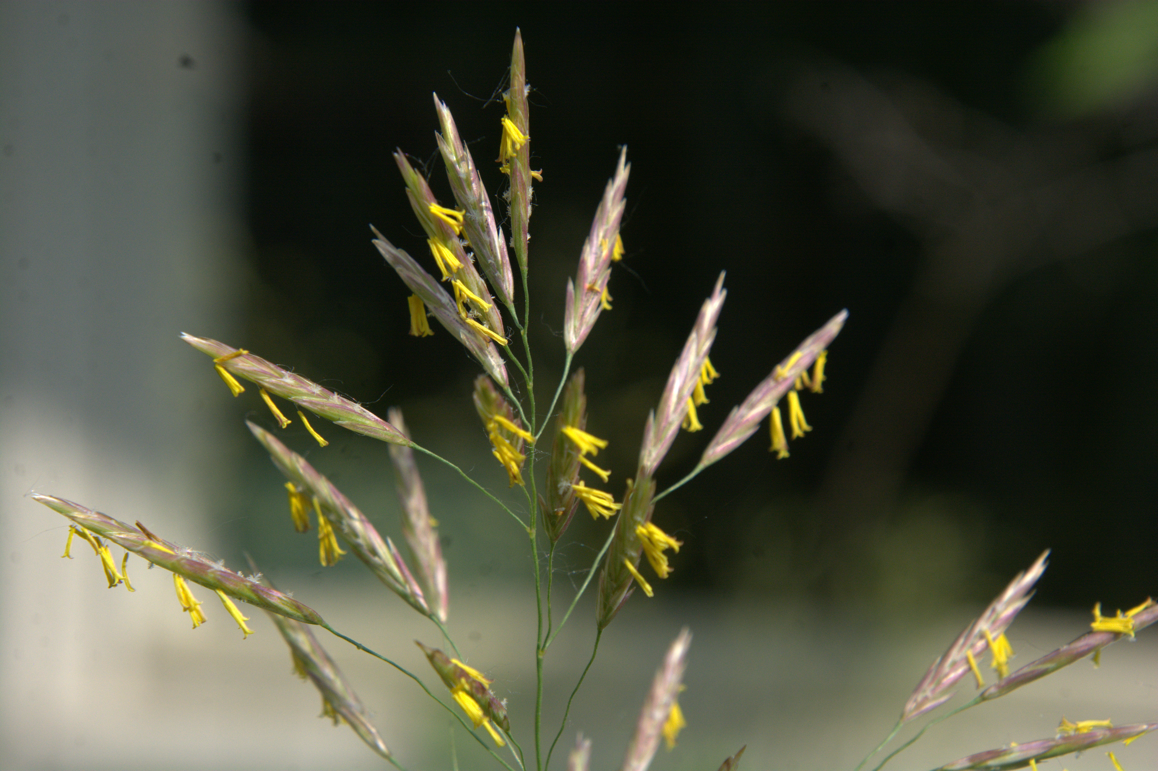
Smooth Brome
Bromus inermis
Notes:
2025_06_16_001 Wehr Nature Center

Slide 5
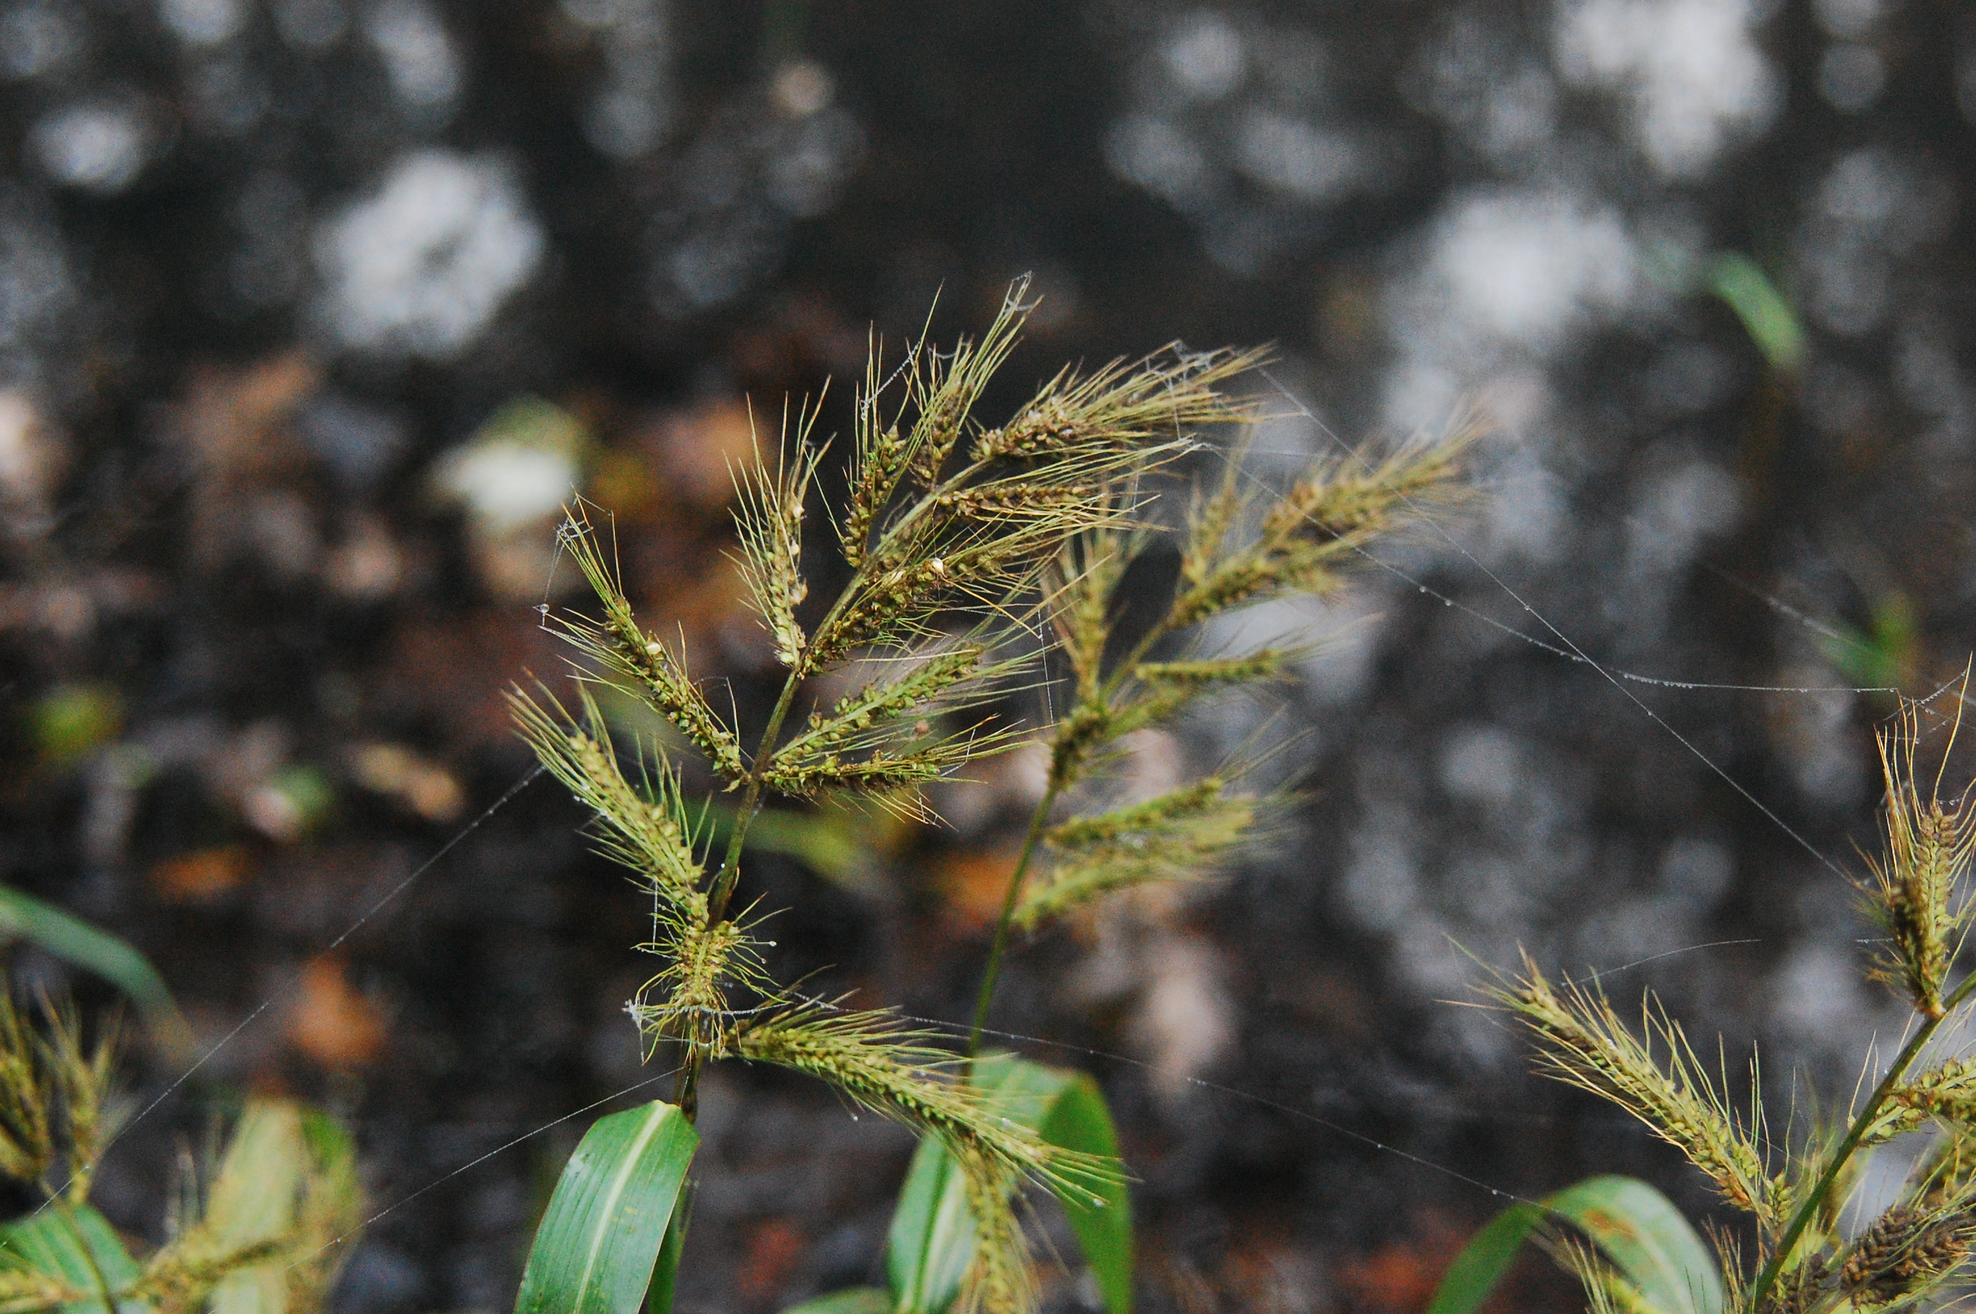
Walter’s Barnyard Grass
Echinochloa walteri

Slide 6
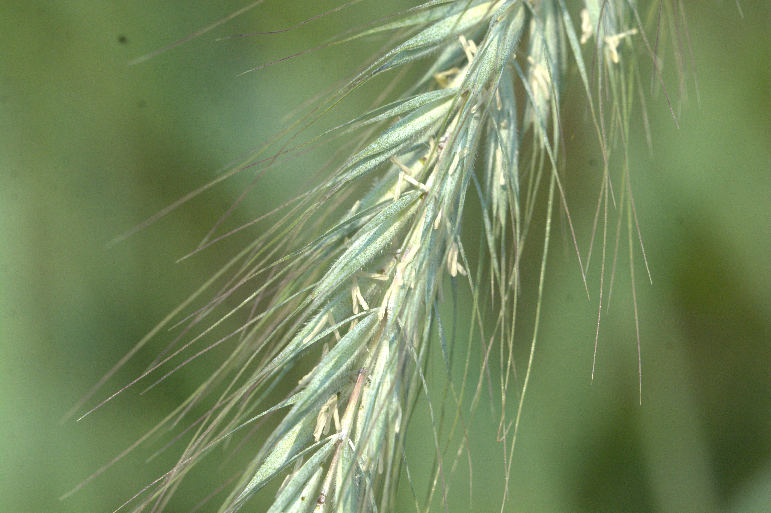
Canada Wild-Rye
Elymus canadensis
Notes:
2024_07_22_001 Wehr Nature Center

Slide 7
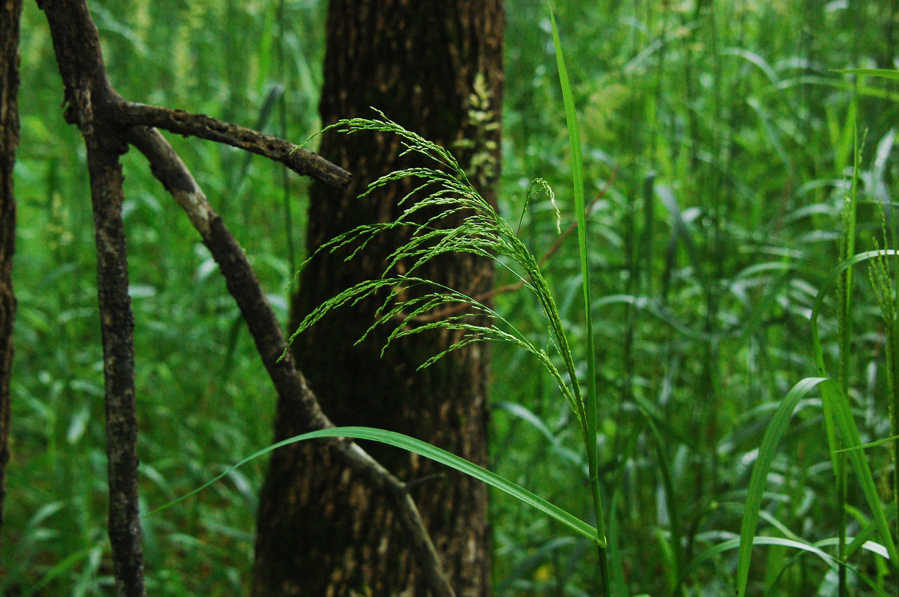
Fowl Mannagrass
Glyceria striata
Notes:
2010_06_14_015 Kickapoo

Slide 8
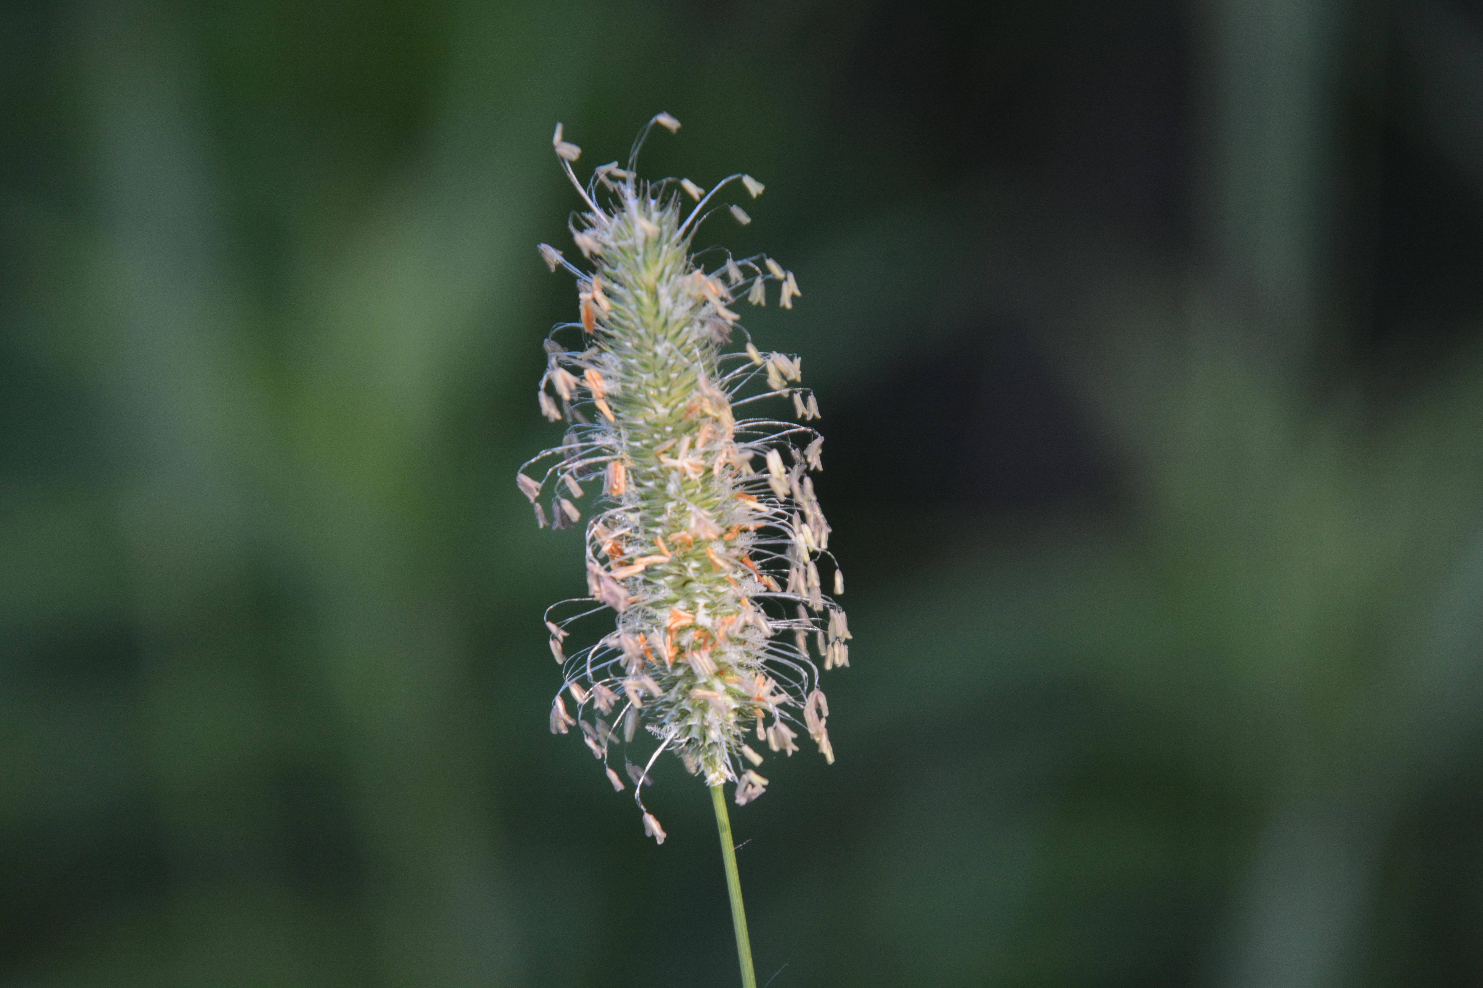
Timothy
Phleum pratense
Notes:
2014_07_10_002 Wehr

Slide 9
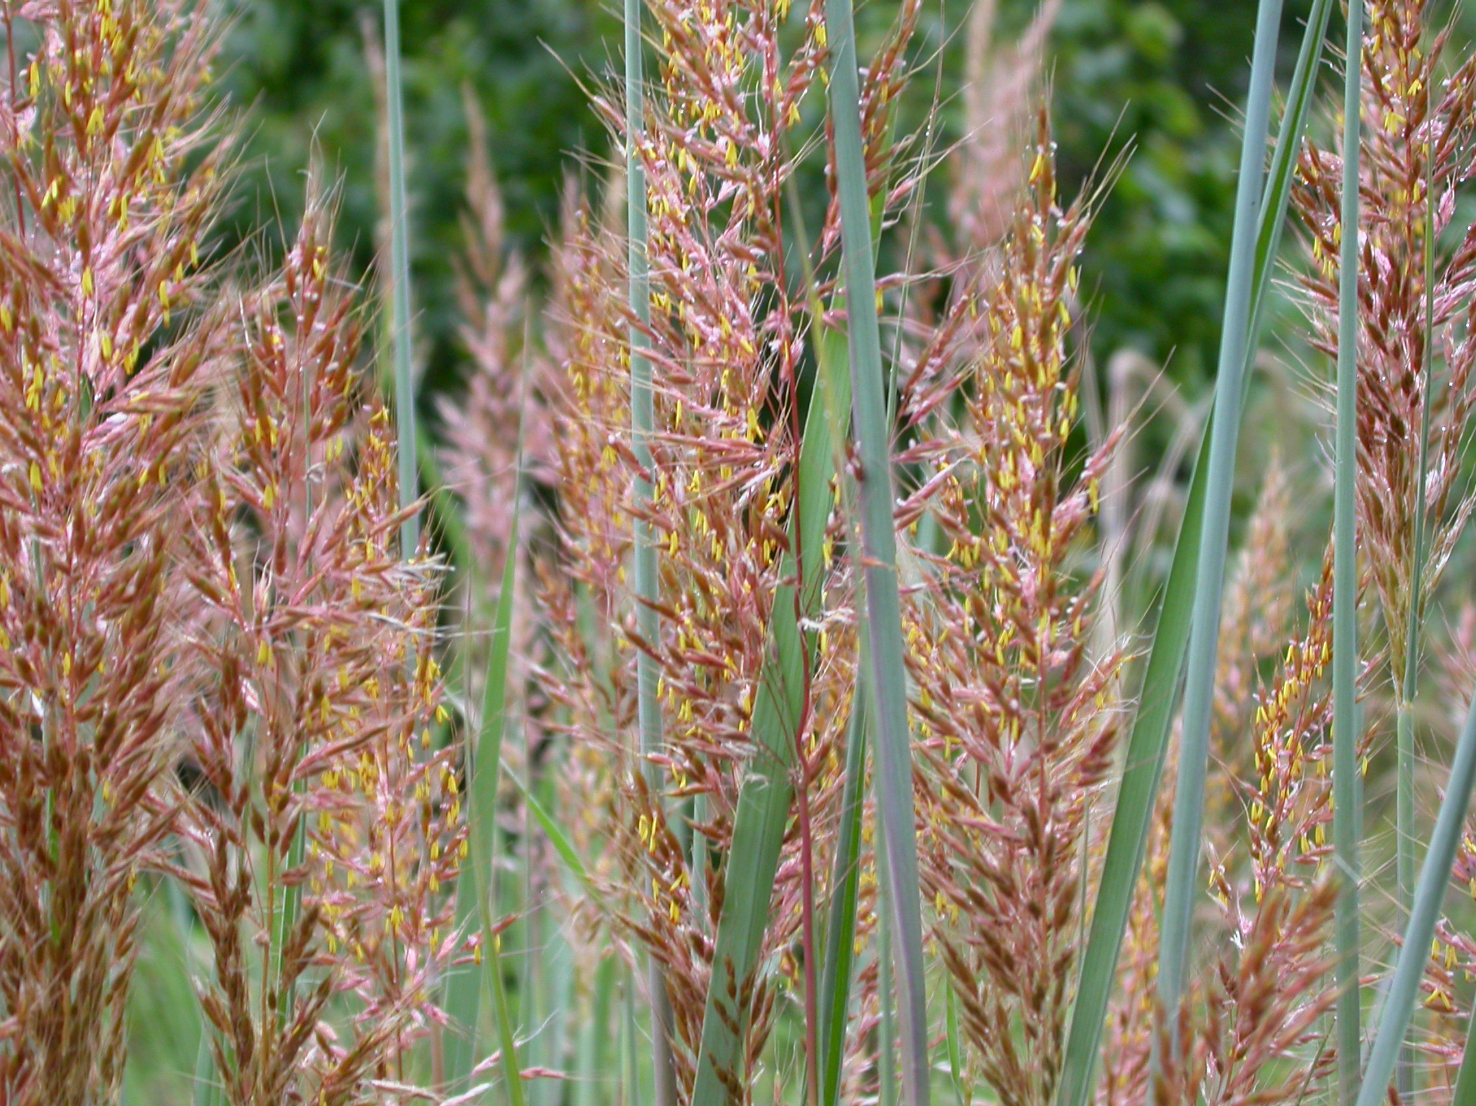
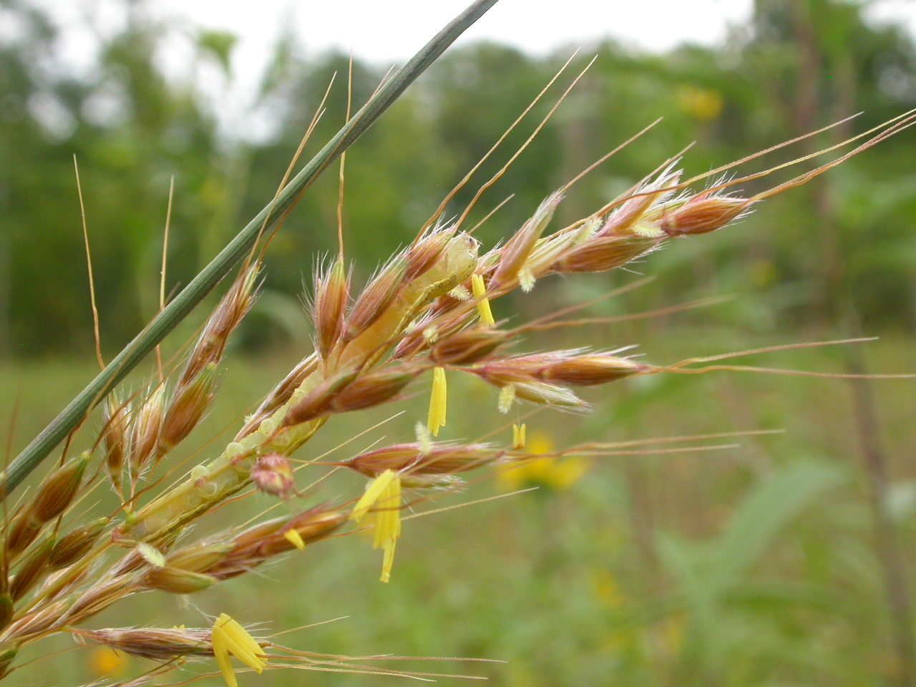
Indian Grass
Sorgastrum nutans
Notes:
2008_09_08_004 Wehr
2007_08_29_030 Wehr

Slide 10
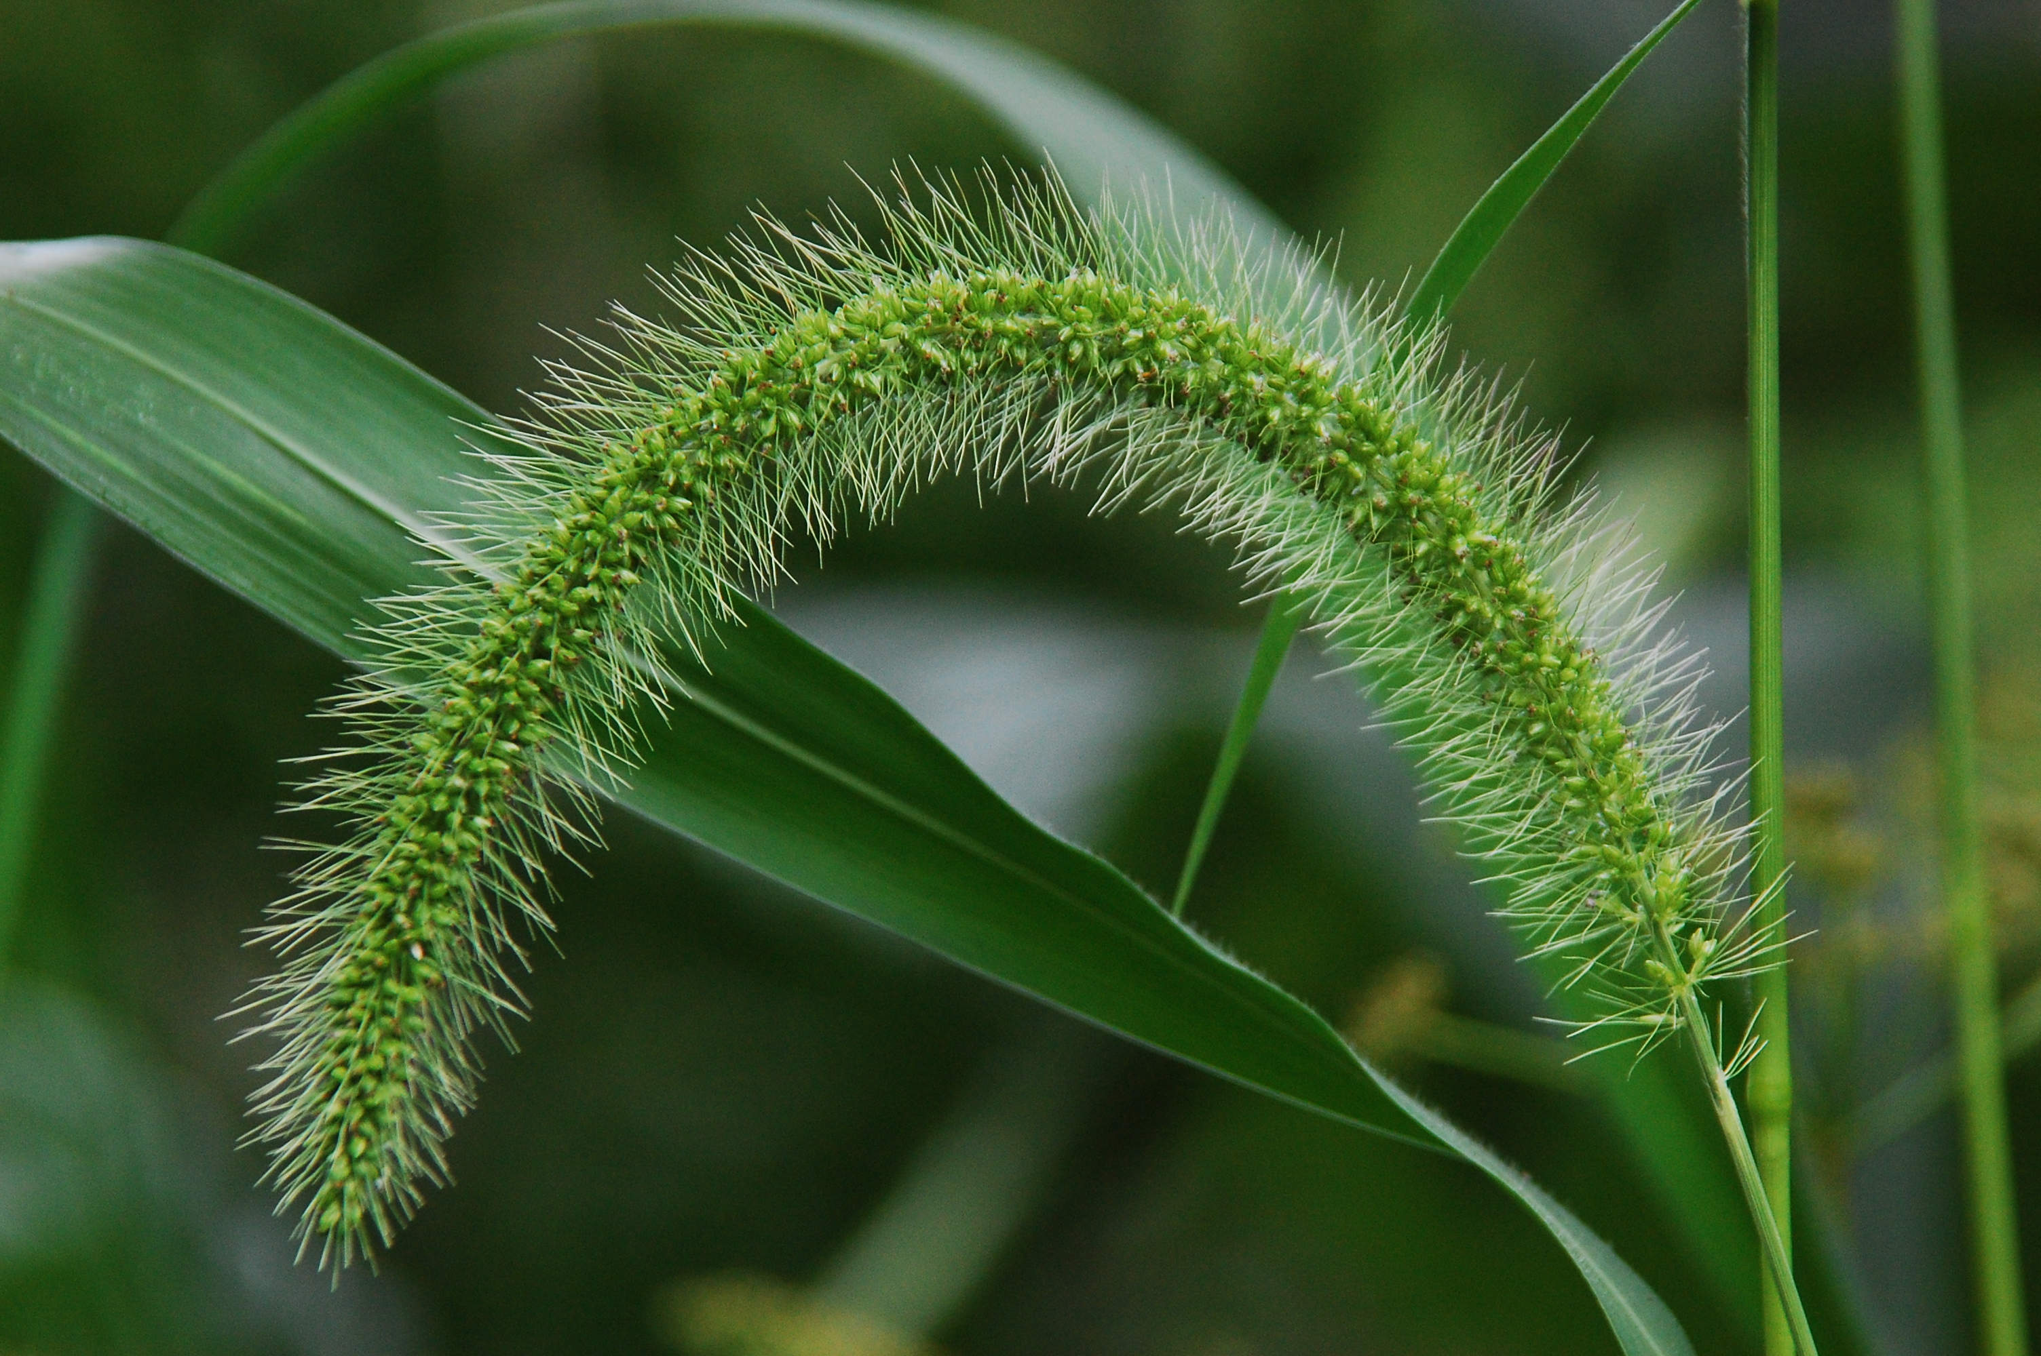
Giant Foxtail
Setaria faberi
Notes:
2010_08_17_047 Franklin.jpg

