Slide 1
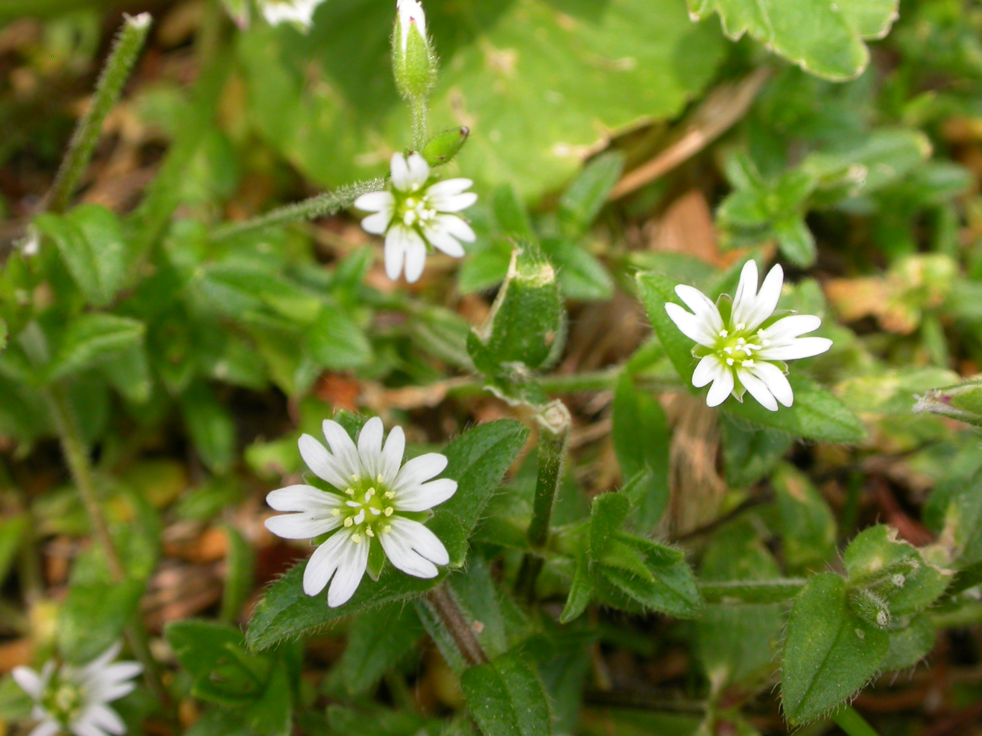
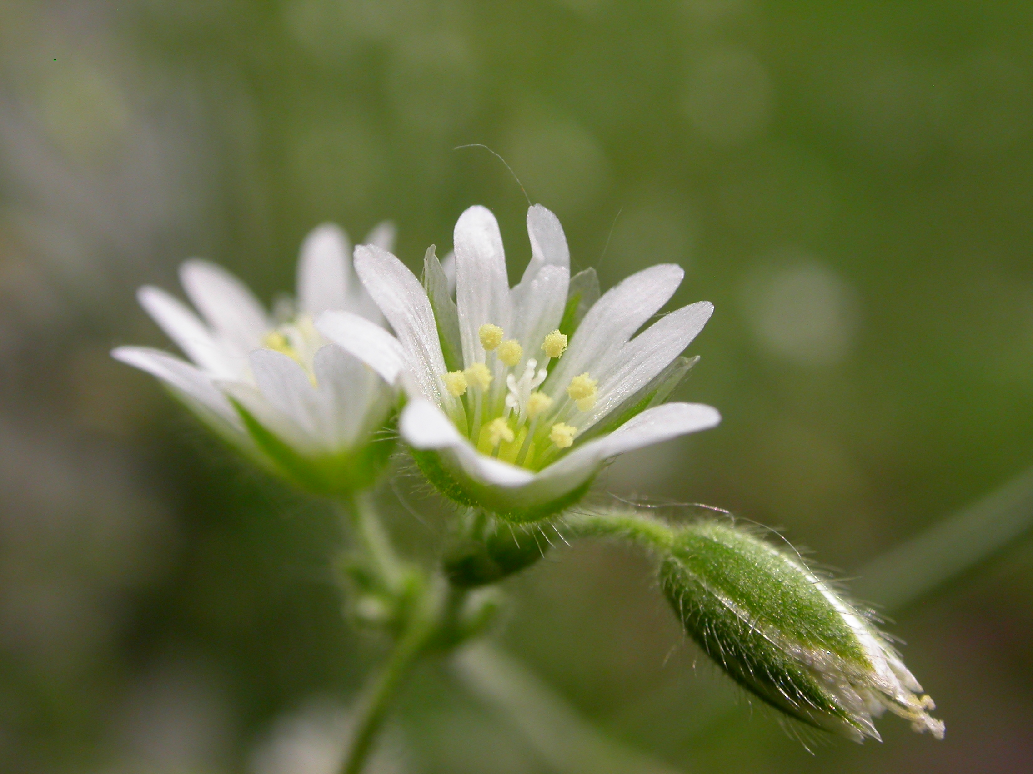
Mouse-eared Chickweed
Cerastium fontanum
Notes:
2009_06_16_013
2009_06_16_010

Slide 2
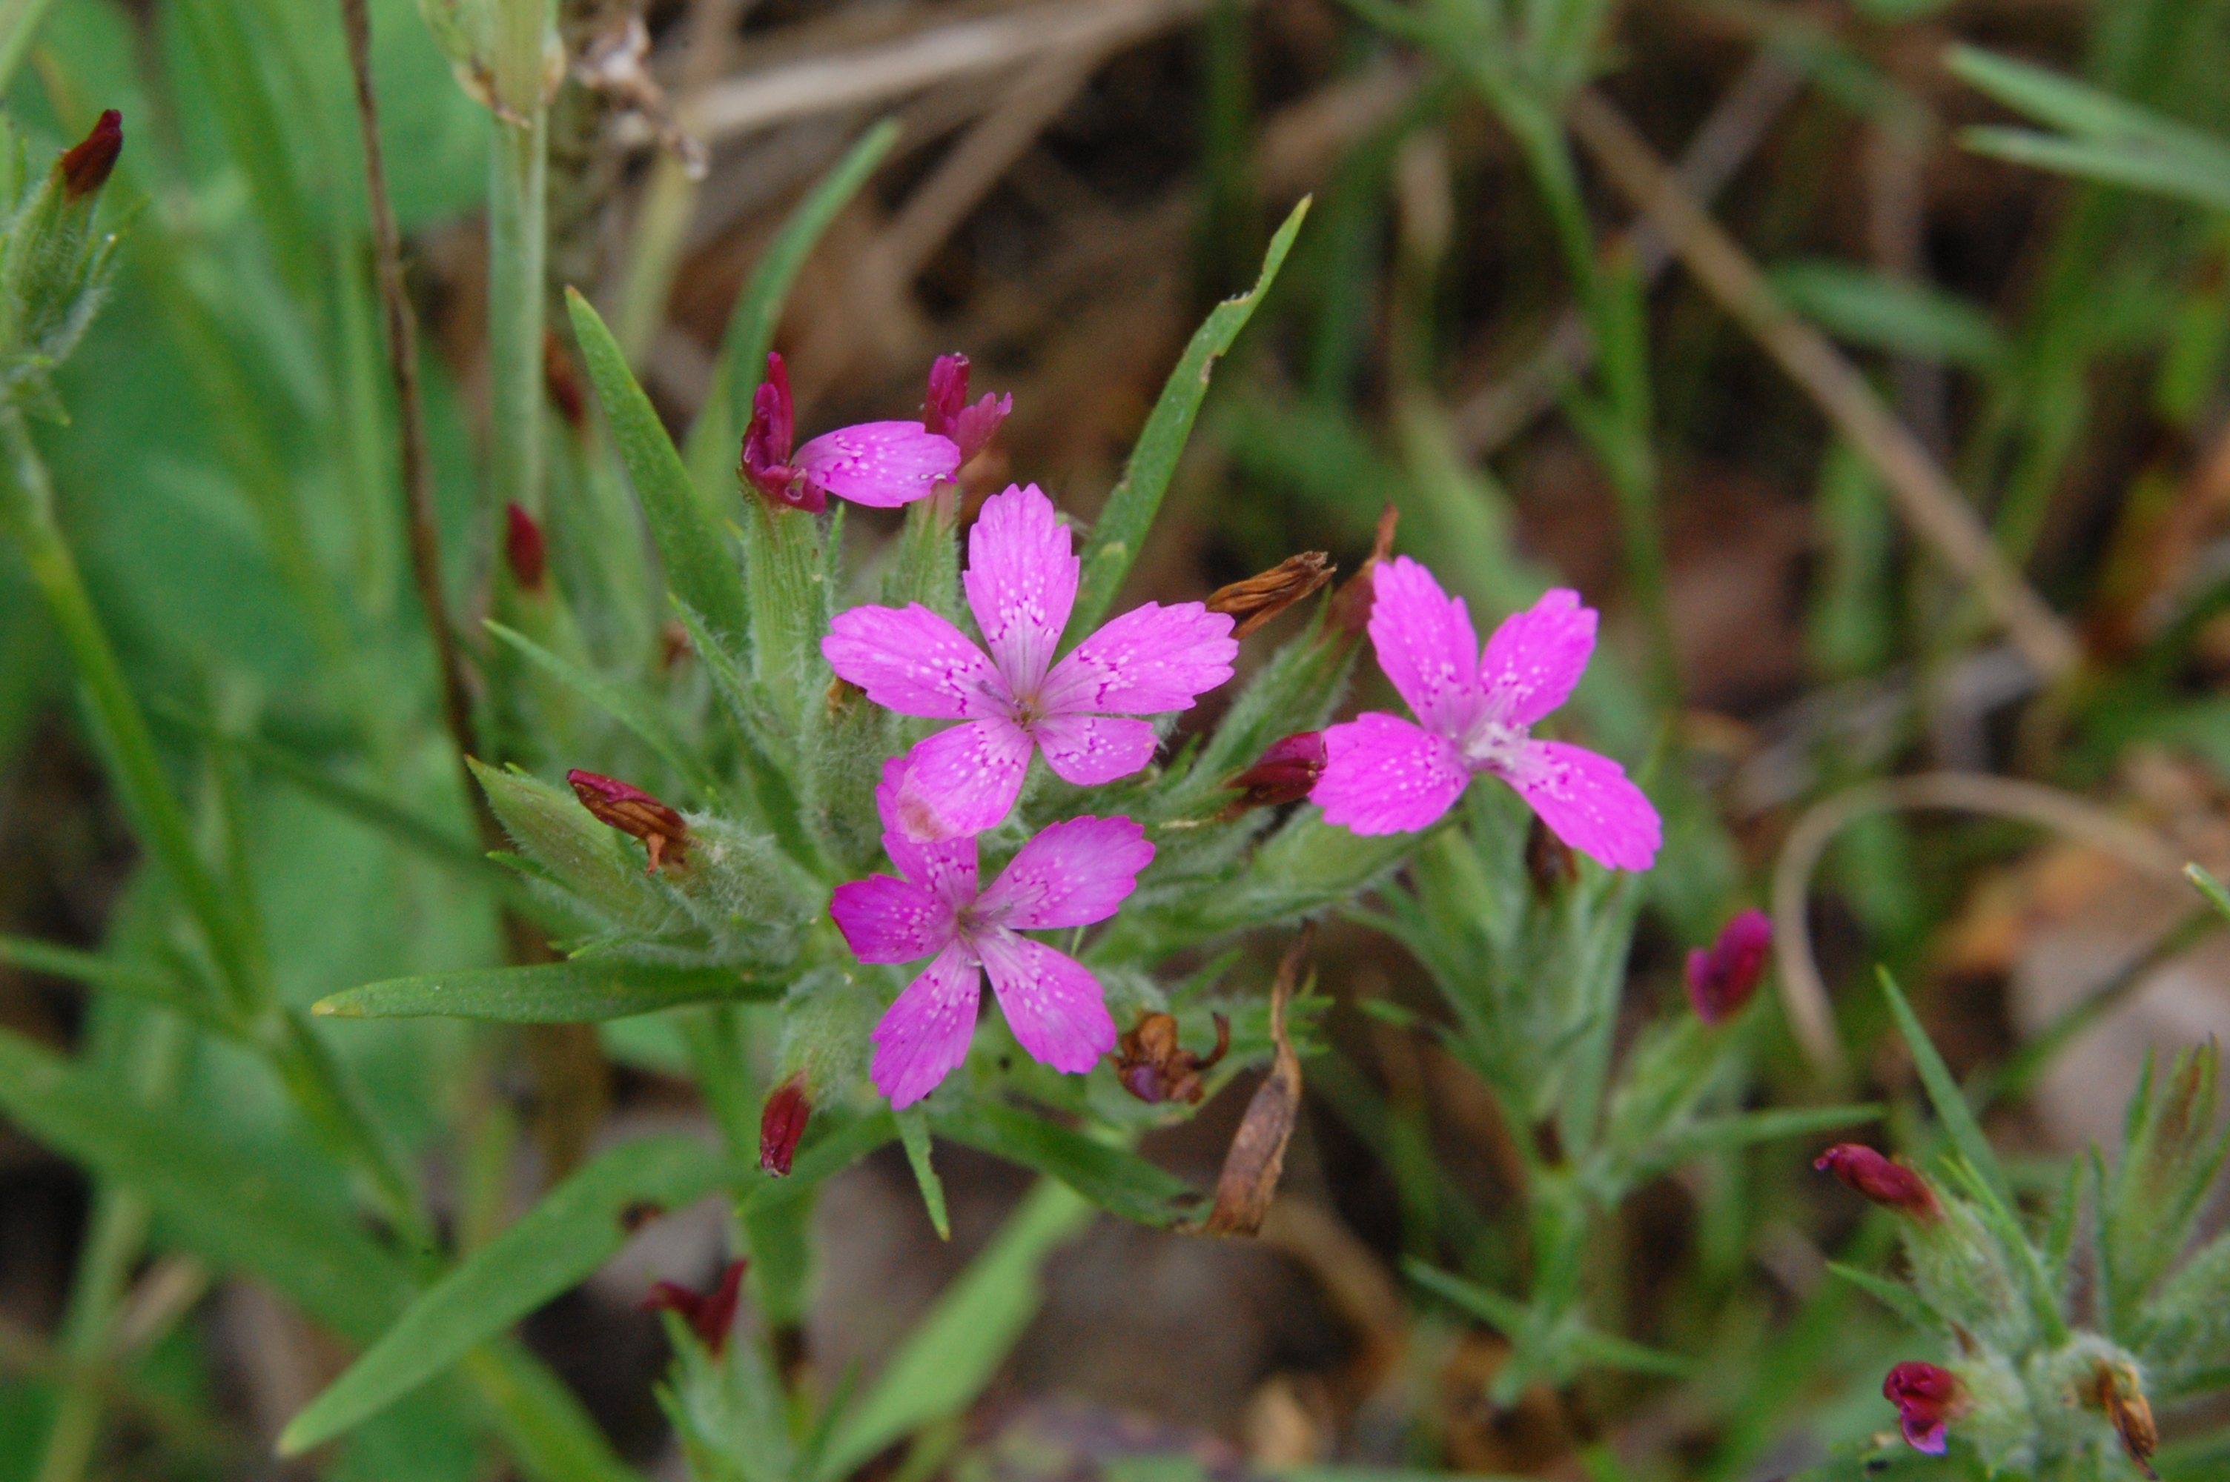
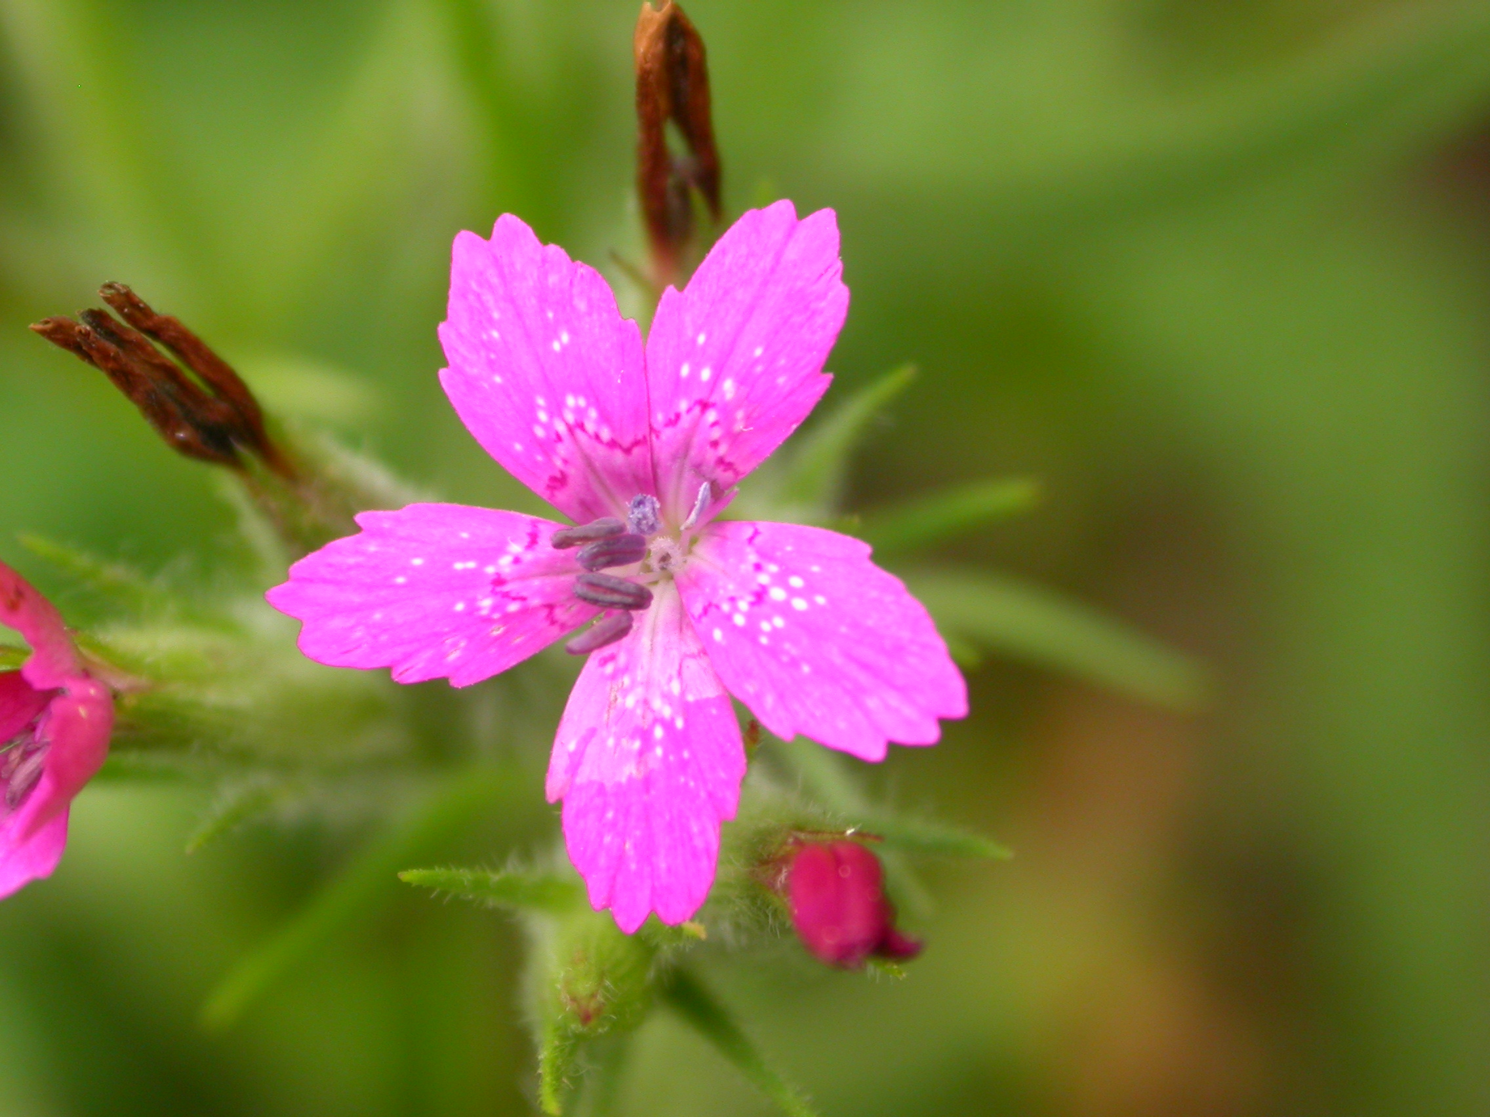
Deptford Pink
Dianthus armeria
Notes:
2009_07_04_012 Kickapoo
2009_07_04_017 Kickapoo

Slide 3
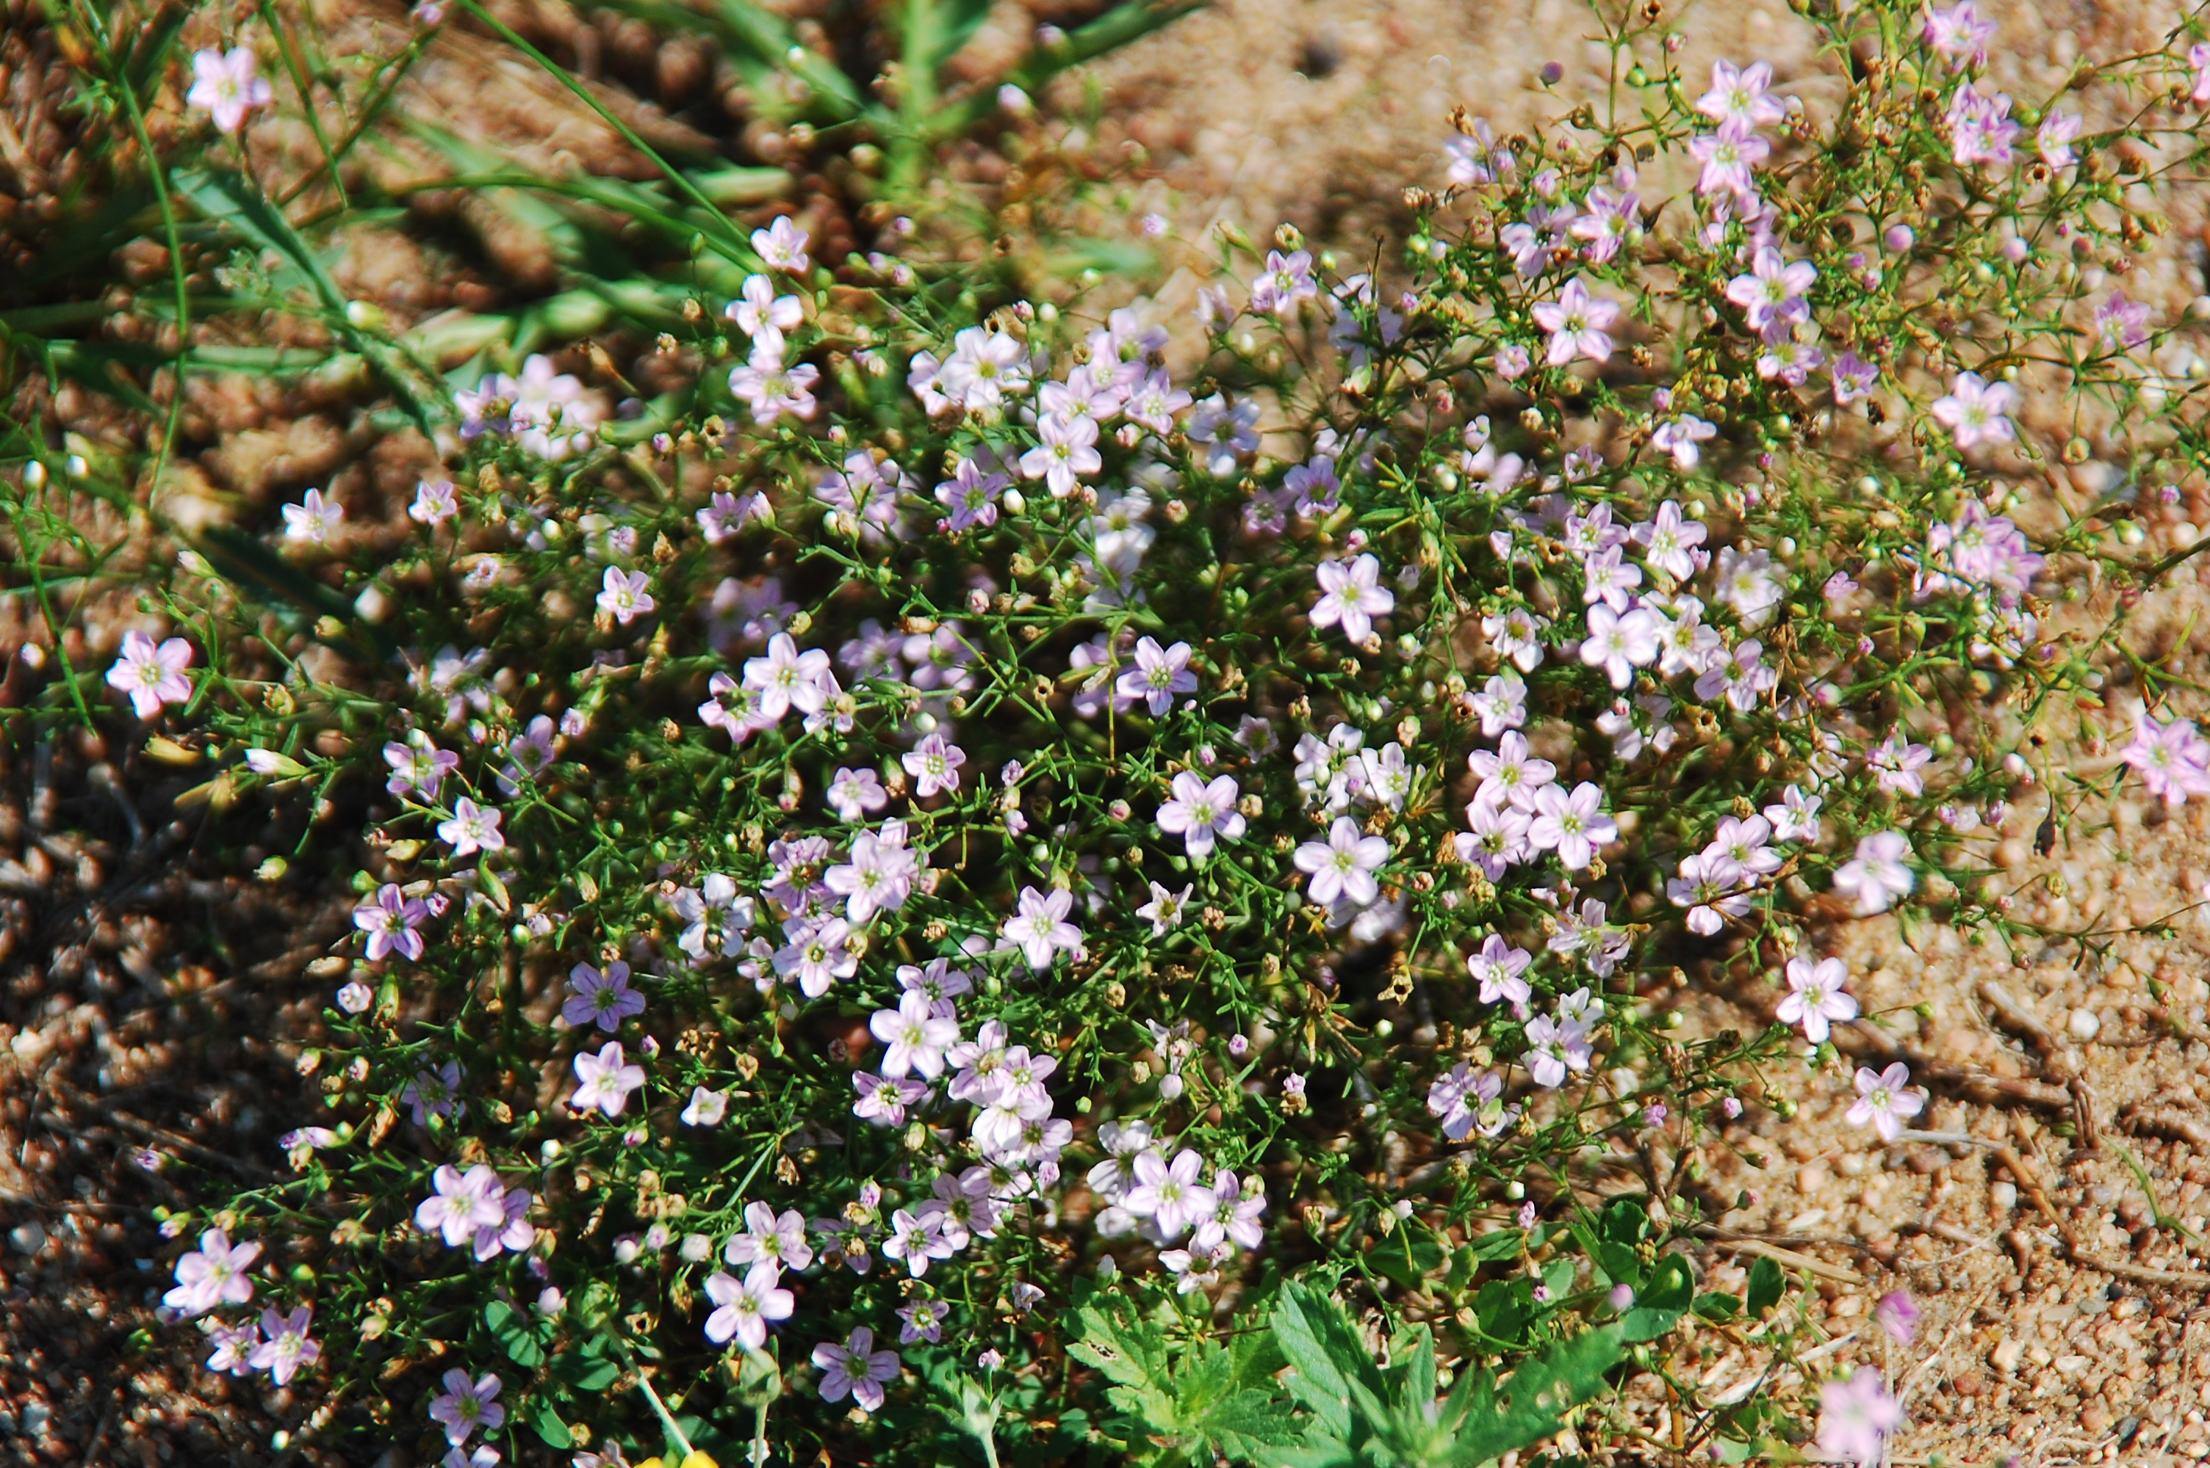
Baby’s-breath, Low
Gypsophyla muralis
Notes:
2012_08_25_008 JordanPark

Slide 4
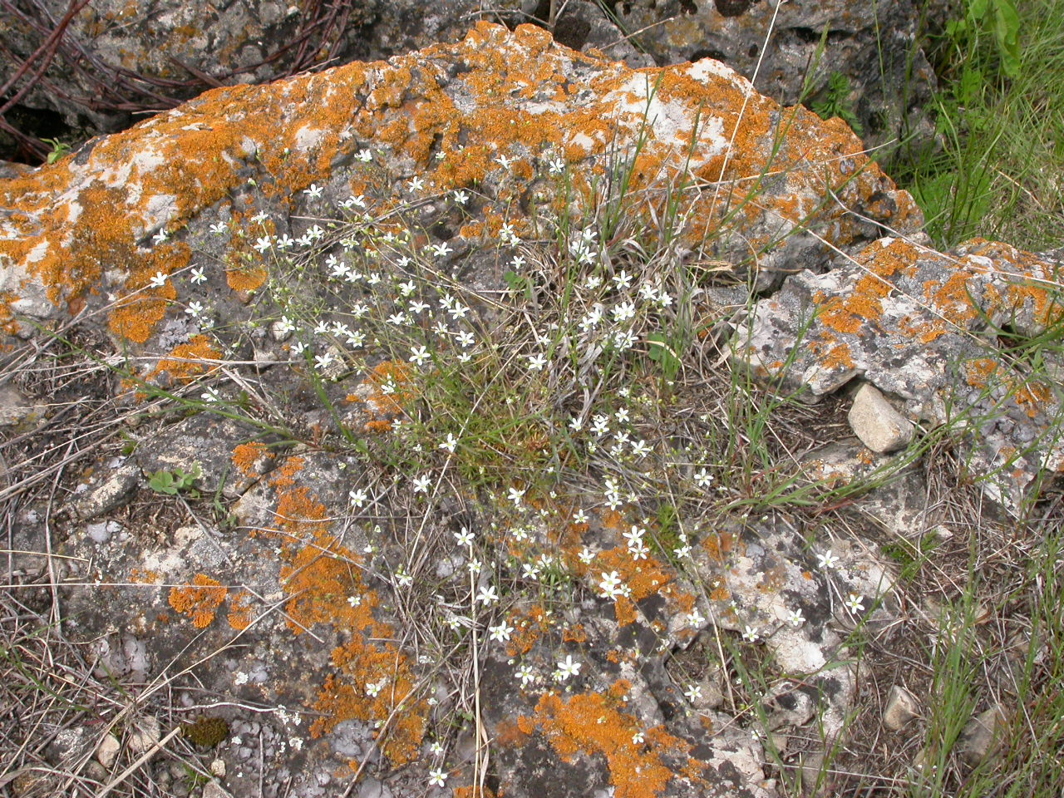
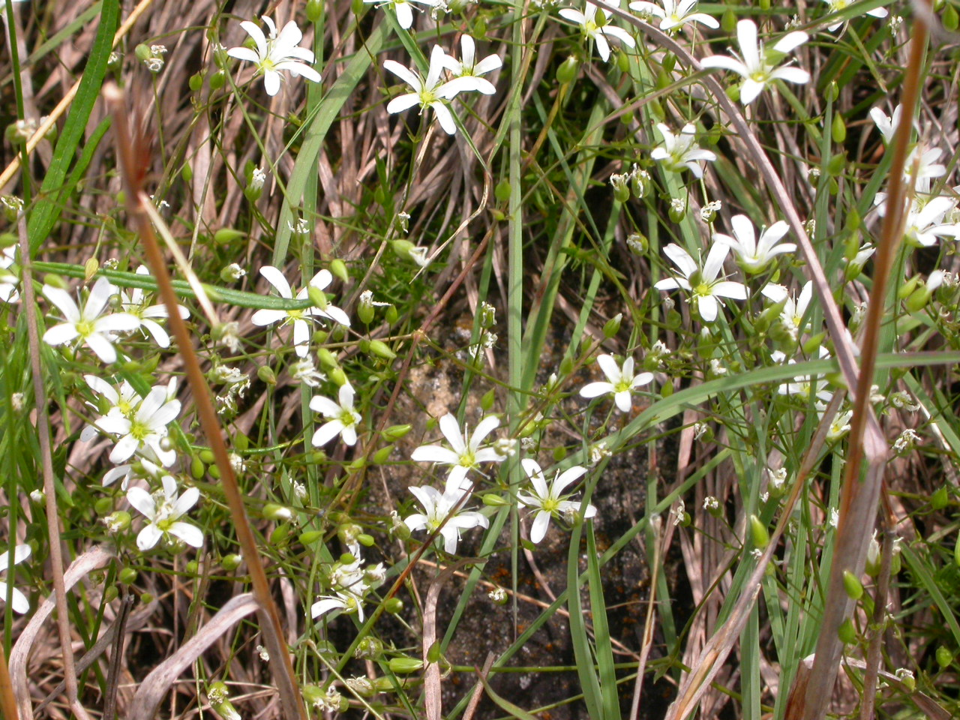
Rock Sandwort
Minuartia michauxii
Notes:
2005_06_01_019 HogBack Prairie
2005_06_01_008 HogBack Prairie

Slide 5
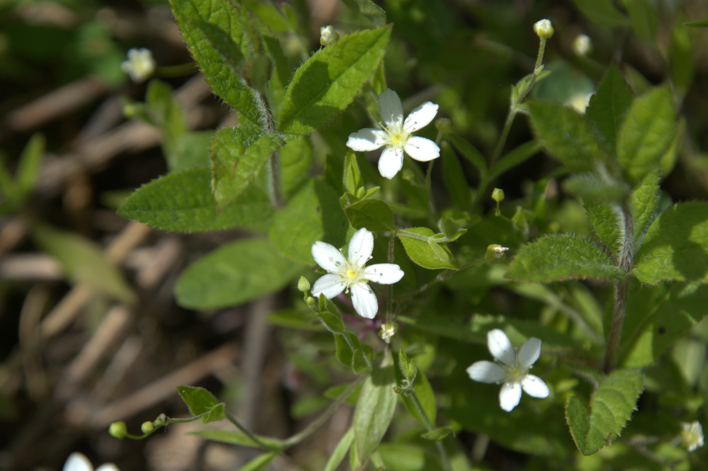
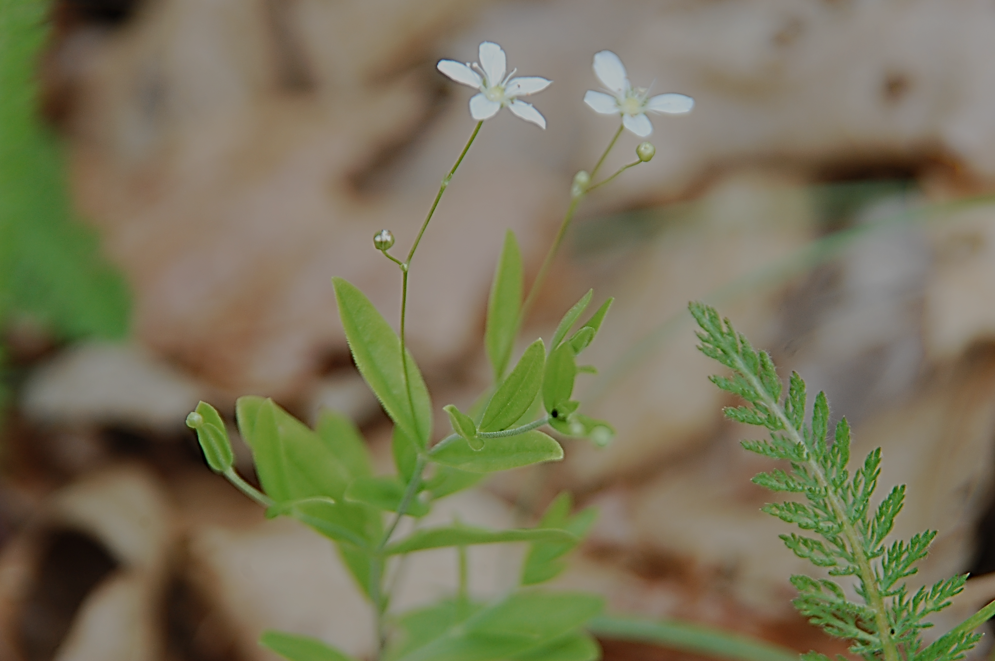
Grove Sandwort
Moehringa lateriflora
Notes:
2012_05_09_029 Muscoda Unit

Slide 6
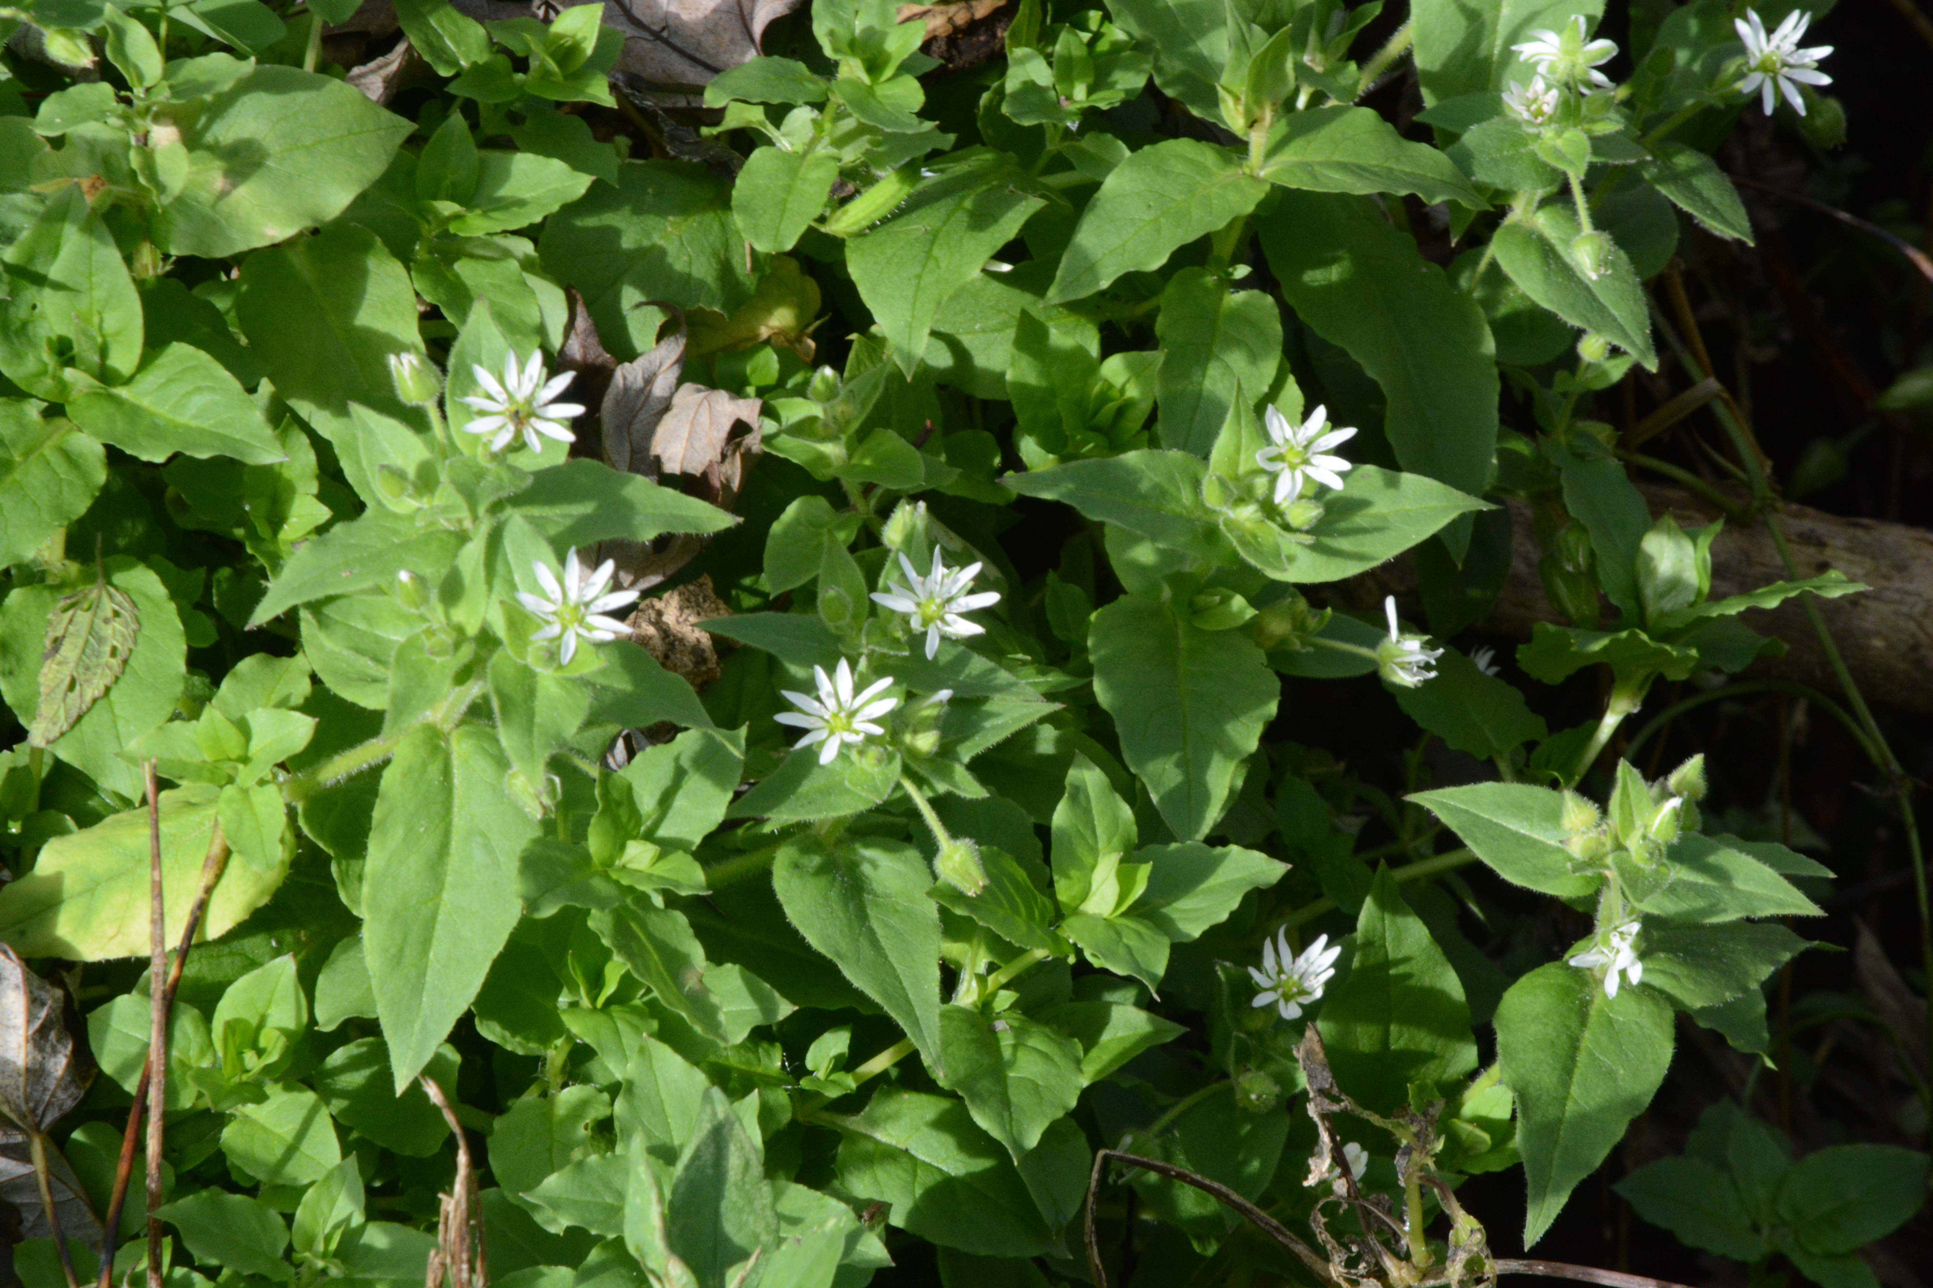
Water Chickweed
Myosoton aquaticum
Notes:
2014_10_16_011 Kickapoo

Slide 7
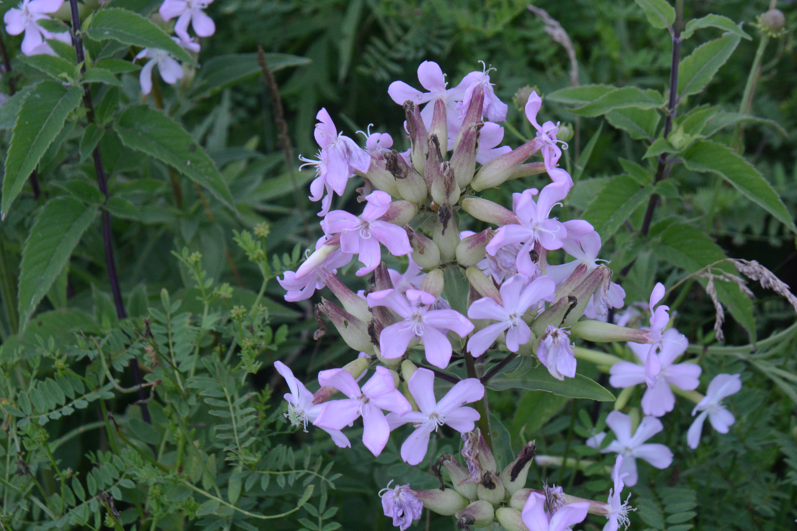
Bouncing-Bet
Saponaria officinalis
Notes:
2022_07_17_018 Lake Park

Slide 8
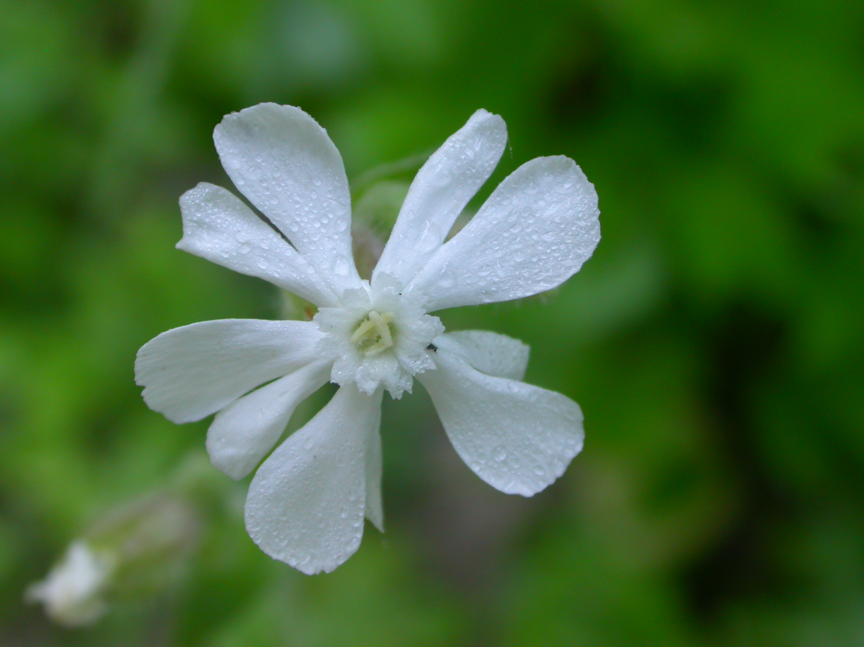
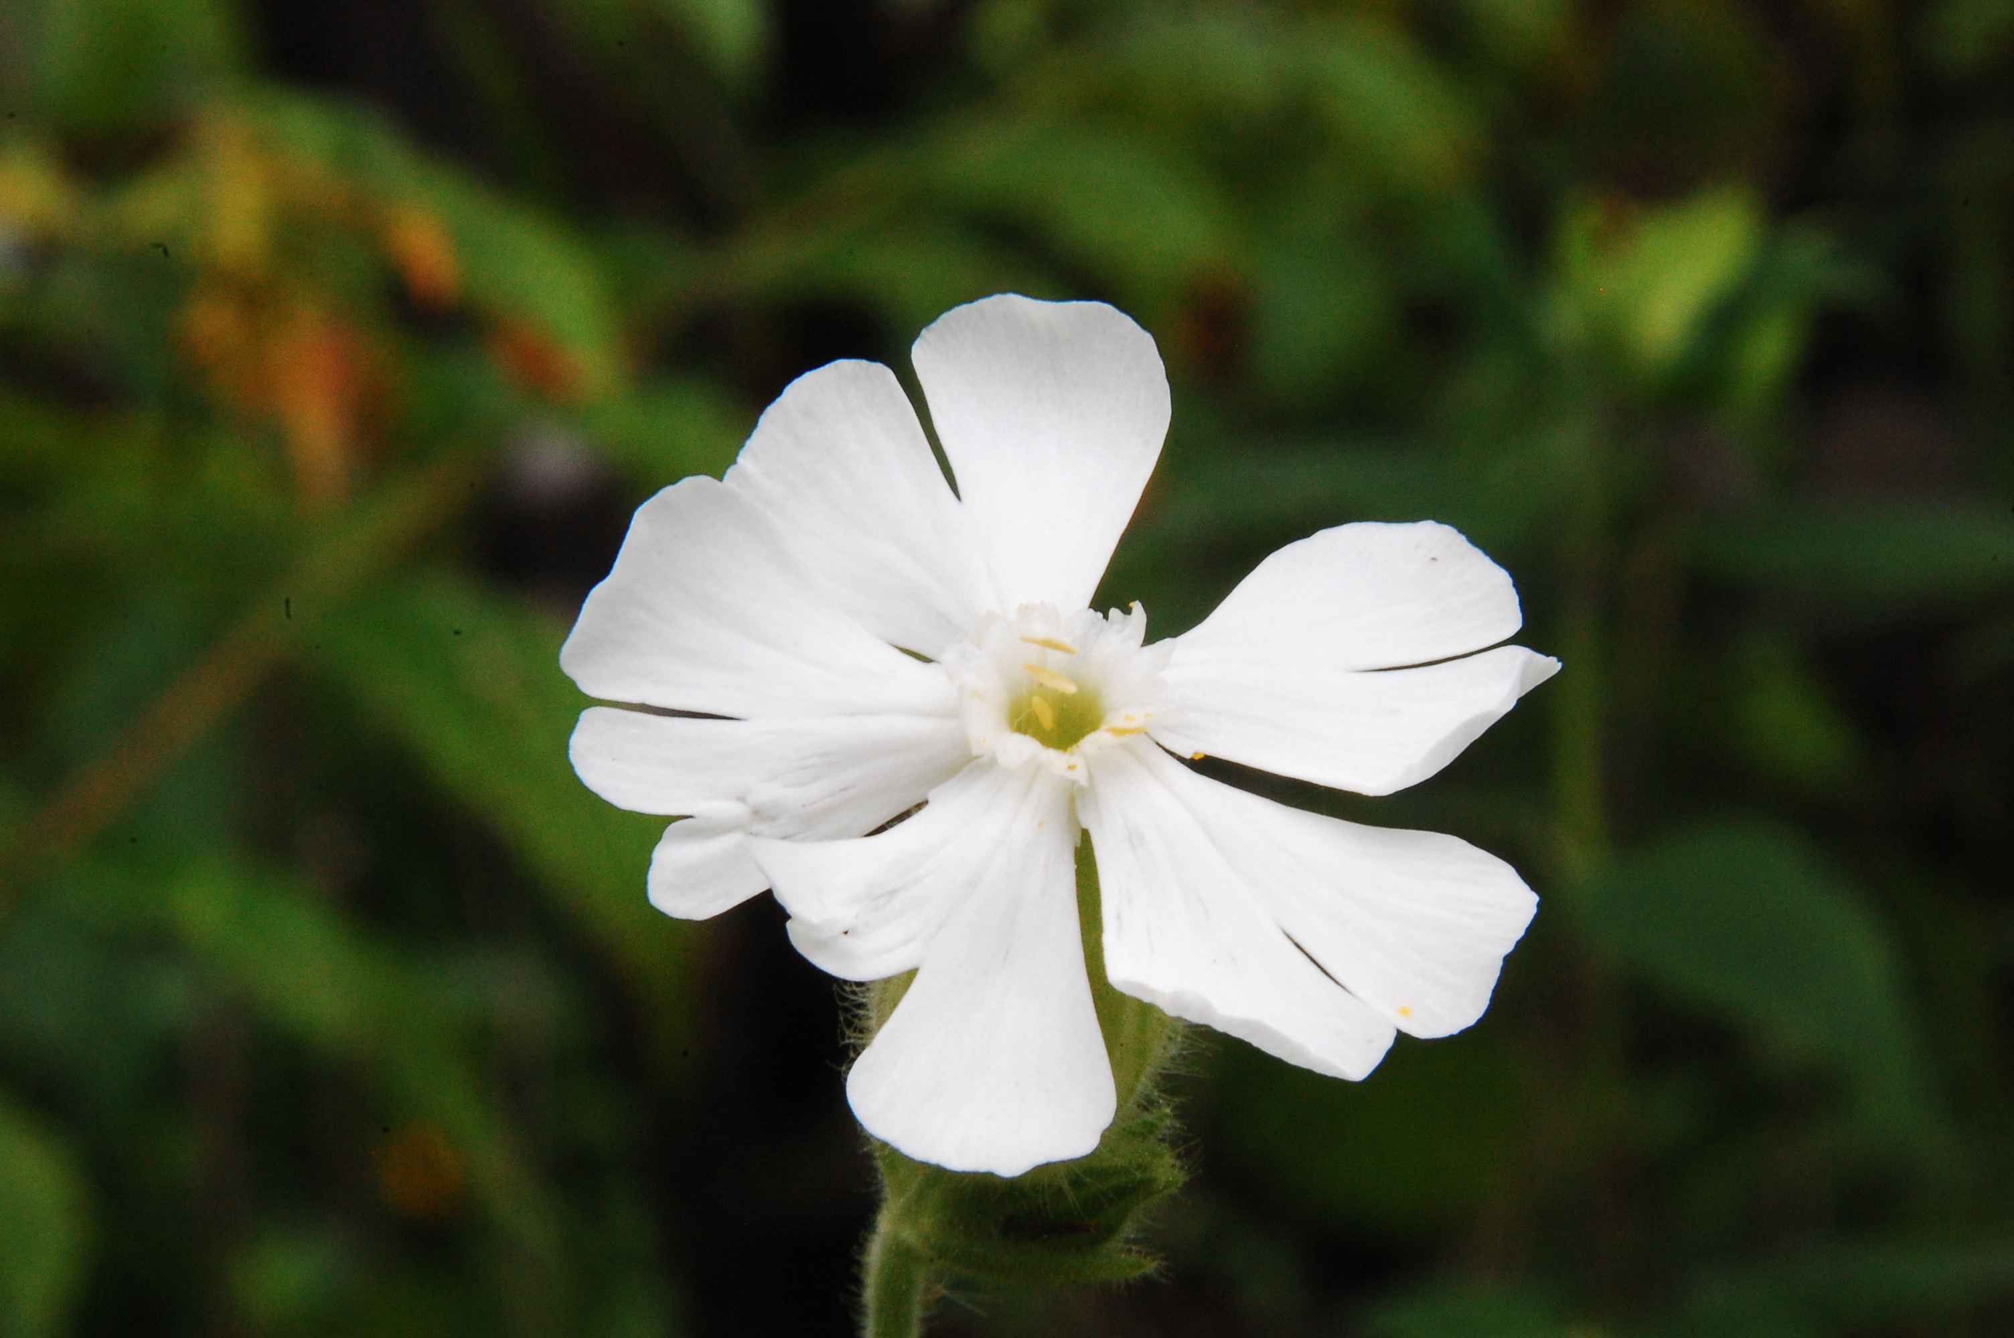
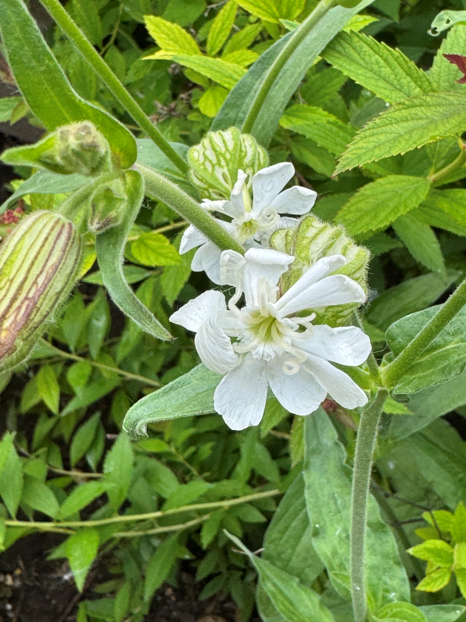
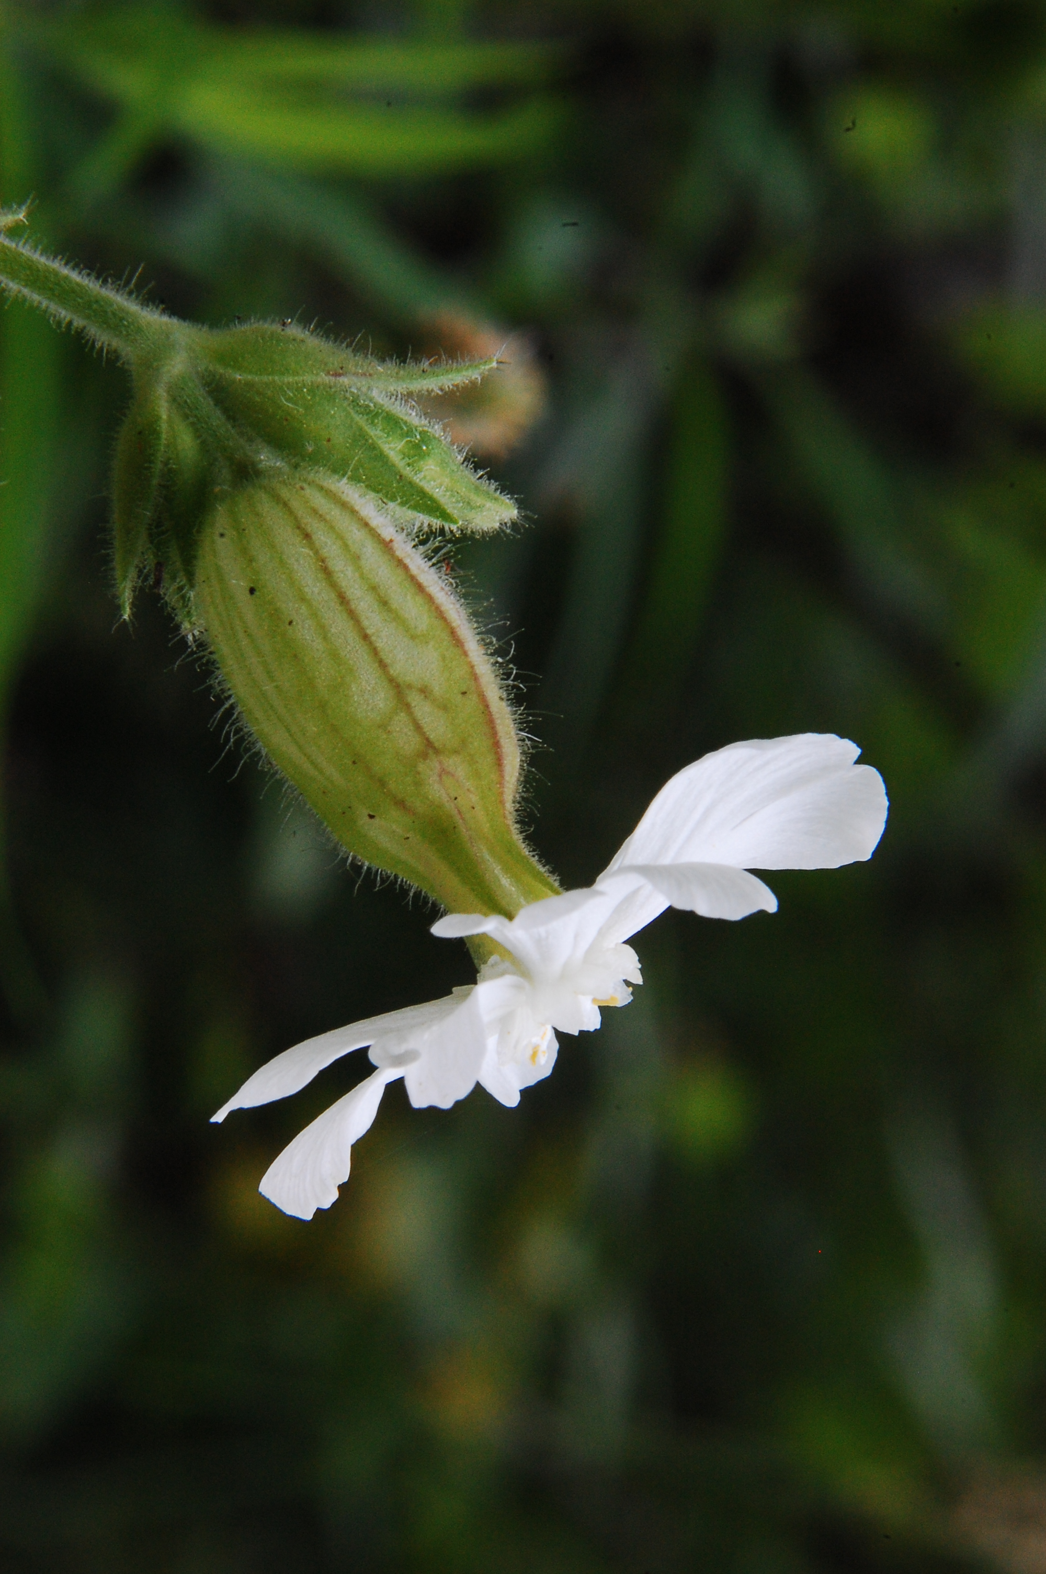
White Campion
Silene latifolia
Notes:
2009_07_05_021 Kickapoo
2009_07_05_023 Kickapoo
2010_07_04_034 Kickapoo

Slide 9
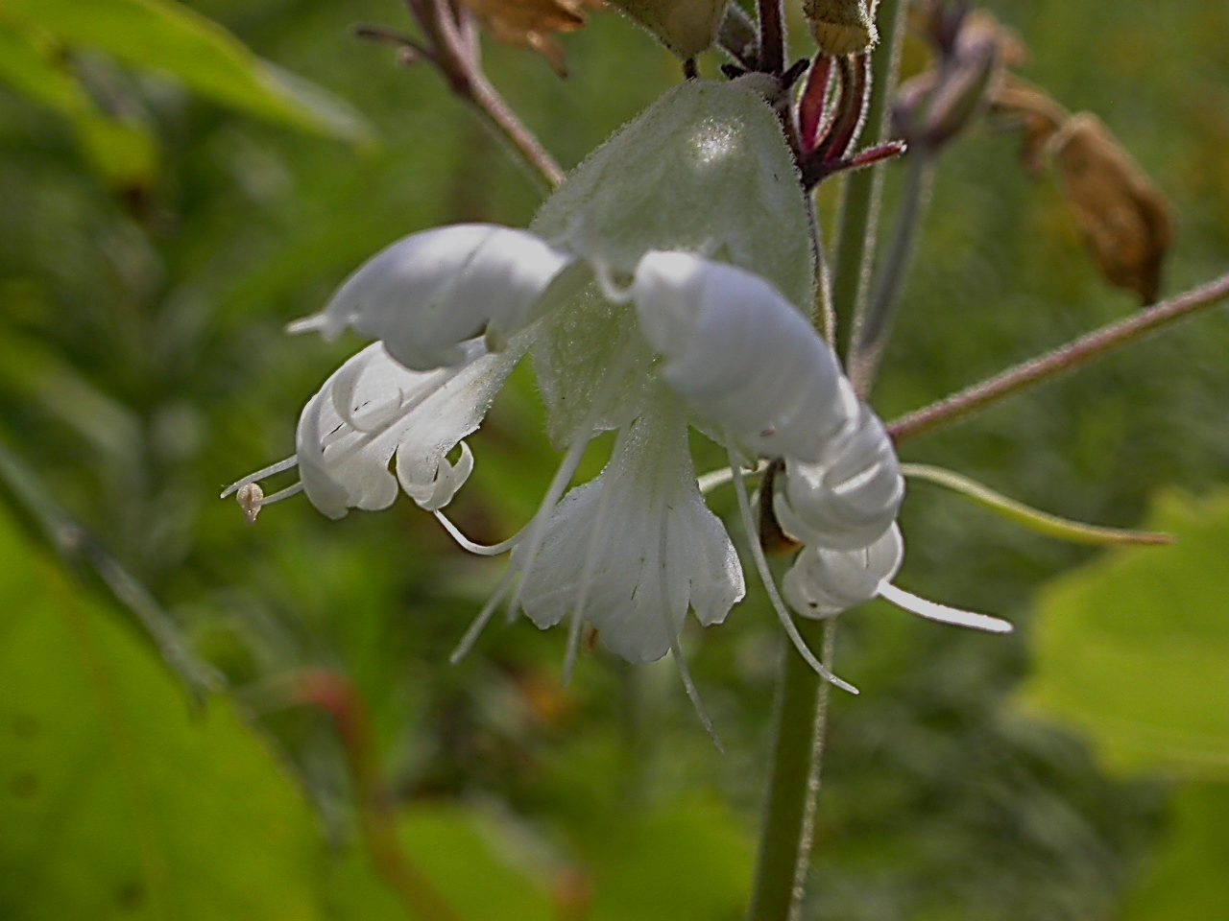
Starry Campion
Silene stellata

Slide 10
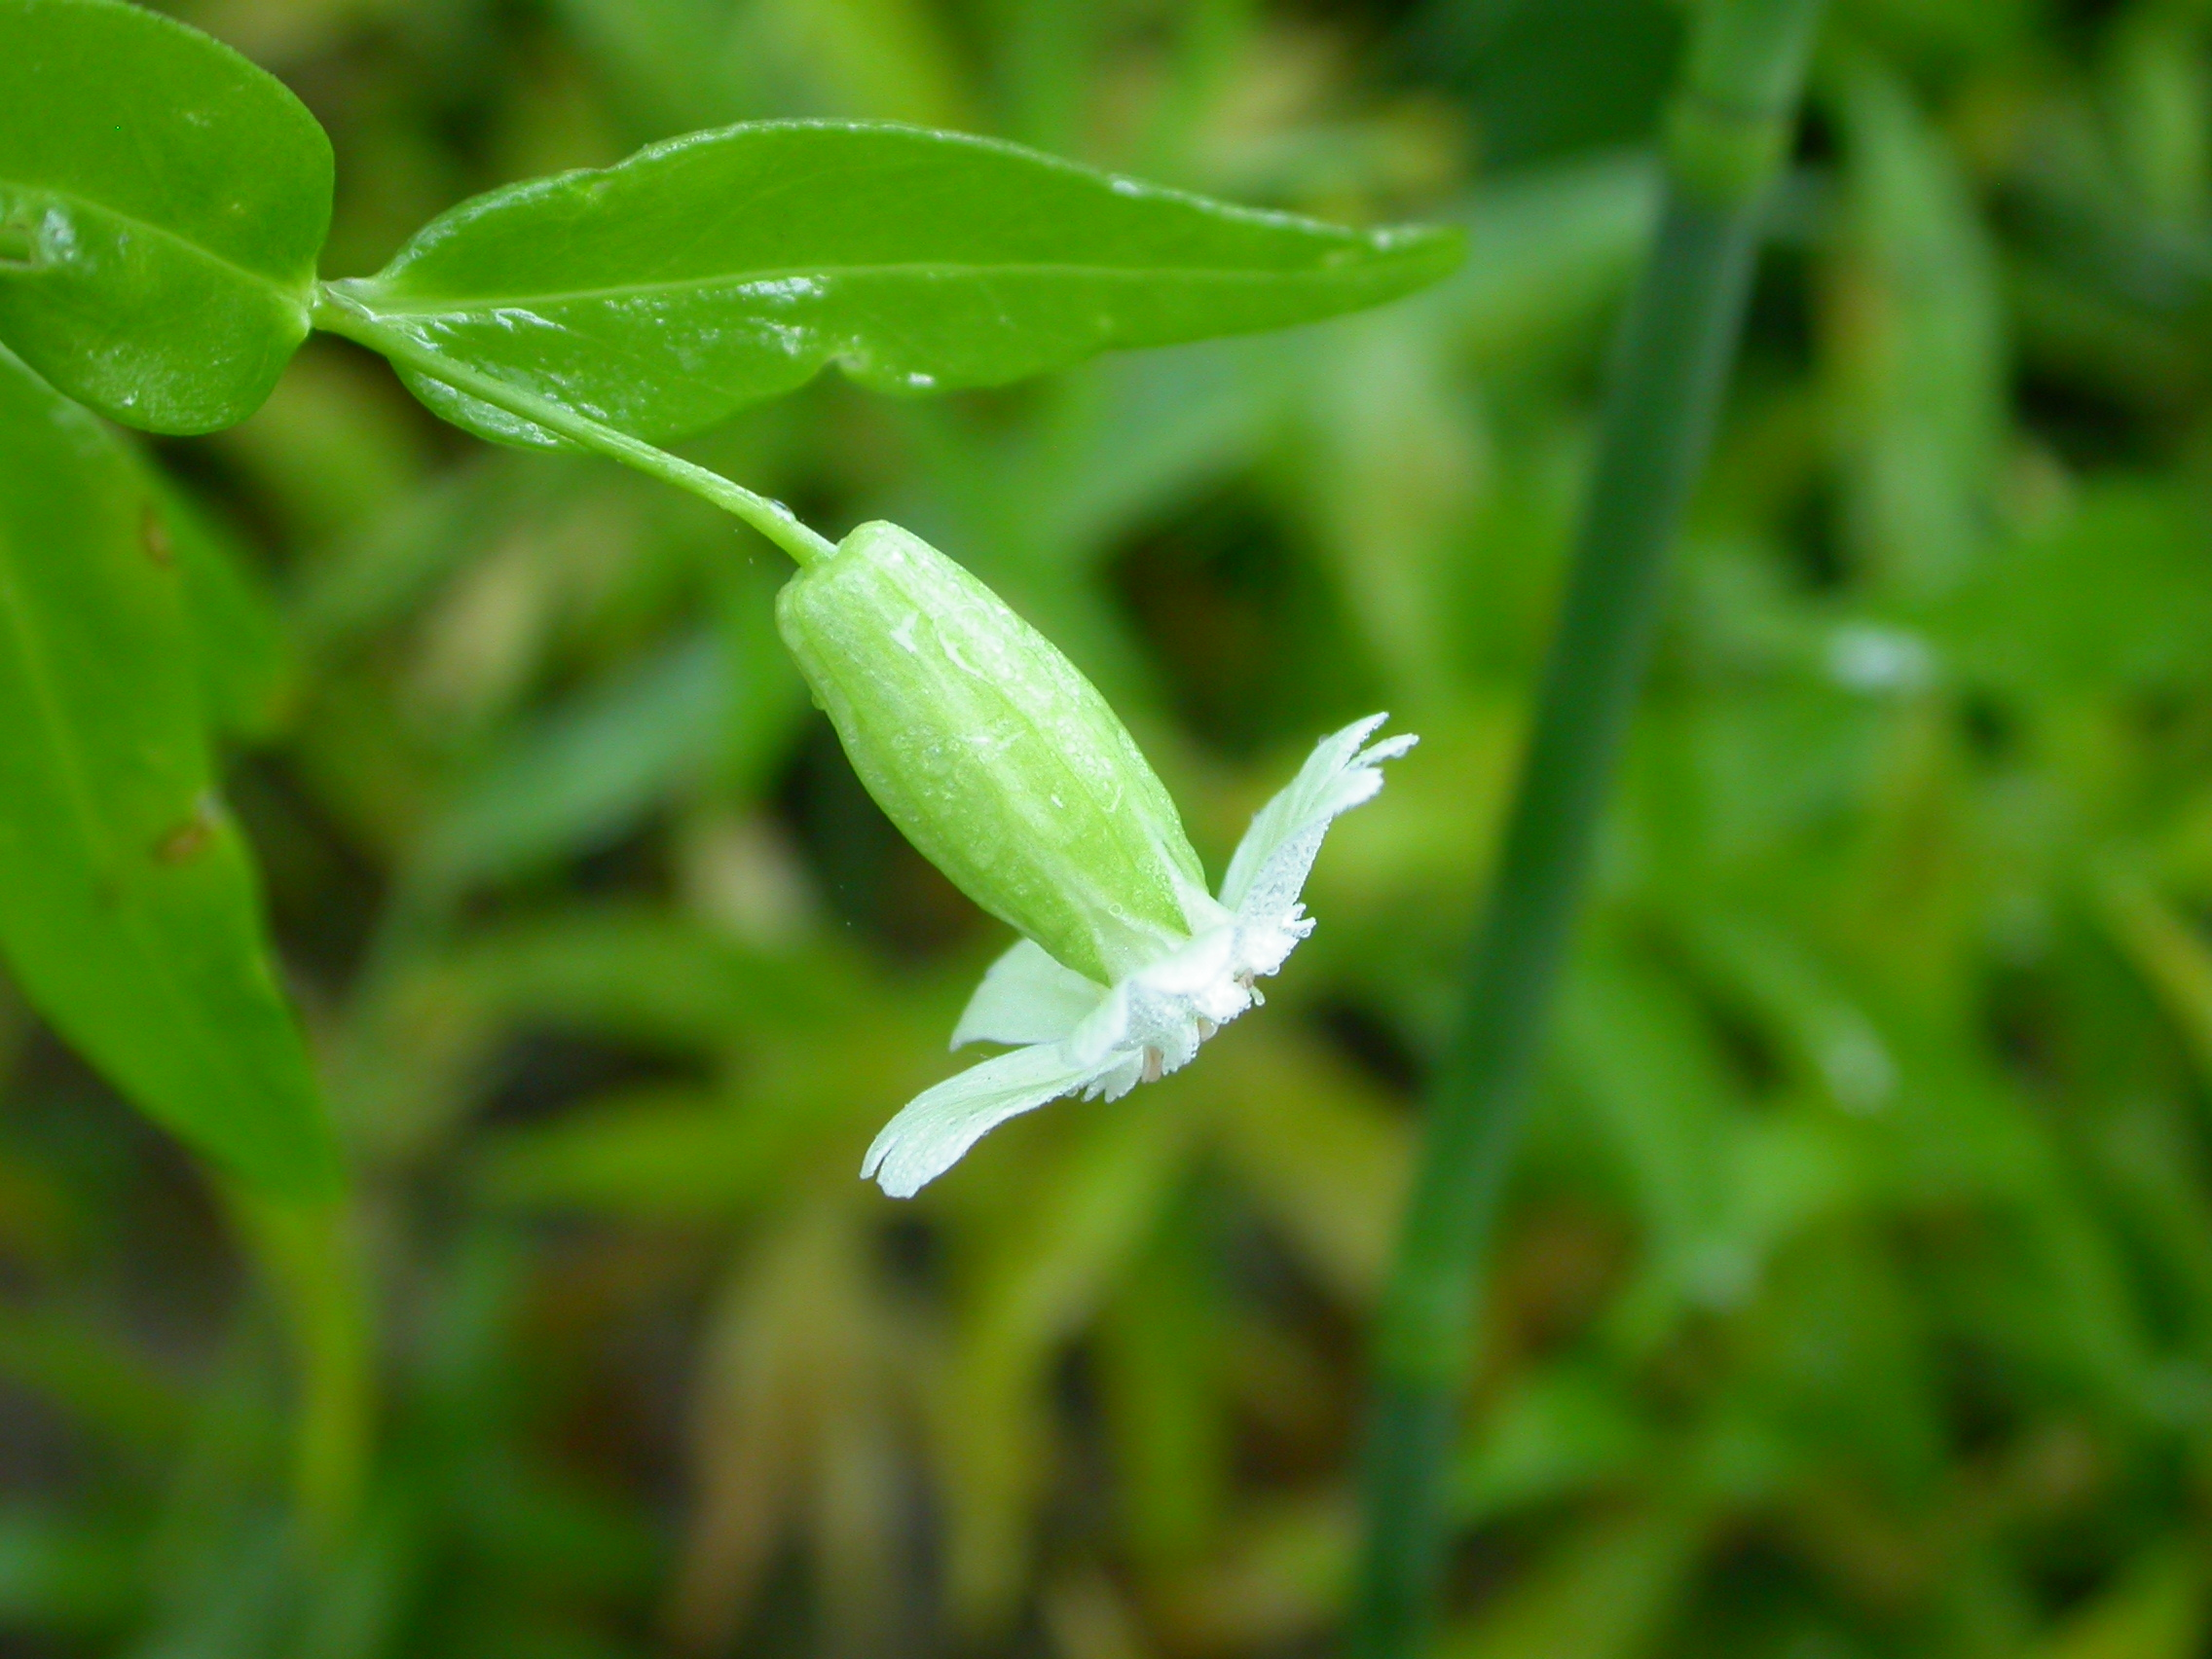
Snowy Campion
Silene nivea
Notes:
2009_07_05_024 Kickapoo

Slide 11
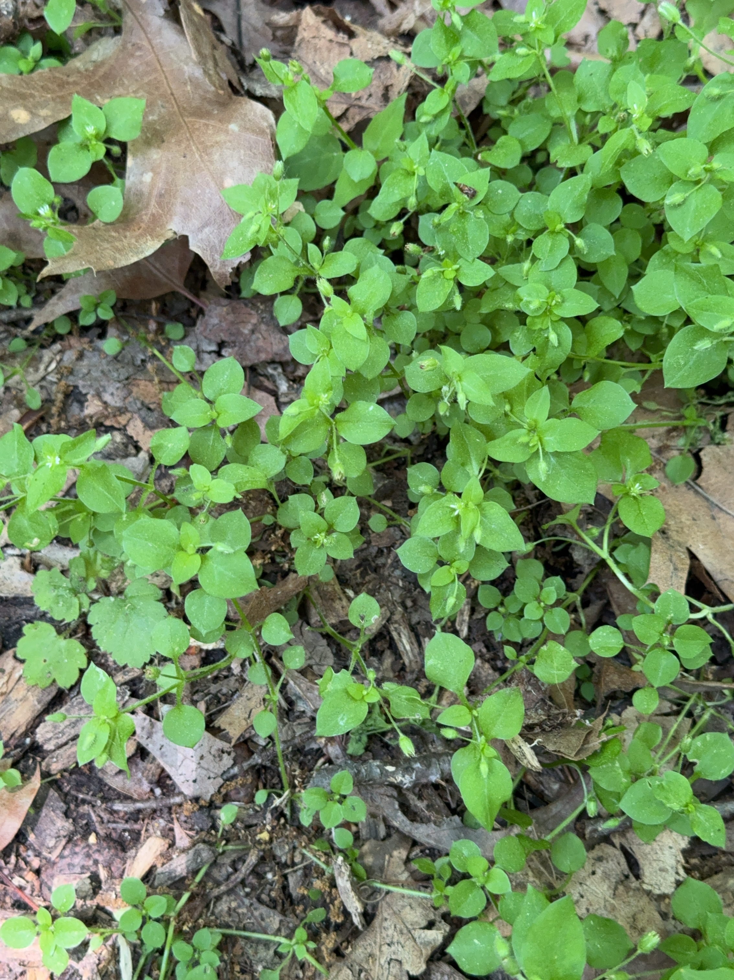
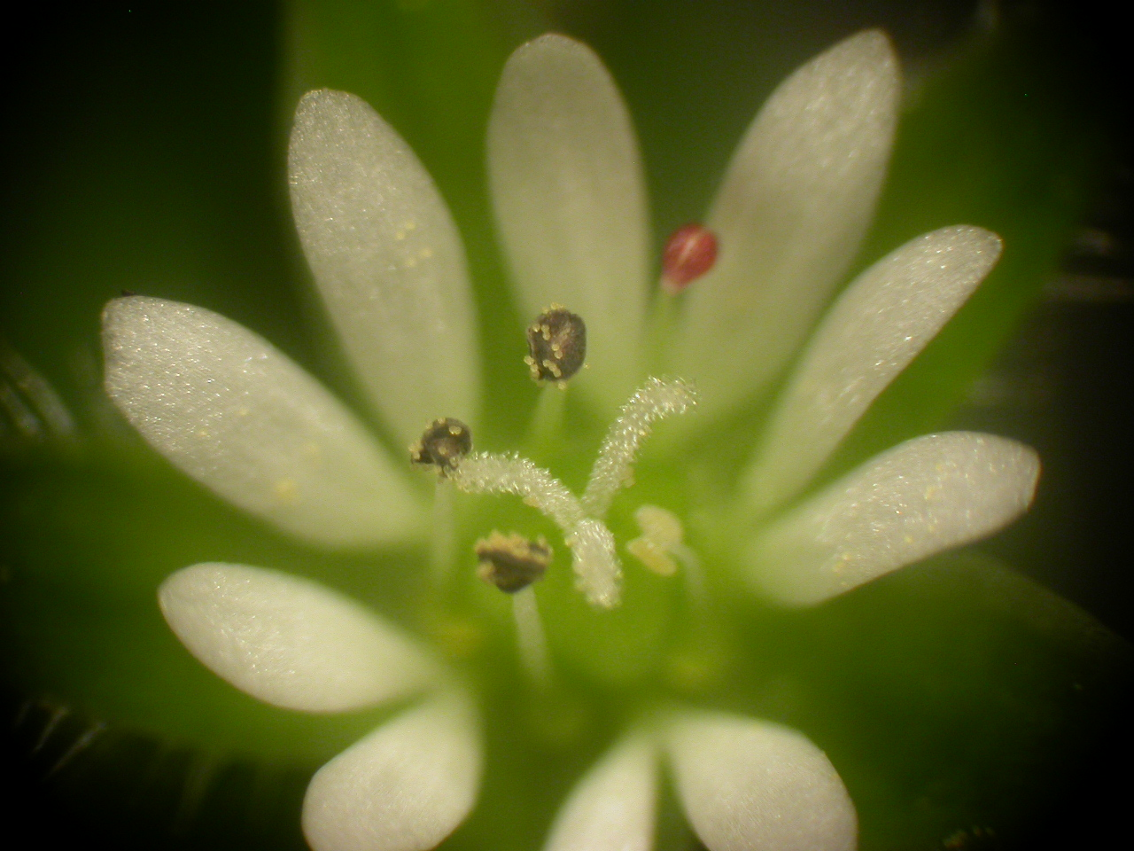
Common Chickweed
Stellaria media
Notes:
2007_04_30_013

