Slide 1
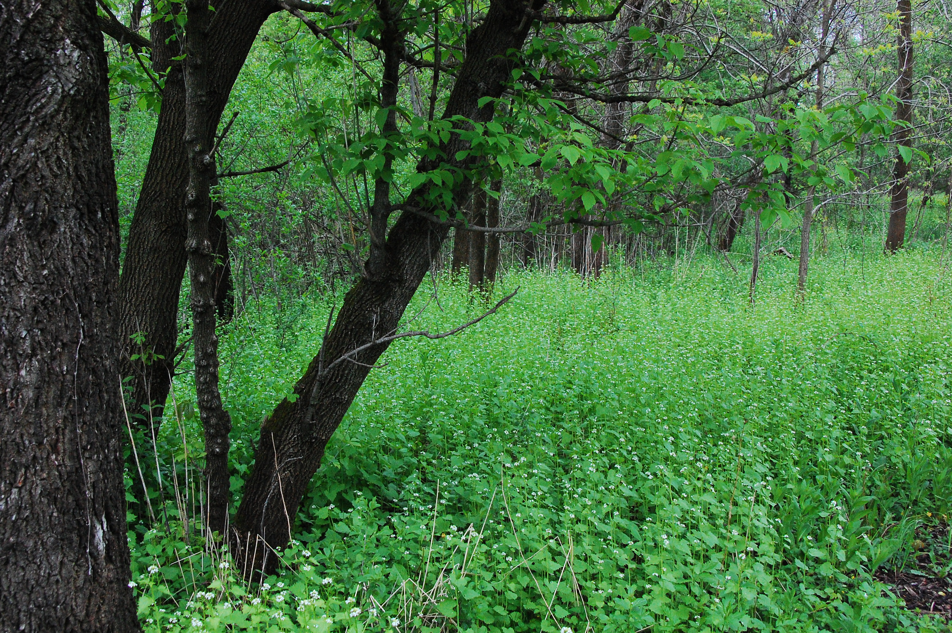
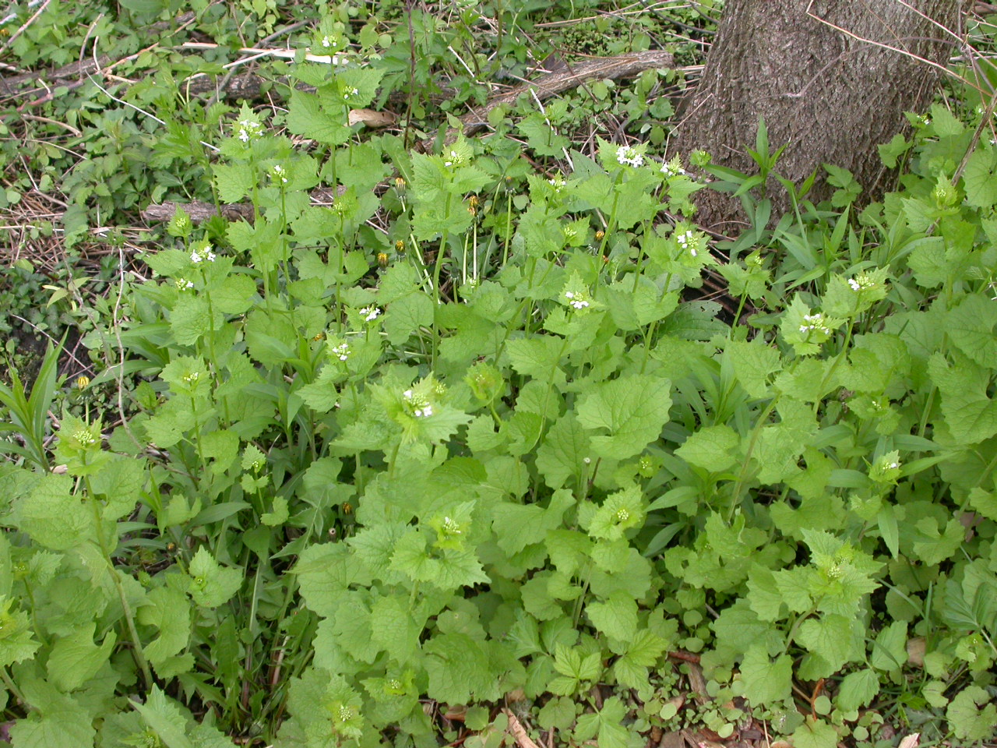
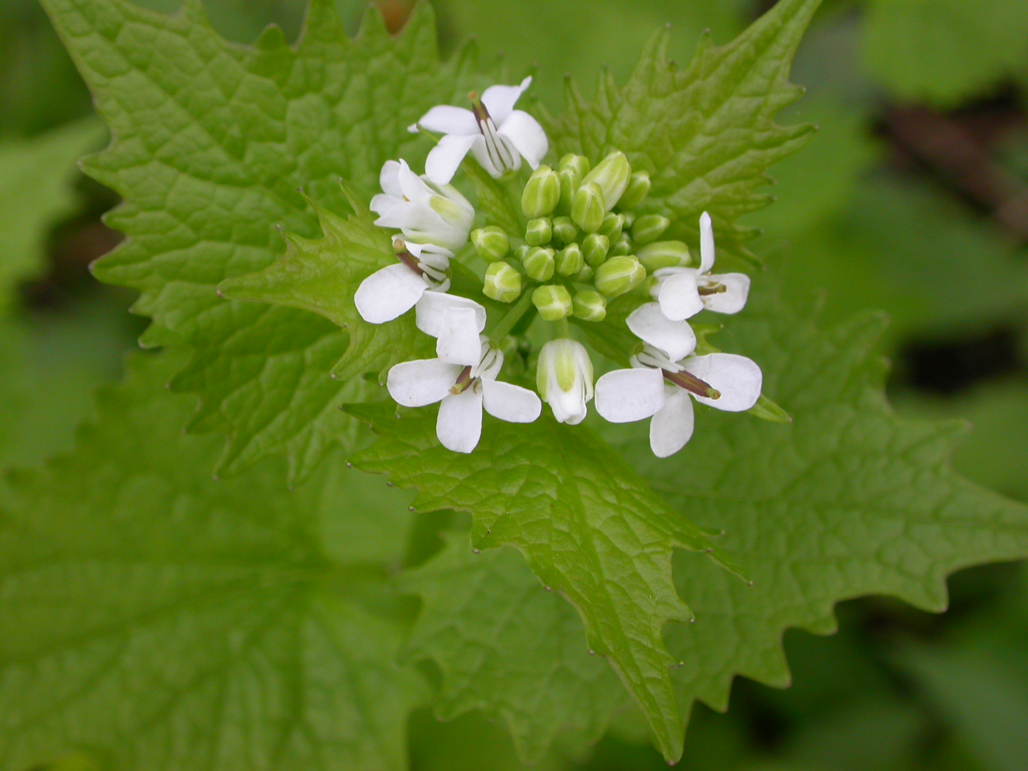
Garlic Mustard
Allaria petiolata
Notes:
2010_05_0_001Wehr.JPG
2005_05_12_010 Wehr
2005_05_12_012 Wehr

Slide 2
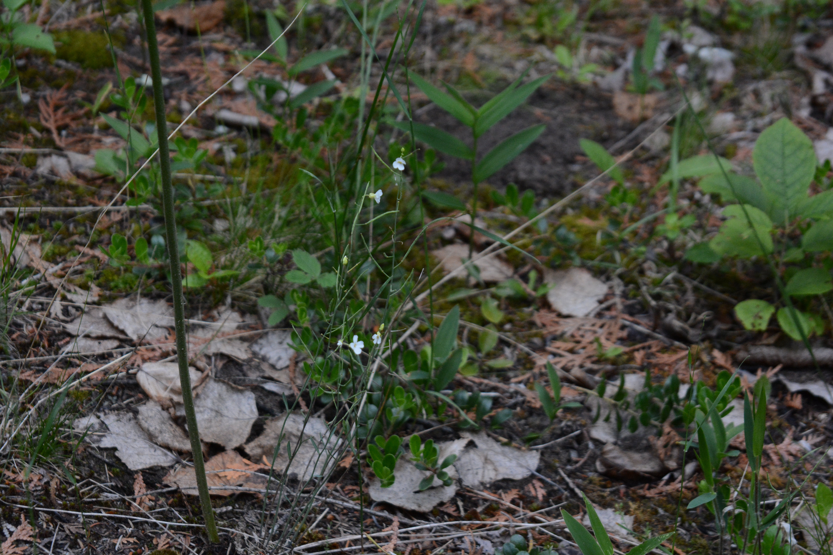
Lyrate Rock-cress
Arabis lyrata
Notes:
2015_07_01_040 Ridges Sanctuary

Slide 3
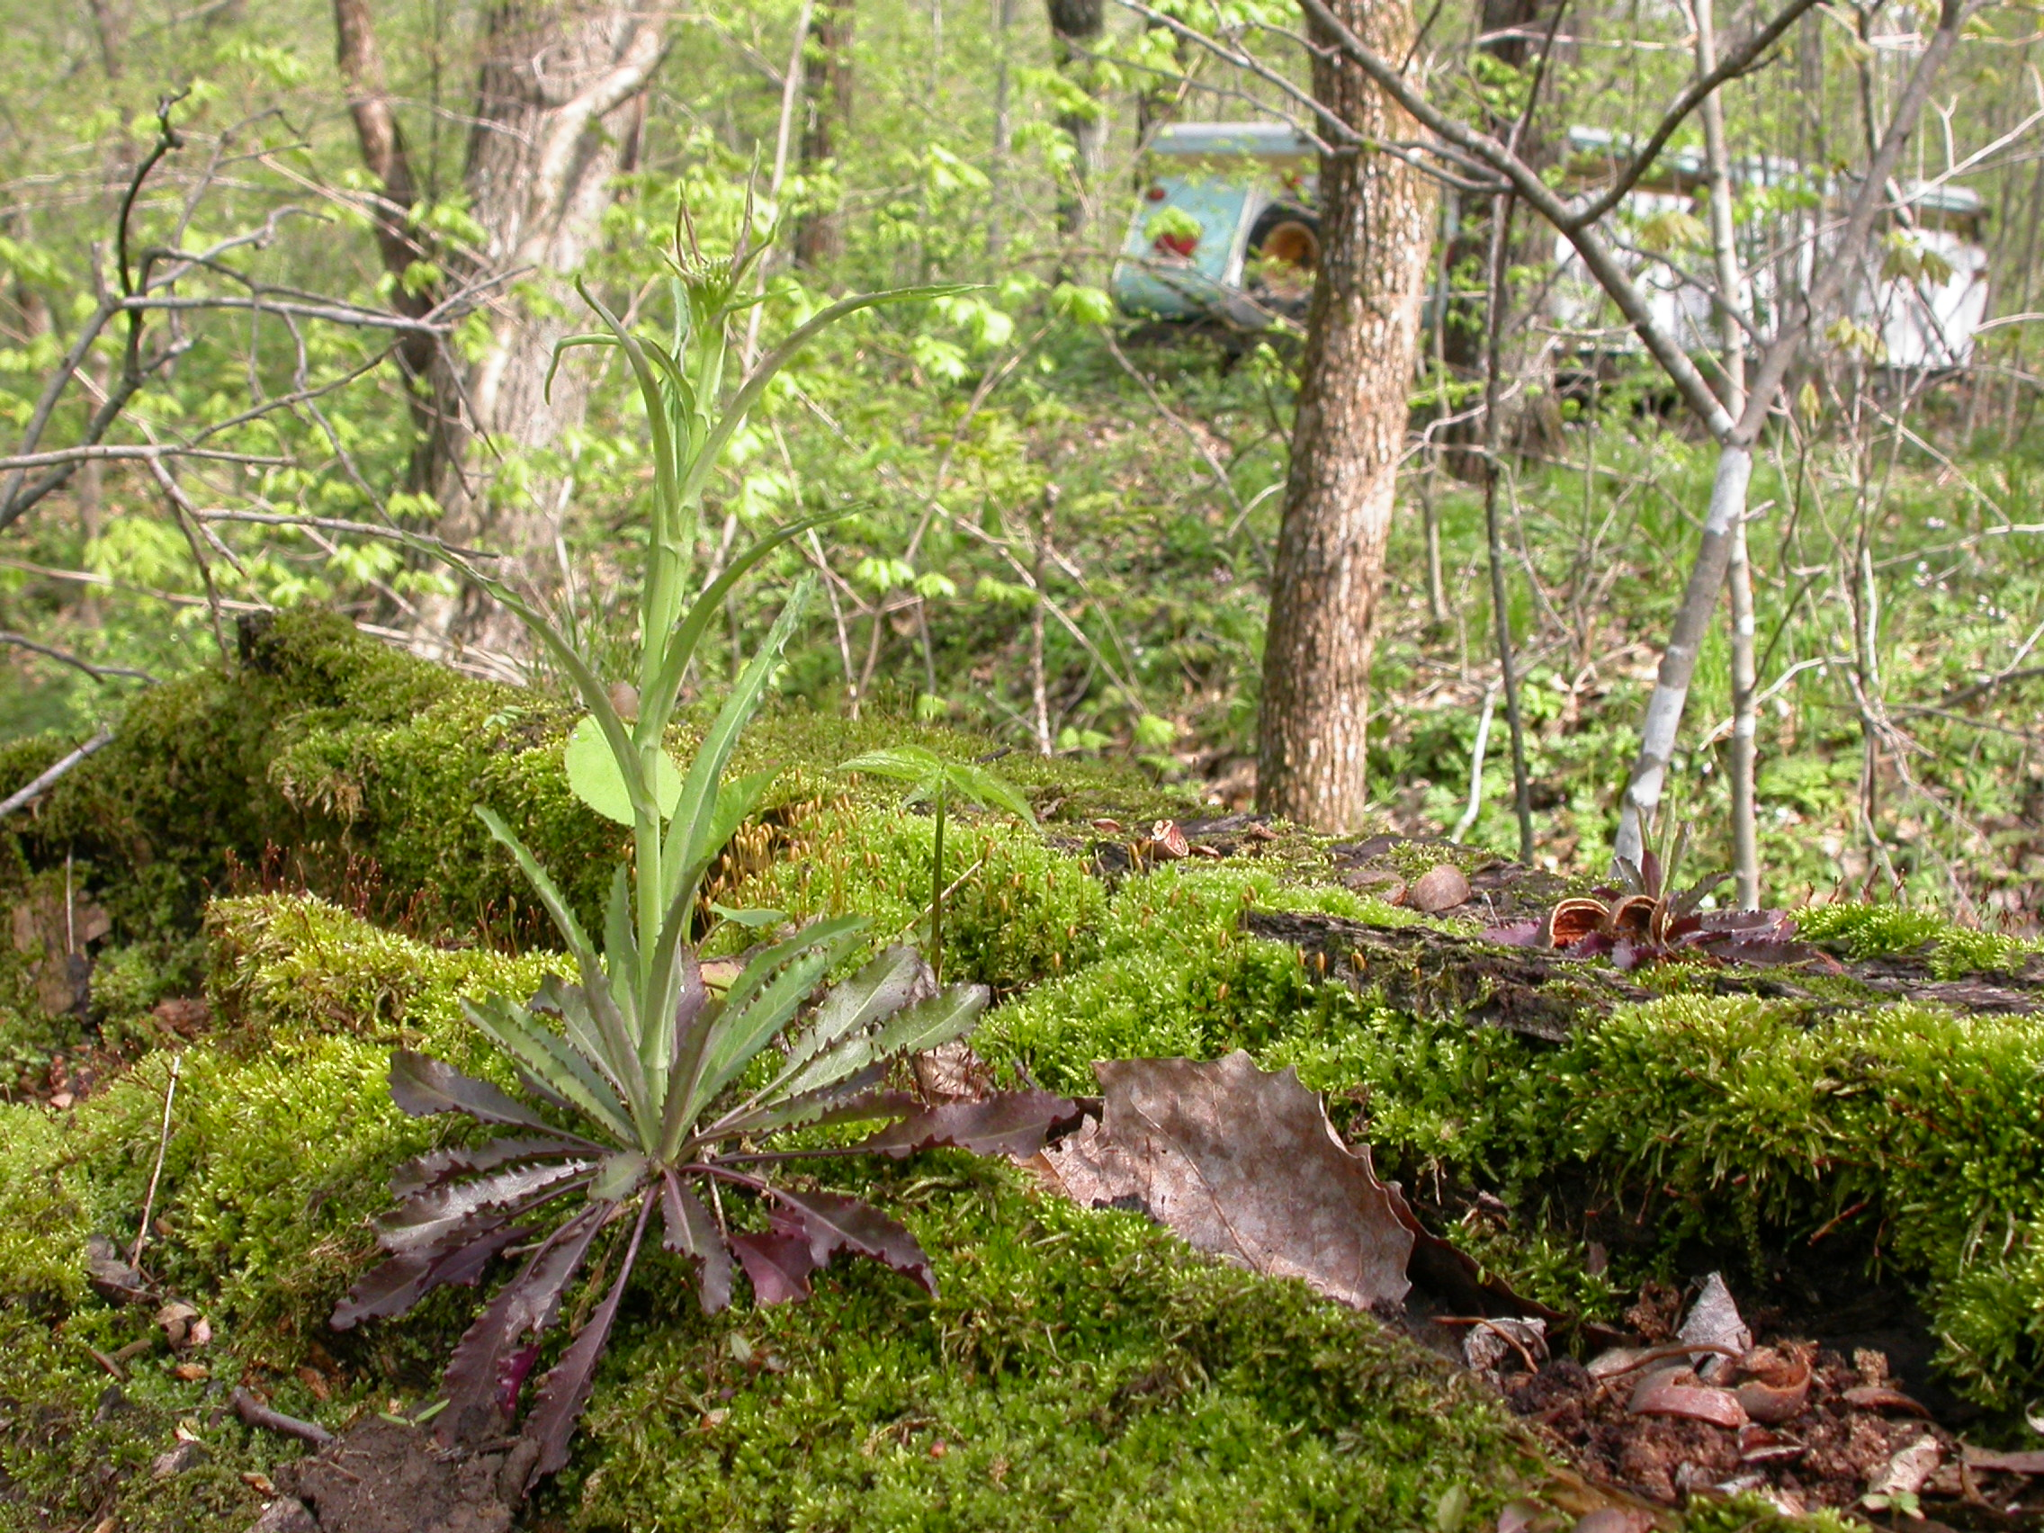
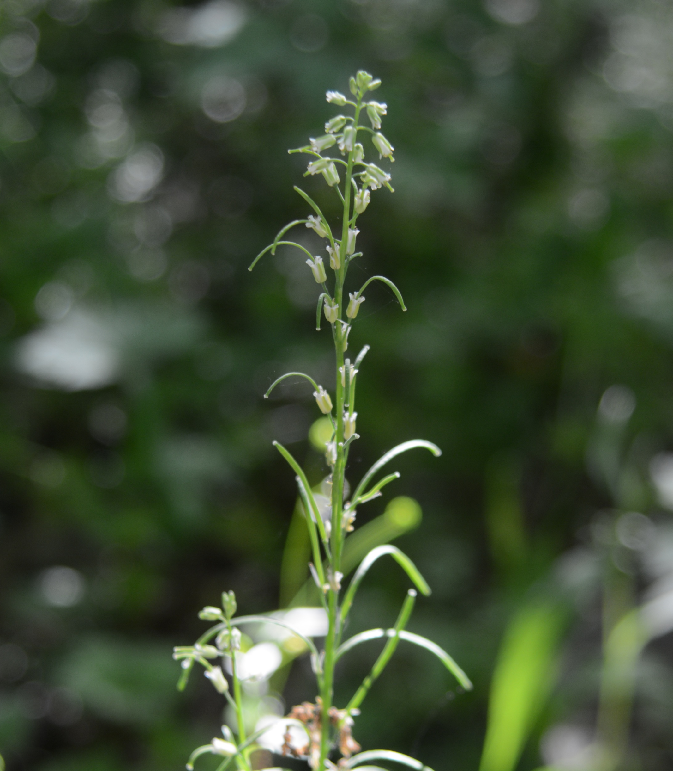
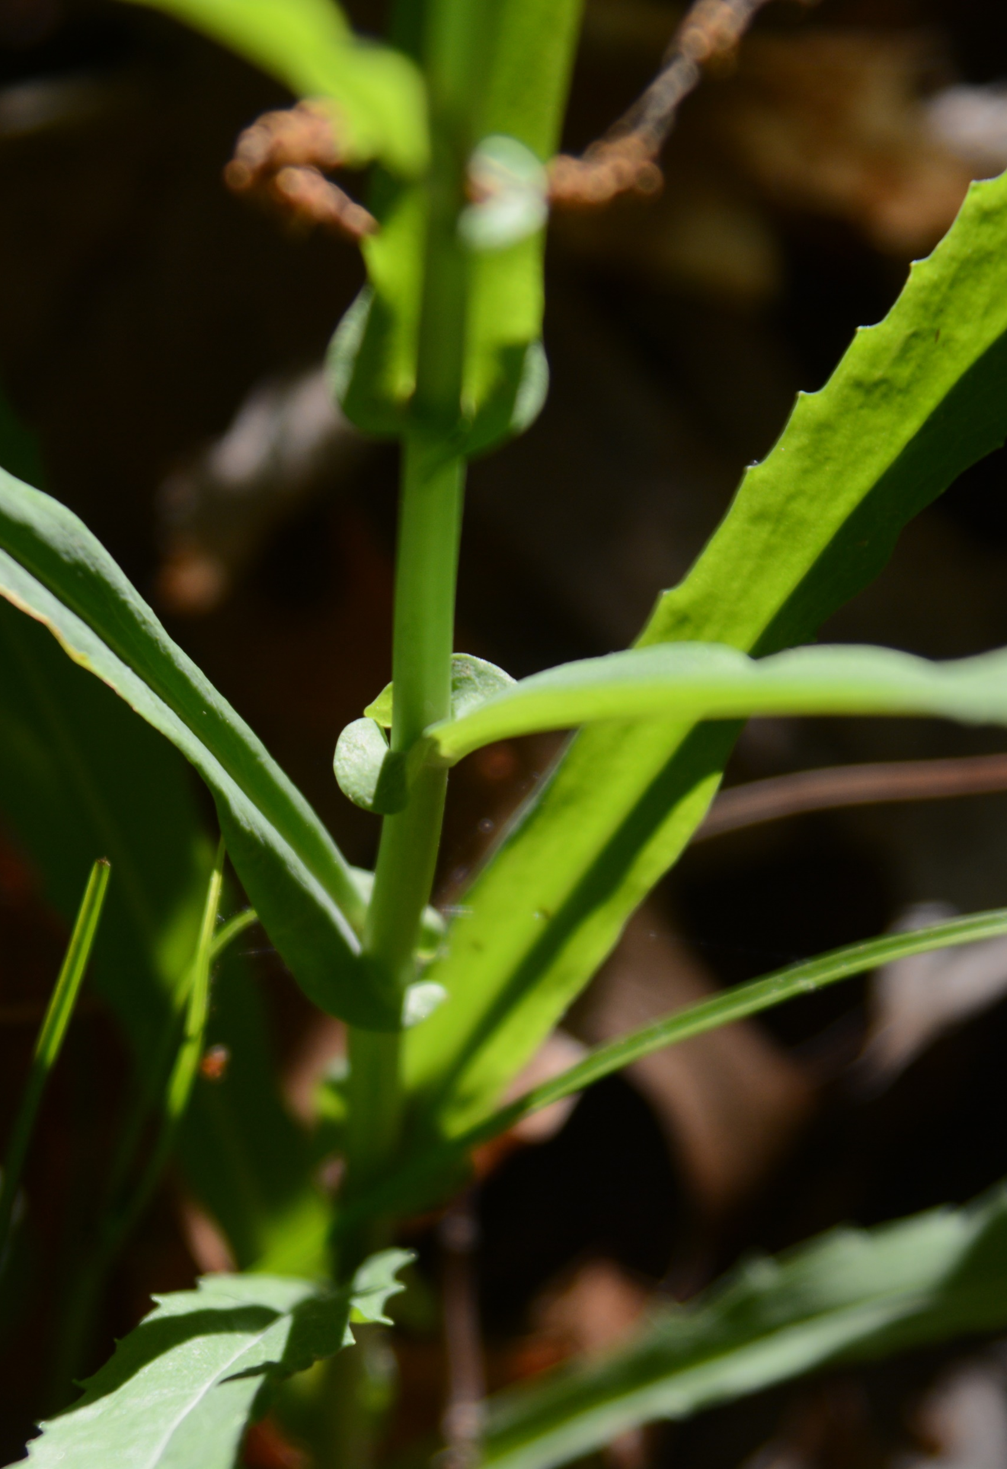
Smooth Rock-cress
Boechera laevigata
Notes:
2008_05_07_023 Kickapoo
2014_05_28_055 Kickapoo
2014_05_28_057 Kickapoo
Seek ID

Slide 4
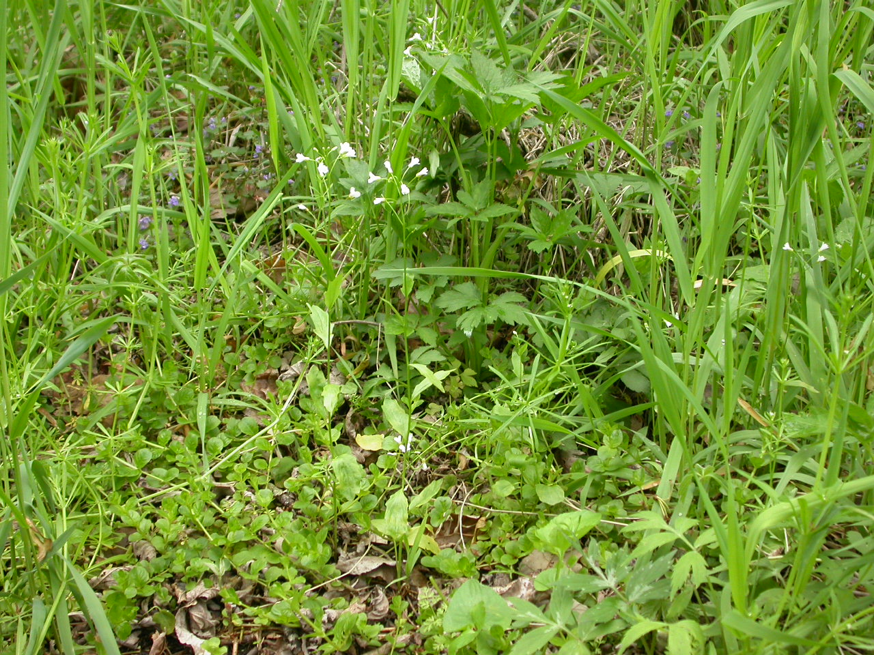
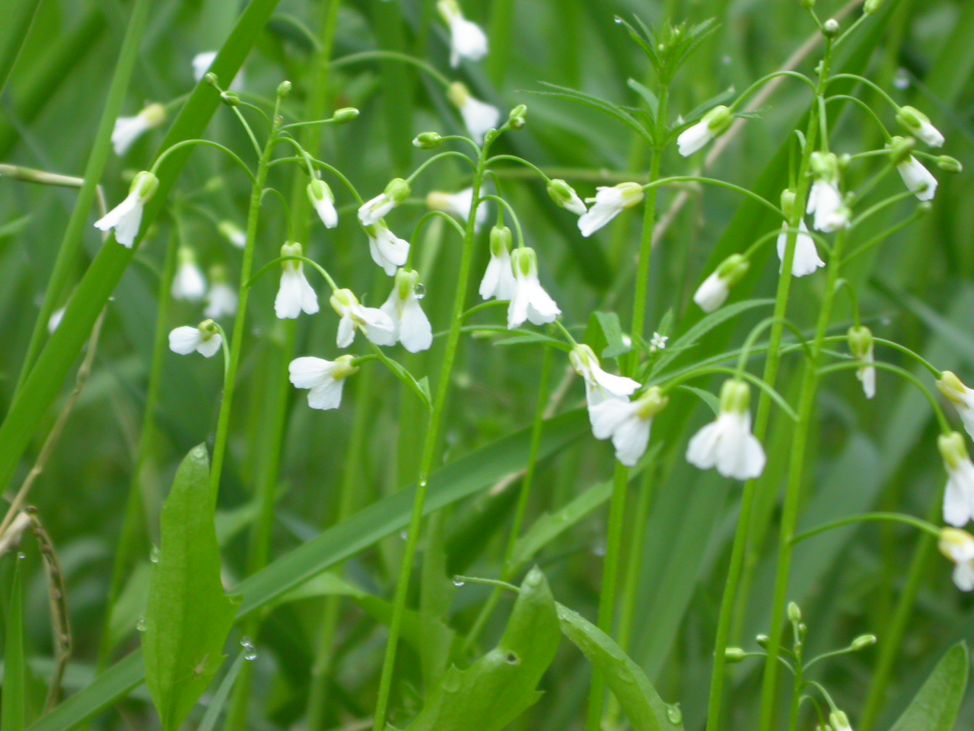
Spring-cress
Cardamine bulbosa
Notes:
2005_05_14_025Kickapoo
2007_05_09_003 Kickapoo

Slide 5
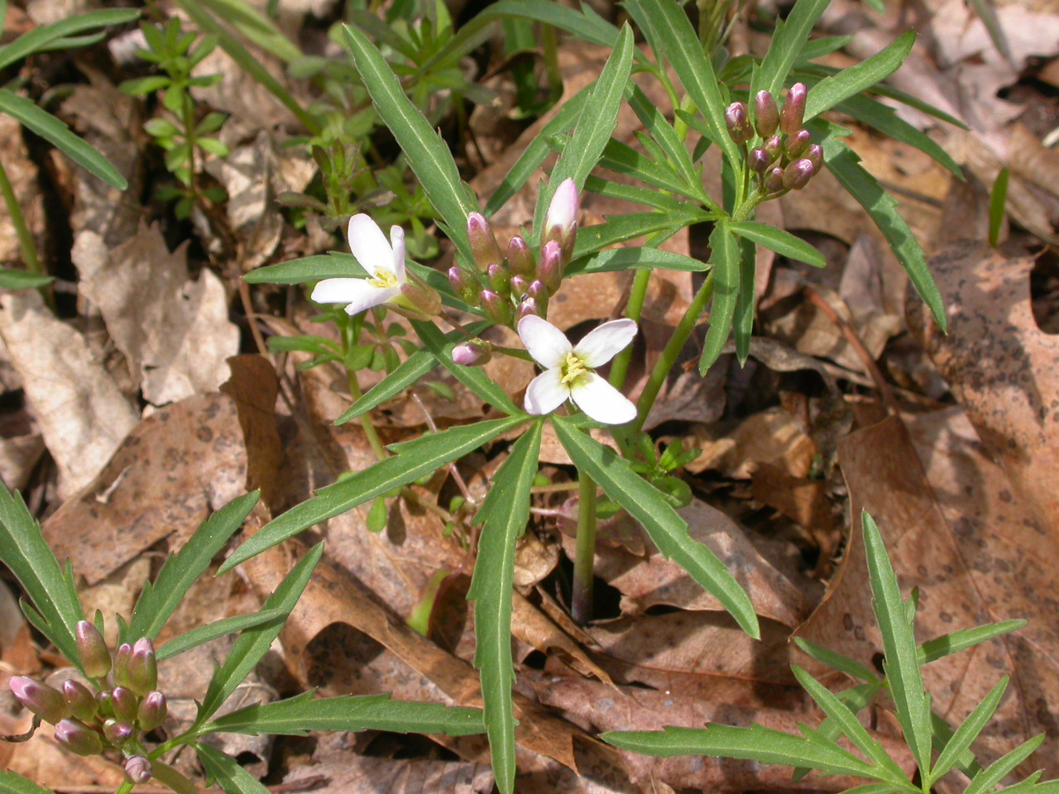
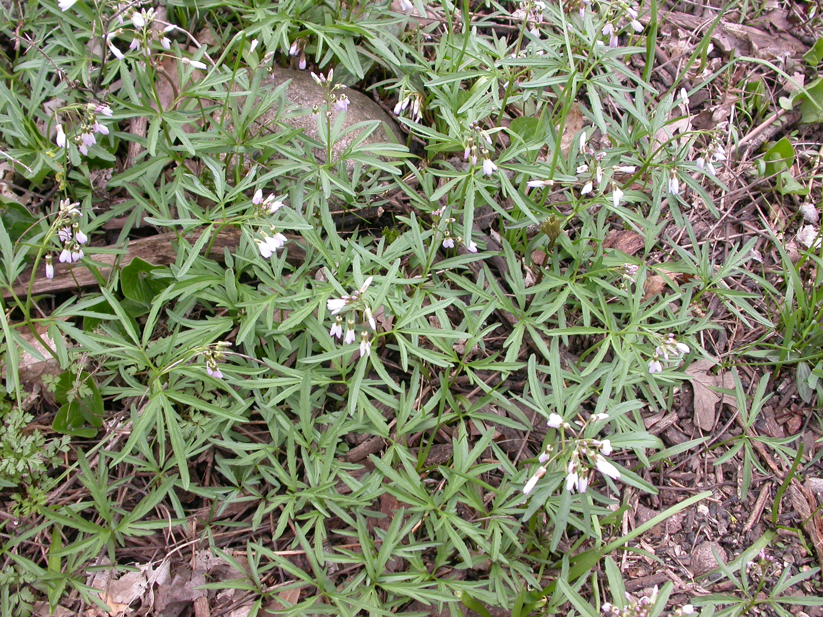
Cut-leaved Toothwort
Carsamine concatenata
Notes:
2007_04_18_017 Kickapoo
2008_04_28_003 Wehr

Slide 6
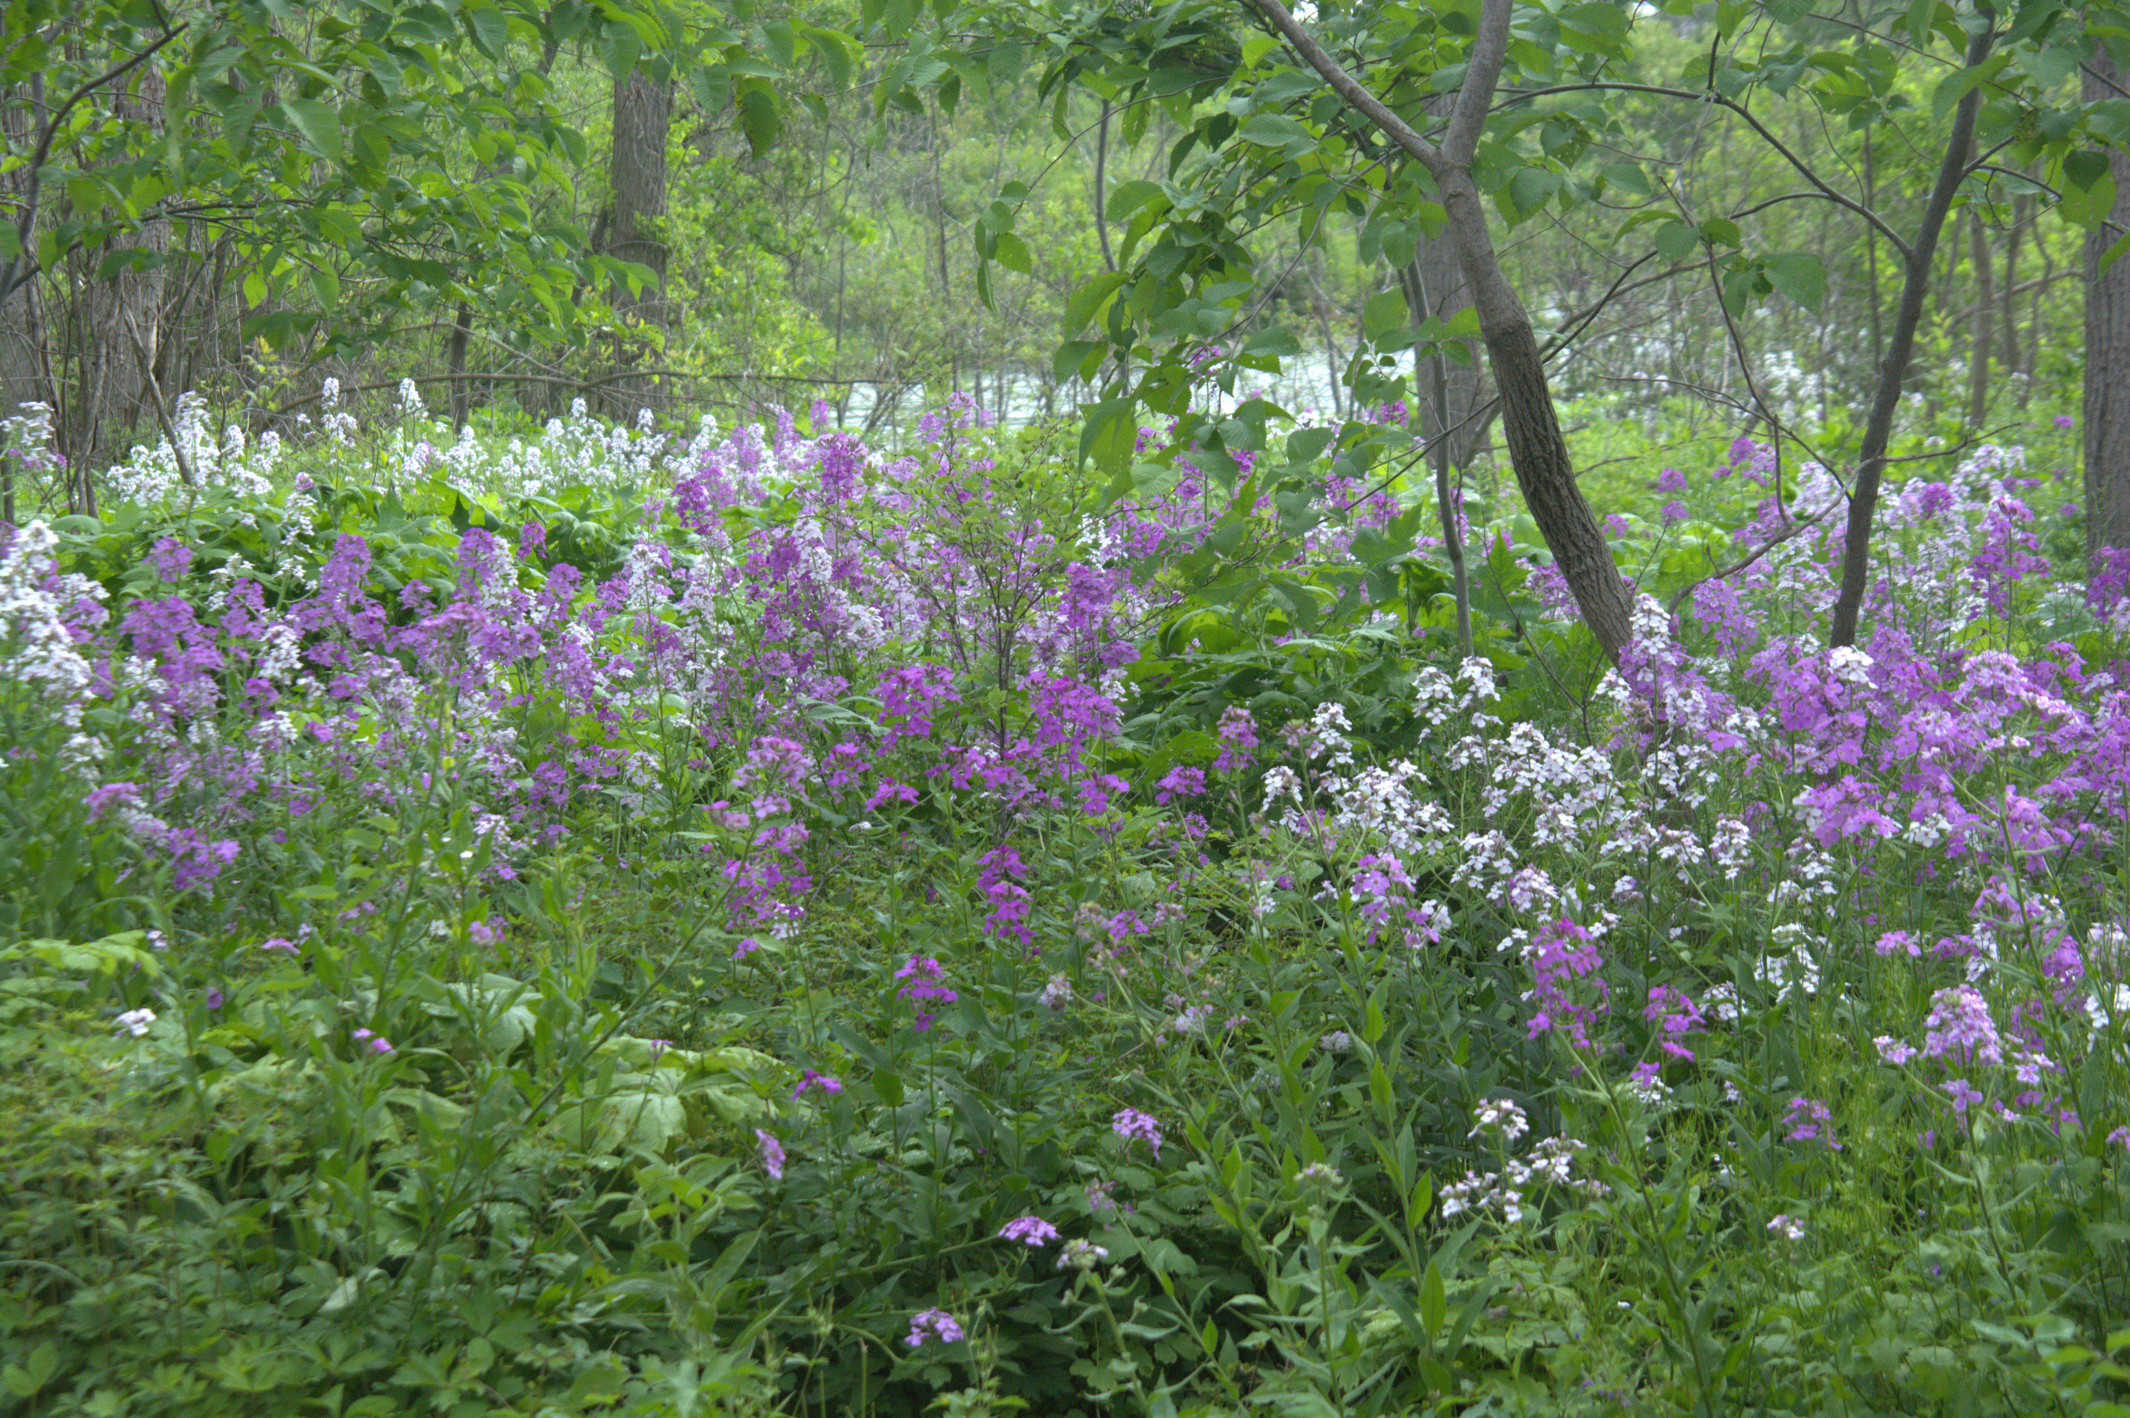
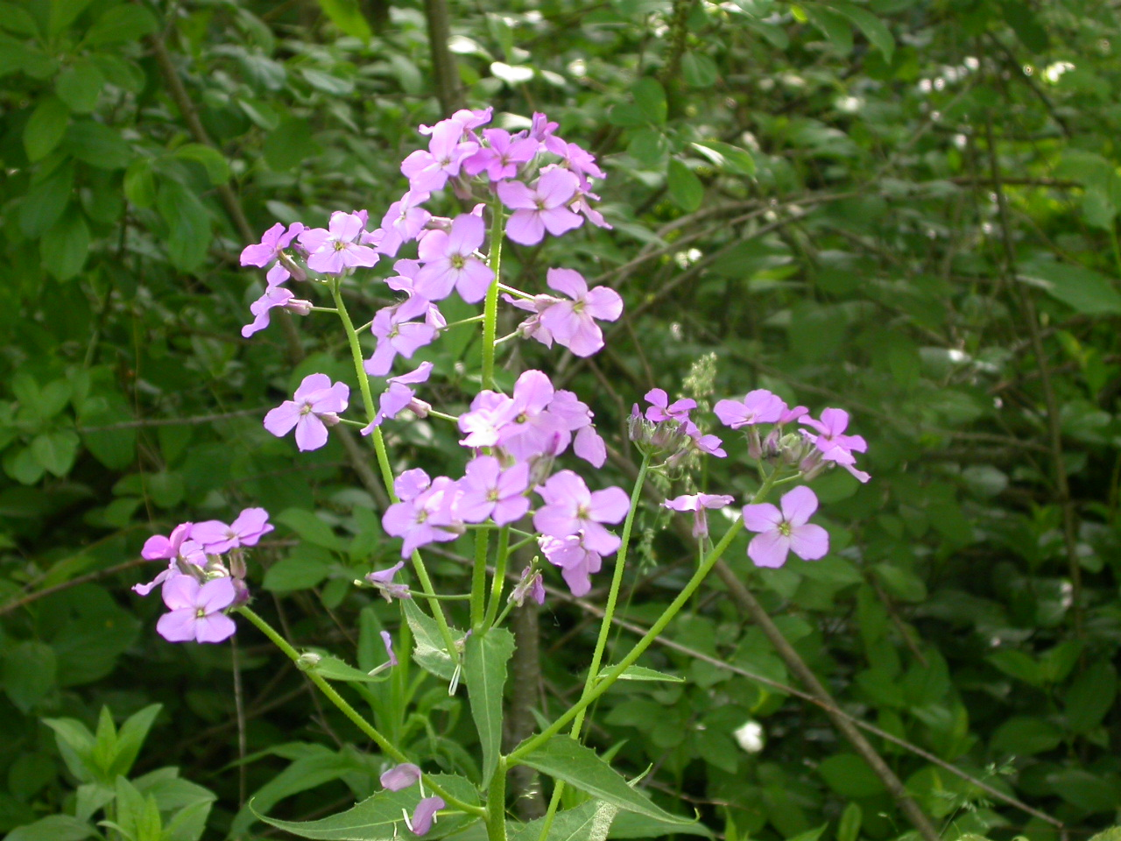
Dame’s Rocket
Hesperis matronalis
Notes:
2018_06_05_020 Wehr

Slide 7
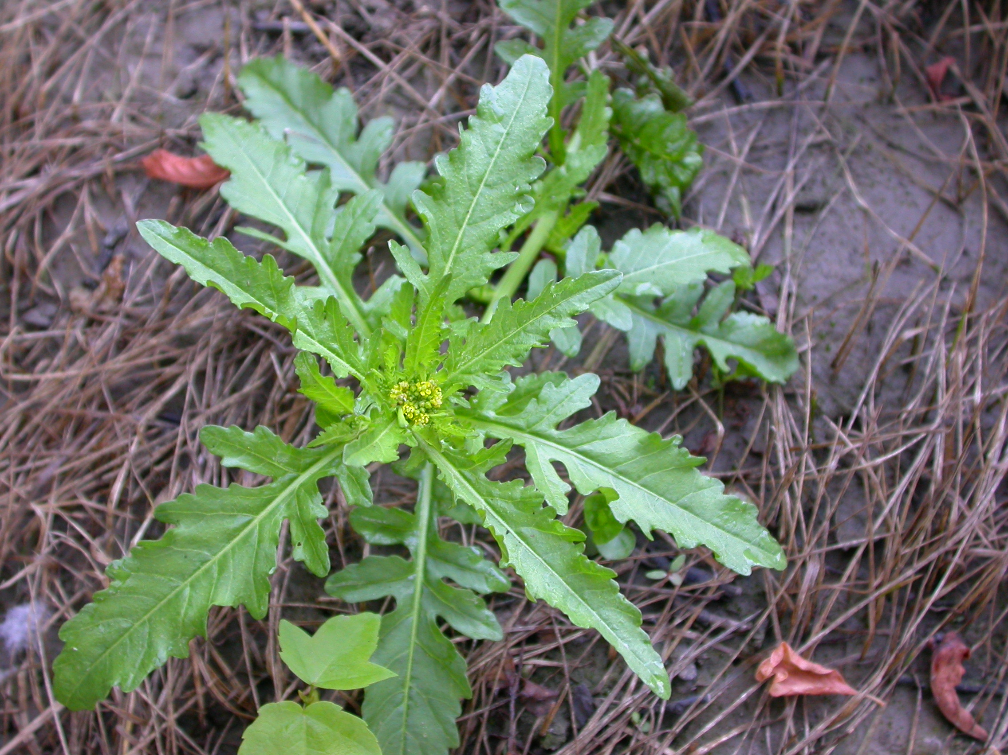
Yellow-cress
Rorippa palustris
Notes:
2008_07_02_001 Kickapoo

Slide 8
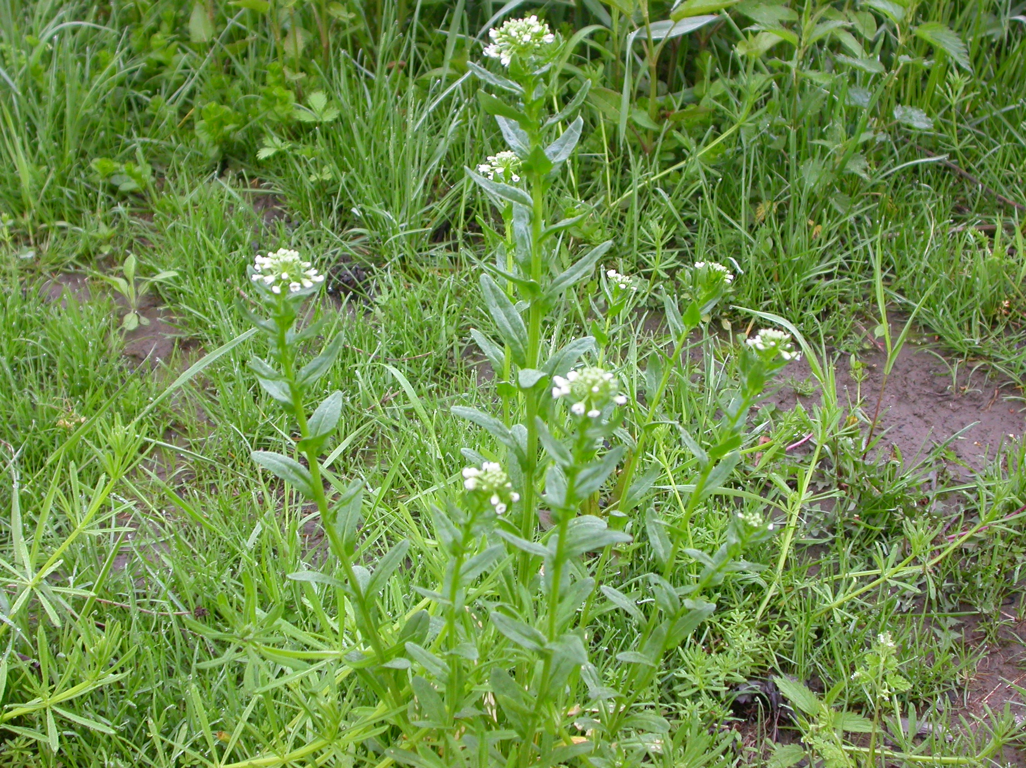
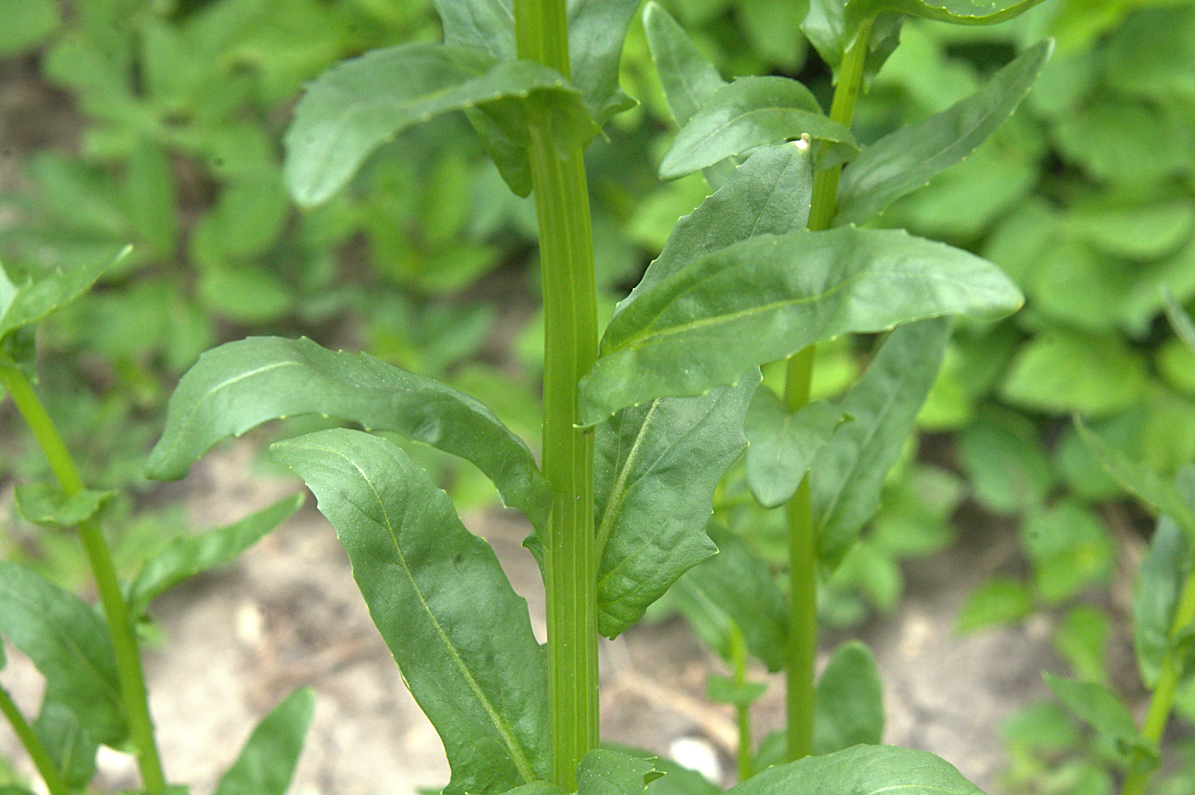
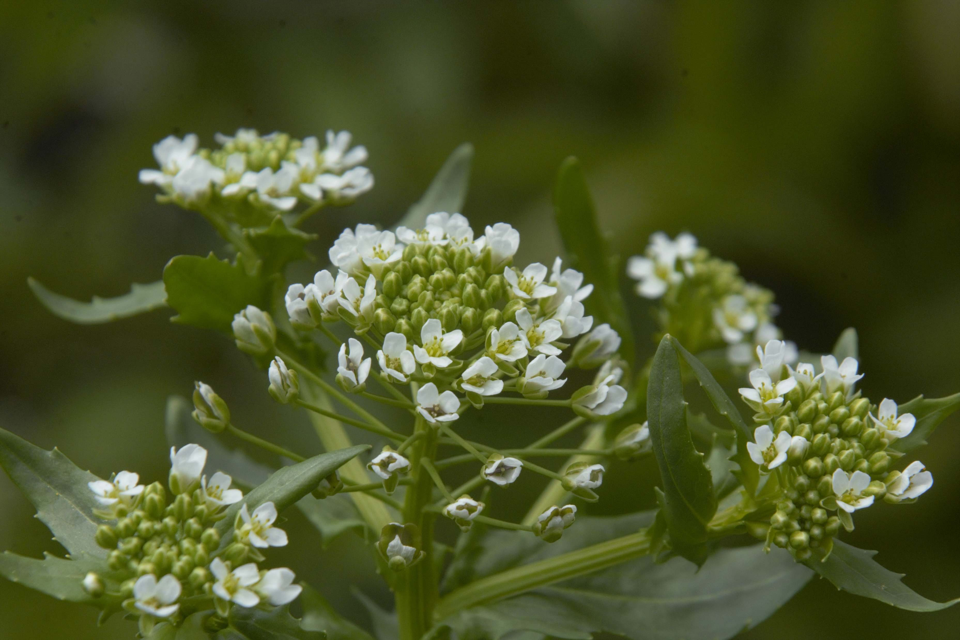
Field Pennycress
Thlaspi arvense
Notes:
2008_05_08_001 Kickapoo
2019_05_14_004 Franklin Residence

Slide 9
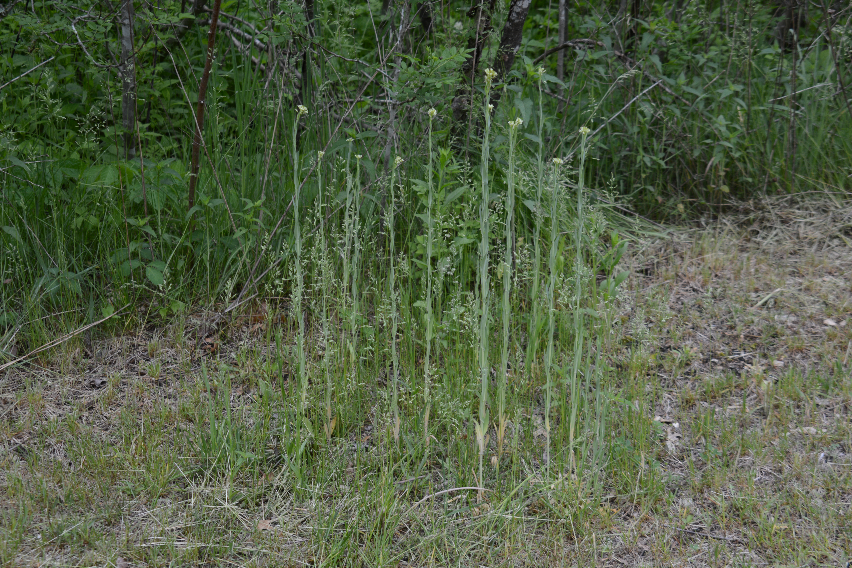
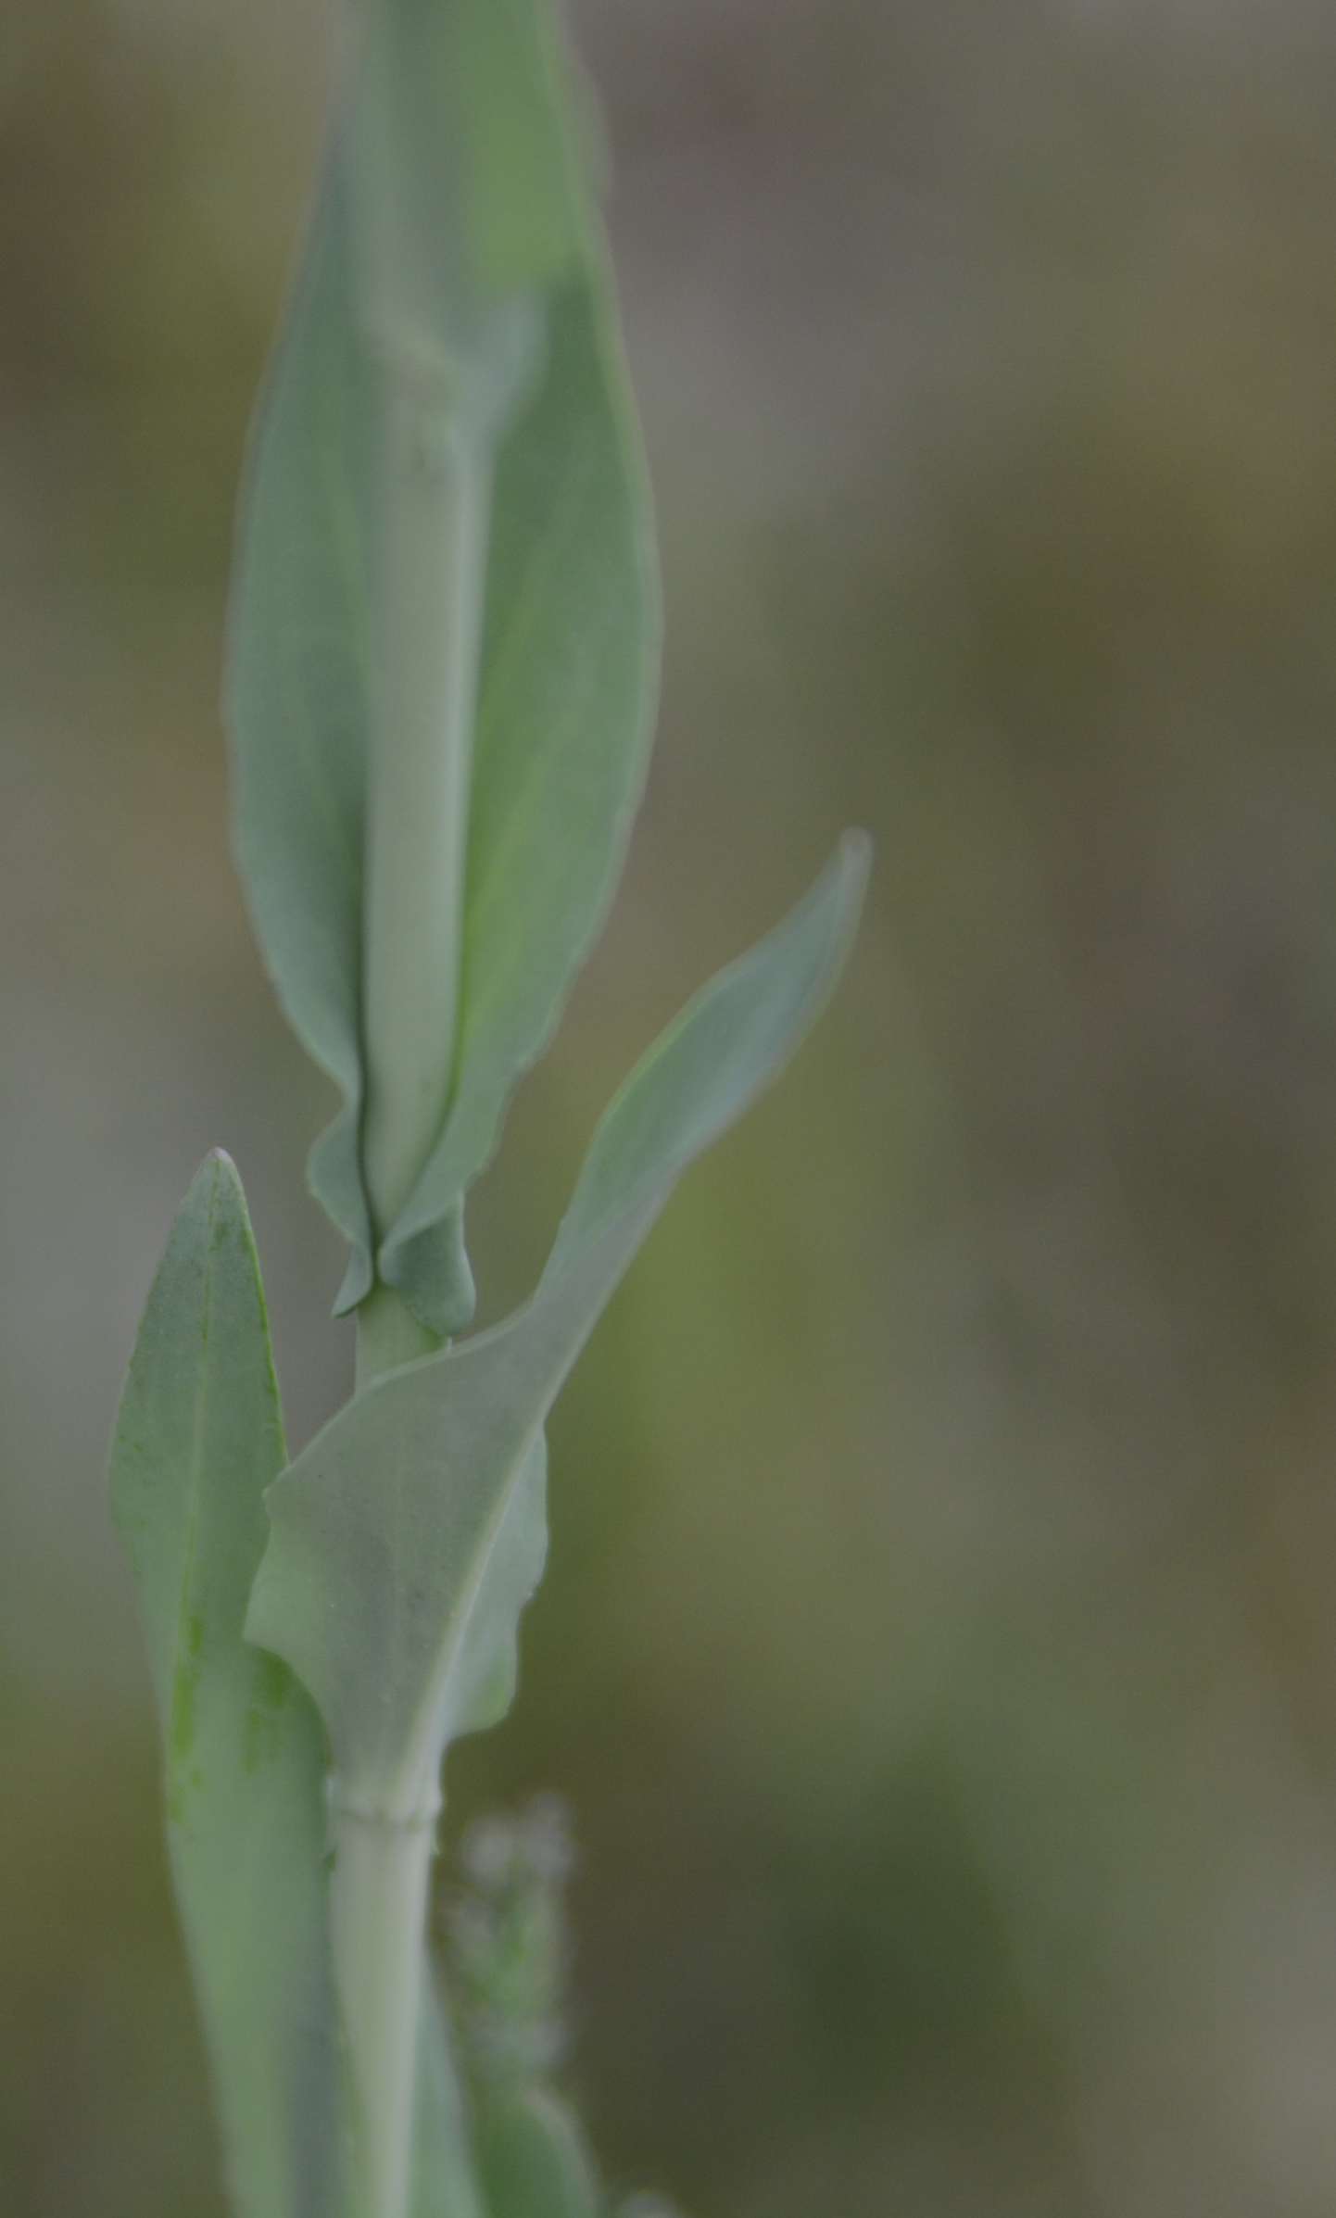
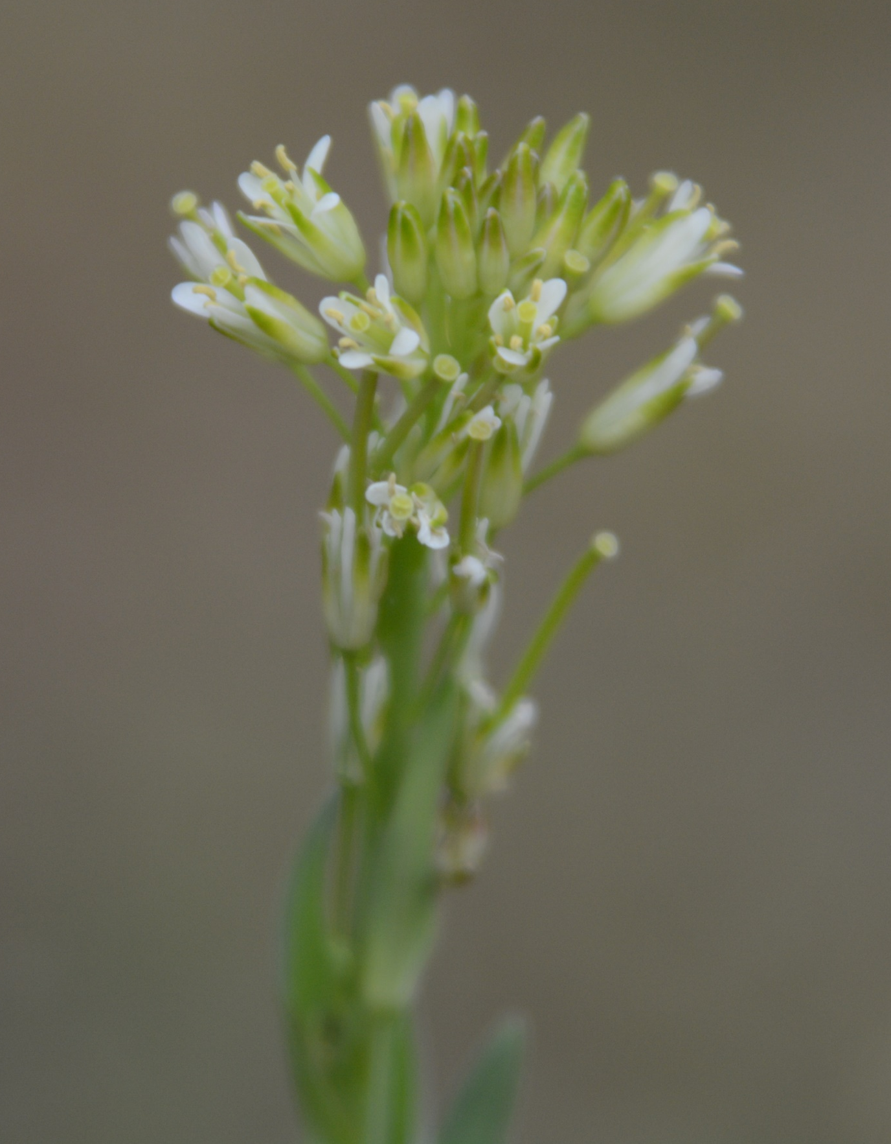
Tower Mustard
Turritis glabra
Notes:
2014_05_28_028 Kickapoo
2014_05_28_031 Kickapoo
2014_05_28_032 Kickapoo

