Slide 1
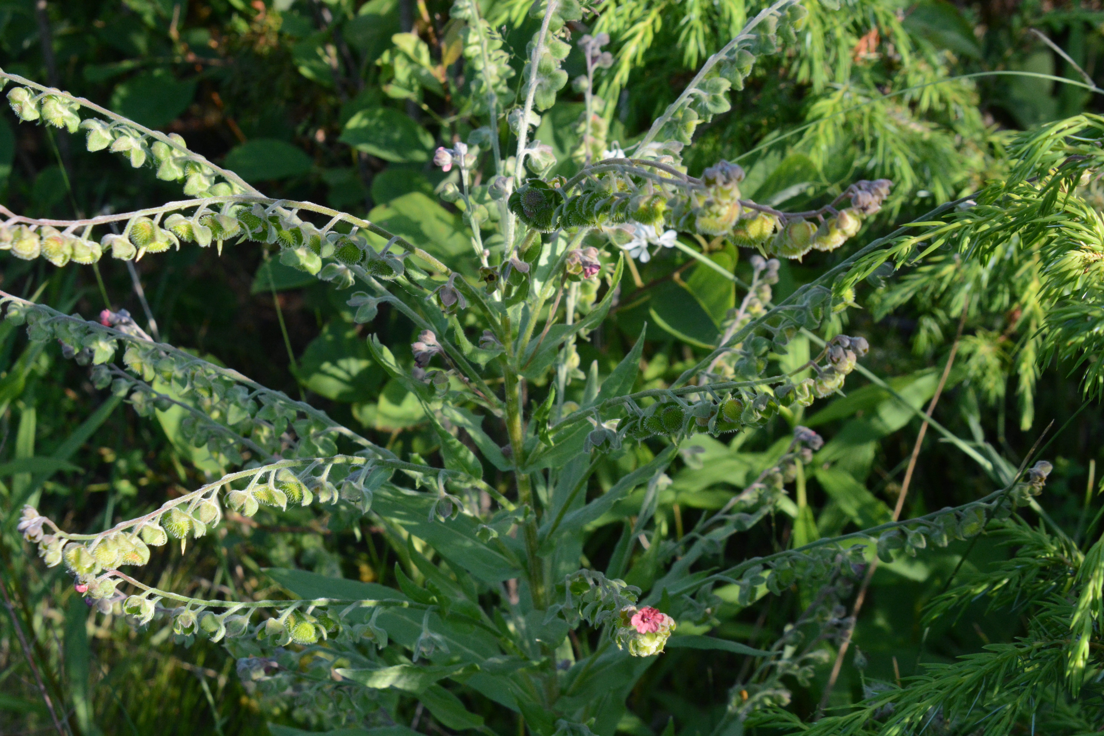
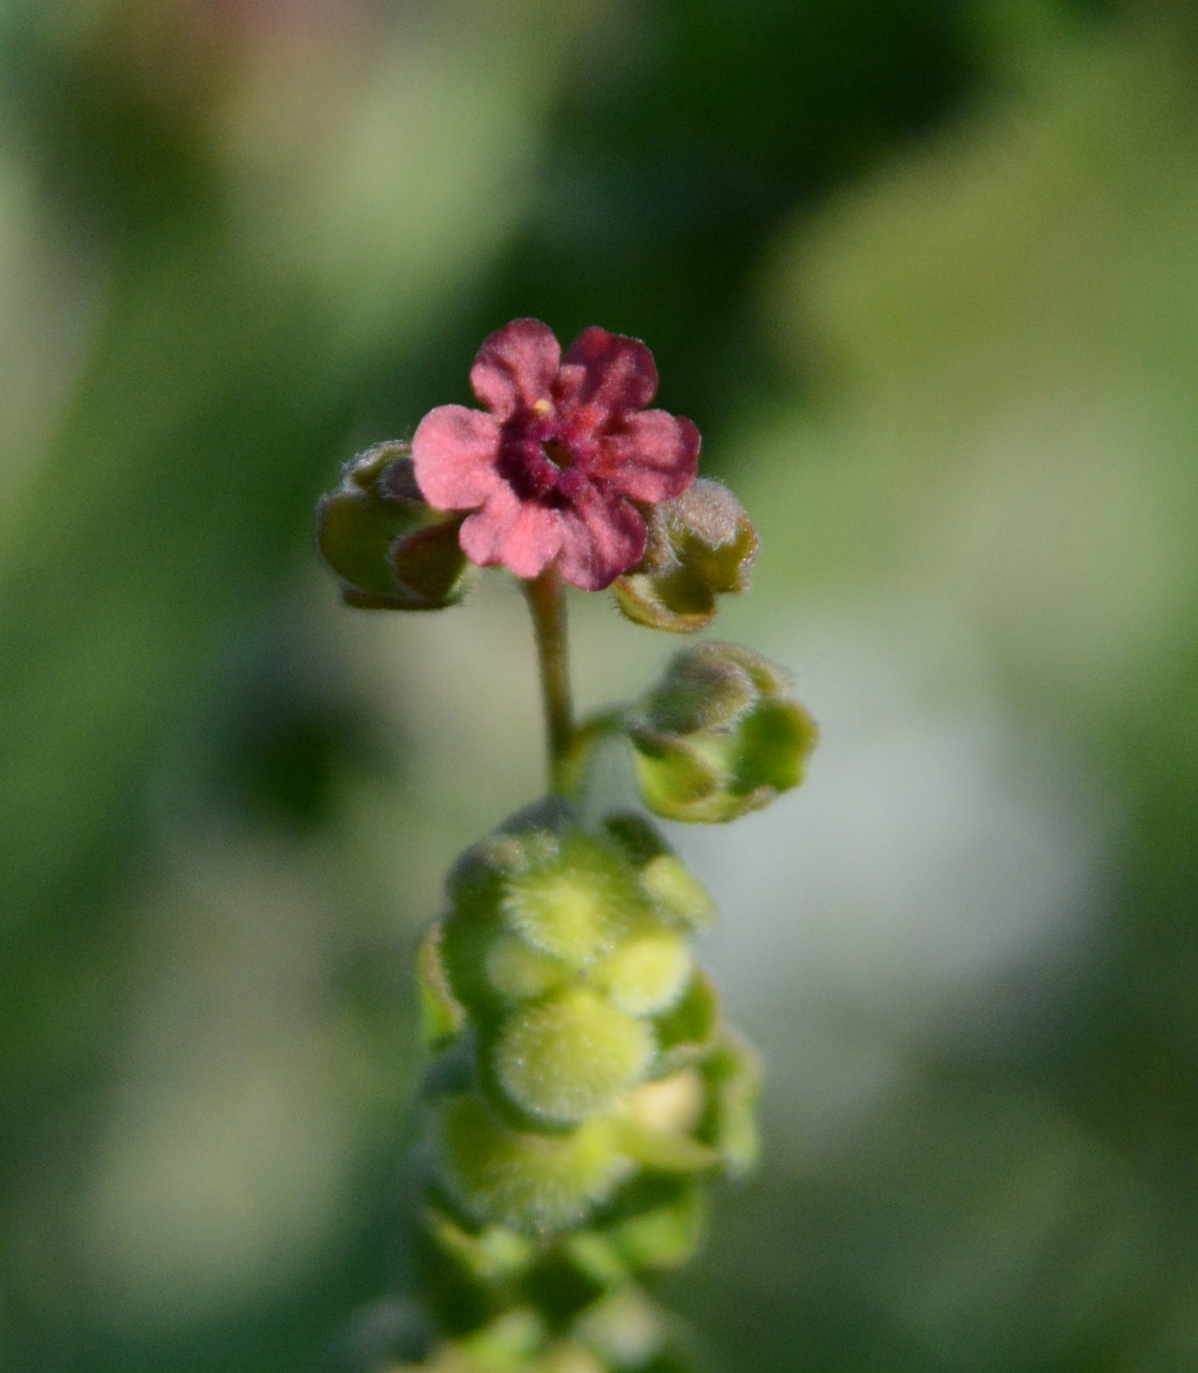
Common Hound’s-Tongue
Cynoglossum officinale
Notes:
2015_07_01_092 Door Co
2015_07_01_089 Door Co

Slide 2
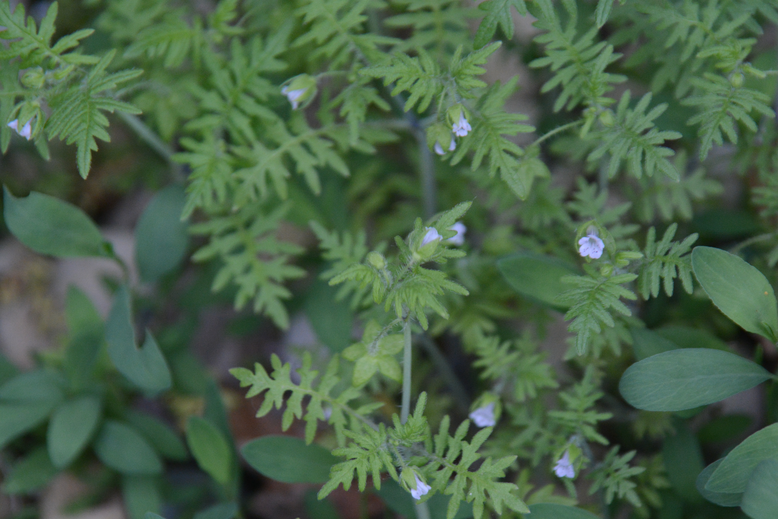
Aunt Lucy
Ellisia nyctelea
Notes:
2022_05_23_008 Wehr

Slide 3
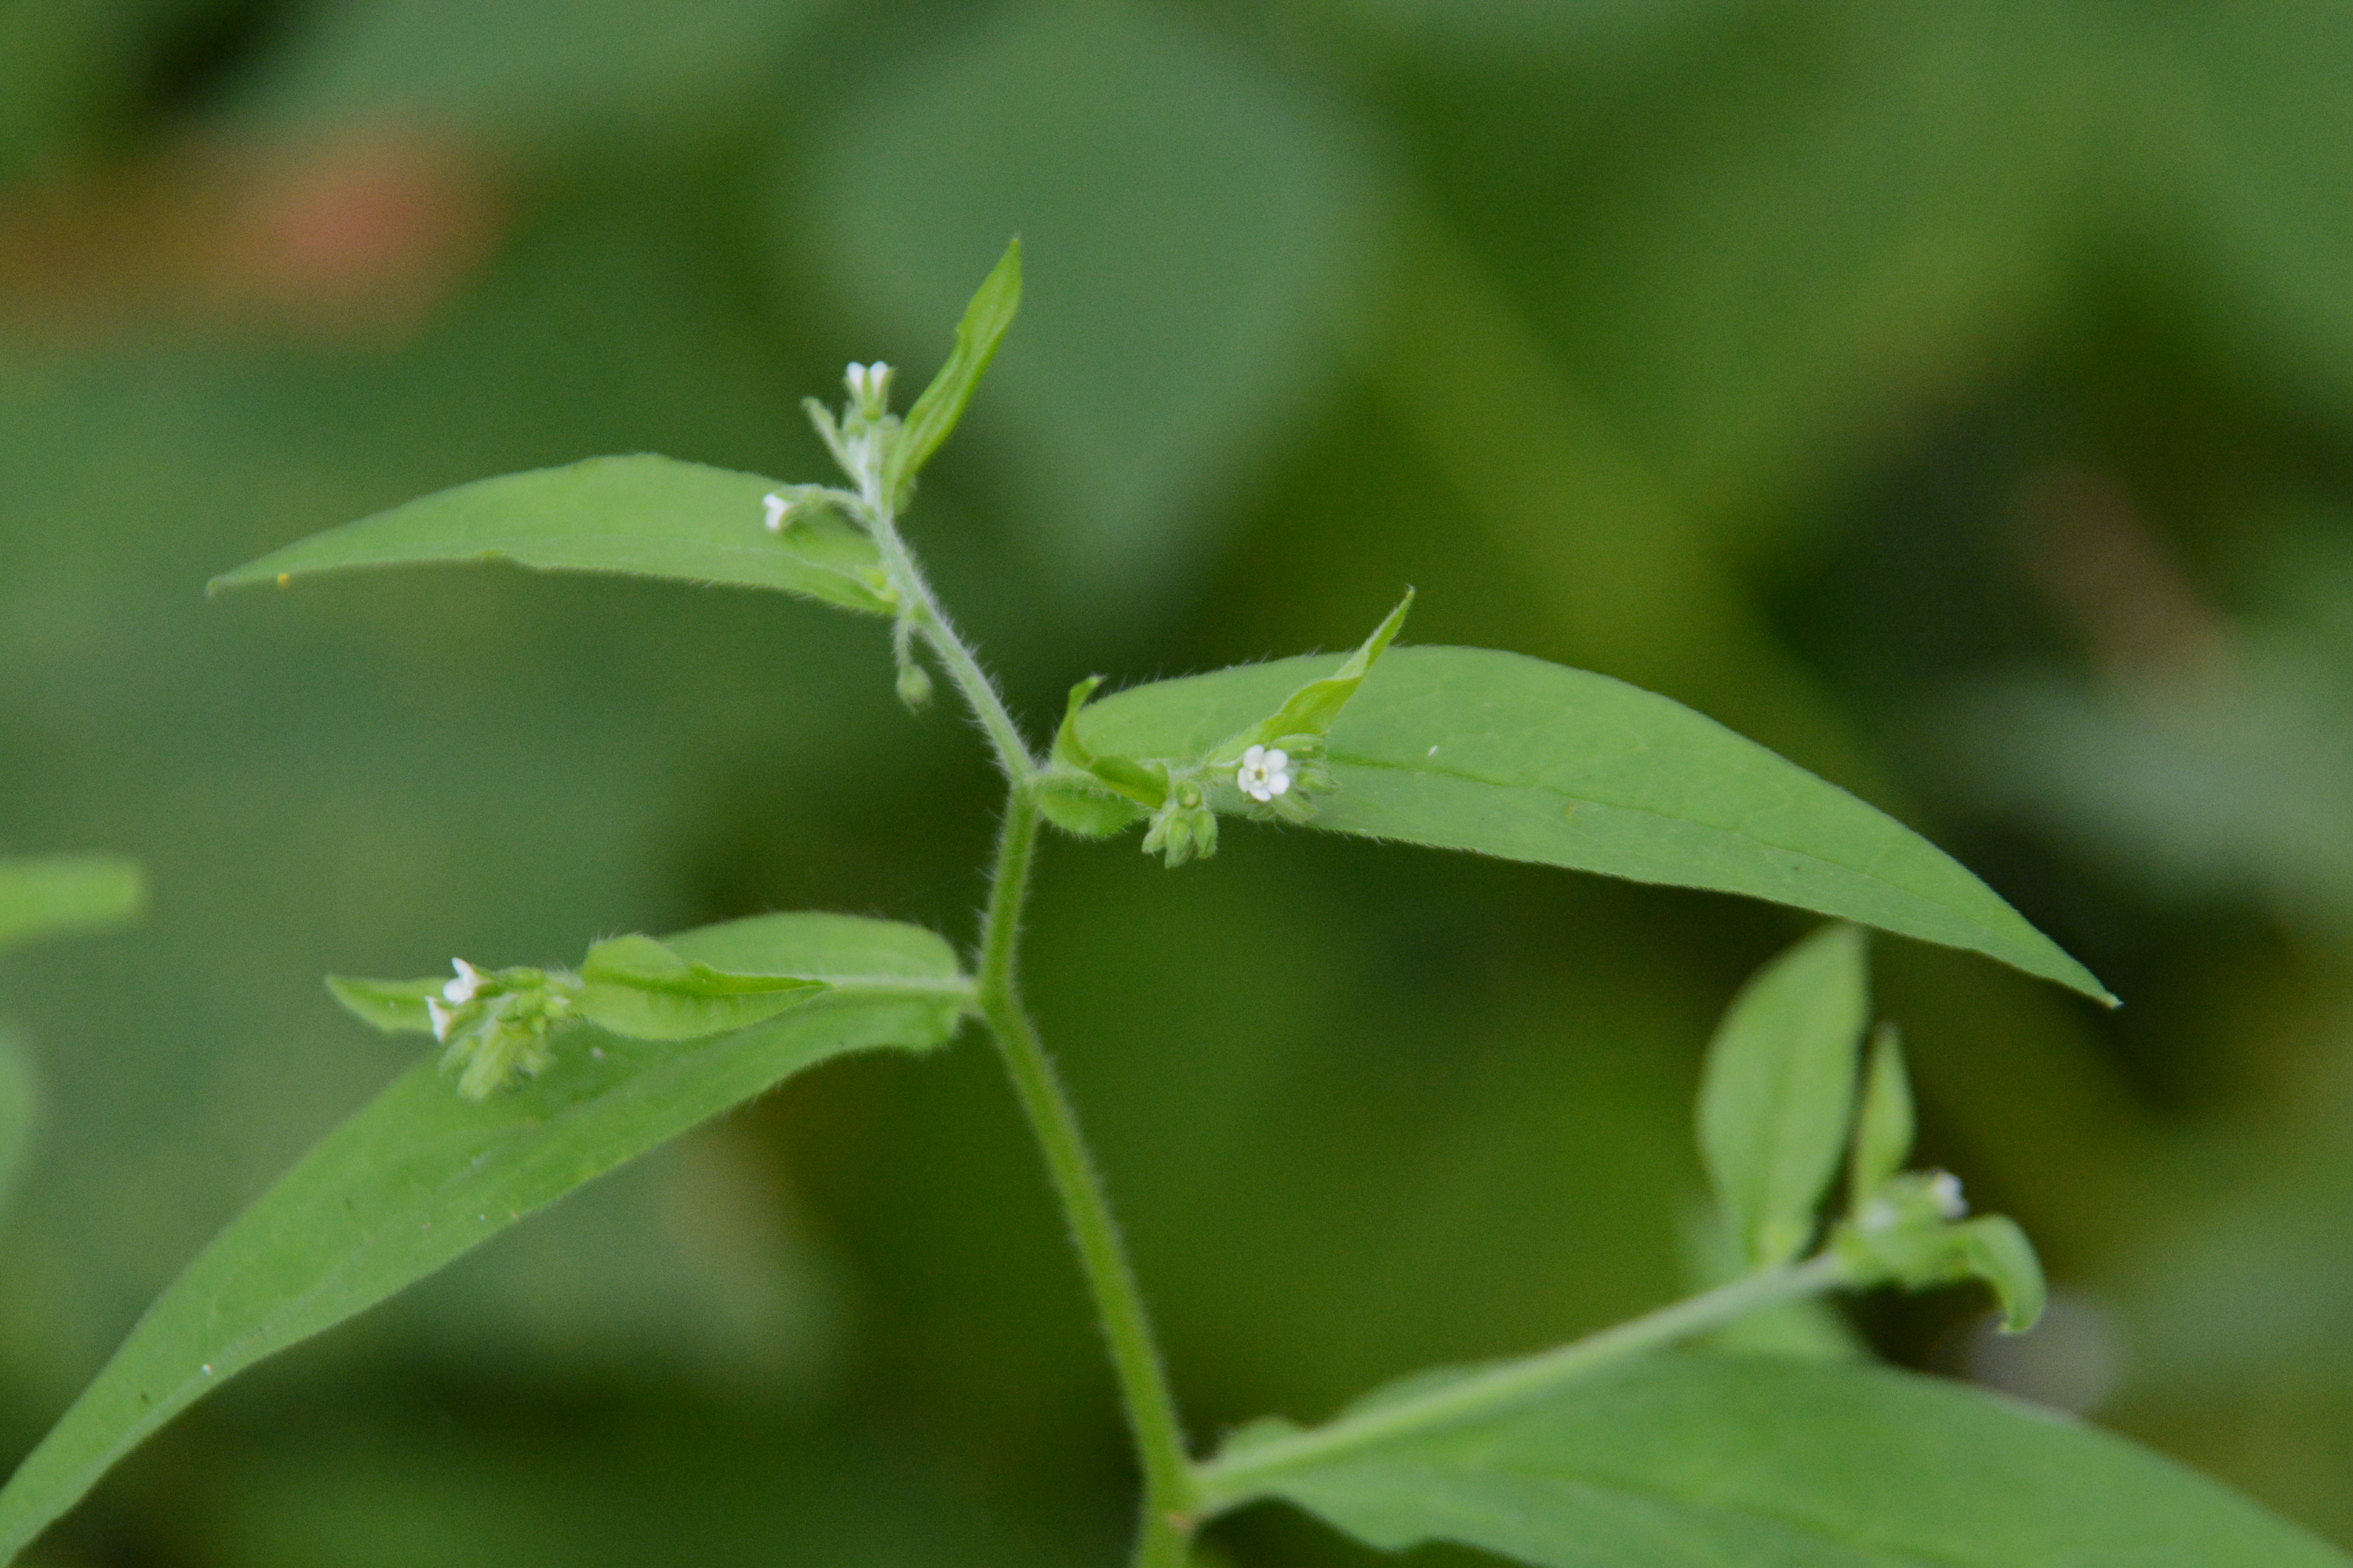
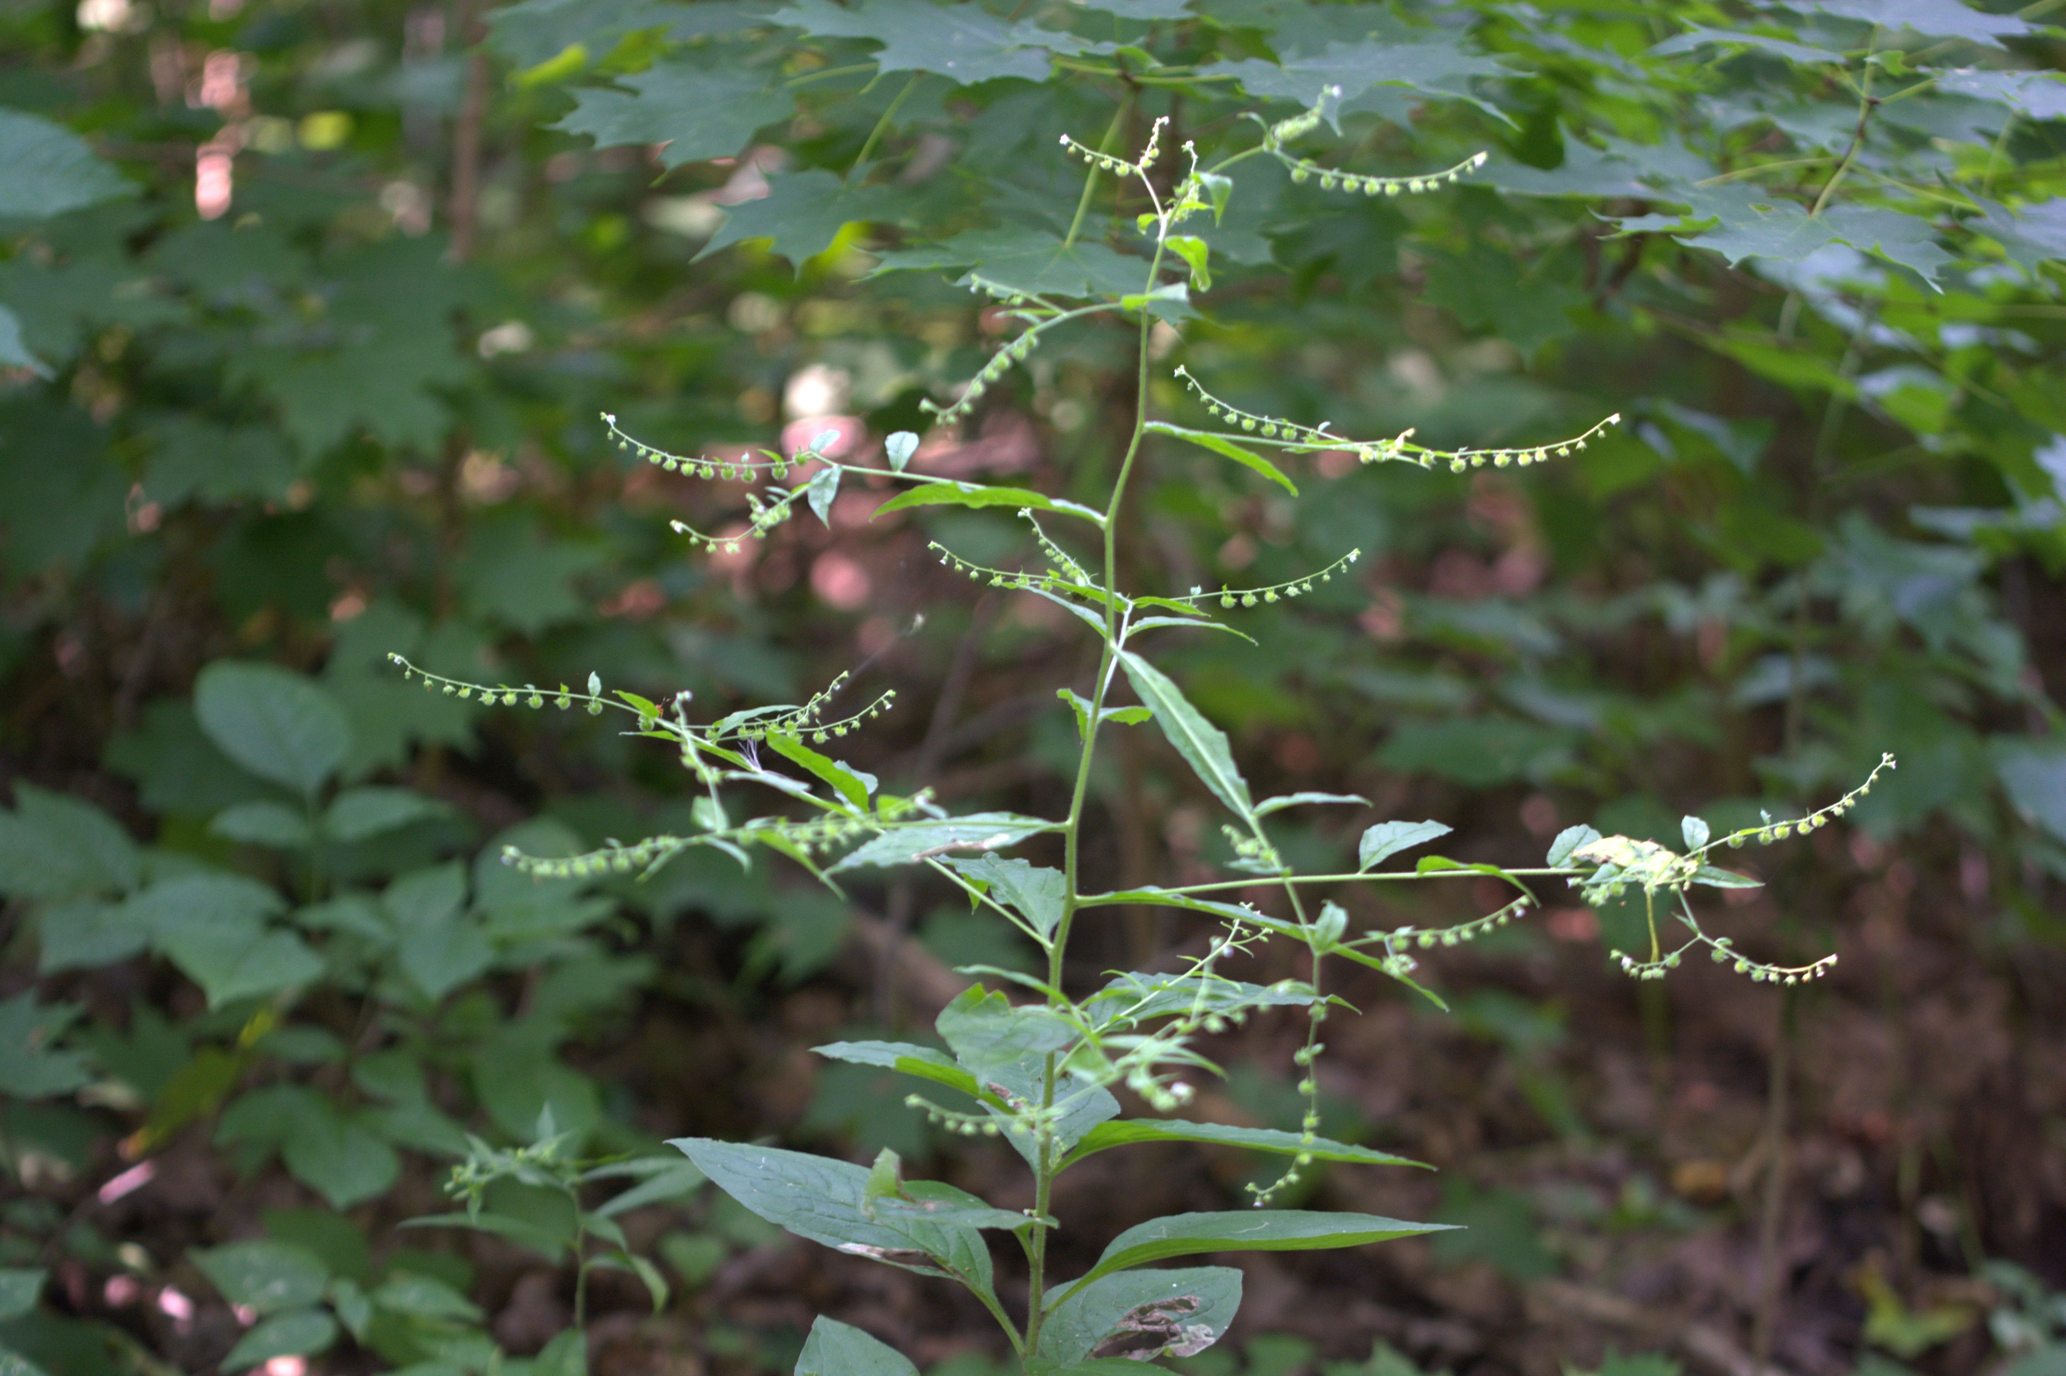
Virginia Stickseed
Hackelia virginiana
Notes:
2015_07_28_011 Wehr

Slide 4
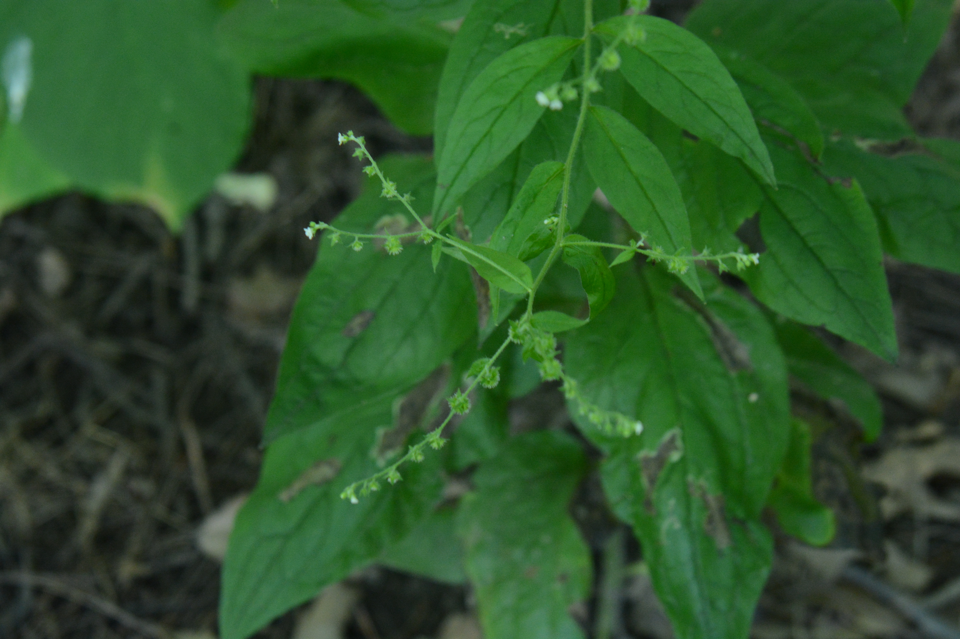

Beggar’s-lice
Hackelia virginiana
Notes:
2022_08_10_004 Tabor Woods
2015_07_28_011Wehr

Slide 5
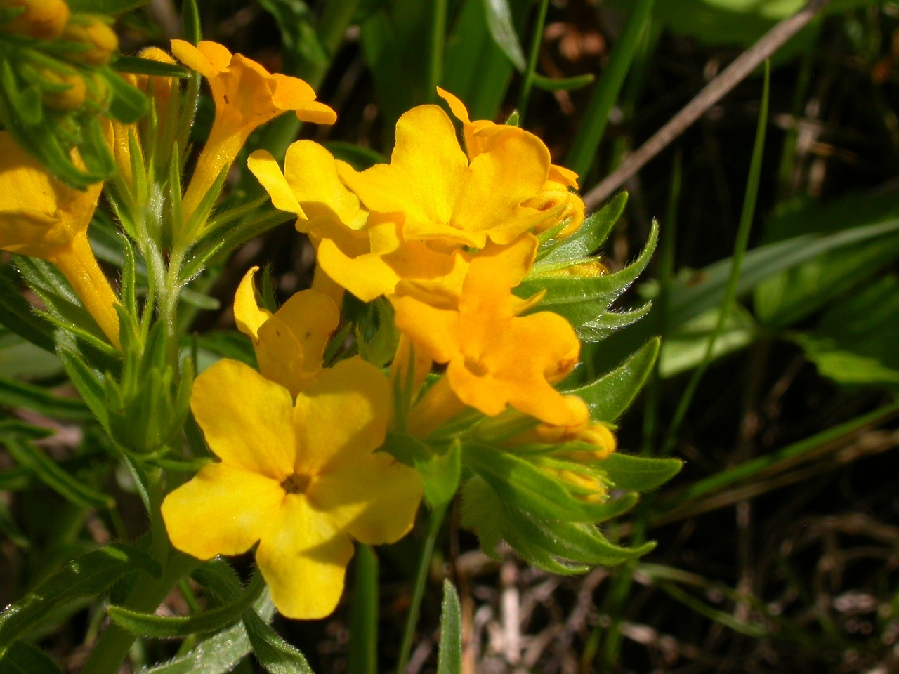
Hoary puccoon
Lithospermum canescens
Notes:
2005_05_31_006 Avoca Praire

Slide 6
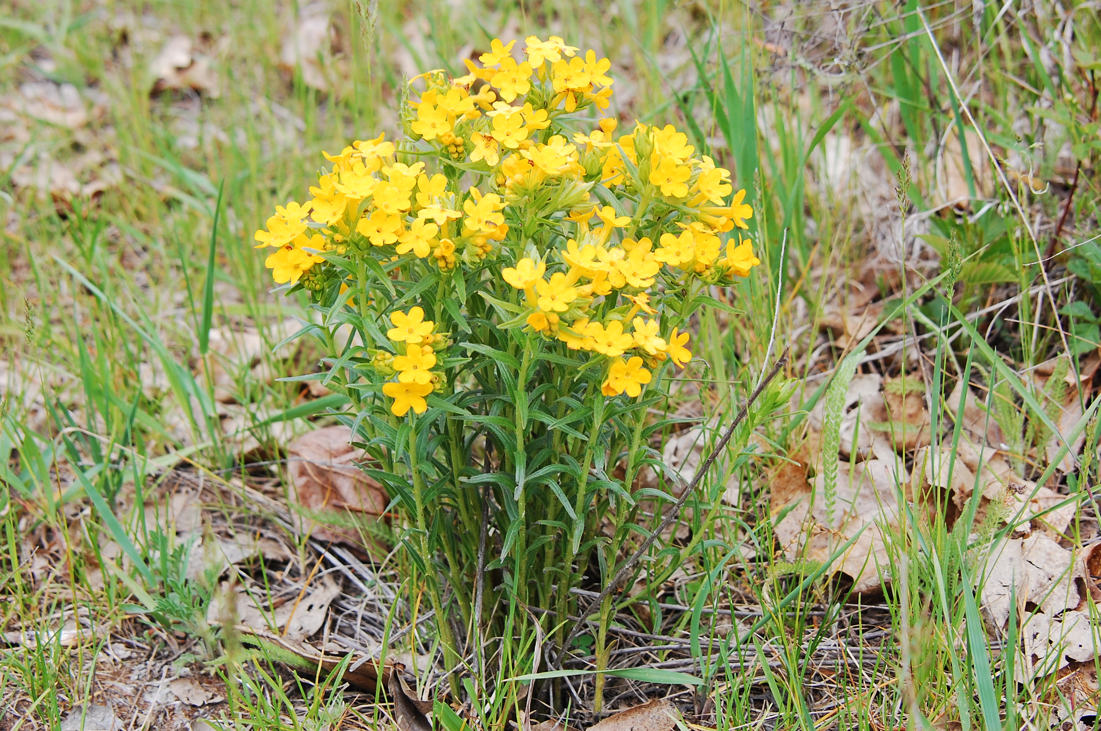
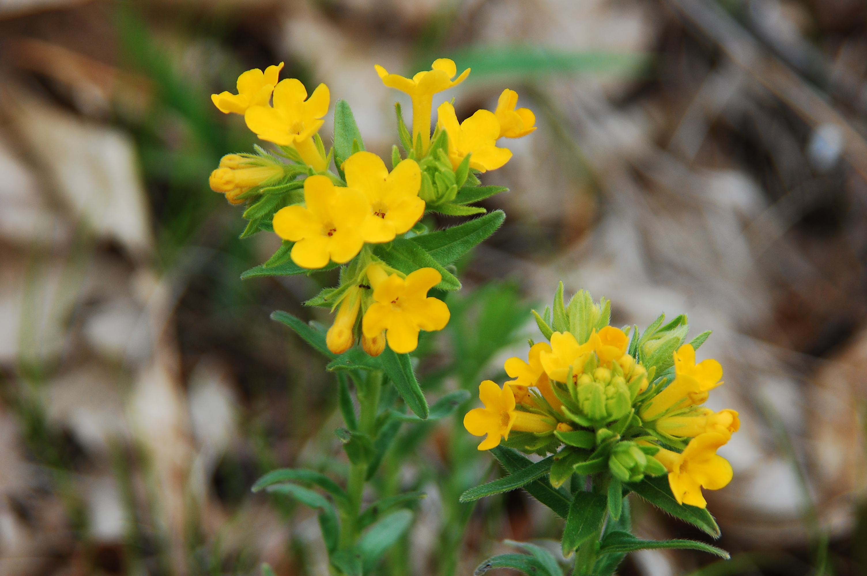
Hairy puccoon
Lithospermum caroliniense
Notes:
2012_05_09_012 Avoca Unit
2012_05_09_015 Avoca Unit

Slide 7
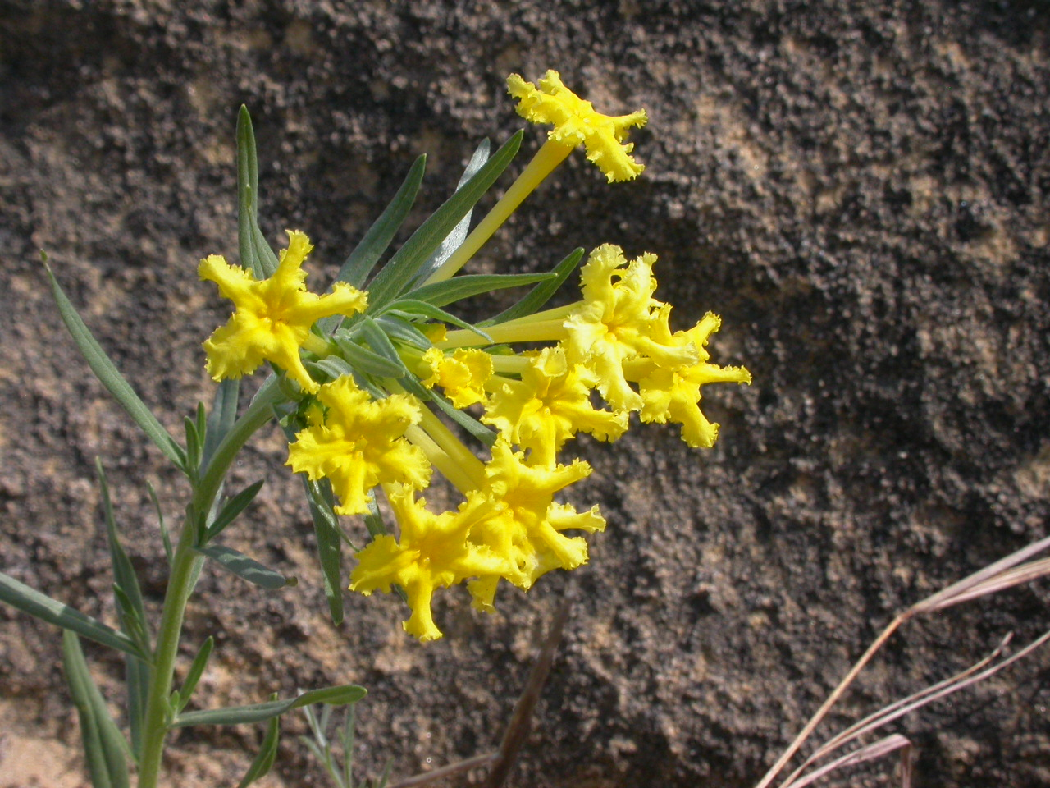
Fringed puccoon
Lithospermum incisum
Notes:
2007_05_10_012 HogBack

Slide 8
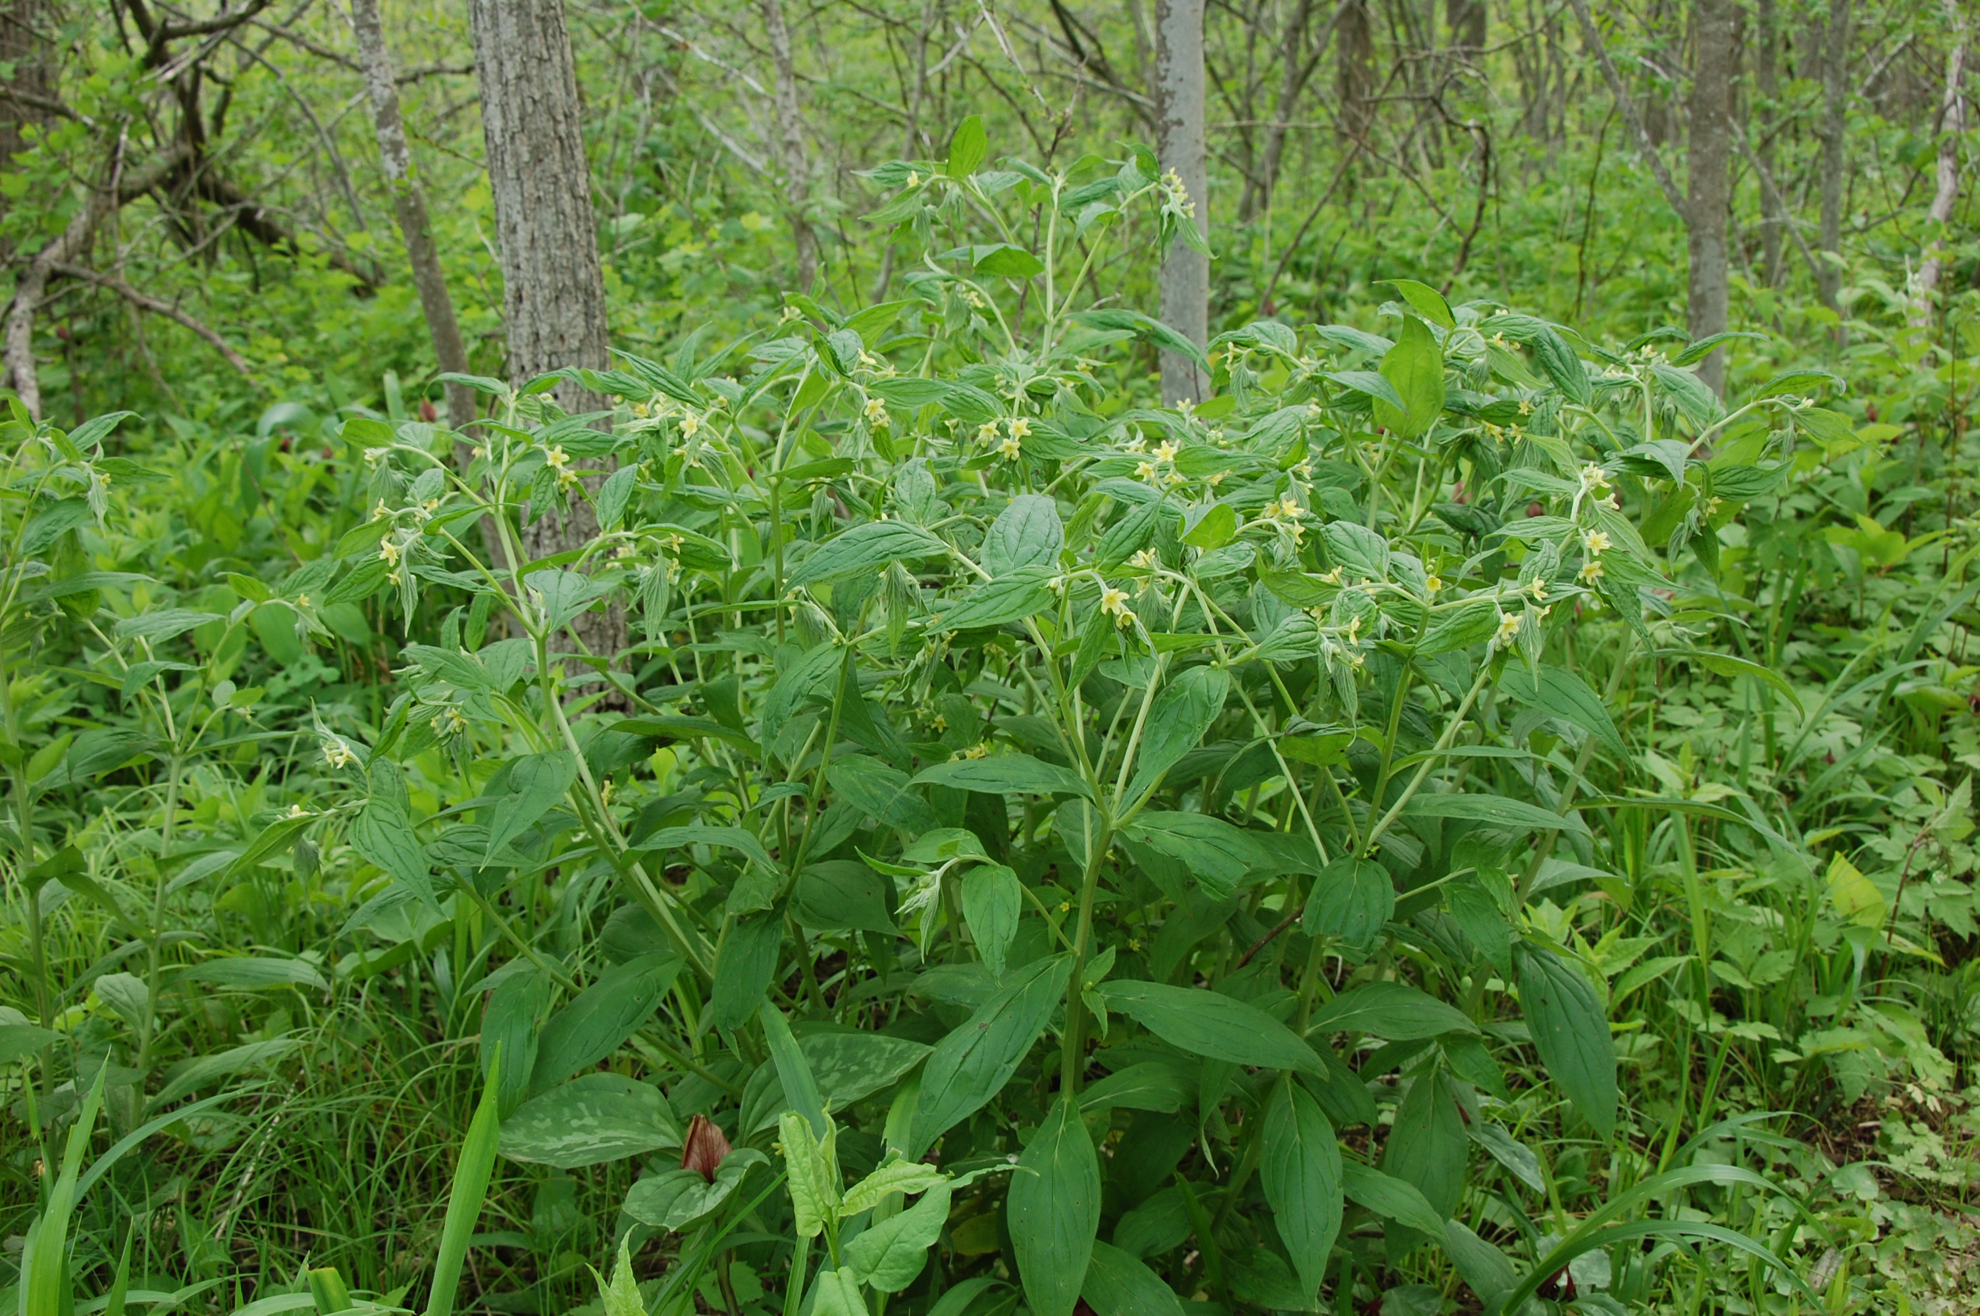
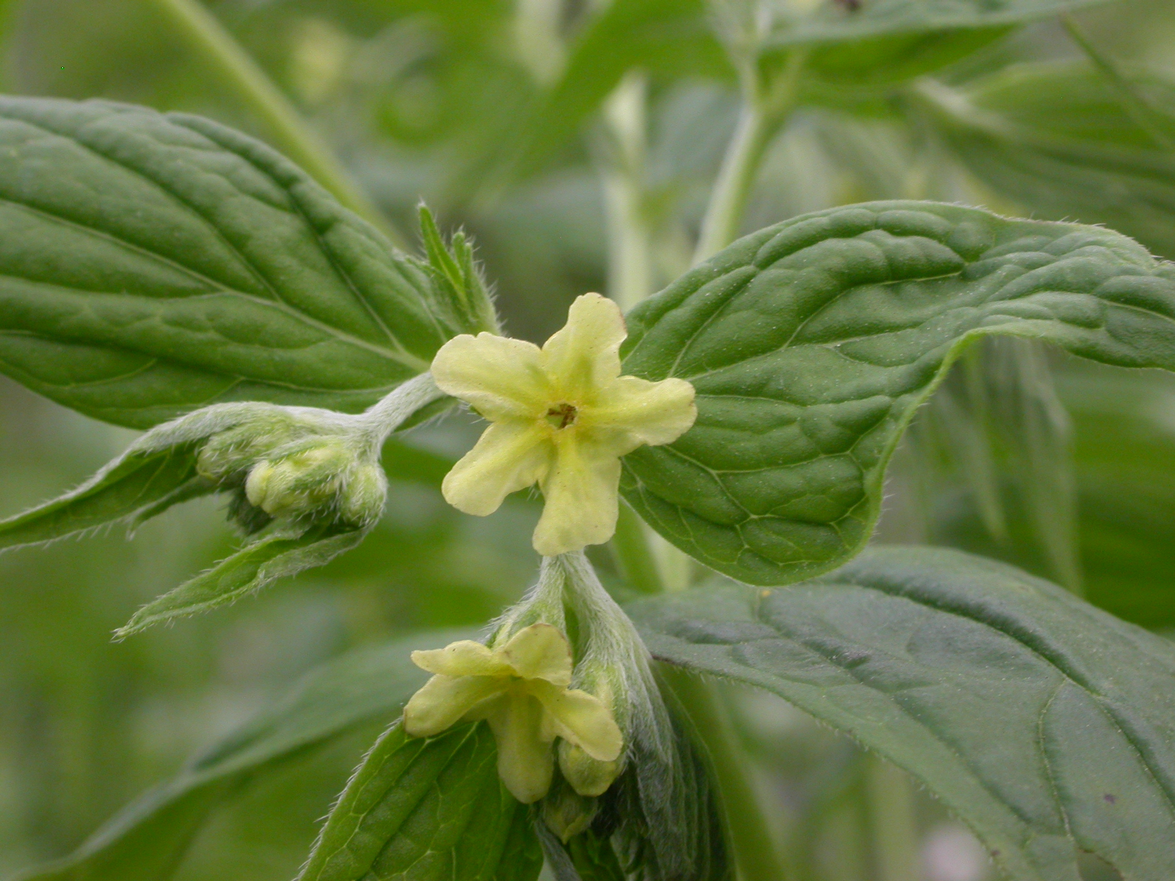
Broad-Leaved Gromwell
Lithospermum latifolium
Notes:
2009_05_25_037 Wehr
2009_05_25_019 Wehr

Slide 9
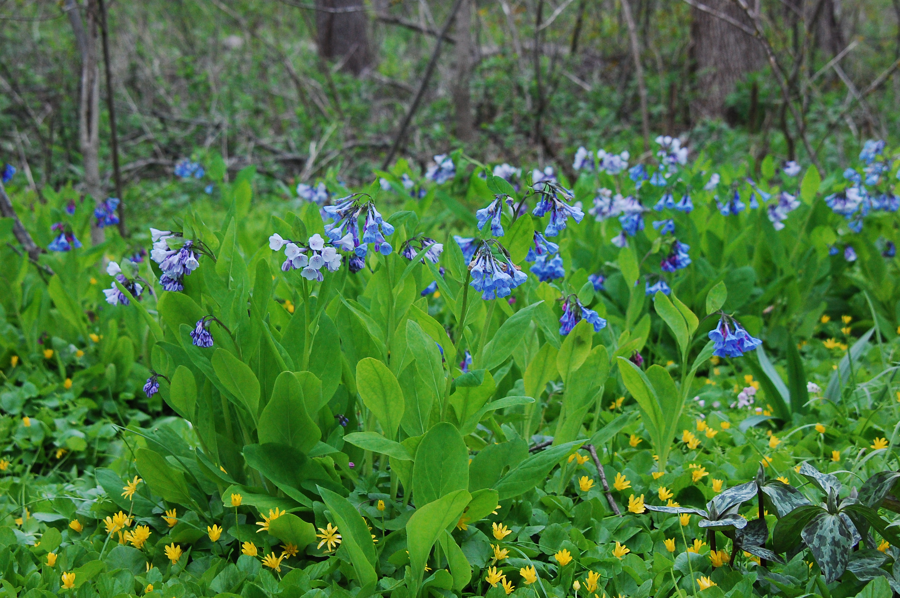
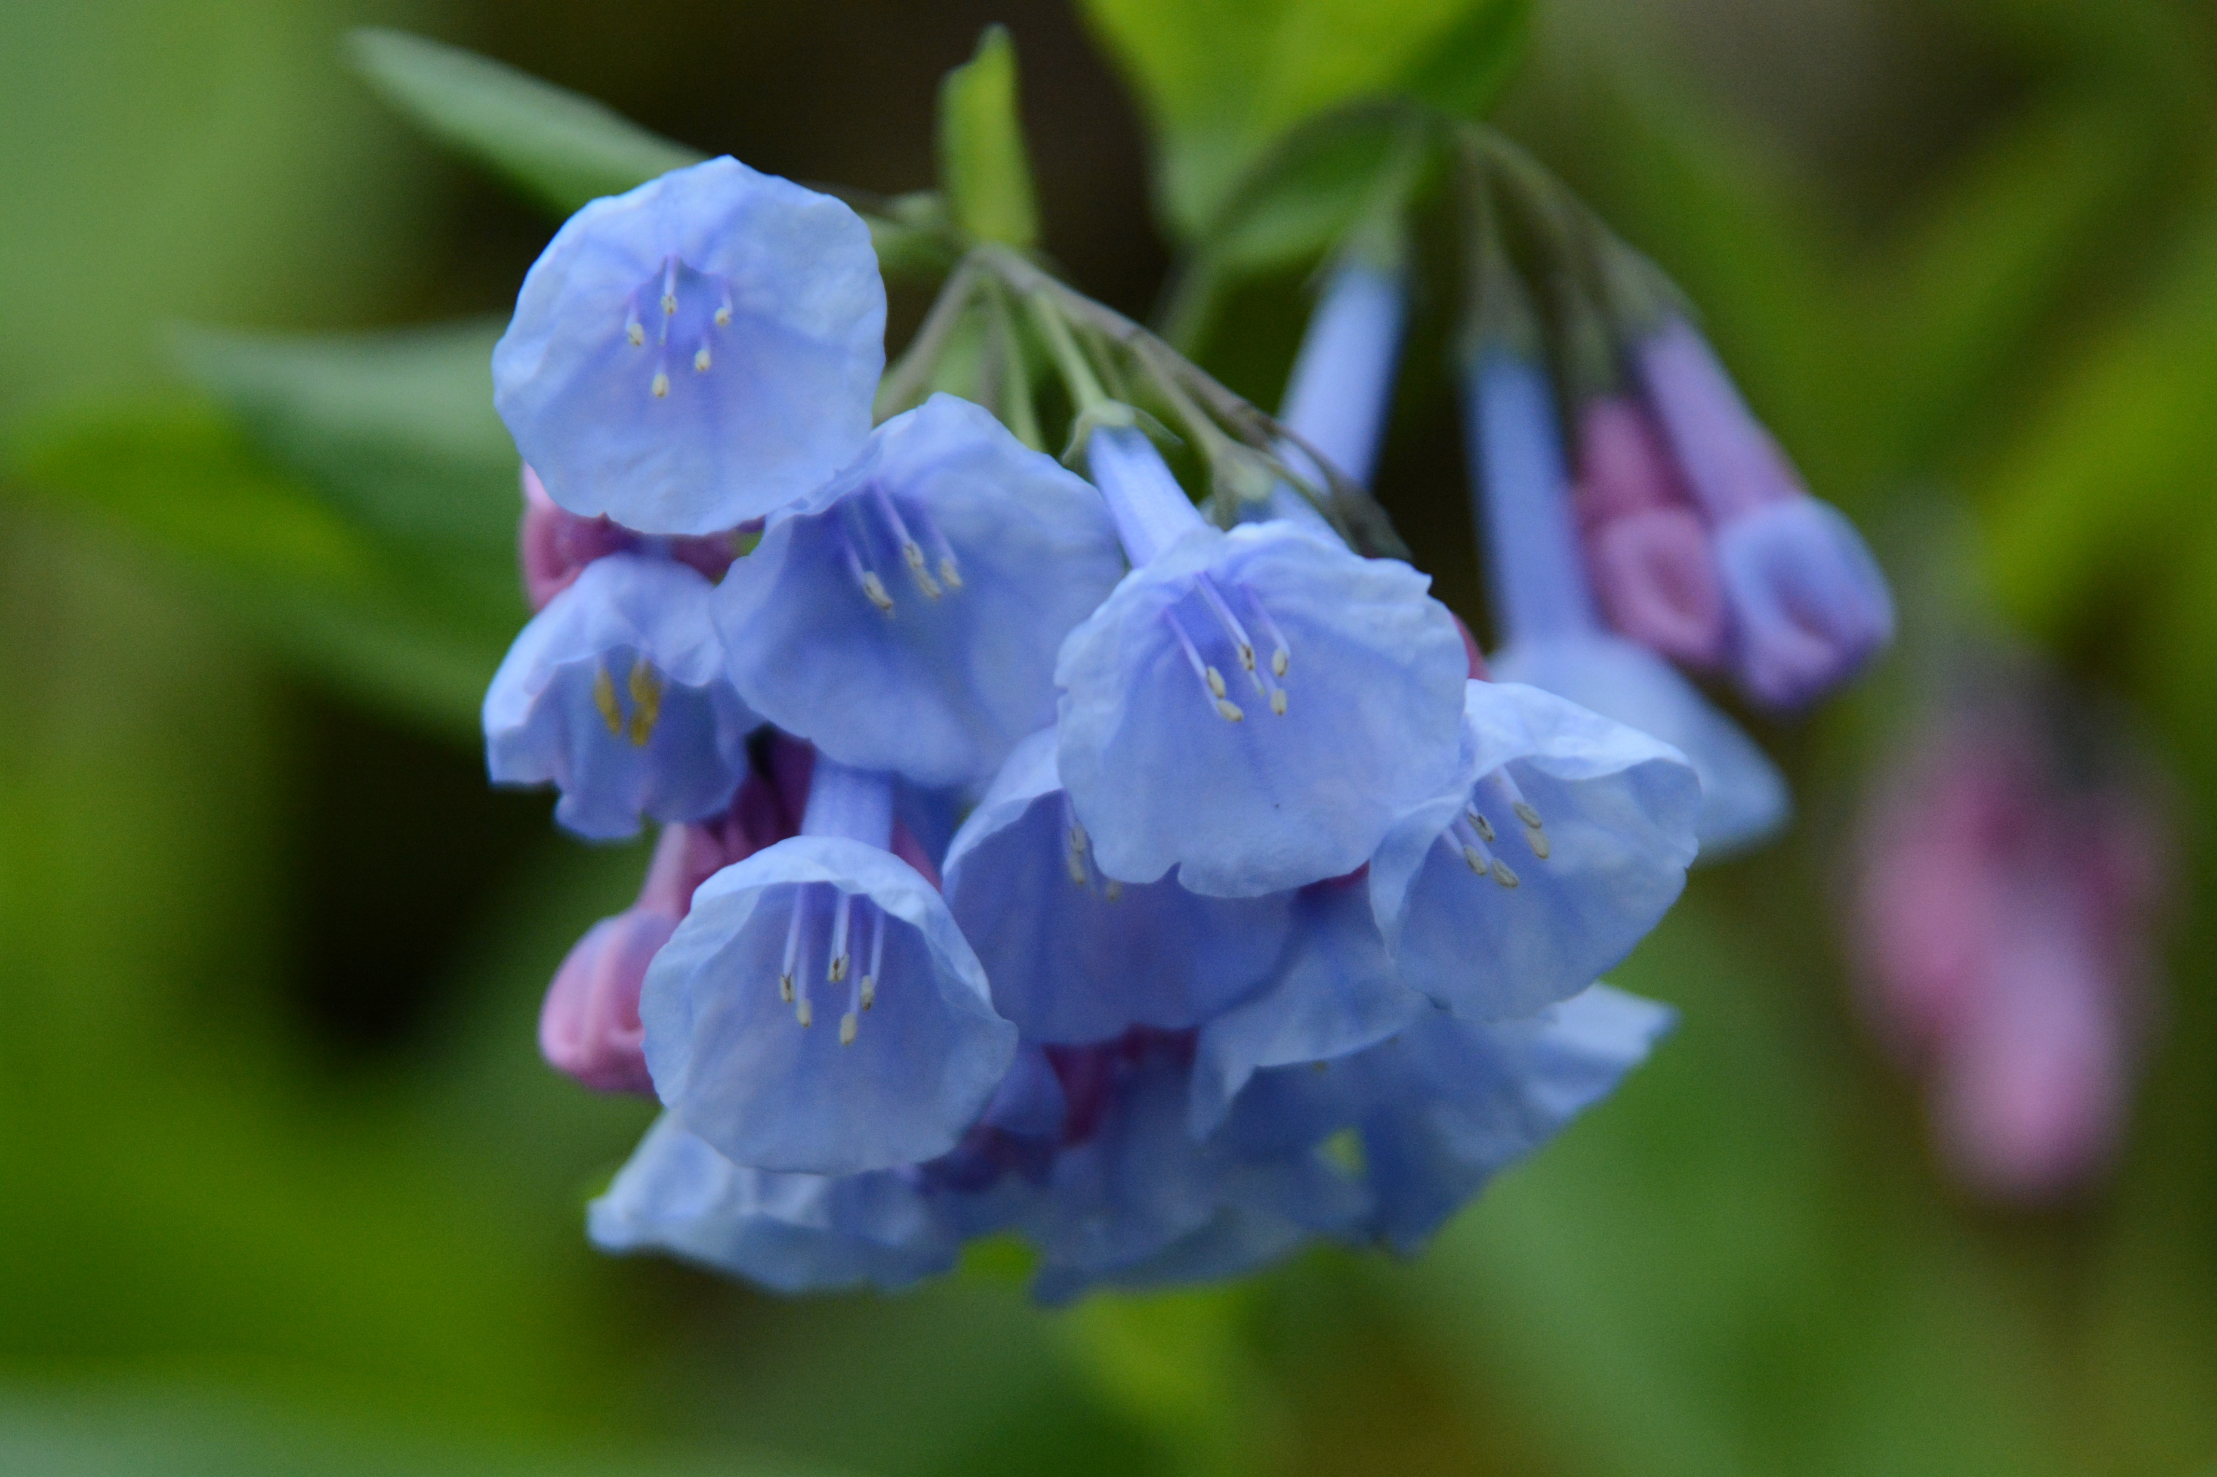
Virginia bluebells
Mertensia virginica
Notes:
2010_04_29_035 Wehr.JPG
2015_05_09_003 Wehr

Slide 10
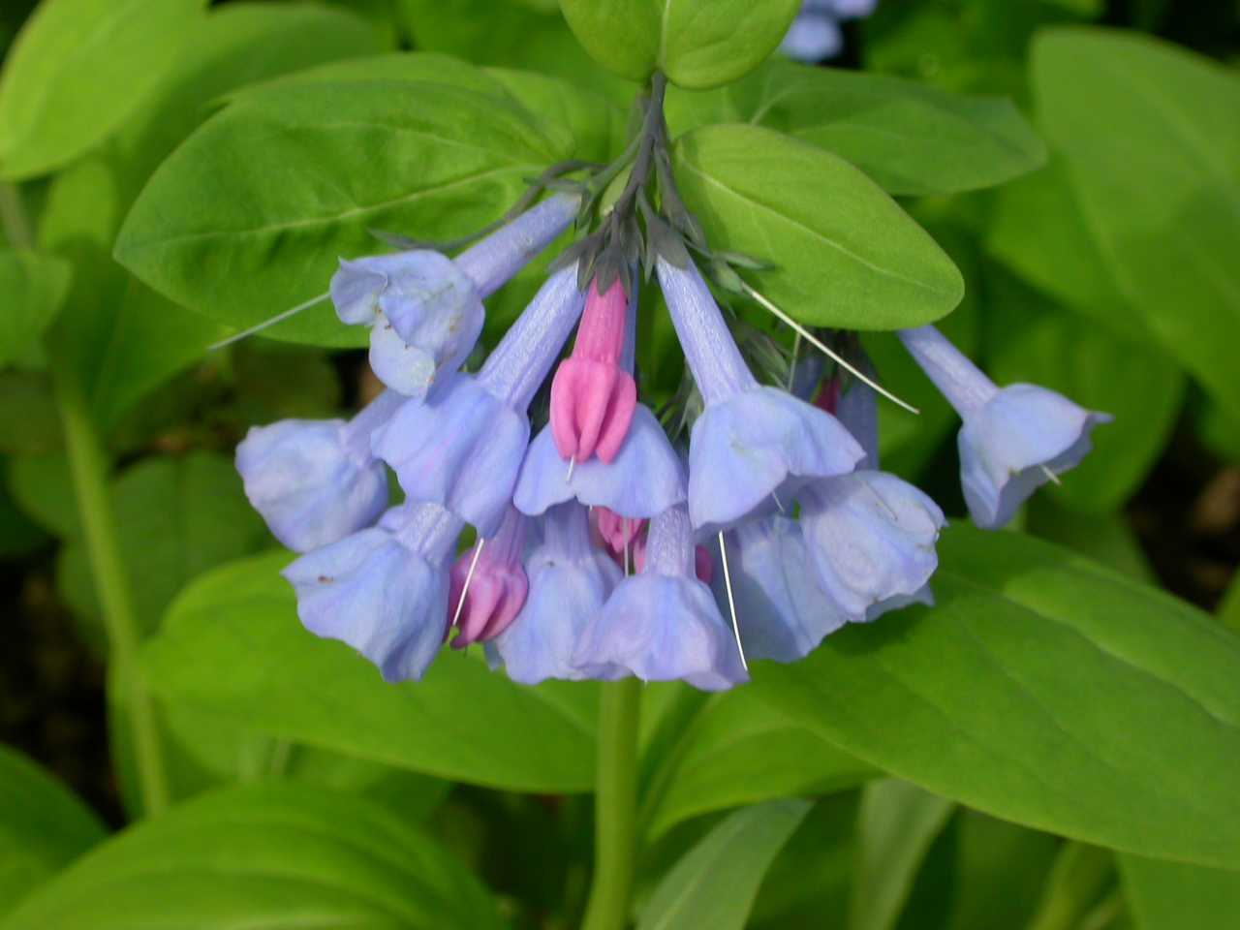
Notes:
2005_05_12_013 Wehr

Slide 11
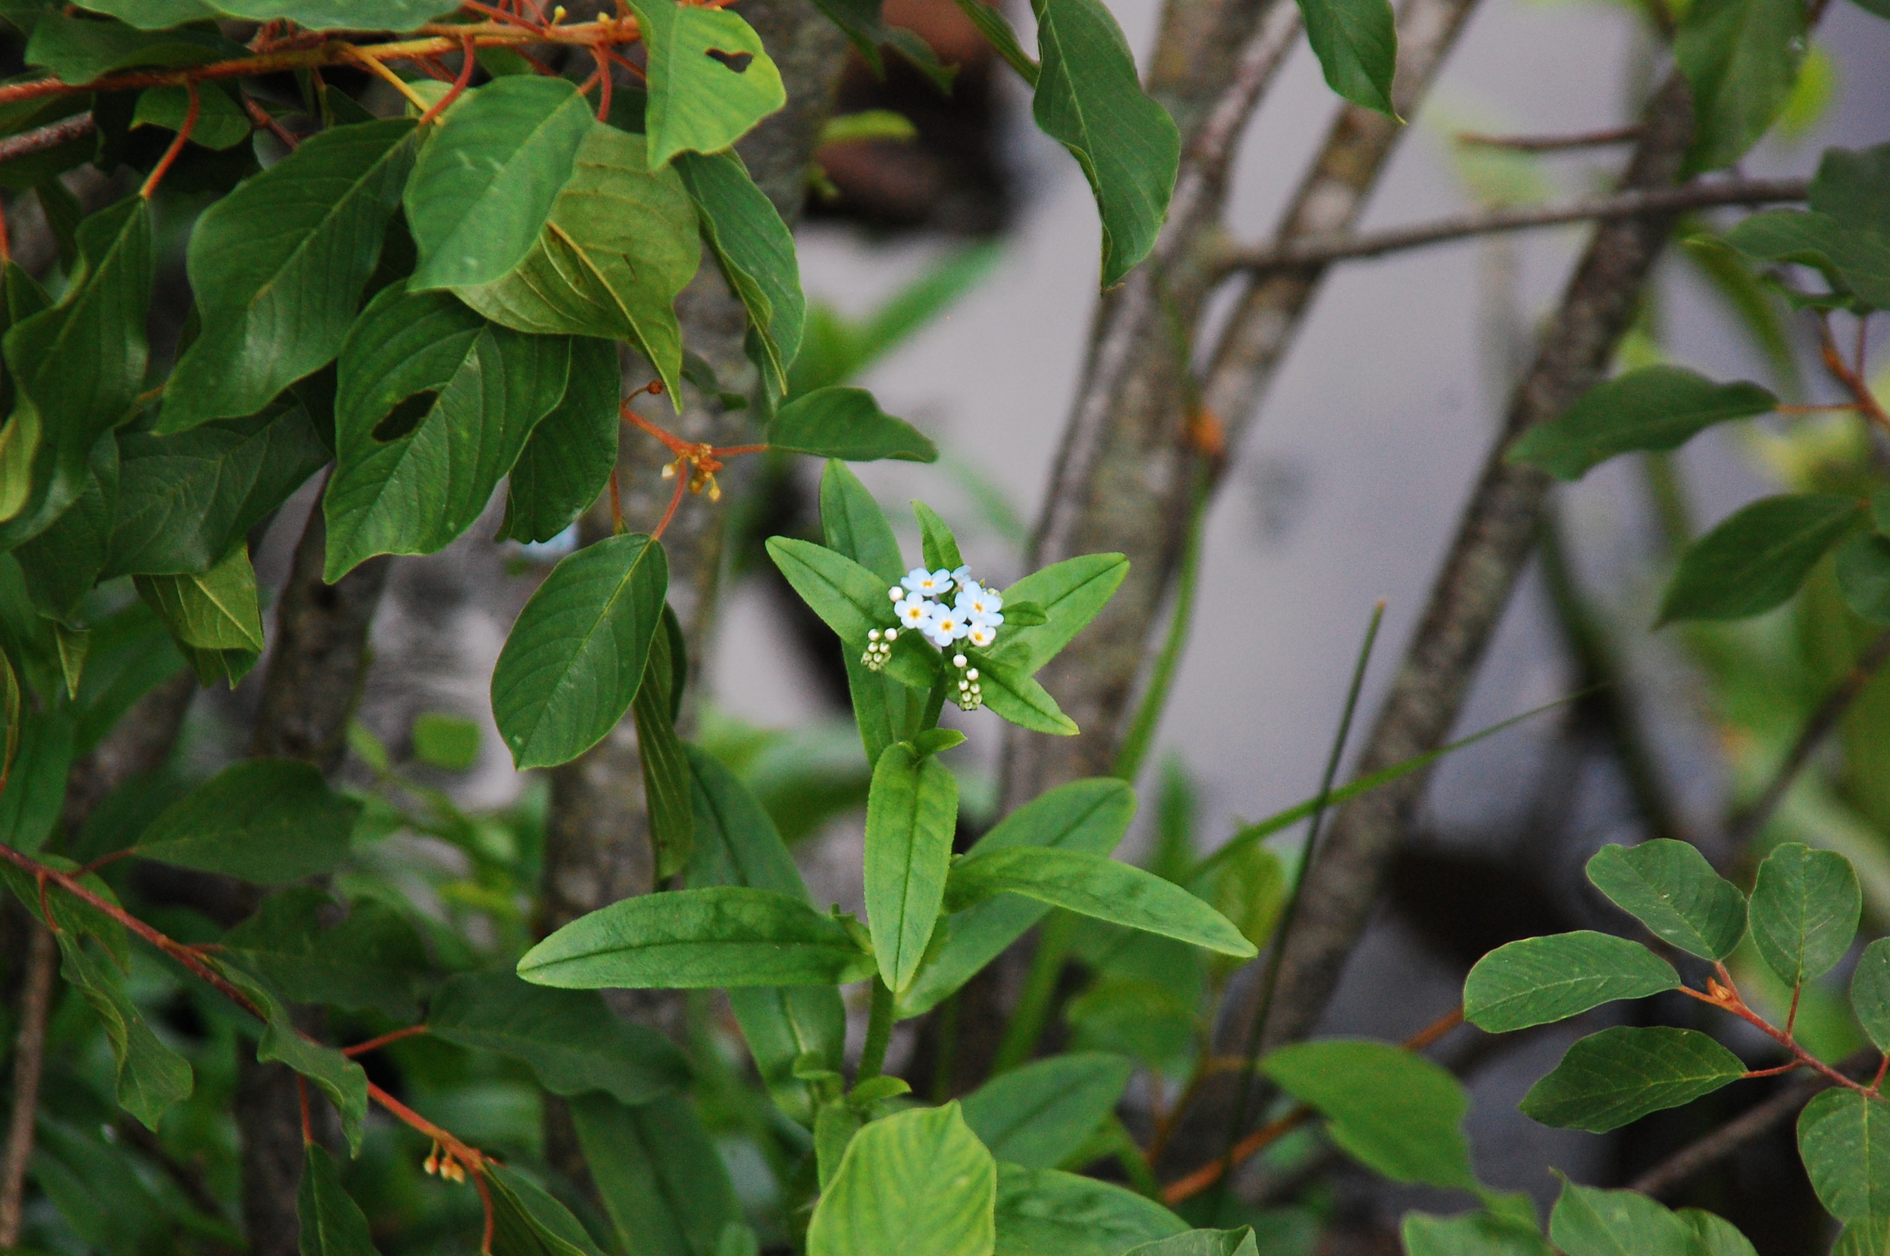
Forget-Me-Not
Myosotis scorpioides
Notes:
2013_07_15_002 Wehr

Slide 12
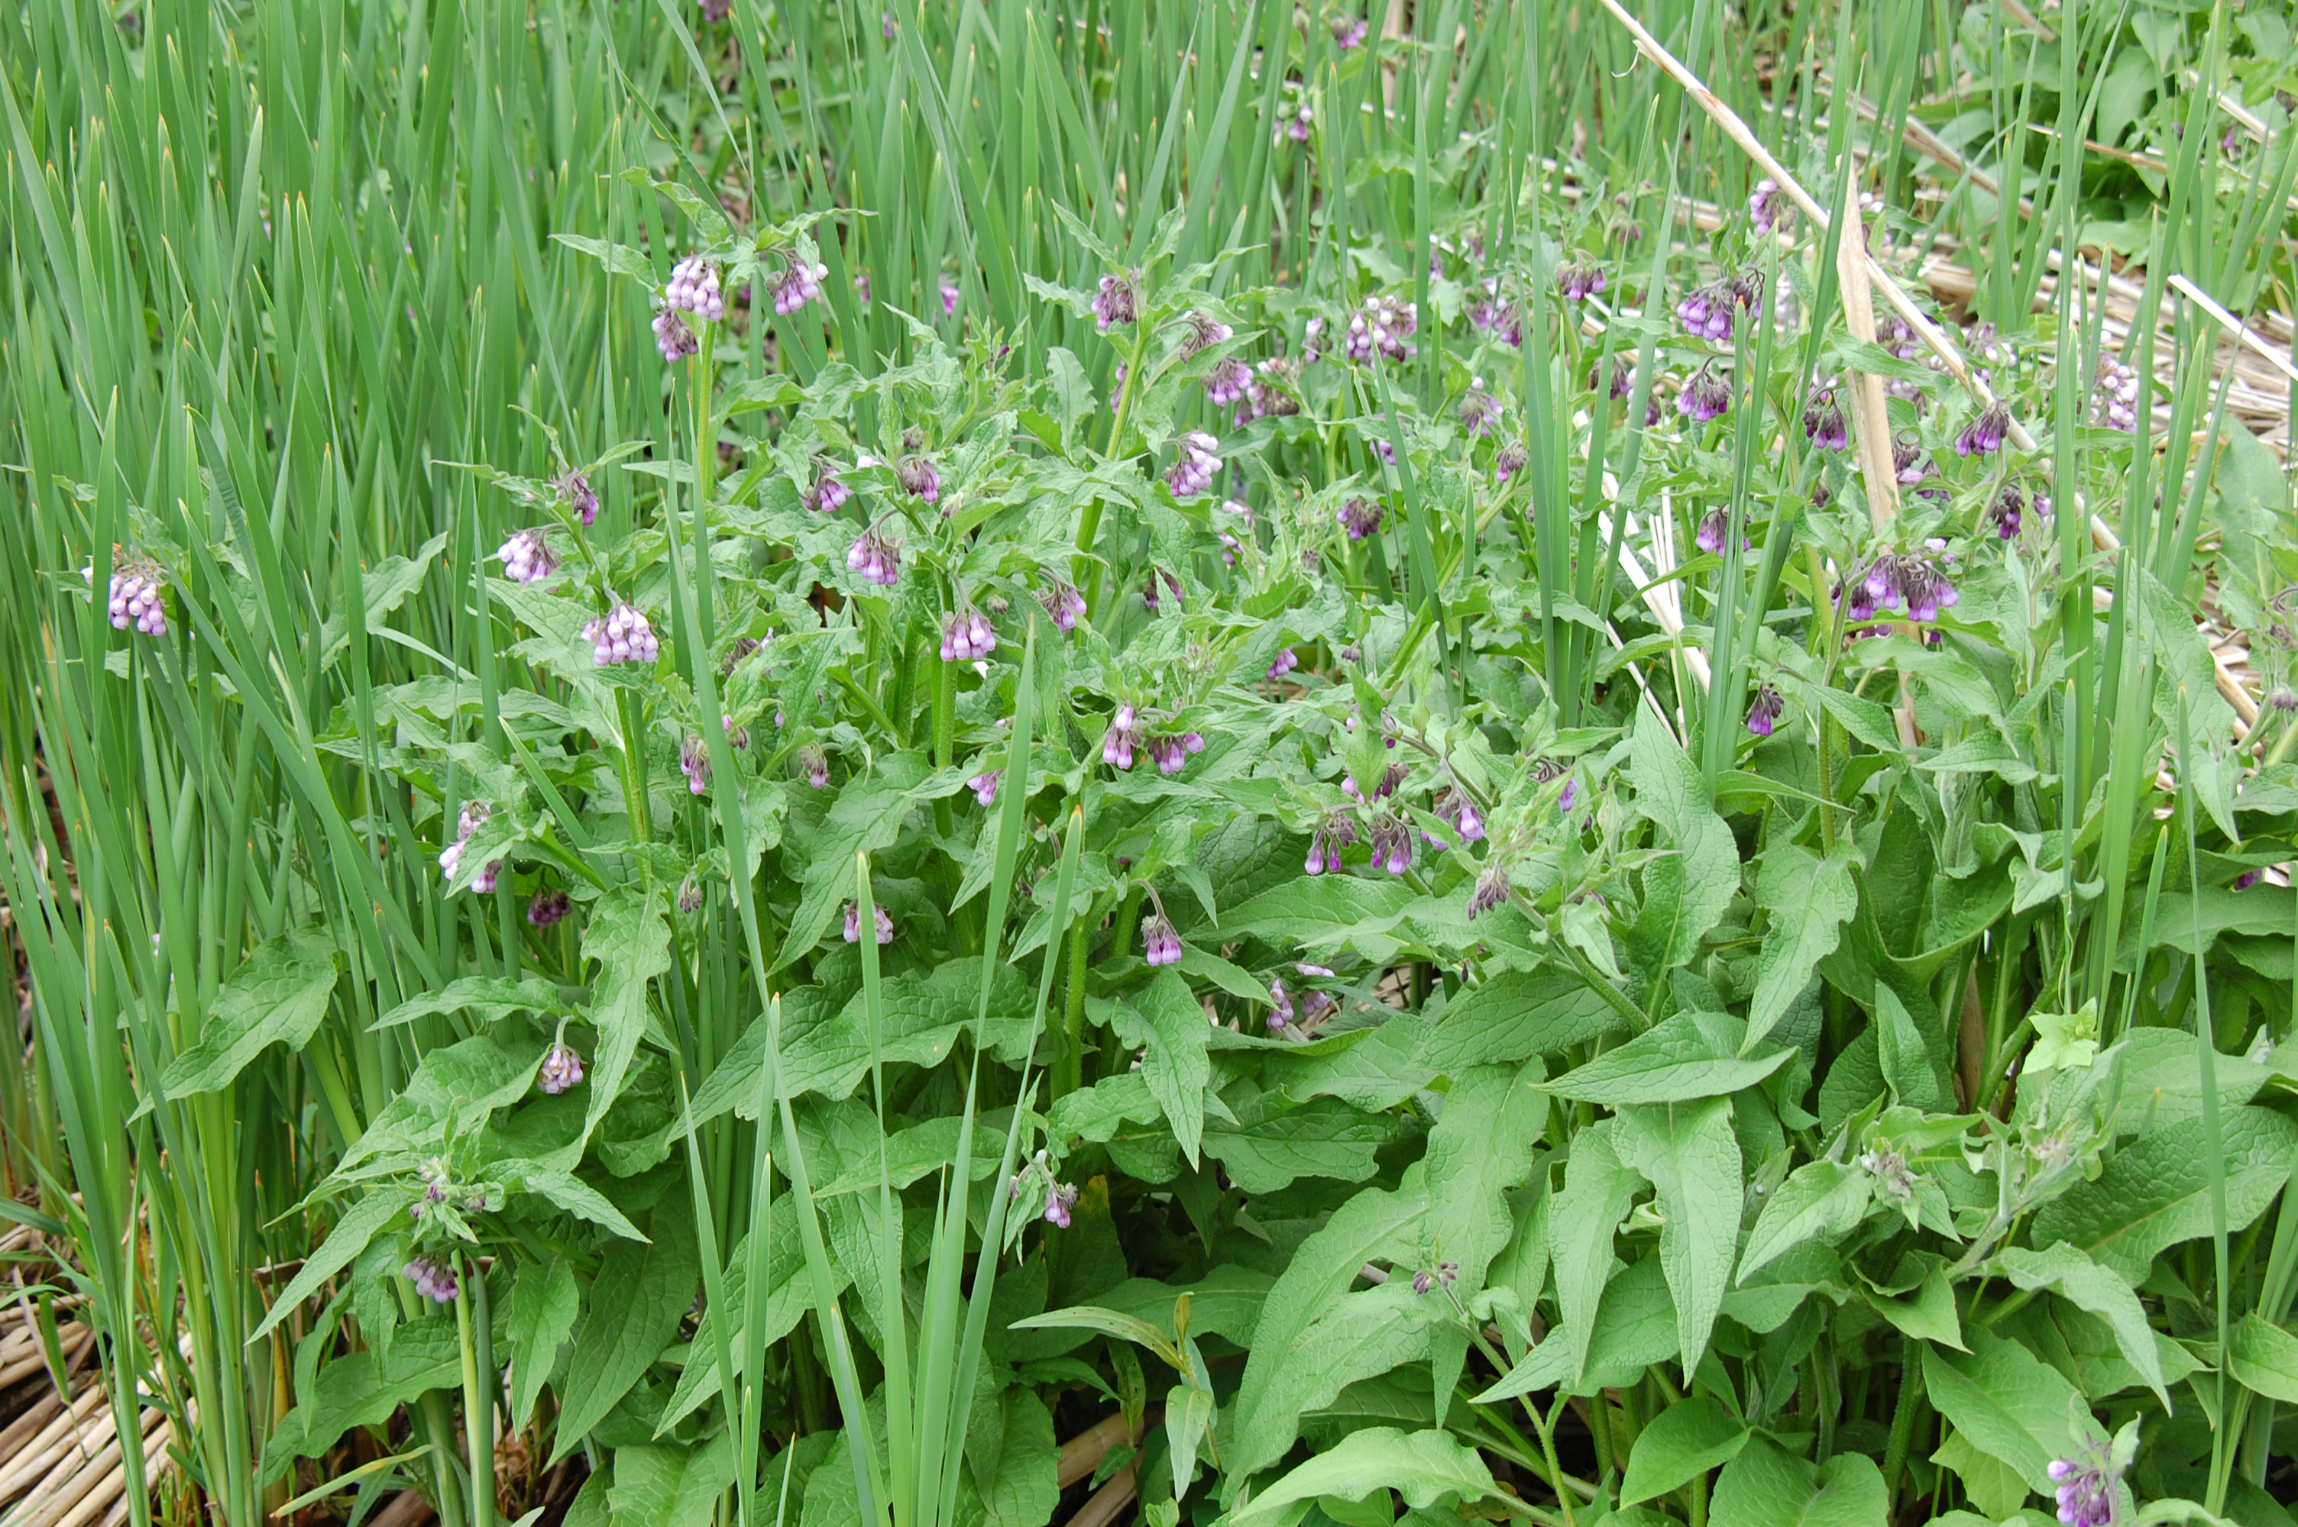
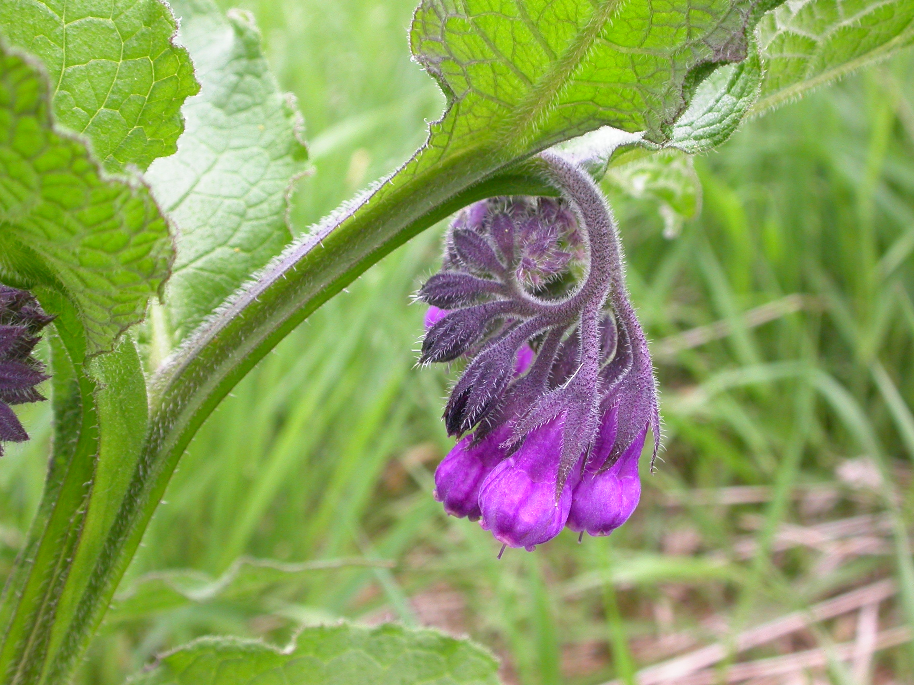
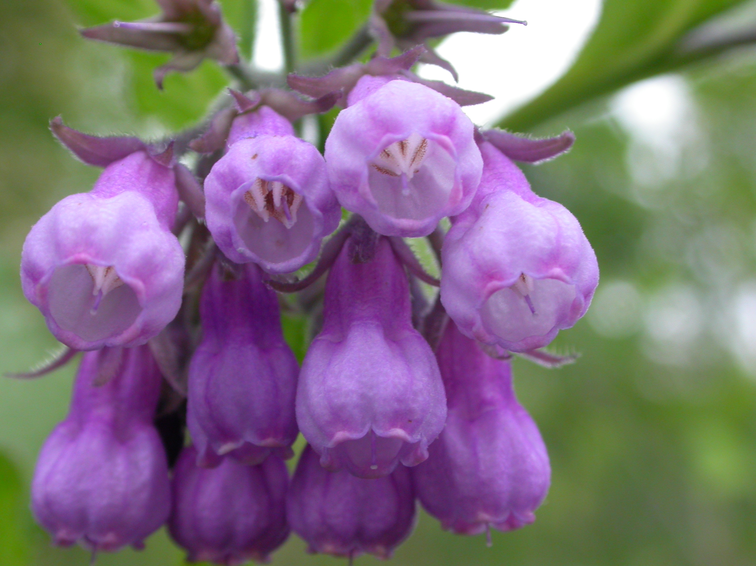
Common Comfrey
Symphytum officinale
Notes:
2009_05_29_002 Franklin
2009_05_29_015 Franklin
2009_05_29_030 Franklin

