Slide 1
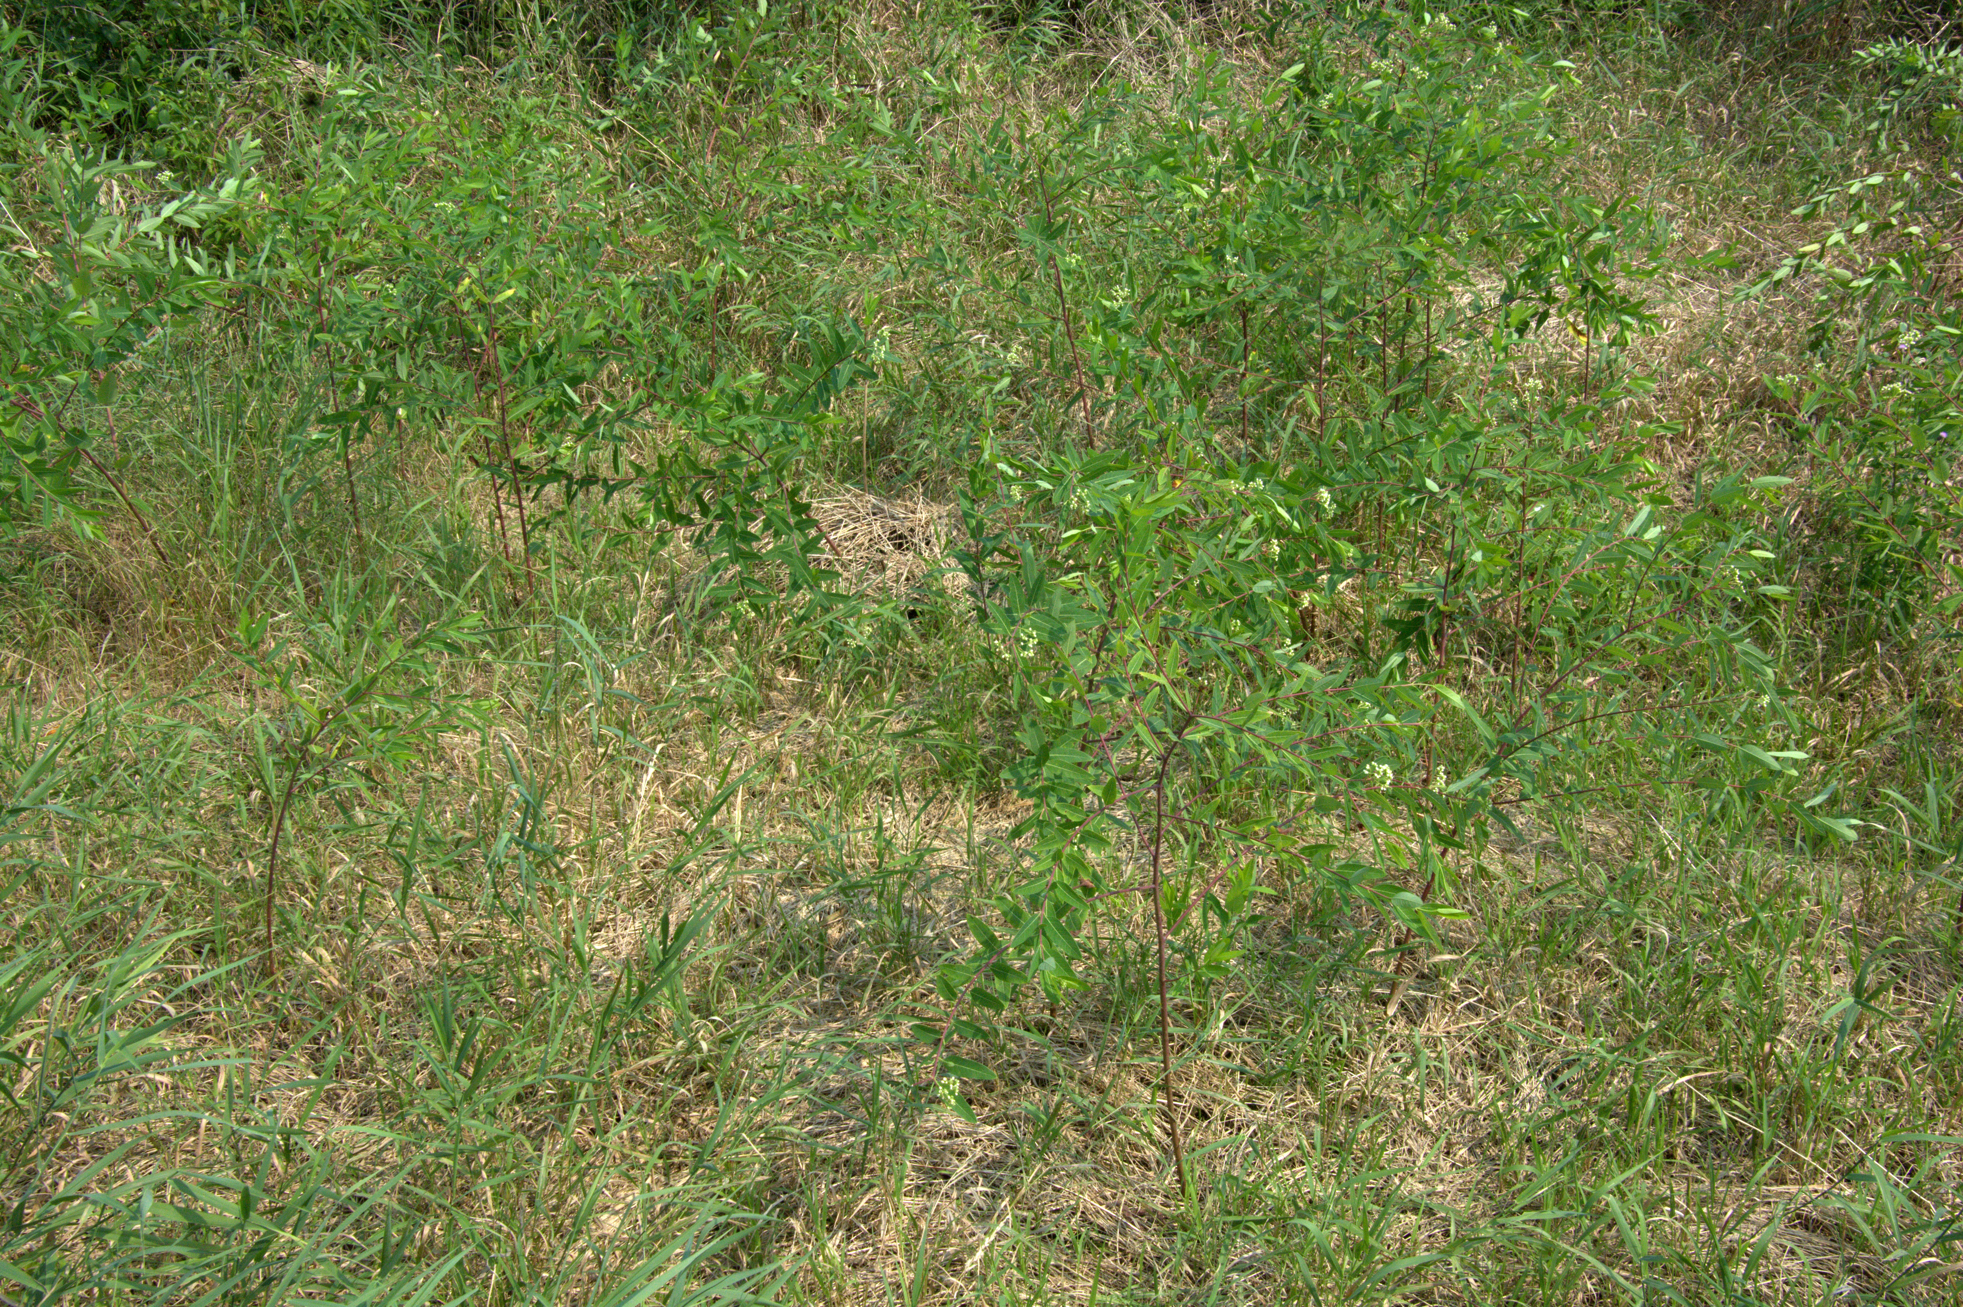
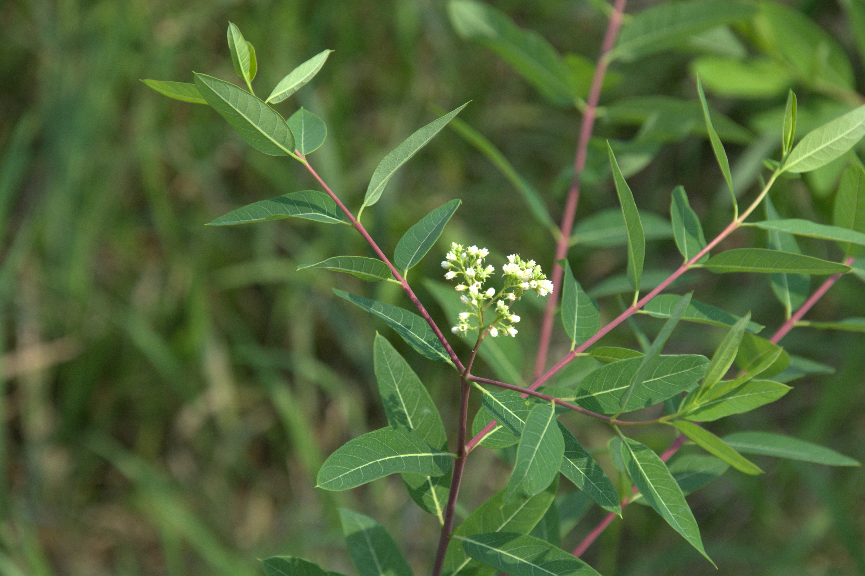
Hemp-Dogbane
Apocynum cannabinum
Notes:
2025_07_31_011 Fox River Boardwalk
2025_07_31_013 Fox River Boardwalk

Slide 2

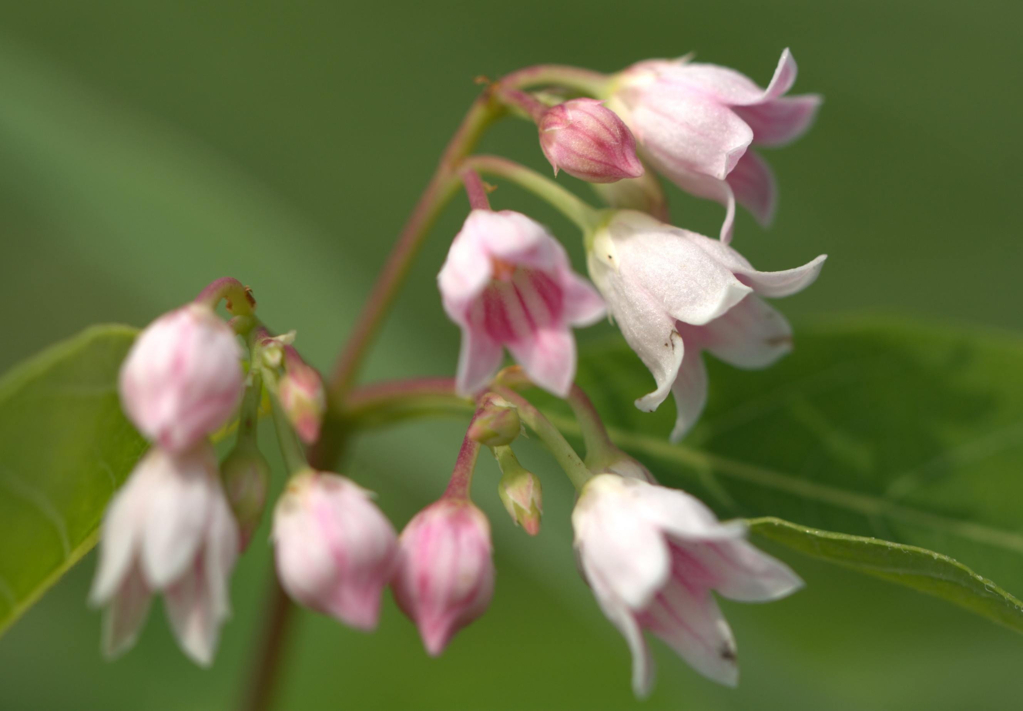
Spreading Dogbane
Apocynum androsaemifolium
Notes:
2019_07_08_004 Wehr

Slide 3
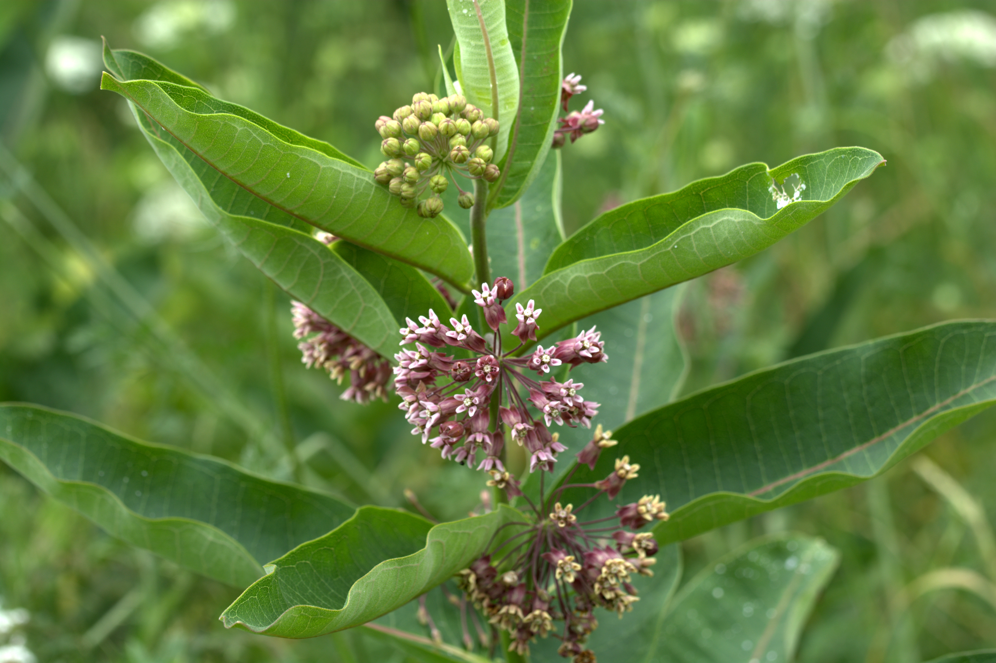
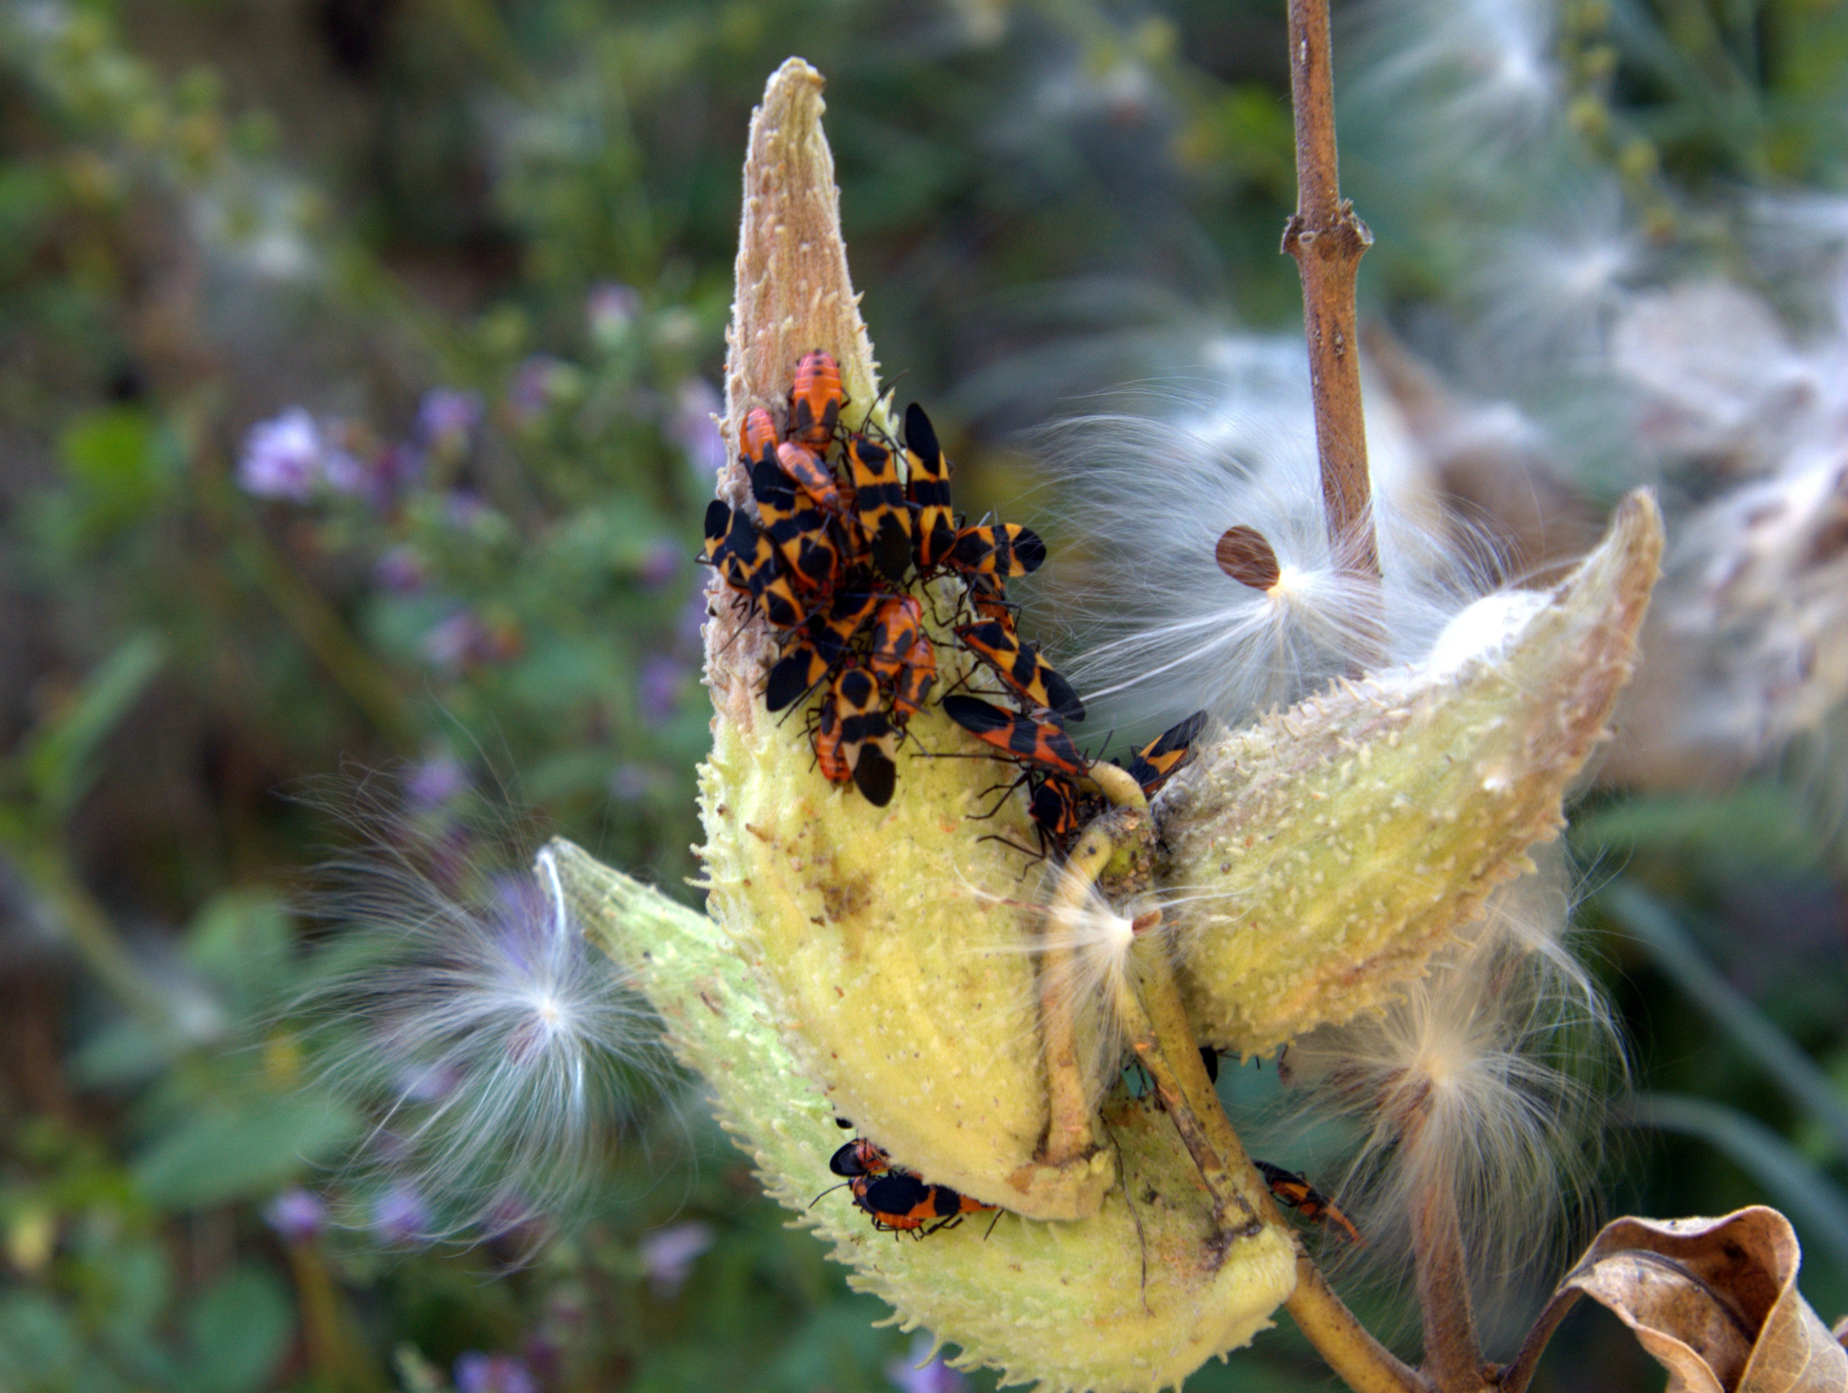
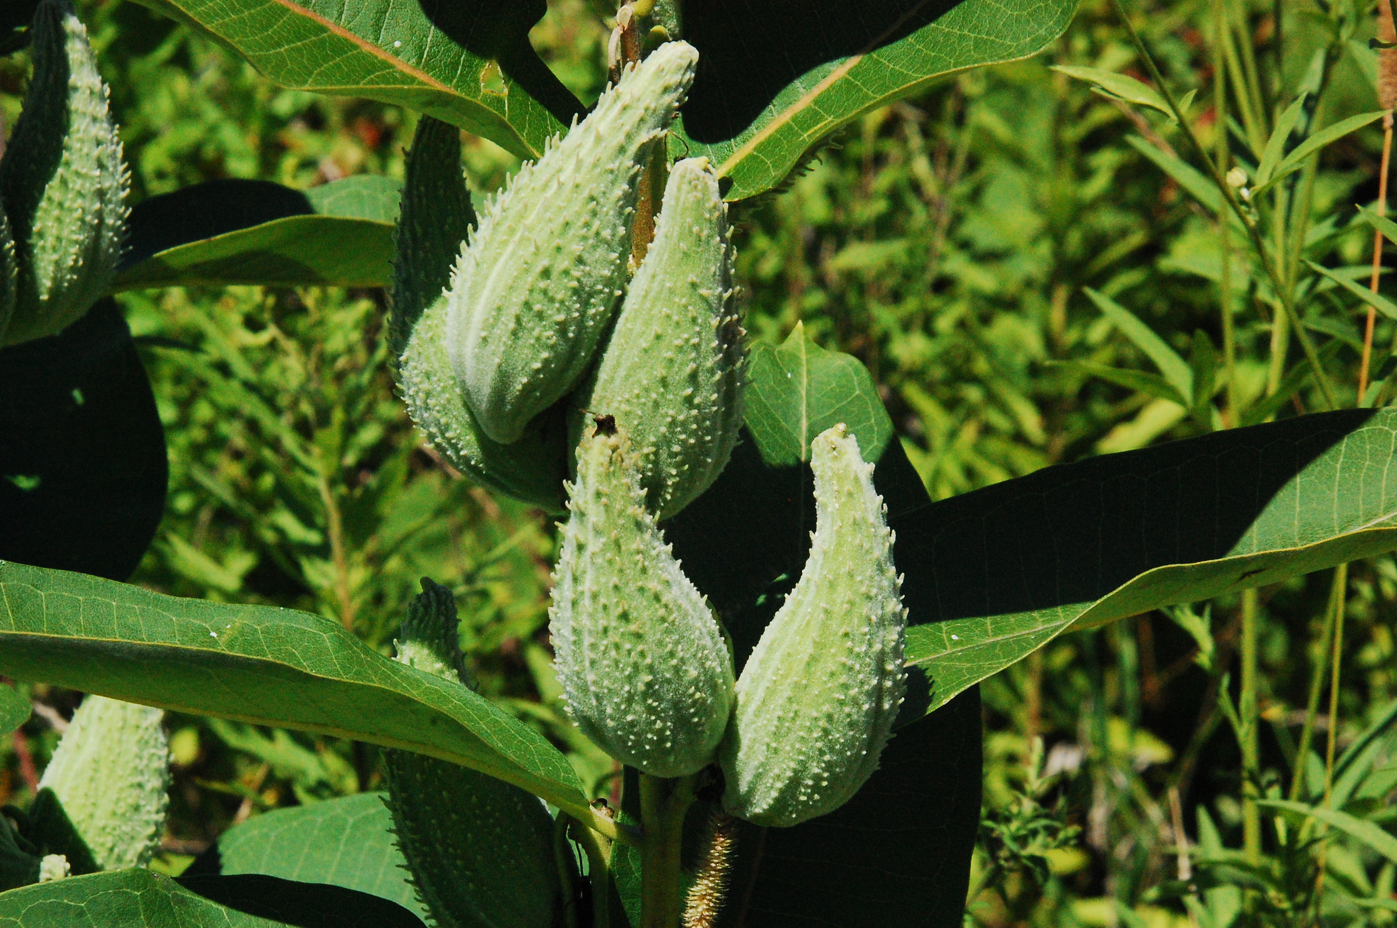
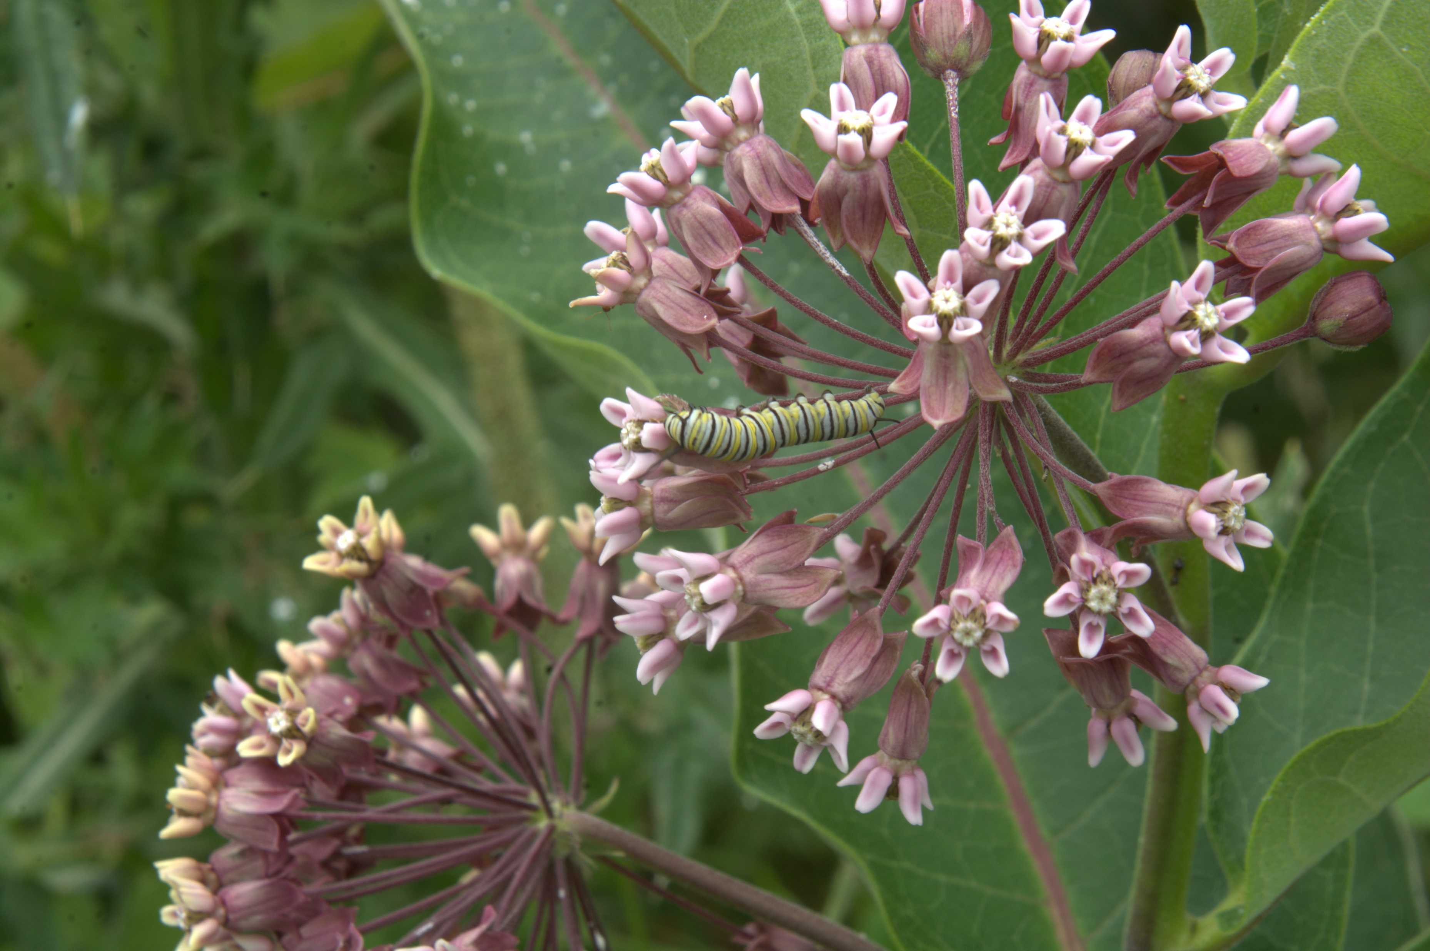
Common Milkweed
Asclepias syriaca
Notes:
2019_07_19_008 Mangan Woods-Tobogan
2019_07_19_021 Mangan Woods-Tobogan
2008_08_13_008 Wehr
2025_10_06_012 Wehr Nature Center

Slide 4
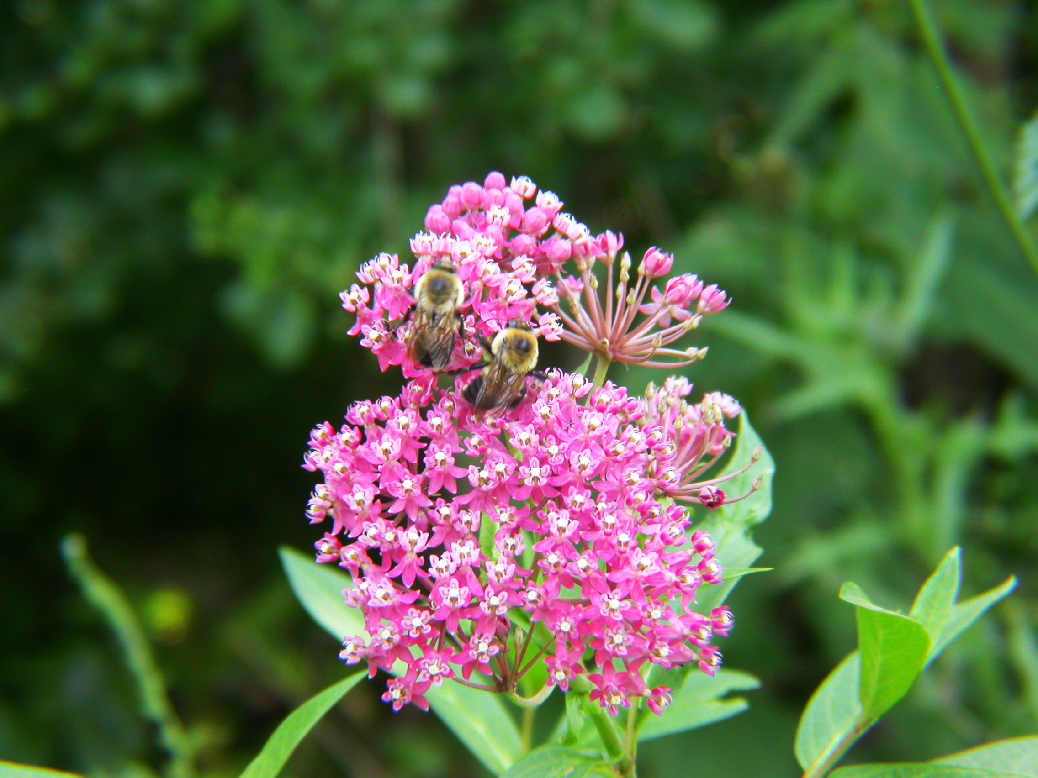
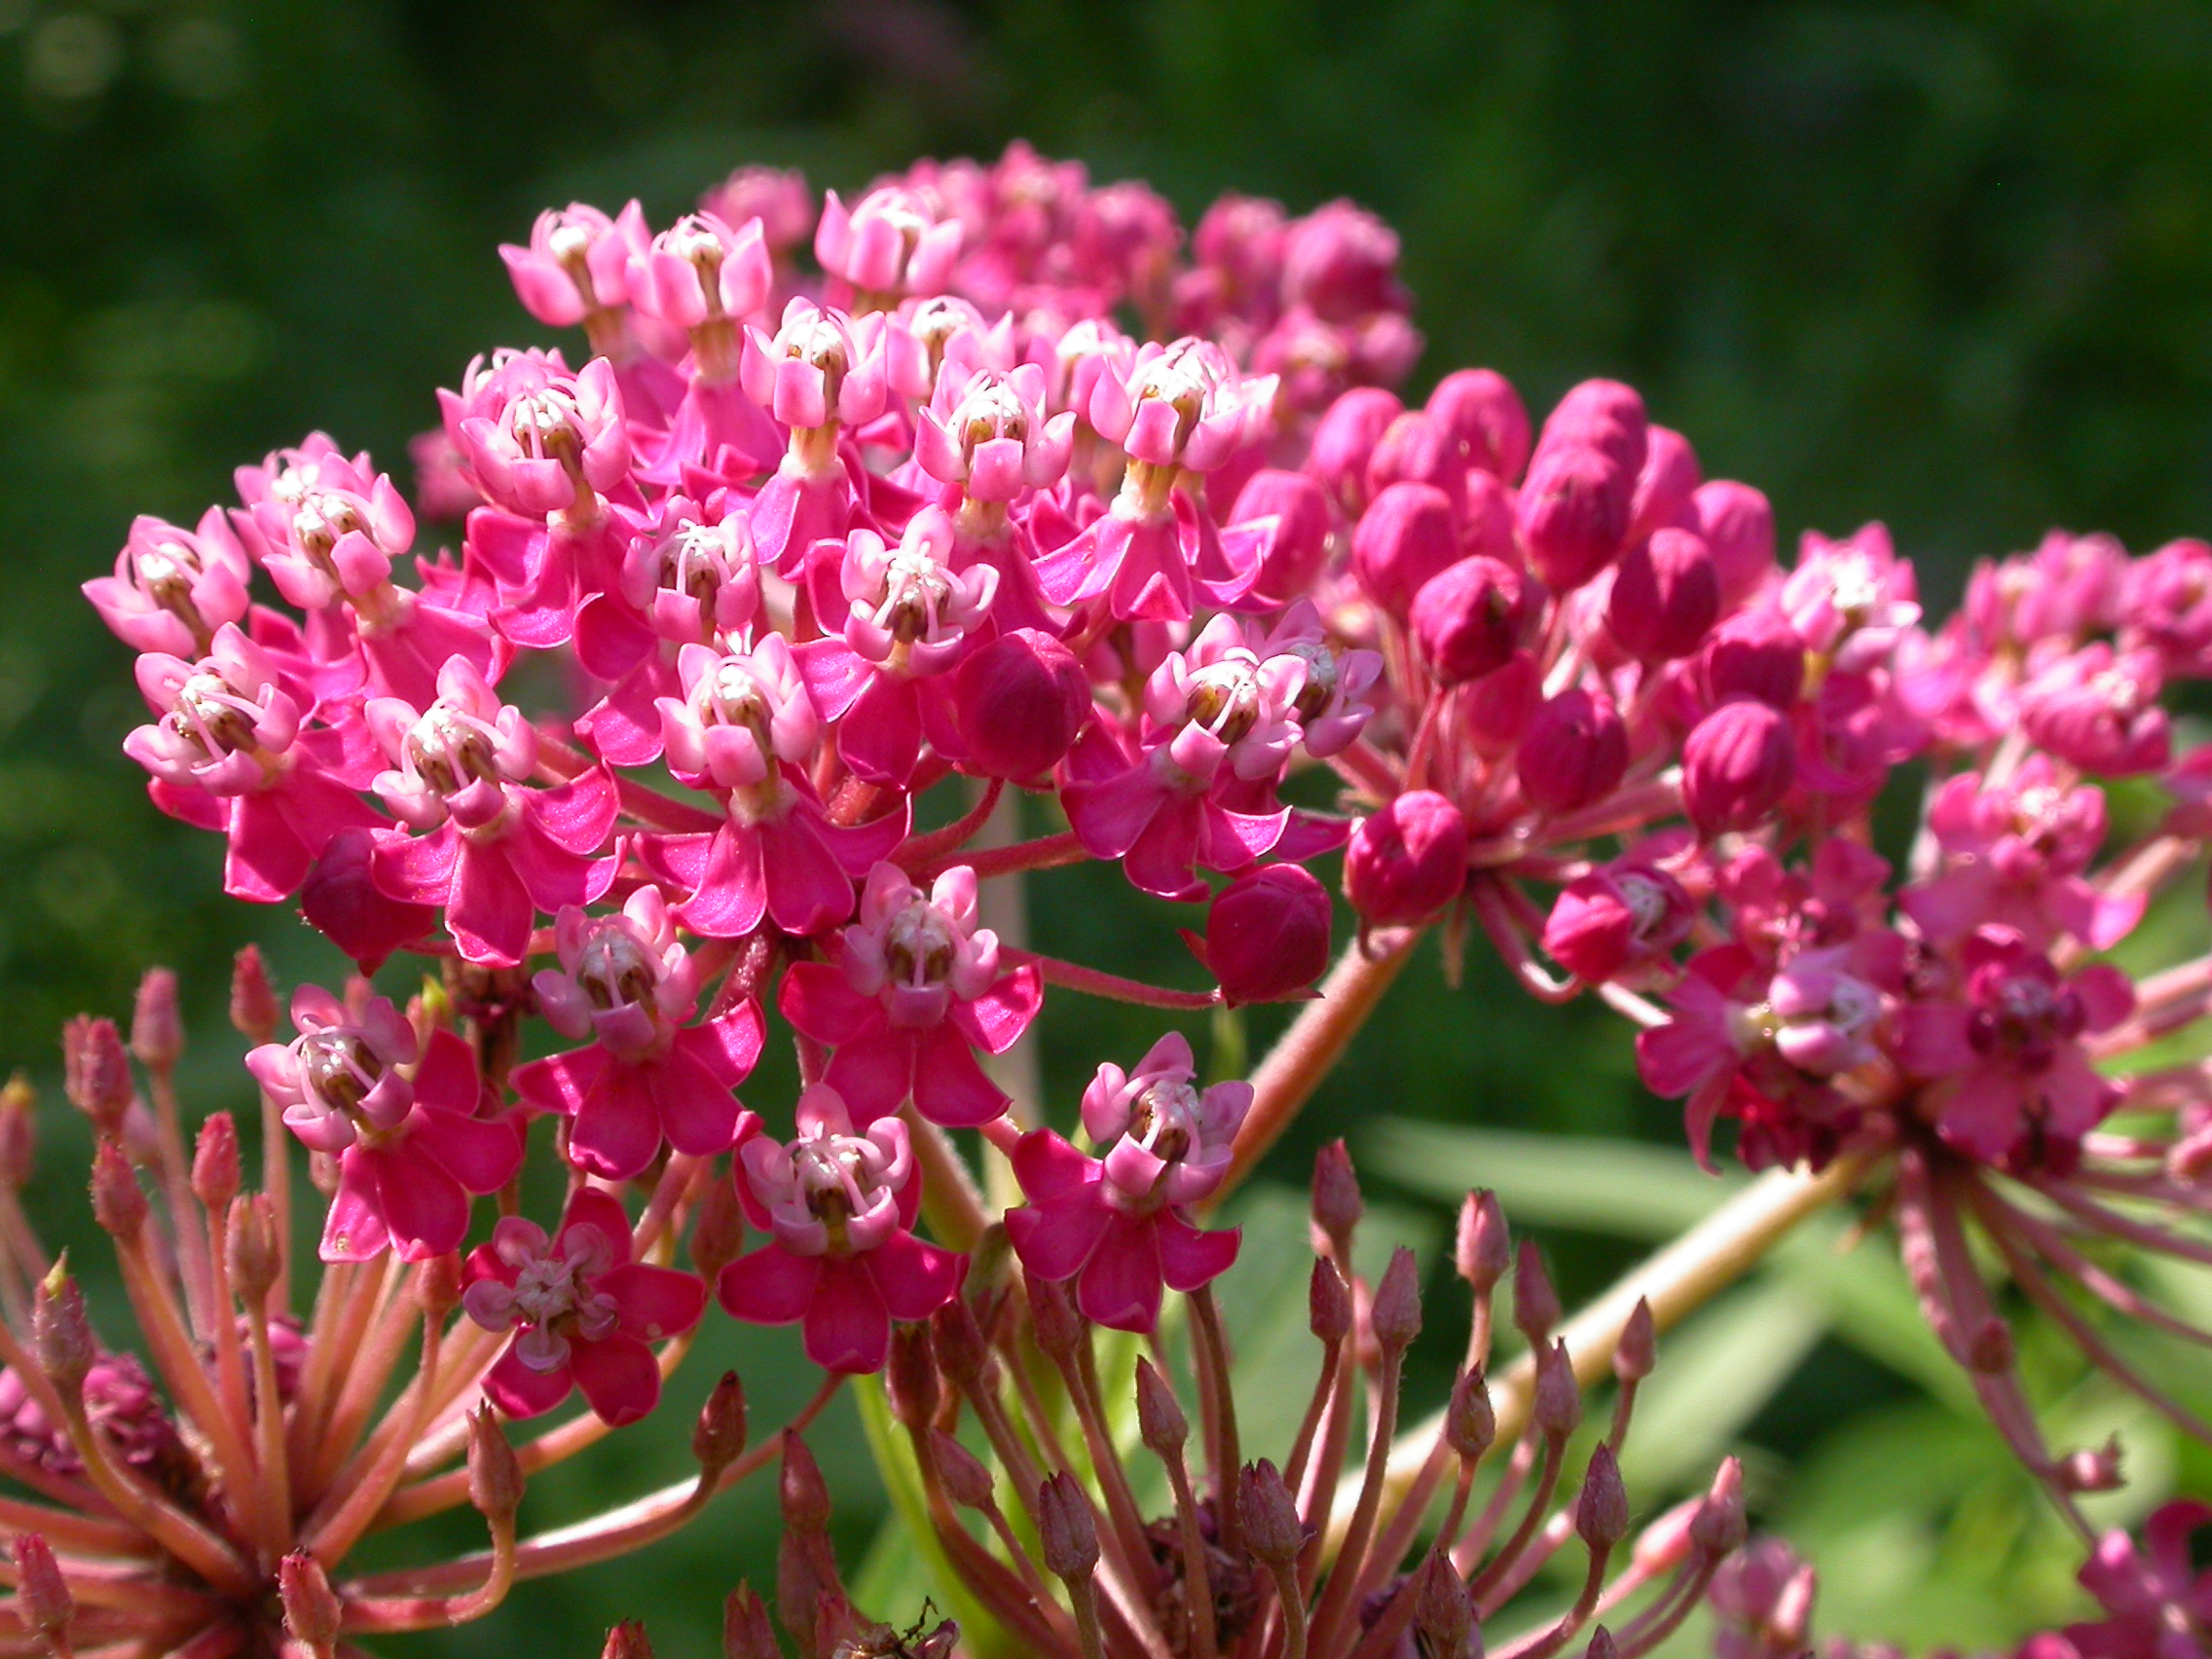
Swamp Milkweed
Asclepias incarnata
Notes:
2008_08_14_019 Wehr
2008_08_14_002 Wehr
Brown-belted Bumblebee

Slide 5
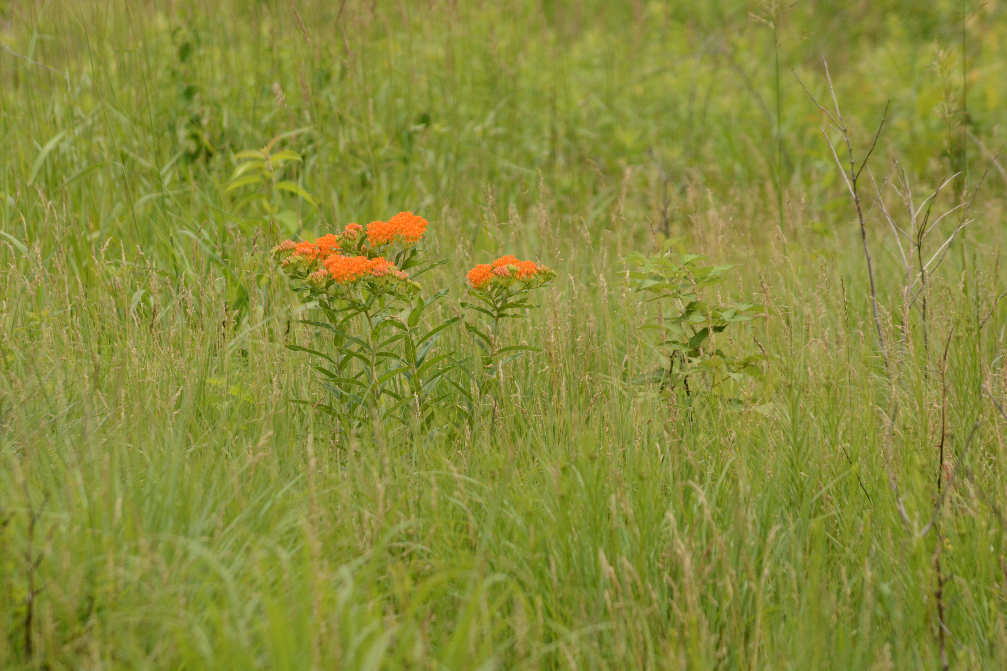
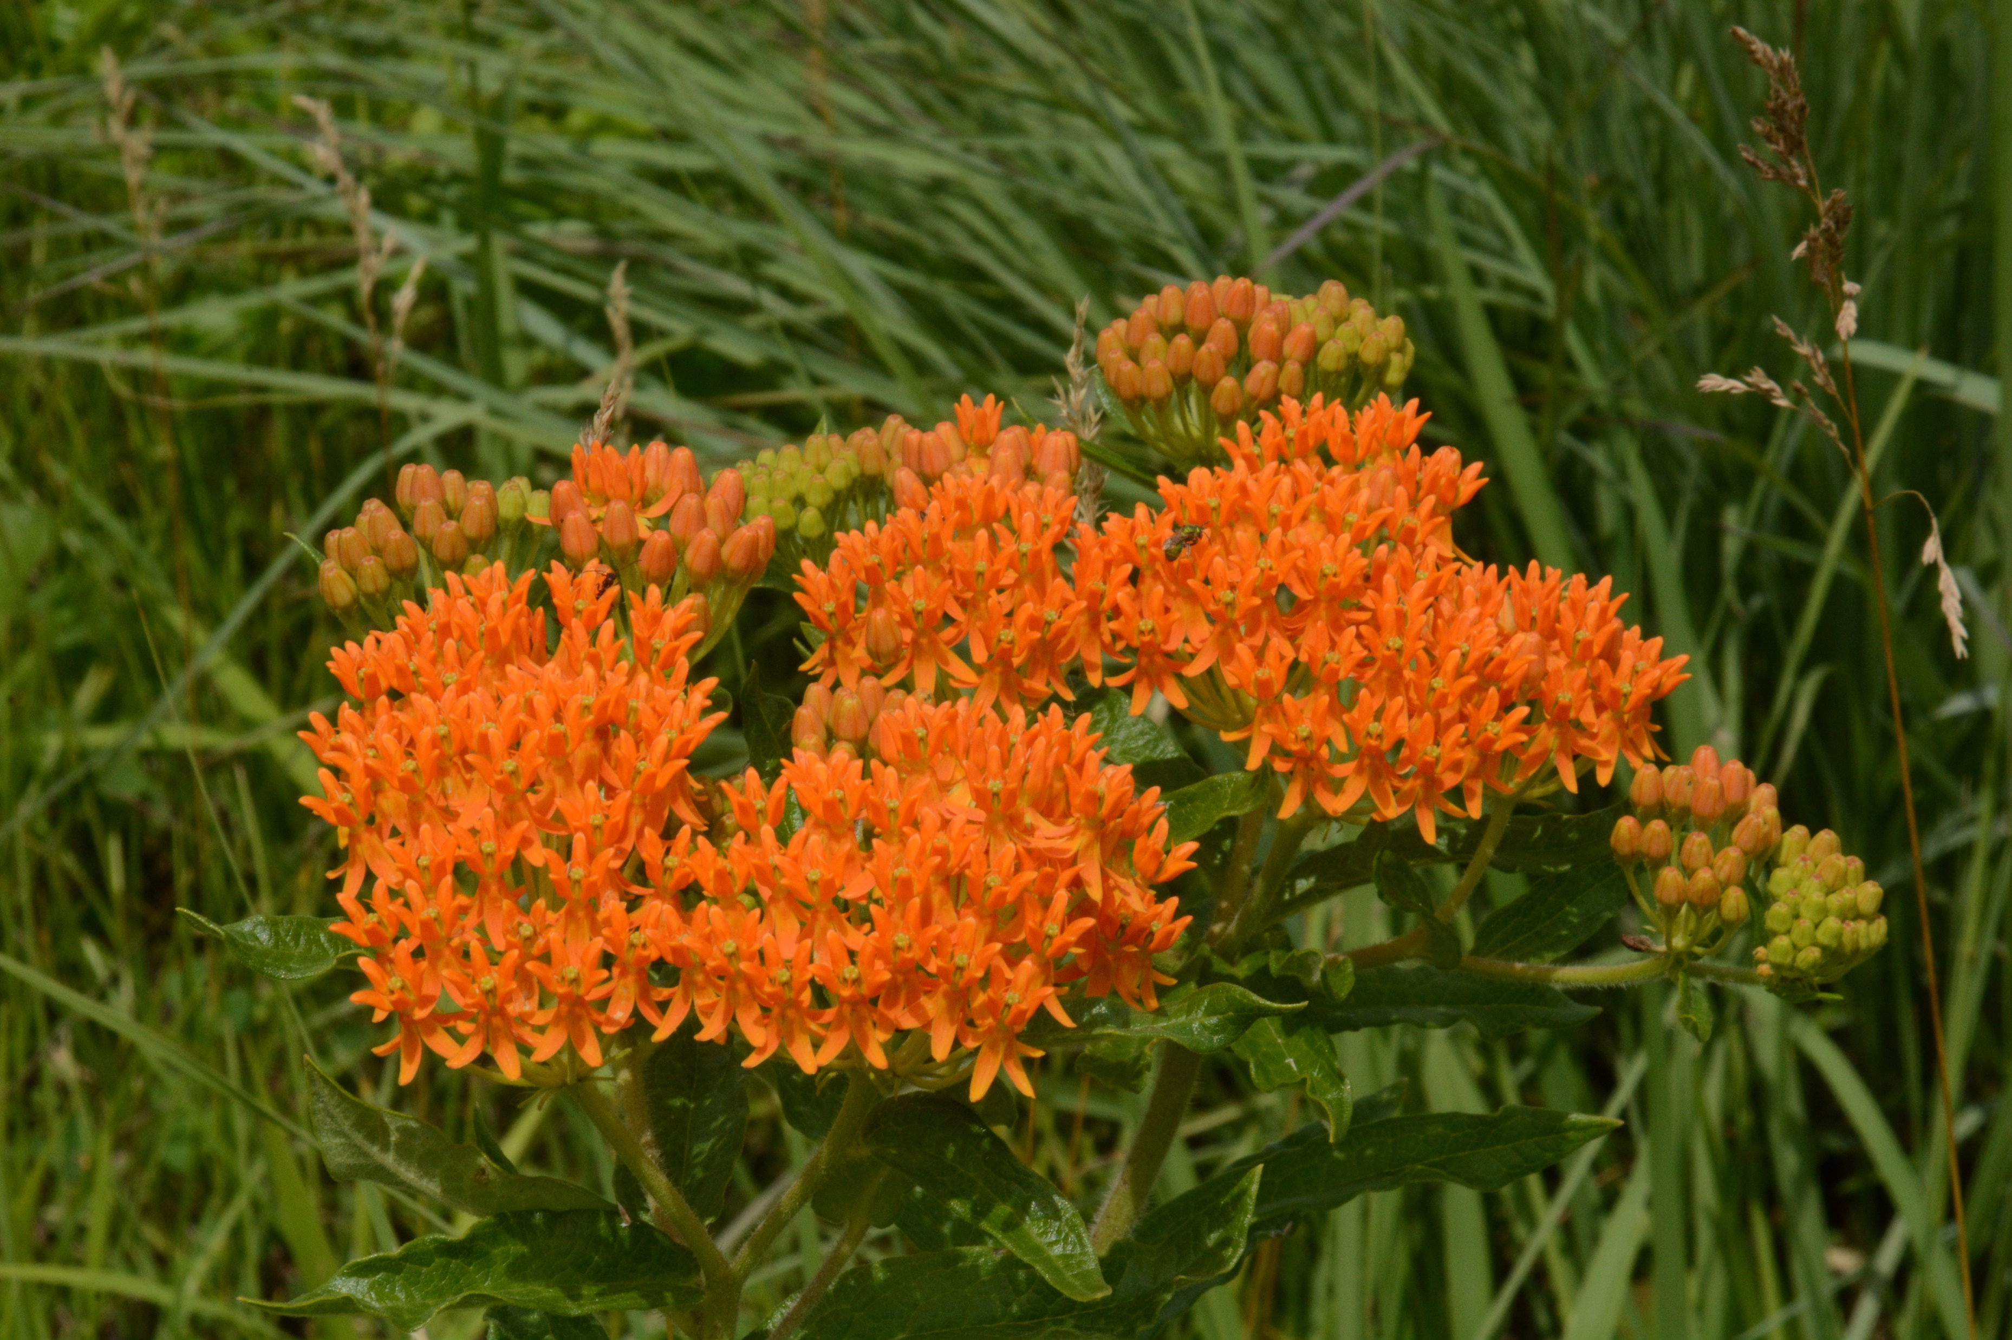
Butterfly Milkweed
Asclepias tuberosa
Notes:
2014_06_26_014 McHenry County
2014_06_26_015 McHenry County

Slide 6
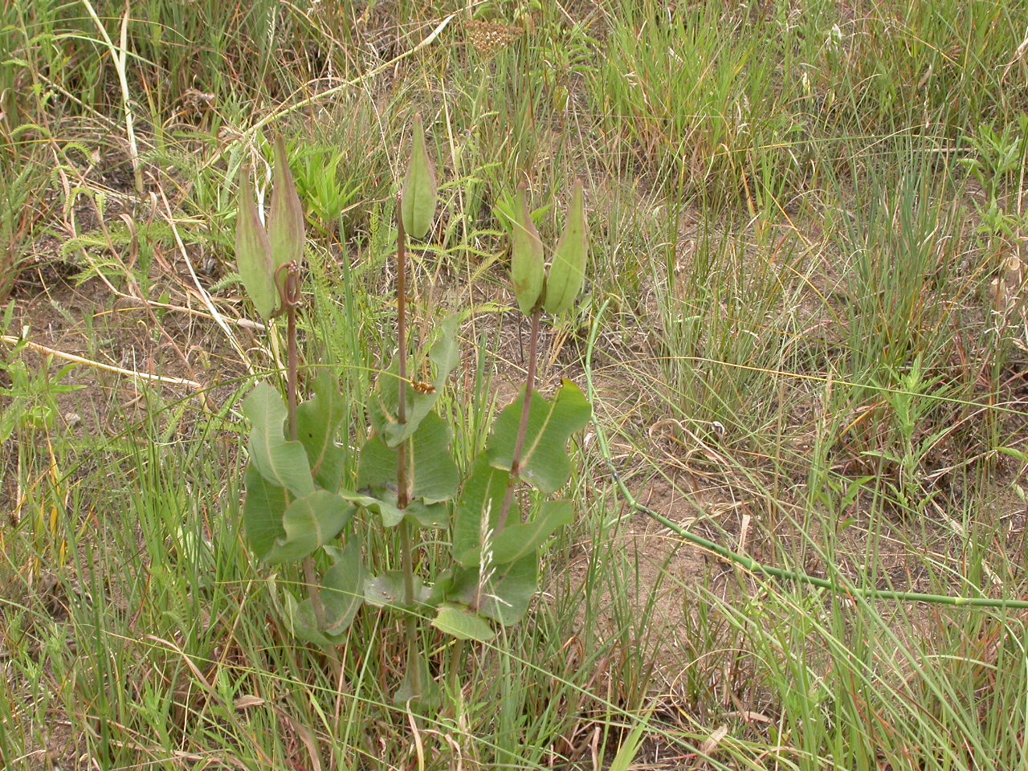
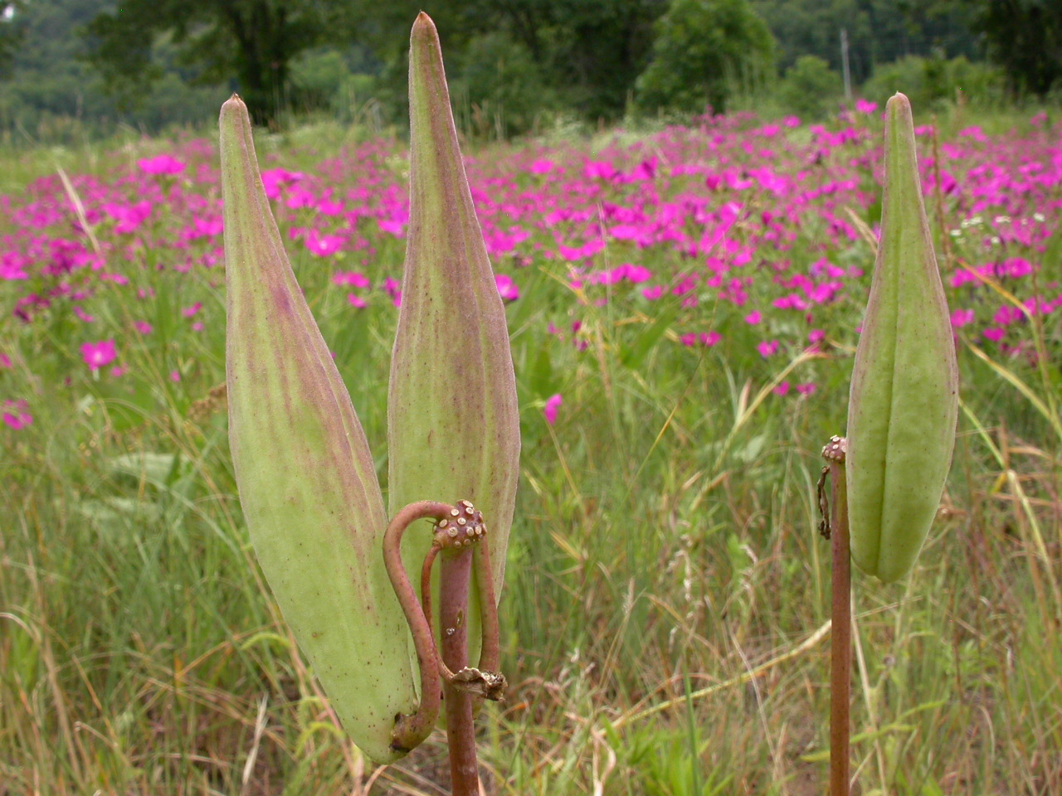
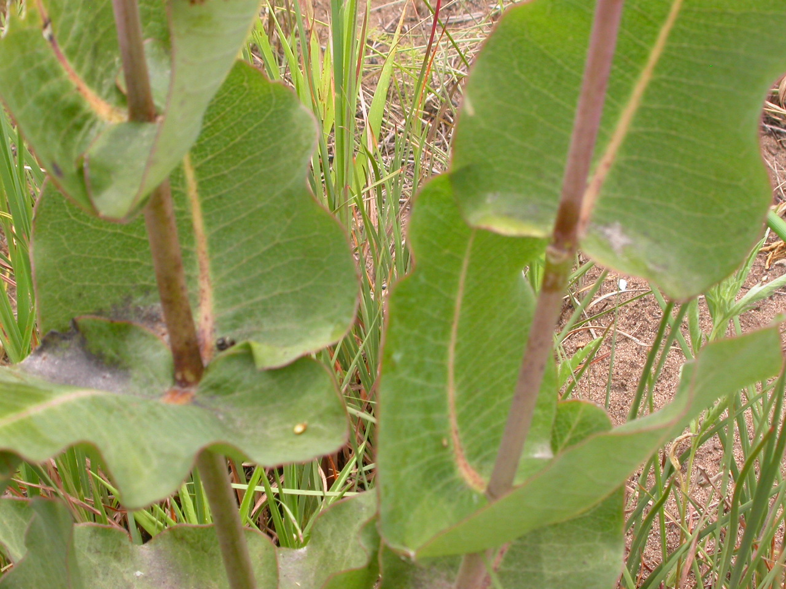
Blunt-leaved Milkweed
Asclepias amplexicaulis
Notes:
2007_07_18_019 Hy133
2007_07_18_022 Hy133
2007_07_18_024 Hy133

Slide 7
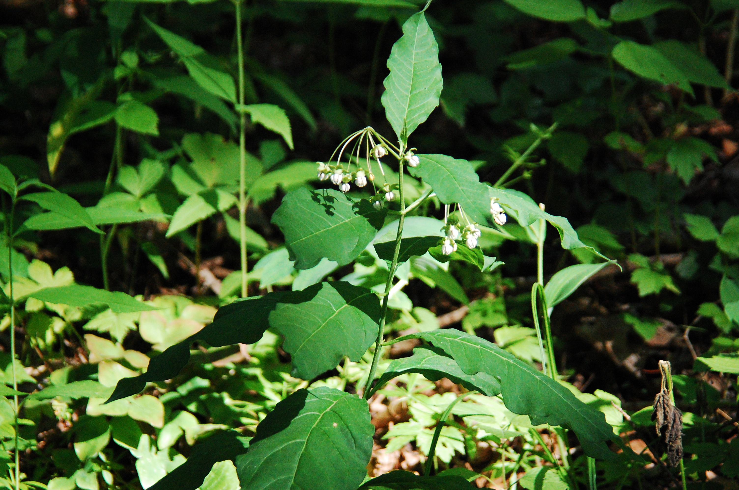
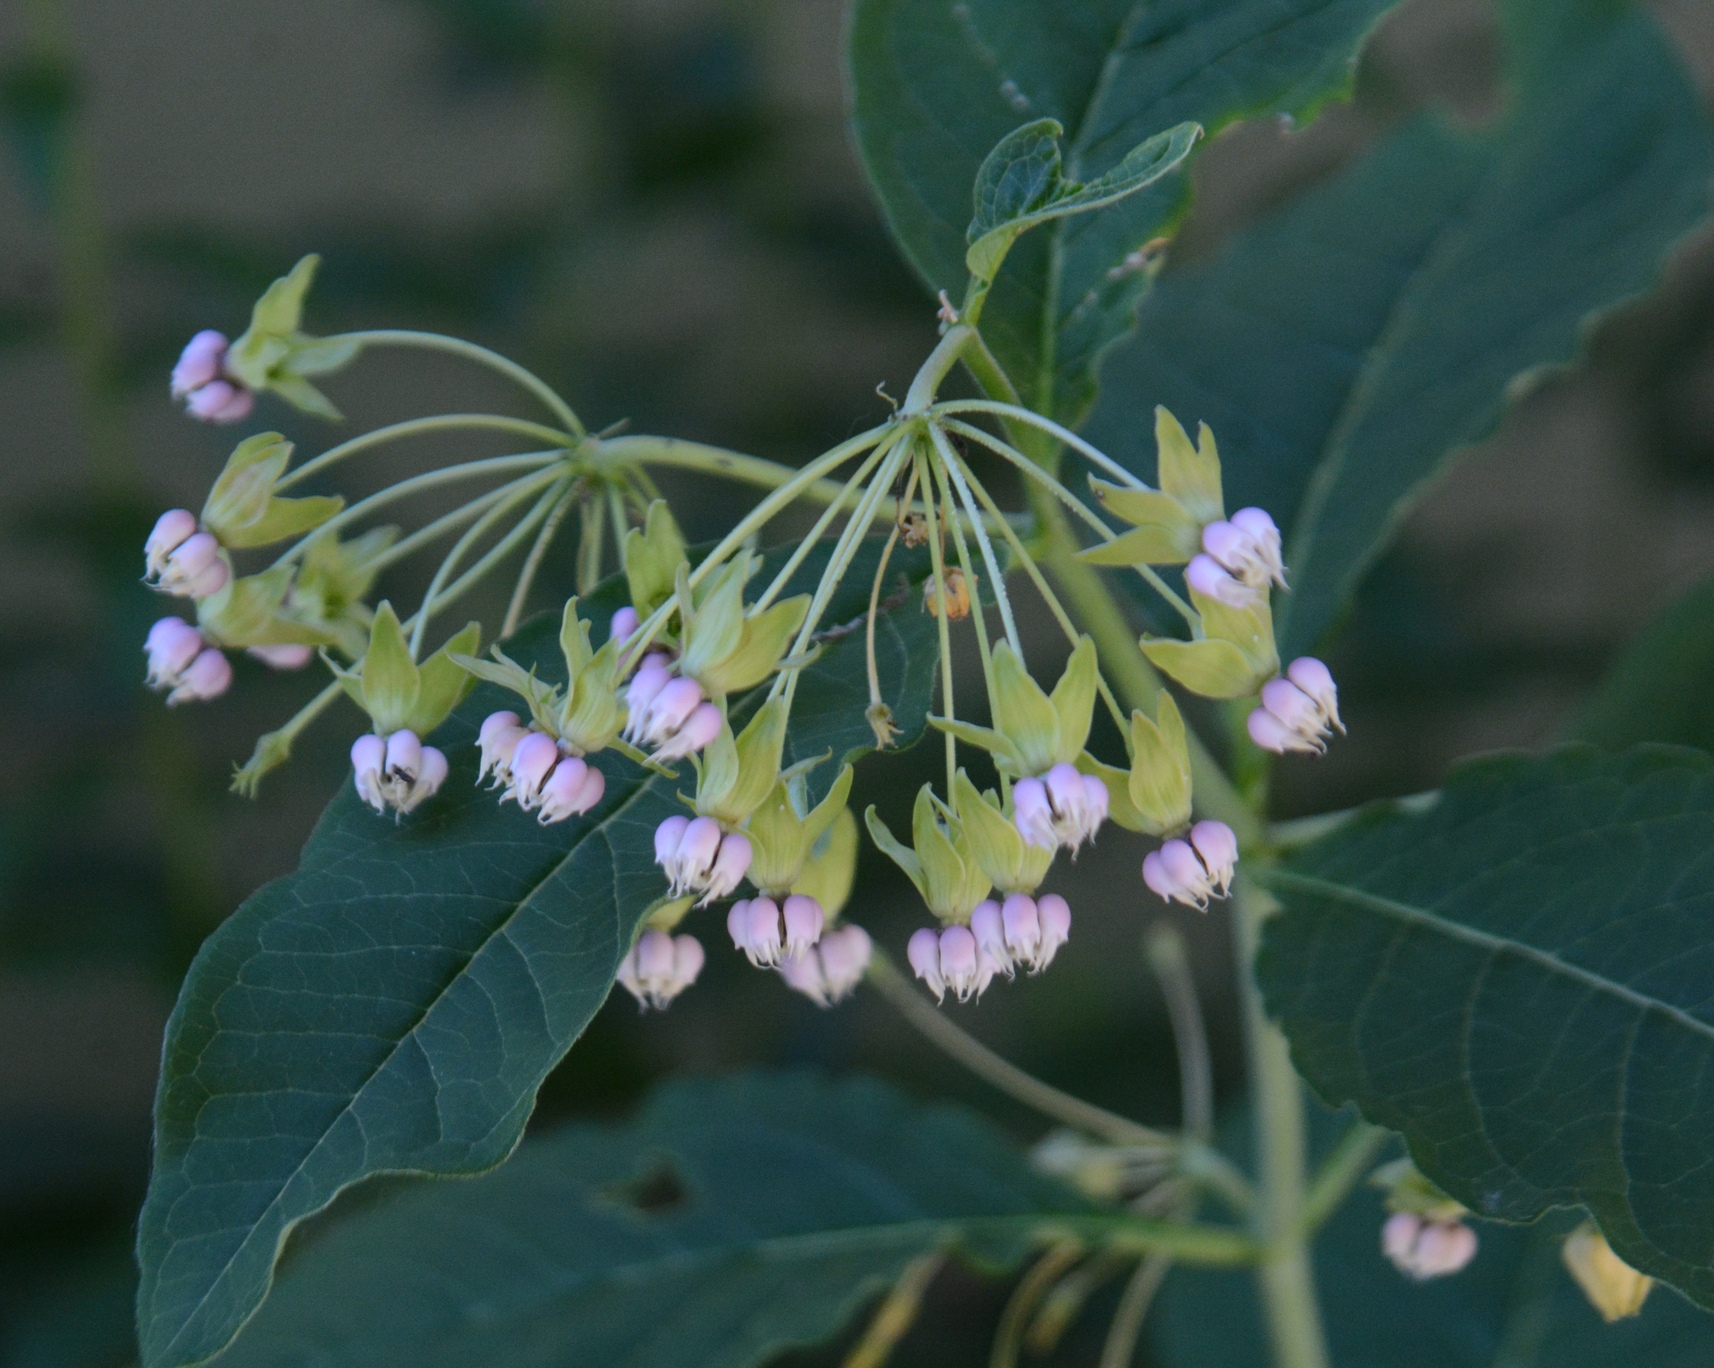
Poke Milkweed
Asclepias exaltata
Notes:
2012_06_09_010 Kickapoo
2022_06_27_003 Wehr

Slide 8
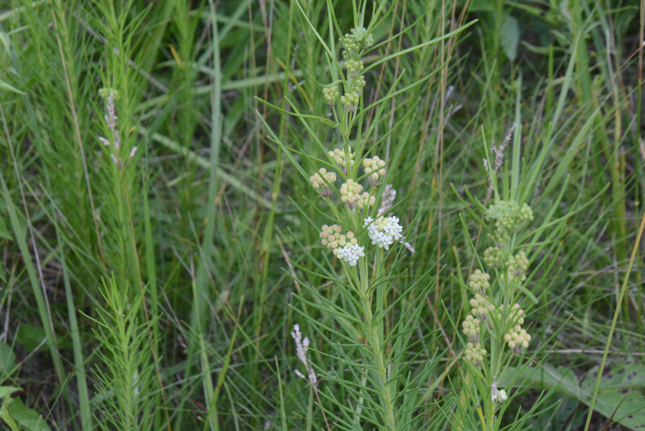
Whorled Milkweed
Asclepias verticillata
Notes:
2022_07_17_032 Cliffside Park

